Slide 1

ULK’s Canteen App
A Food and Drinks Ordering app for Students and Staff
Abobaker Yagoub
Roll Number: 202410487

Slide 2
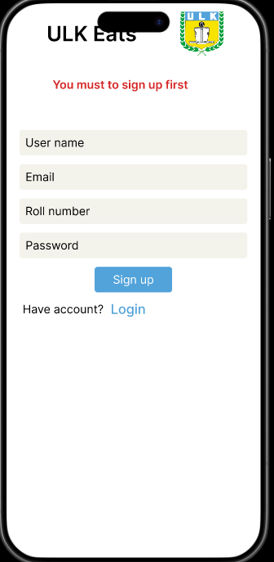
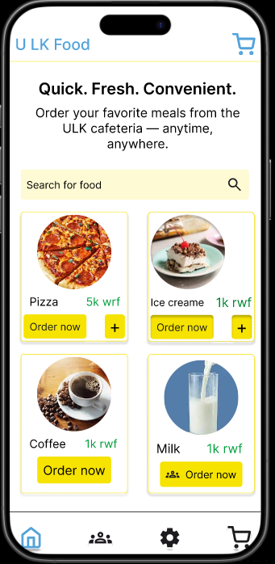
Project overview
The product:
ULK’s canteen app is a foods and drinks app for students and stuff, it lets to order, pick up or devlivery within university area
Project duration:
October 2025 – November 2025

Slide 3
Project overview
The problem:
People have to spent minutes to order and eat their meal. So they have to miss out their classes or working.
The Goal:
Design an app that allows students to easily order food and drinks without going to canteen
.

Slide 4
Project overview
My role :
UX designer, UX researcher, UI Designer .
Responsibilities :
Conducting User interviews, Usability Studies, Research, Creating paper and digital wireframes, Creating Low and High ﬁdelity prototypes, Accounting for accessibilities,and iterating on designs.

Slide 5
User research: pain points
1
2
3
4
Long Waiting Times
Limited Ordering Options
Lack of Time Visibility
Inefficient Payment Process
Users spend several minutes in line, causing them to miss part of their classes or work.
here is no way to pre-order meals, leading to congestion during peak hours.
Users don't know how long they'll have to wait, making it hard to plan their breaks.
Manual payments slow down the ordering process and create bottlenecks at the counter.

Slide 6
Paper wireframes
Digital wireframes
Low-fidelity prototype
Usability studies
Starting
the design

Slide 7
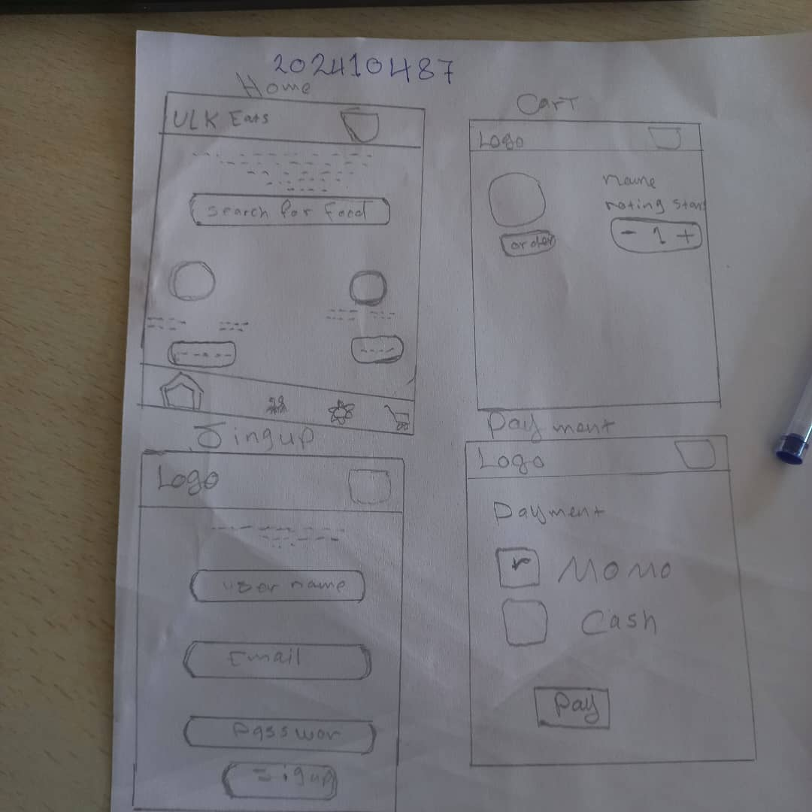
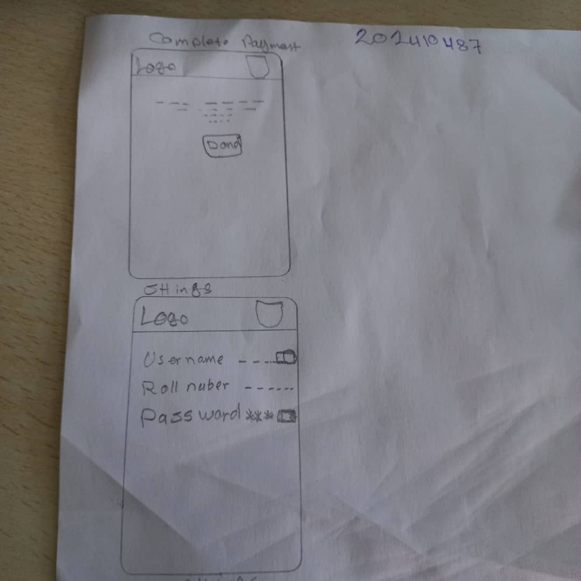

Slide 8
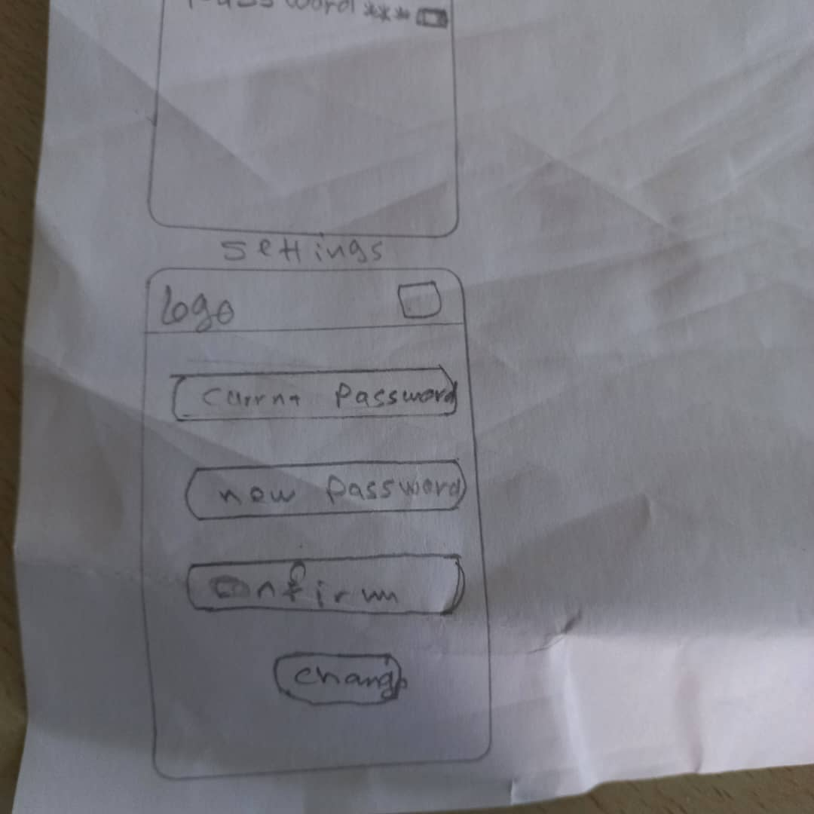

Slide 9
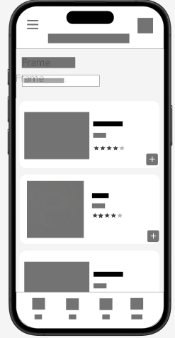
Digital wireframes
Proceeding towards digital wireframes i want to ensure the findings and feedbacks from the user research were covered.
User can easily
choose their favourites food and drinks from the menu section.
User can easily
navigate between section

Slide 10
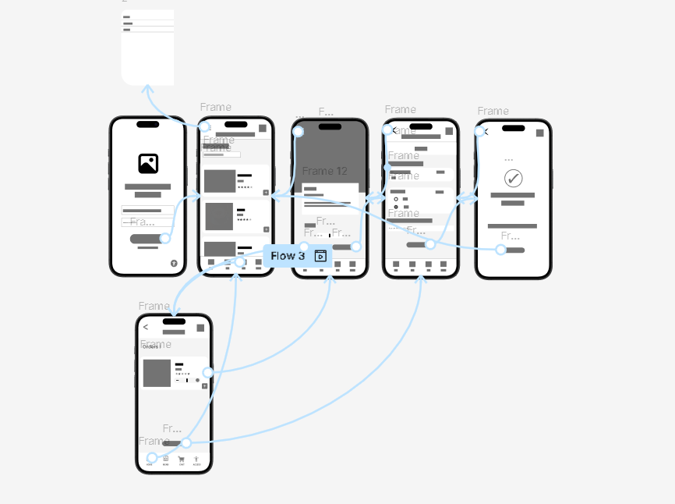
Low-fidelity prototype
The low-ﬁdelity prototype connected to the primary ﬂow of the app.
Link to low-fidelity prototype

Slide 11
Usability study: findings
Write a short introduction to the usability studies you conducted and your findings.
Round 1 findings
Round 2 findings
1
Users want a simpler, clearer ordering process.
1
Users find the improved ordering flow easier to use.
2
Users want accurate and visible wait time estimates.
2
Users appreciate real-time wait time updates.
3
Users want a faster, smoother payment experience.
3
Users want customizable pickup times to better fit their schedules.

Slide 12
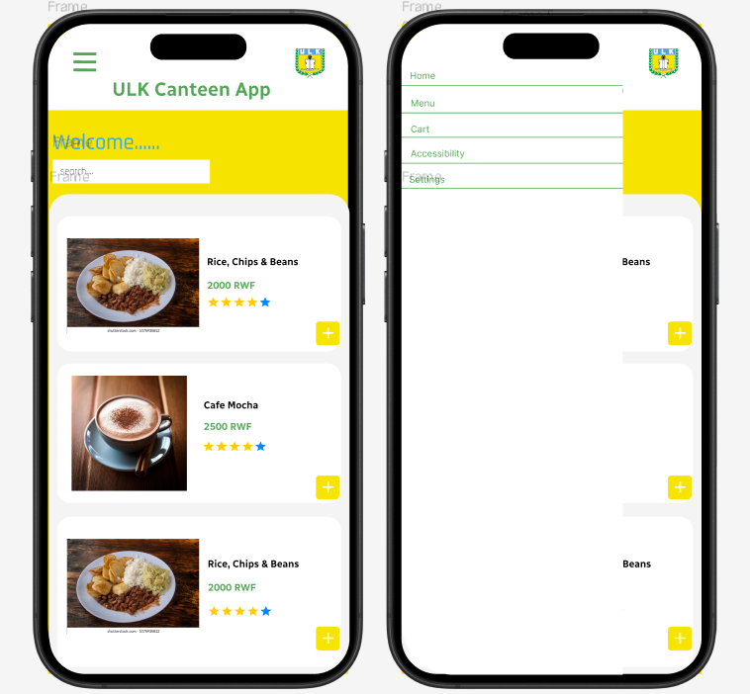
Mockups
Before usability study
After usability study
Before the usability study, users had to access key features like Home, Menu, Cart, and Accessibility through a side navigation drawer, which required multiple steps and was not immediately intuitive. The menu button was hard to locate, and first-time users lacked visual guidance for navigating the app effectively.
After the usability study, a bottom navigation bar was introduced, making Home, Menu, Cart, and Accessibility directly accessible from any page. Layout alignment and spacing were improved for better readability, and the search field was repositioned to create a balanced interface. These changes reduced navigation friction, clarified key actions, and enhanced the overall usability and visual identity of the app.

Slide 13
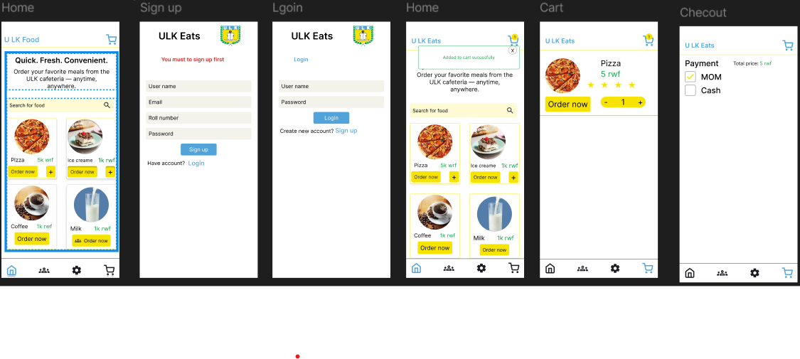
Mockups

Slide 14
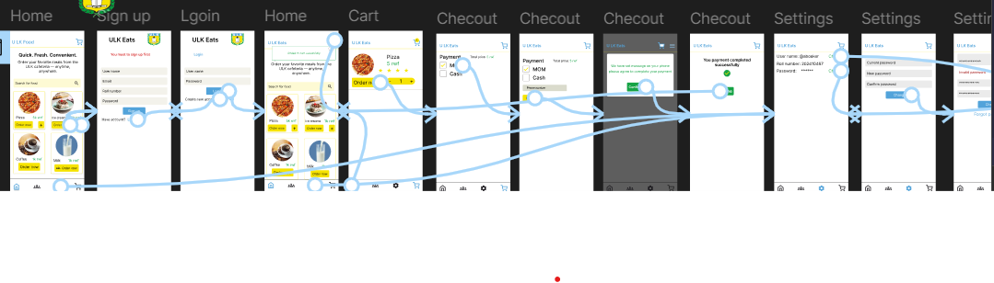
High-fidelity prototype
The ﬁnal high ﬁdelity prototype presented with a main user ﬂow contains adding snacks, scheduling on-seat delivery and the tracking process.
Link to High-Fidelity Prototypy Design

Slide 15
Accessibility considerations
1
2
3
Used Icons to help navigation easier and Used detailed images to identify the item easier.
Included detailed item images to help users easily recognize food options
Used high-quality visuals to enhance item clarity and reduce decision time

Slide 16
Insert a few sentences summarizing the next steps you would take with this project and why. Feel free to organize next steps in a bullet point list.
Let’s connect!
Thank you all for your time and for reviewing my work on the “ULK’s canteen App.” If you liked what you saw and want to see more, please feel free to get in touch:
Email: bakorybashar@gmail.com

Slide 17
Thank you!

