Slide 1


Al-Obour Institute
SON PROJECT: SIMULATION OF NETWORK
Hardware & Cisco Packet Tracer Implementation of a Secure Enterprise Network
Al-Obour High Institute For Management and Informatics | Academic Year 2025-2026 | Team CS-21 (8 Students) | Graduation Project Presentation

Slide 2

PROJECT TEAM & SUPERVISION
CS-21 Team Members
1-Mohamed Abdelmonem Ashmawy
2-Abdelrahman Ahmed Owais
3-Abdelrahman Mohamed Abdelaziz
4- Abdelrahman Elsayed Roman
5-Mohamed Omar
6-Toka Mohamed Mahmoud
7-Salma Nabil Ahmed
8-Tasneem Fathy Rawash

Slide 3

PROJECT OBJECTIVES
Core Goals of the SON Project
• Bridge theory and practical networking through hands-on implementation
• Design a secure, high-availability enterprise network architecture
• Implement dual ISP failover and cybersecurity best practices
• Develop an educational interactive textbook resource for learning
• Validate the complete design via real hardware implementation

Slide 4
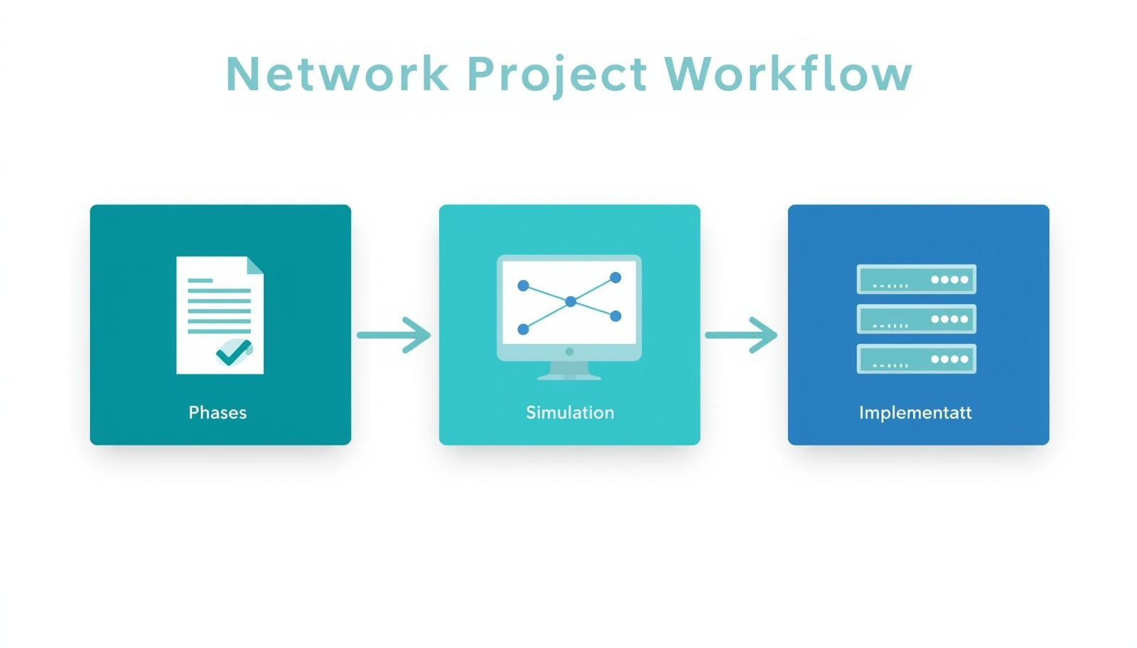
PROJECT STRUCTURE OVERVIEW
Three Main Chapters
Chapter 1: Interactive Textbook & Fundamentals
Comprehensive educational resource featuring interactive videos, visual learning aids, and step-by-step configuration guides. Covers network fundamentals with real-world device examples and hardware interface identification.
Chapter 2: Secure Company Network Design(simulation)
Enterprise network simulation using Cisco Packet Tracer. Implements dual ISP failover, VLAN segmentation, firewall security, and high availability protocols.
Chapter 3: Real Hardware Implementation(simulater)
Physical lab setup validating the simulated design using Cisco routers, D-Link switches, wireless access points, and surveillance integration. Demonstrates practical application of security measures and network services.
Project Flow: Theory → Simulation → Hardware
This structured approach bridges academic knowledge with hands-on practical experience in enterprise networking.

Slide 5

Educational Approach & Fundamentals
CHAPTER 1
INTERACTIVE TEXTBOOK
Our interactive textbook combines visual learning aids with hands-on practice. Features include interactive videos demonstrating network concepts, real-world device examples with Cisco 1841 router interface identification, hardware component recognition guides, and comprehensive step-by-step configuration tutorials for practical skill development.

Slide 6
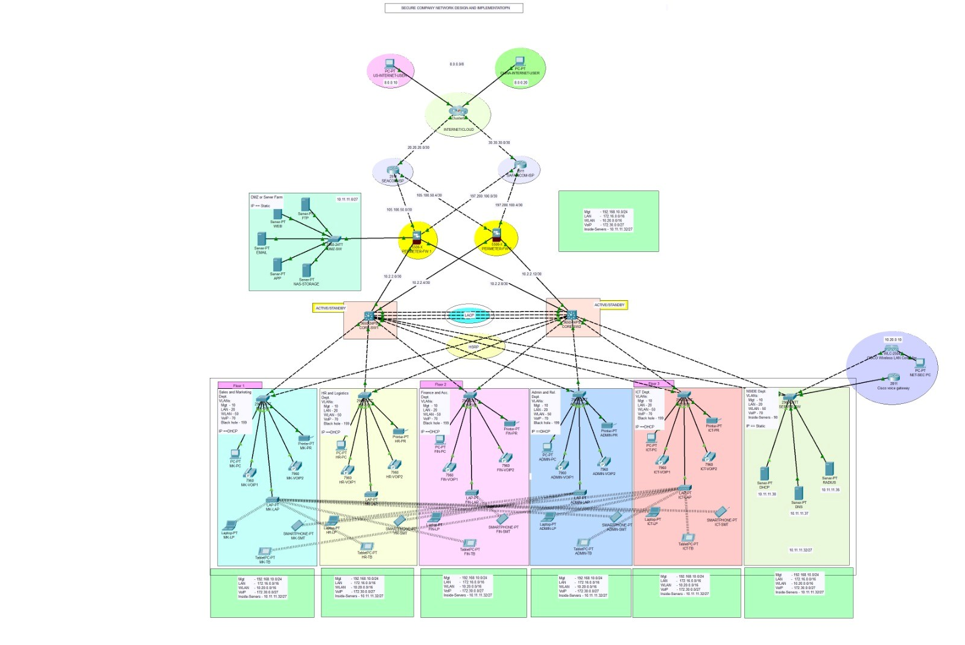
CHAPTER 2: ENTERPRISE NETWORK DESIGN OVERVIEW(SIMULATION)
Three-Tier Architecture
Our enterprise network spans 6 departments across 3 floors, supporting 100+ devices. The design follows industry-standard three-tier architecture: Core layer for high-speed backbone connectivity, Distribution layer for policy enforcement and VLAN routing, and Access layer connecting end-user devices. This scalable structure ensures optimal performance, security segmentation, and simplified management.

Slide 7

DUAL ISP FAILOVER & FIREWALL SECURITY
Redundancy and Perimeter Defense
Our enterprise network utilizes dual ISP connectivity with SEACOM and SAFARICOM for automatic failover, ensuring continuous internet access. The Cisco ASA 5506-X active/standby firewall cluster provides robust perimeter defense. A dedicated DMZ hosts critical servers including Web, FTP, Email, APP, and NAS services, isolating them from the internal network while maintaining accessibility.

Slide 8
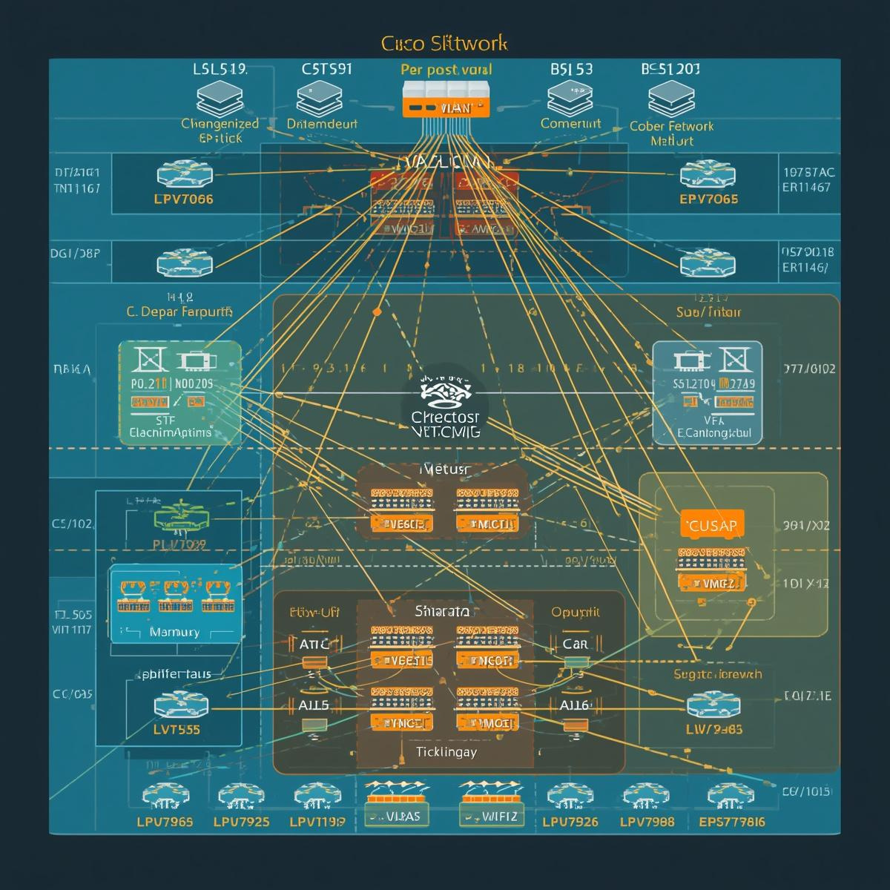
VLAN SEGMENTATION & IP ADDRESSING
Network Organization
• VLAN 10: Management - Network device administration
• VLAN 20: LAN - General workstation connectivity
• VLAN 50: WLAN - Wireless user access
• VLAN 70: VoIP - Voice traffic isolation
• VLAN 99: Blackhole - Security containment
IP Scheme: Class C (192.168.0.0/16) with VLSM optimization for efficient subnet allocation across departments and servers.

Slide 9
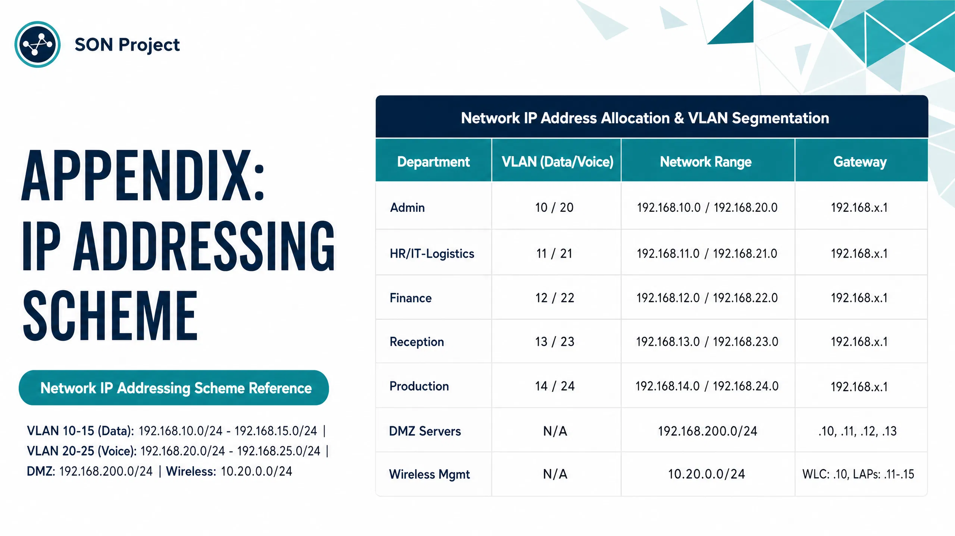

Slide 10

WIRELESS INFRASTRUCTURE & VOIP SERVICES
Unified Communications Platform
Wireless LAN Controller 2504 centrally manages 5 Lightweight Access Points across all three floors, providing seamless roaming and unified wireless coverage. WPA2 Enterprise security ensures encrypted communications with RADIUS authentication for all wireless clients connecting to the network.
Cisco 2811 Voice Gateway with CallManager Express delivers enterprise VoIP services, supporting Cisco 7960 series IP Phones throughout departments. This integration enables internal voice communications, call routing, and voicemail services while maintaining quality of service prioritization for voice traffic.

Slide 11
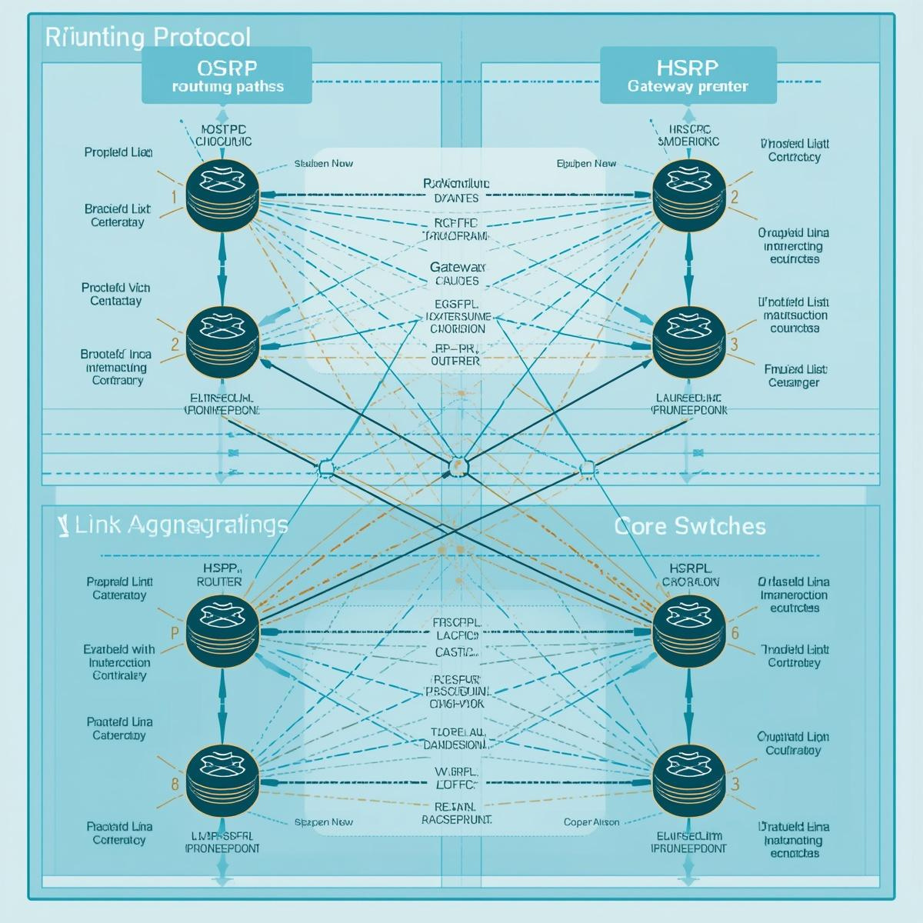
ROUTING & HIGH AVAILABILITY PROTOCOLS
OSPF, HSRP & LACP Implementation
OSPF Area 0: Dynamic routing protocol enabling efficient path selection and network convergence across the enterprise infrastructure.
HSRP (Hot Standby Router Protocol): Provides gateway redundancy ensuring seamless failover between primary and backup routers for uninterrupted connectivity.
LACP (Link Aggregation Control Protocol): Bundles multiple physical links into a single logical channel for core switch uplinks, increasing bandwidth and providing link redundancy.

Slide 12
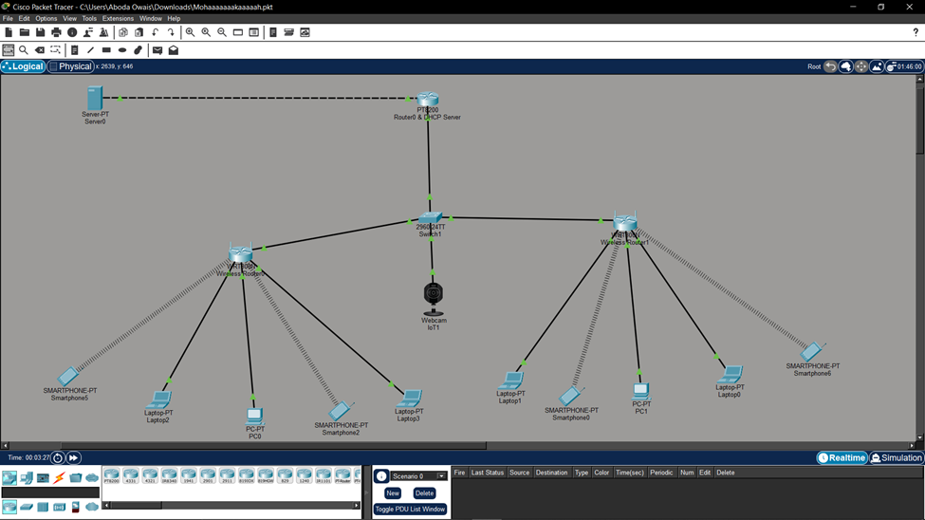
CHAPTER 3: REAL HARDWARE IMPLEMENTATION
CISCO PACKET TRACER SIMULATION DESIGN & PHYSICAL LAB SETUP
Design Overview
Central Infrastructure: Router serving as DHCP server for automatic IP assignment, Core Switch (2960-24TT) for Layer 2 connectivity, and Central Server handling network services. Design emphasizes scalability and hybrid connectivity for real-world enterprise application.
Wireless & IoT Networking: Dual wireless routers providing comprehensive Wi-Fi coverage across zones, supporting mobile devices including smartphones, laptops, and tablets. Webcam connected to central switch enables real-time IoT monitoring capabilities.

Slide 13
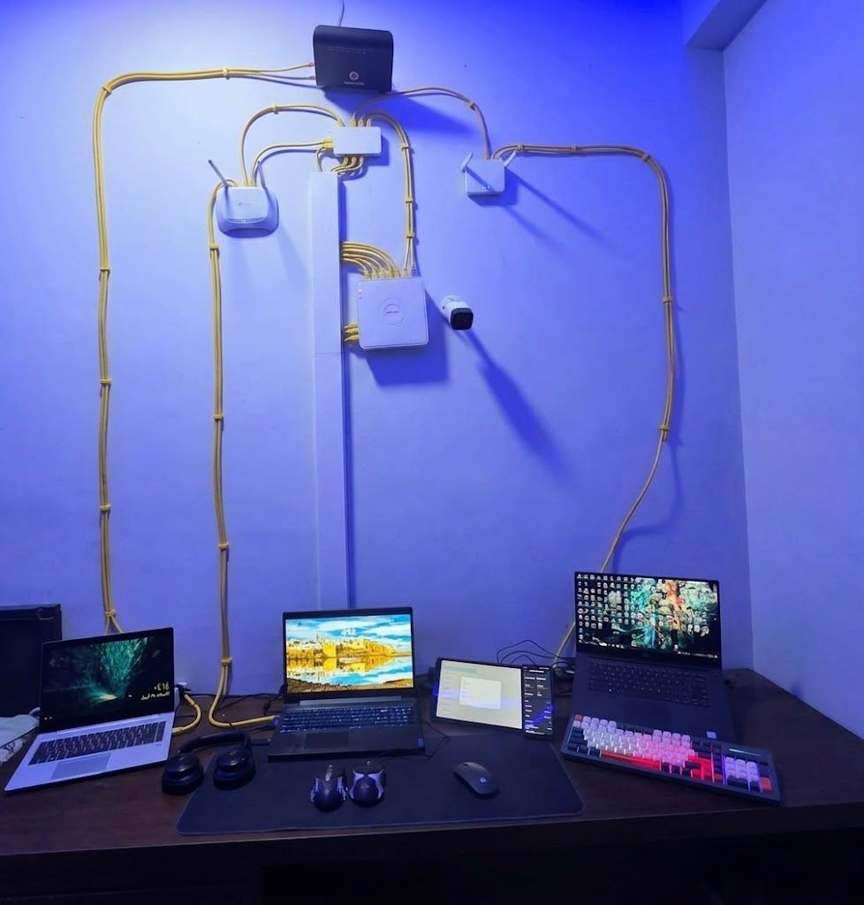
PHYSICAL LAB IMPLEMENTATION
CORE HARDWARE SETUP
Physical Device Inventory
Main Router & Network Switch: Central gateway providing DHCP services and internet routingSwitches: D-Link managed switch enables wired connectivity and port expansion for all lab devices.
Dual Access Points & Surveillance: TP-Link and Mercusys APs deliver Wi-Fi coverage with wired expansion ports
FTP Server & Workstations: Dedicated file transfer environment with high-performance laptops for VLAN testing, security analysis, and network performance evaluation. Smart TV and peripherals for real-world simulation.

Slide 14

PHYSICAL LAB SETUP
Physical networking hardware and surveillance system in the lab environment. The setup includes the main router serving as central gateway, D-Link network switch, TP-Link and Mercusys access points, Hikvision DVR with surveillance cameras, and high-performance workstations for testing.

Slide 15
ROLES OF CORE HARDWARE COMPONENTS
Main Gateway Router
• Internet access gateway
• DHCP server functionality
• Traffic routing & NAT
• Central management hub
• Firewall integration
• Network address translation
Network Switch
• Physical device connectivity
• Layer 2 traffic management
• Port expansion capability
• Congestion reduction
• Core backbone support
• VLAN segmentation ready
Access Points & Surveillance
• Wireless signal distribution
• Multi-zone Wi-Fi coverage
• Static IP management
• DVR video processing
• Night vision & audio features
• Converged security networking

Slide 16


HARDWARE ROLES COMPARISON
Wired Devices (Router, Switch, Wired PCs): Stable, high-bandwidth connections forming the core network backbone. Reliable data transfer with minimal latency, essential for critical infrastructure and server communications.
Wireless & Security Devices (APs, Cameras, Mobile): Flexible coverage enabling mobility across zones. High-bandwidth video streaming for surveillance and IoT traffic management with seamless roaming capabilities.
Hybrid Integration: Ensuring seamless connectivity across wired, wireless, and security infrastructure. Unified management enables efficient bandwidth allocation and comprehensive network monitoring.

Slide 17

STRATEGIC IMPORTANCE OF INTEGRATION
Cyber-Physical Security: Combined data network and physical security monitoring creates comprehensive protection infrastructure.
Bandwidth Management: Handling high-bandwidth video streams from surveillance cameras without network lag or performance degradation.
Realistic Professional Environment: Hands-on experience with enterprise-grade hardware including Hikvision cameras, TP-Link and Mercusys access points.
Real Traffic Handling: Practical troubleshooting of actual network traffic patterns, device conflicts, and performance optimization scenarios.

Slide 18

KEY CHALLENGES & SOLUTIONS
Overcoming Project Obstacles
Managing Complexity: The multi-VLAN architecture with dual ISP failover required careful planning to avoid configuration conflicts. Solution: Systematic documentation and modular design approach allowed incremental testing of each network segment before full integration.
Hardware-Simulation Sync: Maintaining consistency between Cisco Packet Tracer simulations and physical hardware configurations posed challenges. Solution: Version-controlled configuration files and parallel testing ensured both environments remained synchronized throughout development.

Slide 19

EDUCATIONAL VALUE & LEARNING OUTCOMES
Bridging Theory & Practice
• Interactive textbook serves as comprehensive learning tool with embedded videos and visual aids
• Hands-on practice bridges theoretical networking concepts with real lab implementation
• Exposure to enterprise network design best practices and industry standards
• Visual learning aids including network diagrams and step-by-step configuration guides
• Students gain practical experience with Cisco hardware and Packet Tracer simulation

Slide 20

PROJECT ACHIEVEMENTS SUMMARY
Key Milestones & Accomplishments
✓ Fully functional secure enterprise network simulation completed in Cisco Packet Tracer with 100+ devices across 6 departments
✓ Real hardware implementation successfully validated the theoretical design using Cisco routers and switches
✓ Interactive educational textbook created with visual learning aids and step-by-step configuration guides
✓ Successful integration of multiple technologies: VoIP telephony, wireless infrastructure, and comprehensive security measures

Slide 21

FUTURE WORK & IMPROVEMENTS
Roadmap for Project Enhancement
• Expand interactive textbook with advanced networking scenarios including SD-WAN and network automation
• Integrate cloud services simulation (AWS, Azure) for hybrid network architectures
• Automate configuration deployment using Python scripts and Ansible playbooks
• Enhance wireless infrastructure coverage with additional access points and mesh networking

Slide 22

SON Project
CS 21
THANK YOU!
Questions & Discussion Welcome
Thank you for your attention throughout this presentation of the SON Project. We welcome any questions about our Secure Enterprise Network implementation, the Cisco Packet Tracer simulations, or our hardware lab setup.

