Slide 1
On fair division under heterogenous constraints Presented by: Abed El Kareem Massarwa Advisor: Prof.erel segal-Halevi ID : 319071379

Slide 2
AGENDA
Motivation behind the research
Explaining use-cases for each algorithm
Presenting experiments and concluding findings
Final thoughts

Slide 3
Motivation behind the research

Slide 4
Introduction &Motivation
This research focuses mainly on finding fair allocation of indivisible items among agents/people with different capacities and preferences
The researchers are motivated to solve these problems because such scenarios occur frequently in daily life.
Allocating resources, such as assigning tasks to emergency room staff , is a good example of a resource that isn’t divisible

Slide 5
obstacles

Slide 6
Impossibilities
When dealing with indivisible item allocation F-EF Allocation may not always exist
When dealing with different partitioning (each agent categorizes items differently) F-EF1 may not exist

Slide 7
Use-Cases

Slide 8
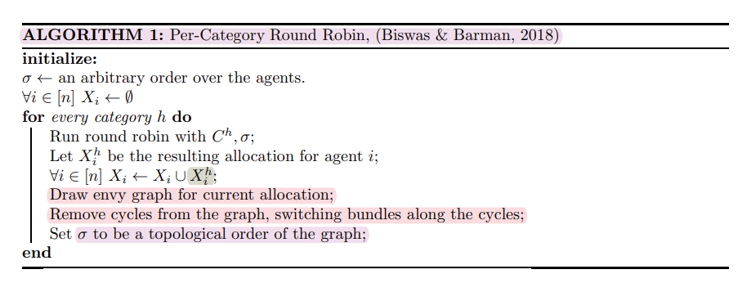
Algorithm 1 (per category round robin)
Appropriate input
A good example of daily life scenario would be , assigning different tasks to a development team with identical capabilities/capacities
Input limitations
Identical capacities
May have different valuations

Slide 9
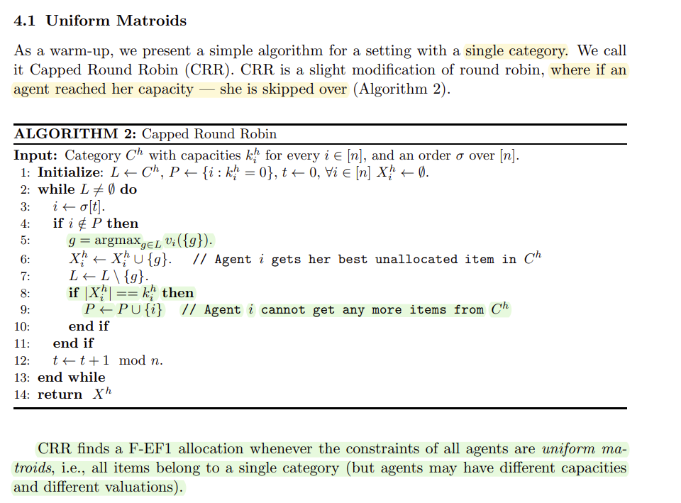
Algorithm 2 (Capped round robin)
Appropriate input
A good example of daily life scenario would be , assigning tasks(1 category) to a group of teachers of the same course with different time limitations (capacities) , different valuations (some teacher might prefer one subject over the other so they give it a higher valuations)
Input limitations
Single category
May have different valuations

Slide 10
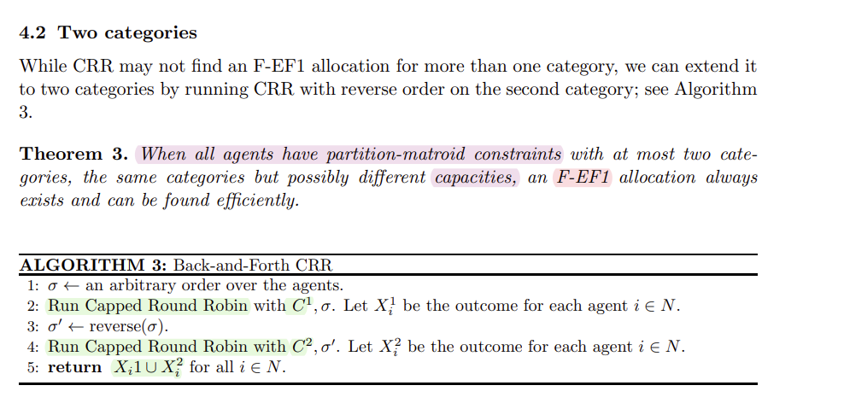
Algorithm 3 (2 categories Capped round robin)
Appropriate input
A good example of daily life scenario would be , assigning tasks(1 category) to a group of teachers who teach 2 common courses with different time limitations (capacities) , different valuations (some teacher might prefer one subject over the other so they give it a higher valuations)
Input limitations
Two categories category
May have different valuations

Slide 11
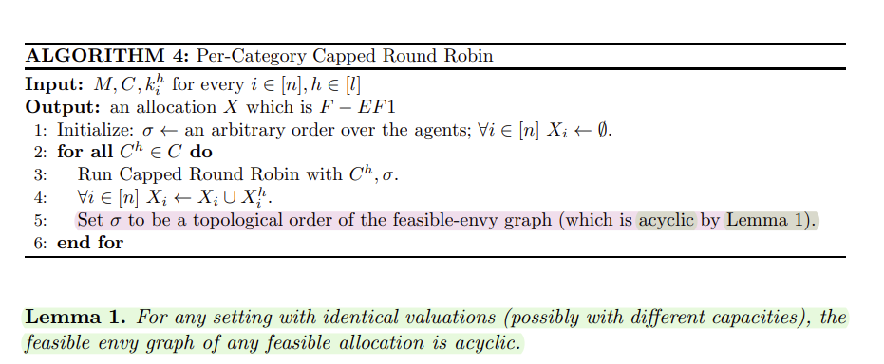
Algorithm 4 (per category-capped round robin)
Appropriate input
A good example of daily life scenario would be , assigning dividing late father’s belongings among his sons , his sons are equal-minded and valuate their father’s items identically (land=100,car=50,…..)
Input limitations
Indetical valuations (each agent values items the same as the other agents)
May have different capacities

Slide 12
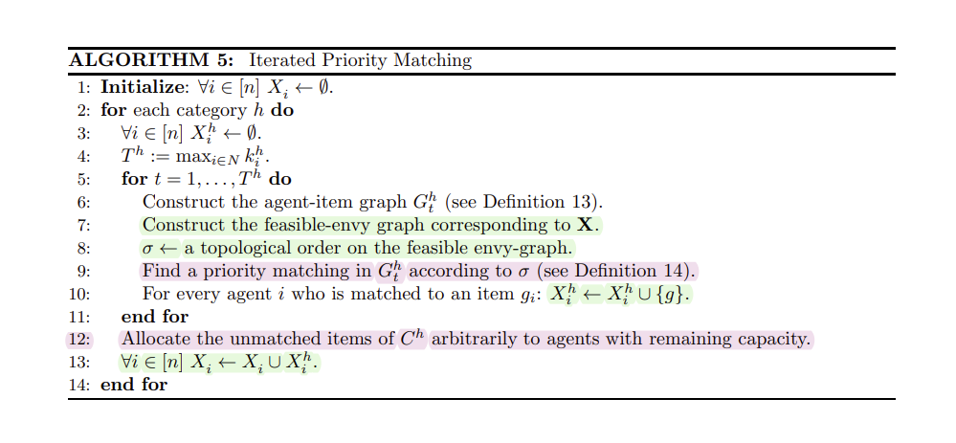
Algorithm 5 (iterated priority matching)
Appropriate input
A good example of daily life scenario would be , dividing stolen items over a teach of thieves ☹ , they are greedy and don’t have prioritized items its either they want the item (1) , or they don’t (0) (binary valuations)
Input limitations
Binary valuation (lack of priority)
May have different capacities/valuations(binary)

Slide 13
Experiments and findings

Slide 14
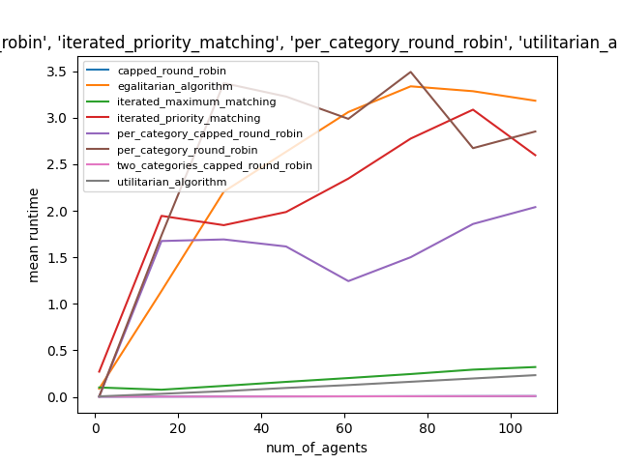
Runtime
We can easily identify the the slowest algorithm (due to nested looping & advanced graph algorithms like matching algorithm) , its algorithm5 iterated priority matching , (optimized using cython)
Two categories round robin (pink) and capped round robin (we believe its hiding behind the pink line) are the fastest due to the fact they only work on a limited number of categories compared to the other algorithms which works on up to 120 categories

Slide 15
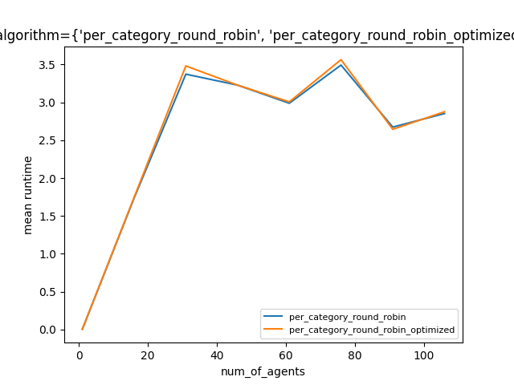
Runtime optimizing algorithm 1
Though we did our best to optimize algorithm 1 , we didn’t reach impressive results , but we can pay attention that sometimes the optimized is a little bit beneath the non-optimized algorithm , saving maybe couple of micro-seconds
This could be due to the fact that our overall algorithms run fairly fast

Slide 16
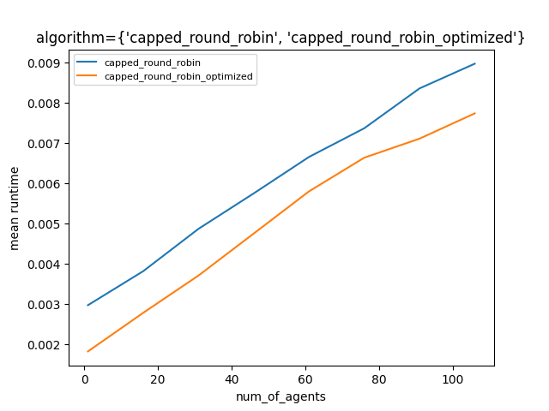
Runtime optimizing algorithm 2
Now here we have some impressive results (but pay attention its in micro-seconds not seconds) , at least we can clearly see optimized runs faster
Algorithm has been cythonized ,part of it (helper_categorization_friendly_picking_sequence) has been additionally optimized with cache

Slide 17
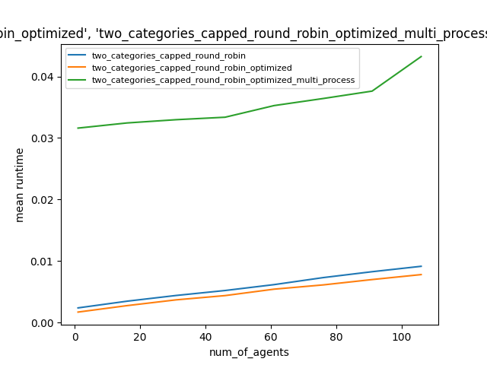
Runtime optimizing algorithm 3
Again we have fair results (but pay attention its in micro-seconds not seconds) , at least we can clearly see optimized runs faster , excluding the multi-process , we chose to keep it just to show that multi-processing method in here didn’t get us the desired results

Slide 18
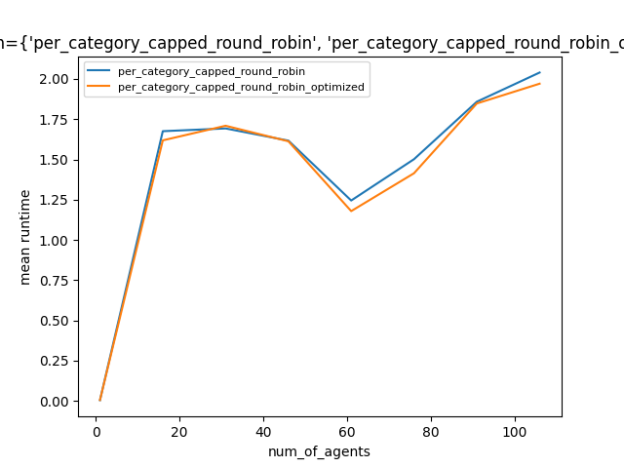
Runtime optimizing algorithm 4
Again we have fair results, at least we can pay attention optimized runs faster .

Slide 19
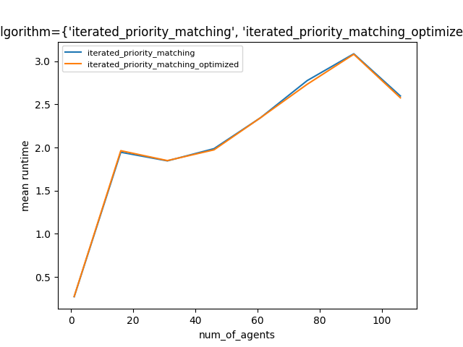
Runtime optimizing algorithm 5
Again we have fair results, at least we can pay attention optimized runs faster .
Optimized has been cythonized , it also sometimes relies on picking_sequence which has been cythonized + cached

Slide 20
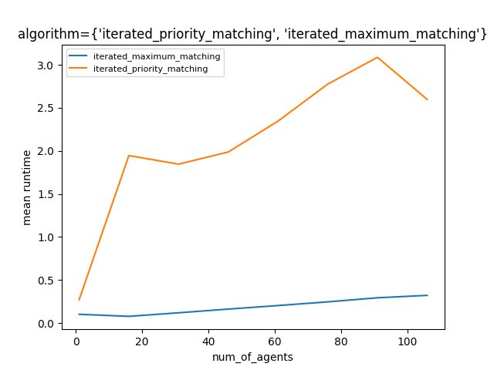
Runtime iterated priority matching vs iterated max matching
We can clearly see our algorithm iterated priority matching (algorithm 5) runs fairly slower than iterated max matching (iterated max matching has been implemented by another dev)

Slide 21
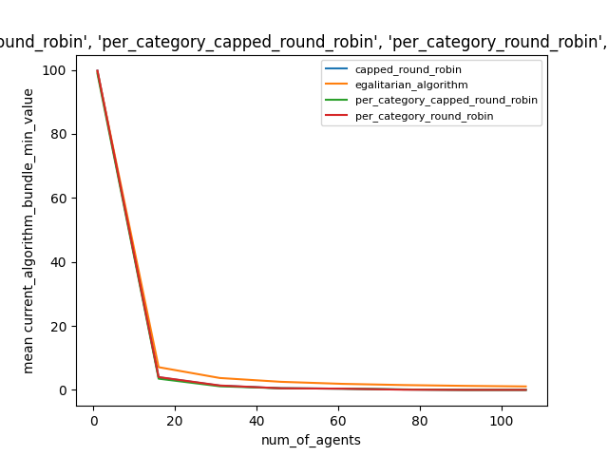
Egalitarian value single category
Egalitarian algorithm , as its name states , it’s the best in its own task which is to maximize the minimum value of bundle (cares for the poor)
We can clearly see it tops the other algorithms meaning the graph makes sense !

Slide 22
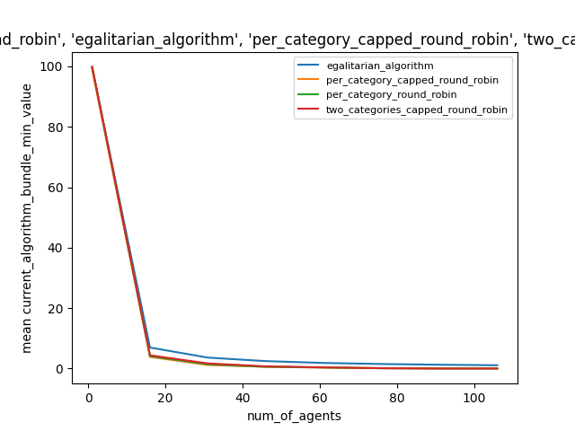
Egalitarian value many categories
Egalitarian algorithm , as its name states , it’s the best in its own task which is to maximize the minimum value of bundle (cares for the poor)
We can clearly see it tops the other algorithms meaning the graph makes sense !

Slide 23
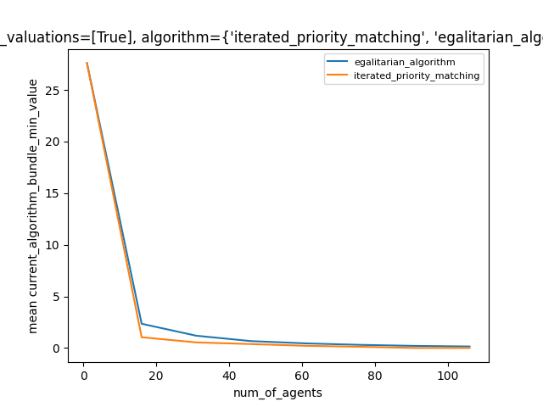
Egalitarian value binary valuations
Egalitarian algorithm , as its name states , it’s the best in its own task which is to maximize the minimum value of bundle (cares for the poor)
We can clearly see it tops the other algorithms meaning the graph makes sense !

Slide 24
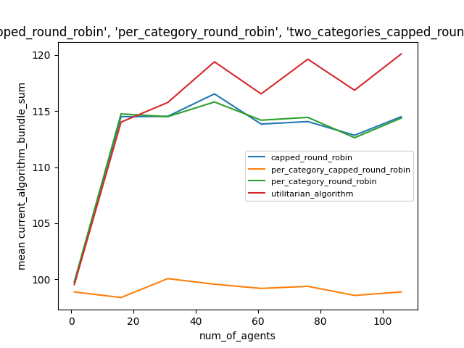
Utilitarian value single category
Utilitarian algorithm is known for being the best in its task , maximizing the bundle values (cares for the rich/whoever values more)

Slide 25
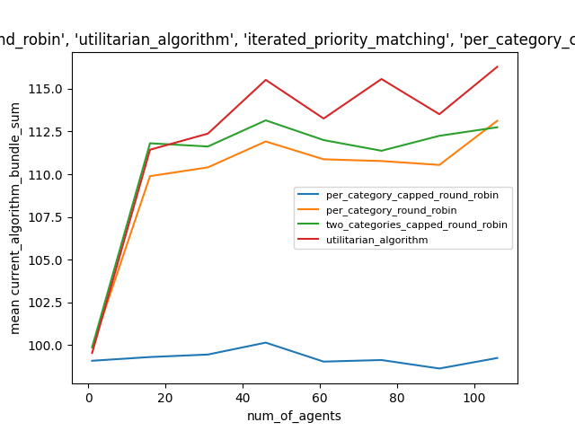
Utilitarian value multiple categories
Utilitarian algorithm is known for being the best in its task , maximizing the bundle values (cares for the rich/whoever values more)

Slide 26
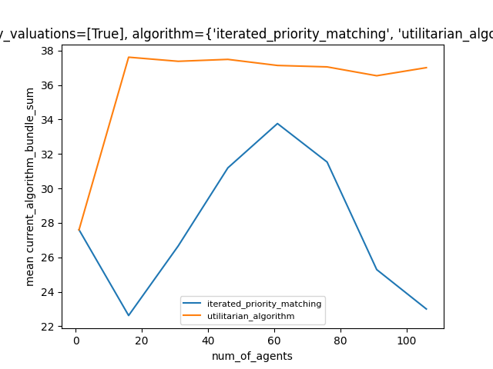
Utilitarian value binary valuations
Utilitarian algorithm is known for being the best in its task , maximizing the bundle values (cares for the rich/whoever values more)
We can clearly see out of all algorithms iterated priority matching is the worst in trying to maximize the sum of bundles

Slide 27
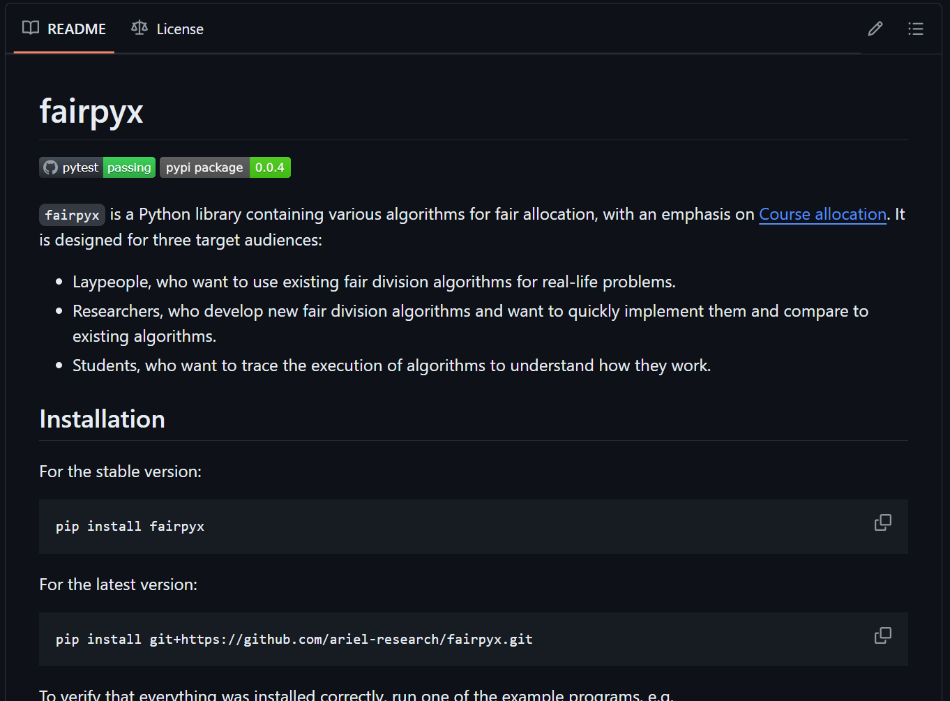
Website
Worth mentioning we built a website showcasing the 5 algorithms, bridging the website with the the module we’re implemented the code in FairPyx
User has the the ability to write input manually , or simply generate a random input with respect to the parameters selected (number of categroies , number of agents , number of items ….)

Slide 28
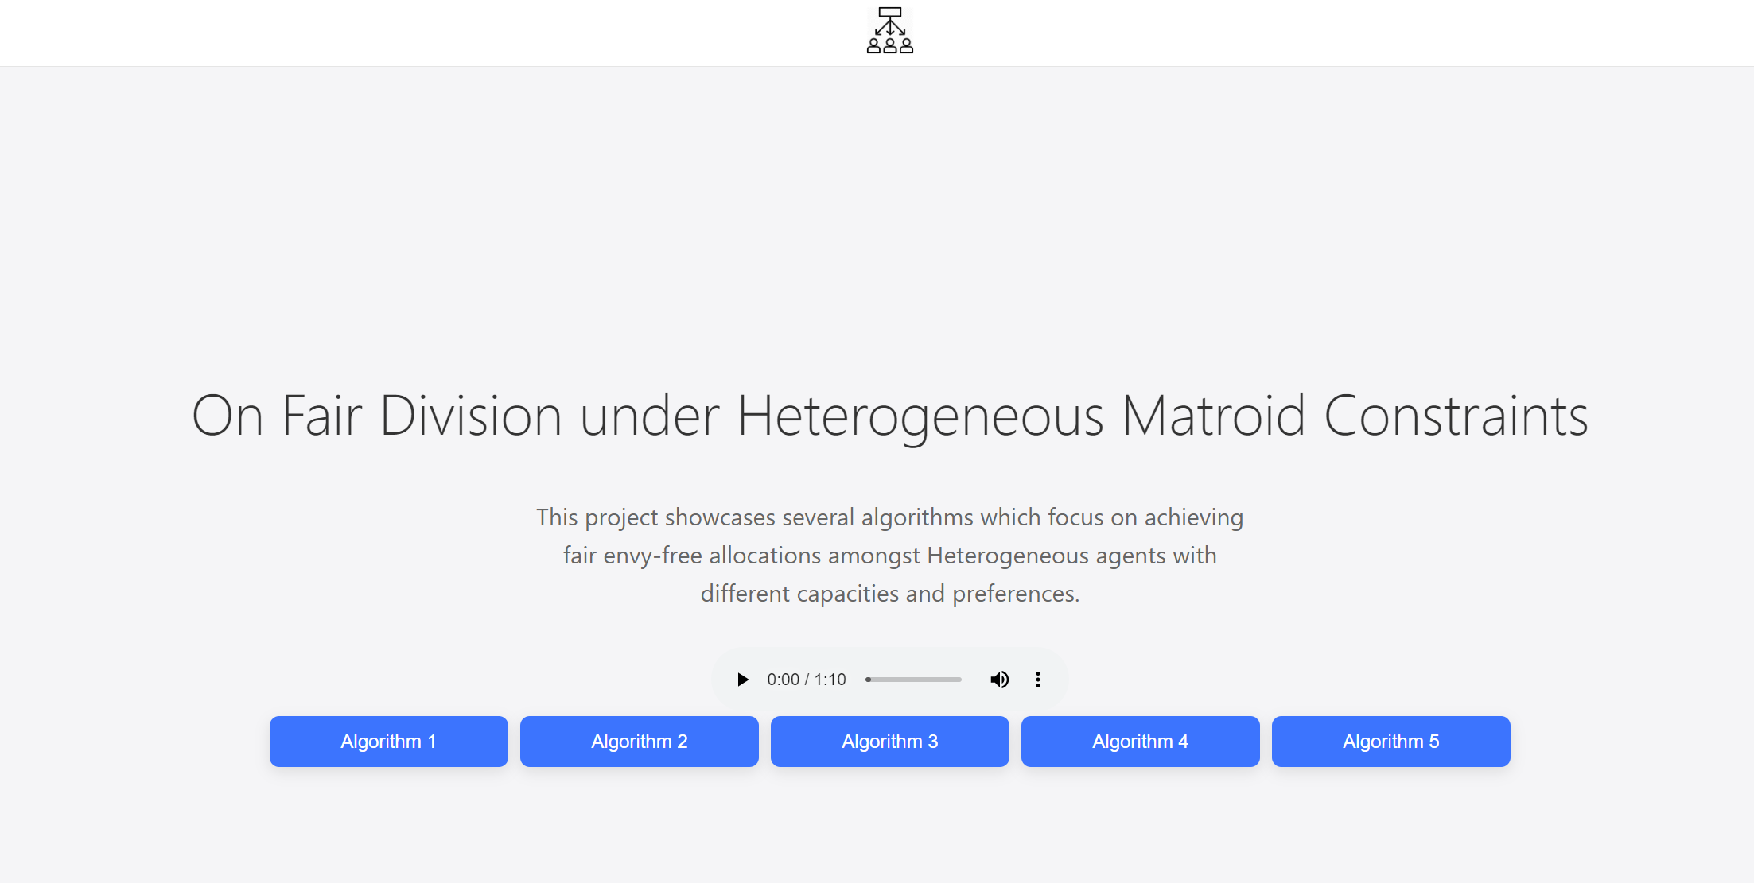
Main page
Main page with a simple design showing buttons for each algorithm with a description about the project in a few words

Slide 29
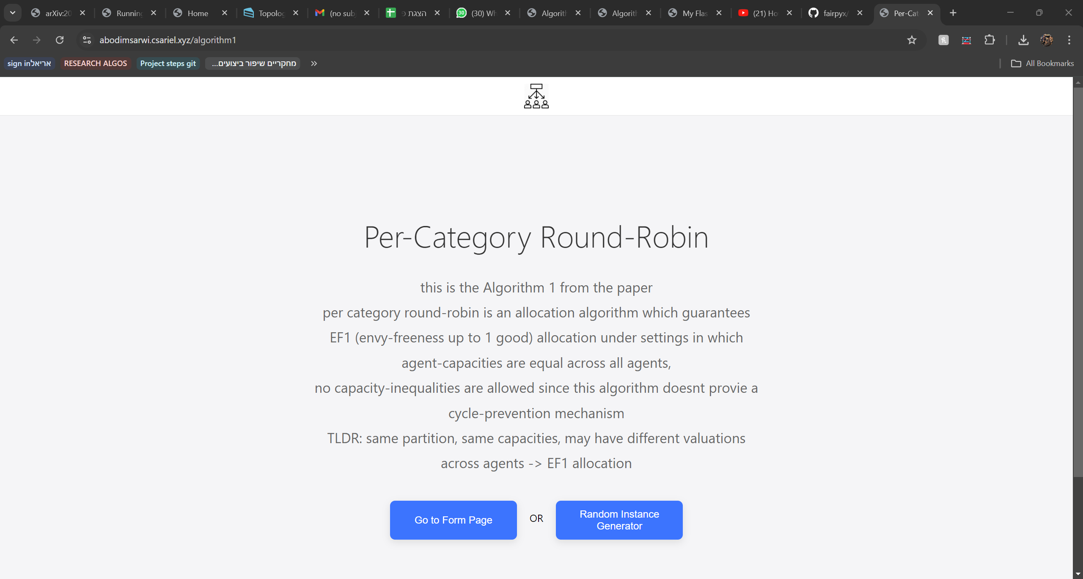
Algorithm page
All the algorithms have a page explaining their nature of work and an option to use OR generator for instances or manually inputing a specific instance/example

Slide 30
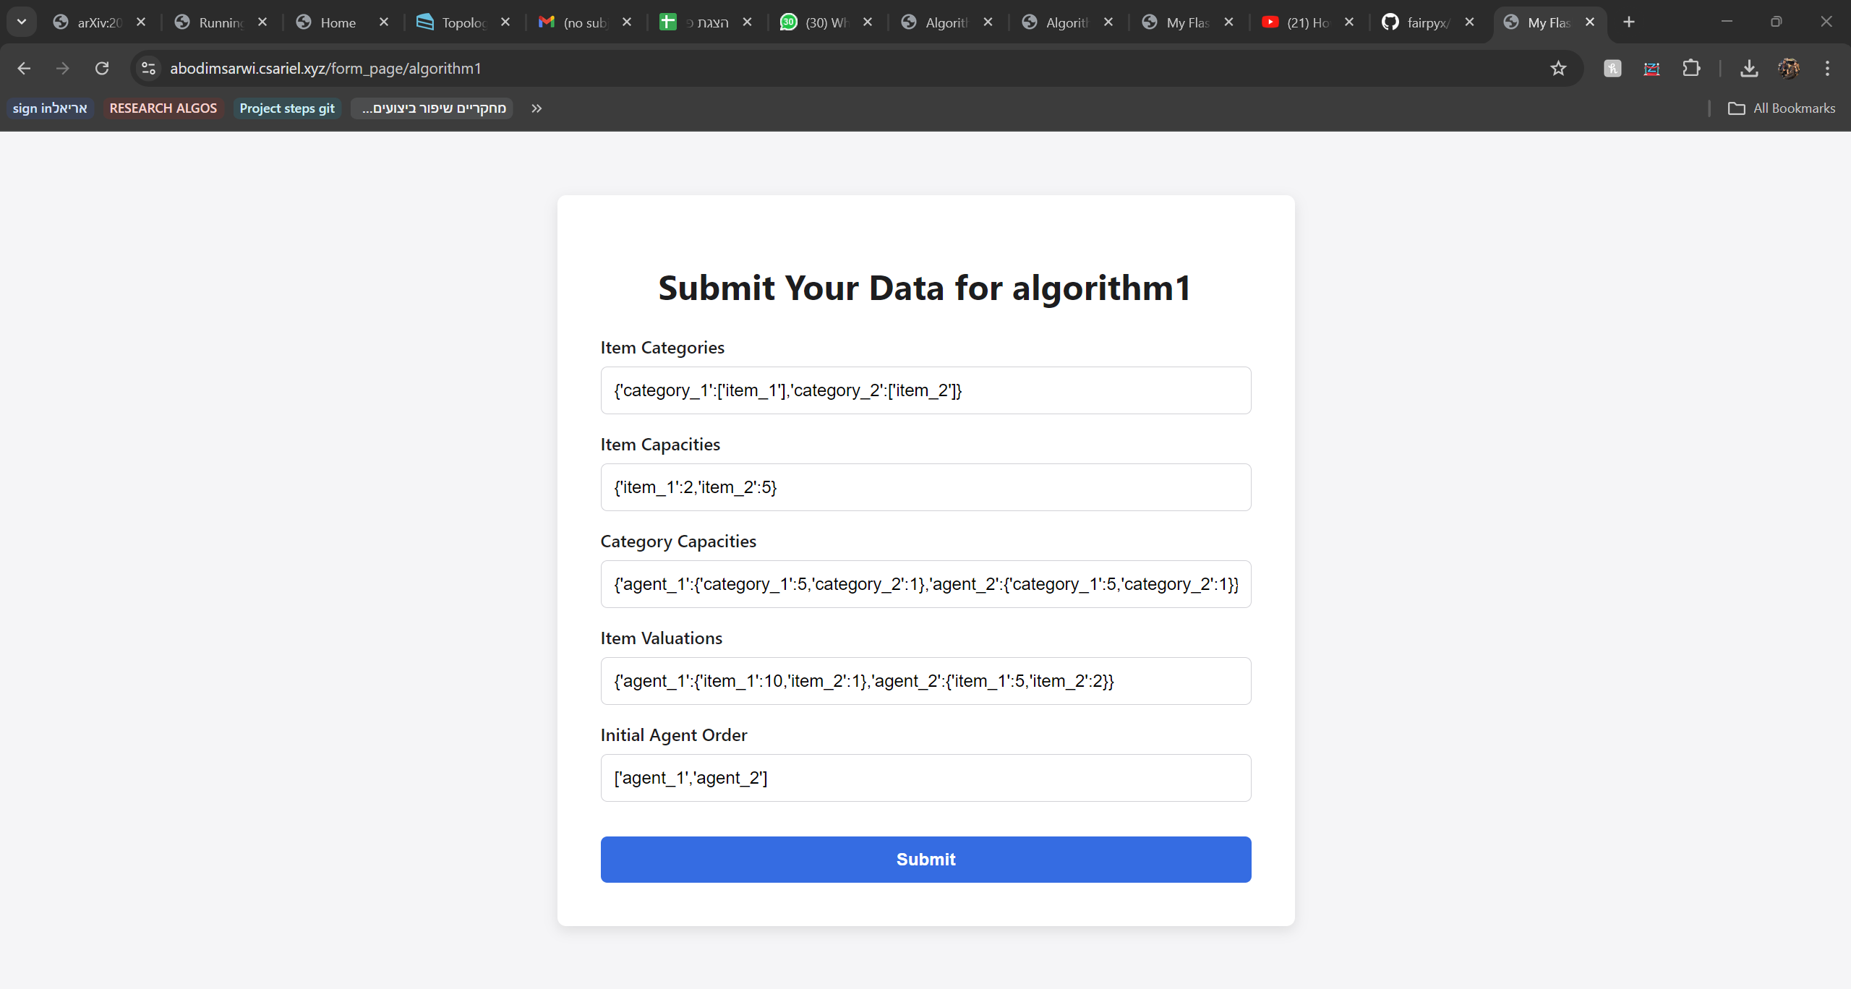
Form page
In which we input manually a specific example we’re interested in

Slide 31
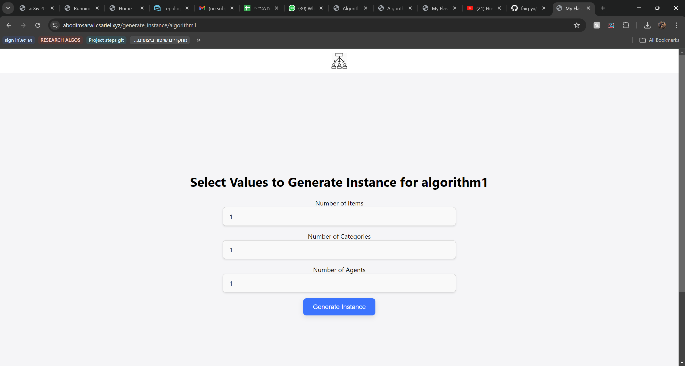
Random generator page
Simply creating for the user a random instance based on the criterions he selects

Slide 32
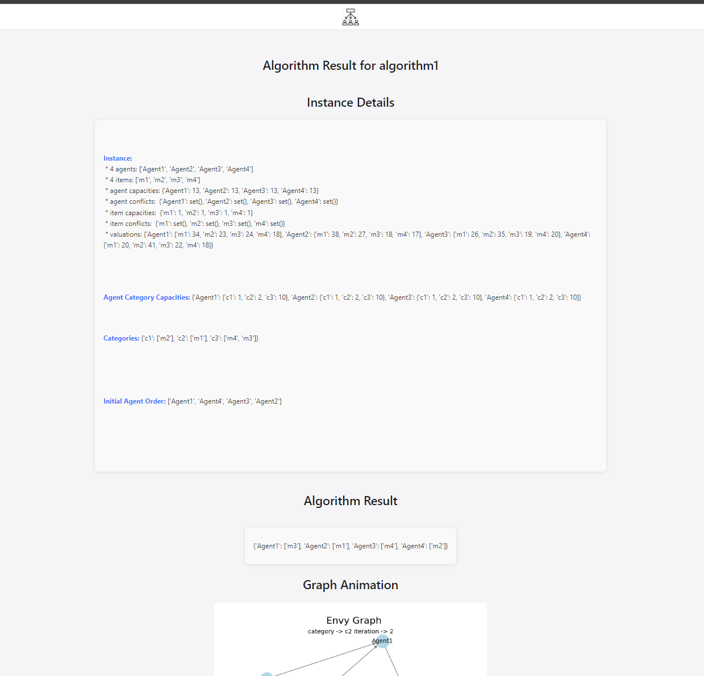
Result page
This page showing the input , the output and the visualizations of the graphs during the execution of the algorithm
It also has the functionality to show logs printed in the code in order to provide clarity on the nature of the algorithm

Slide 33
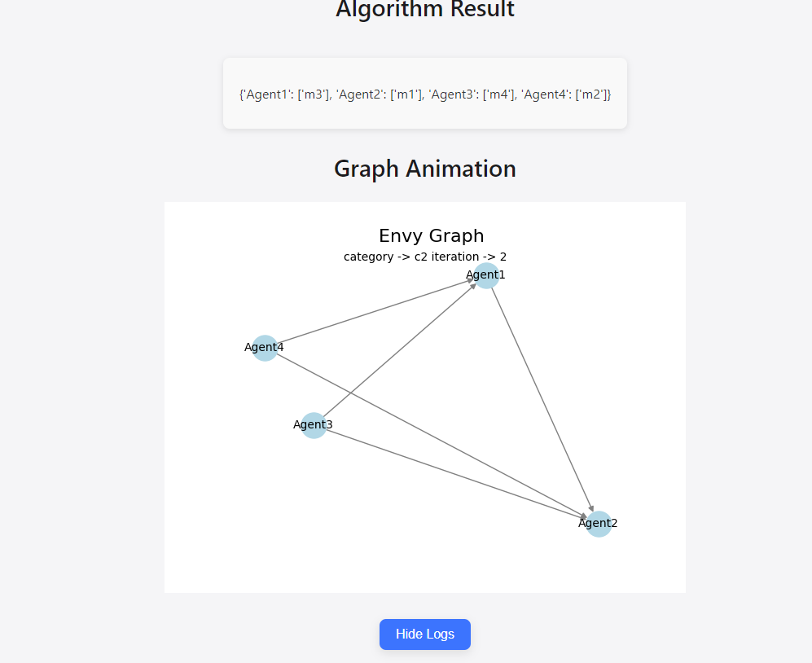
Result page

Slide 34
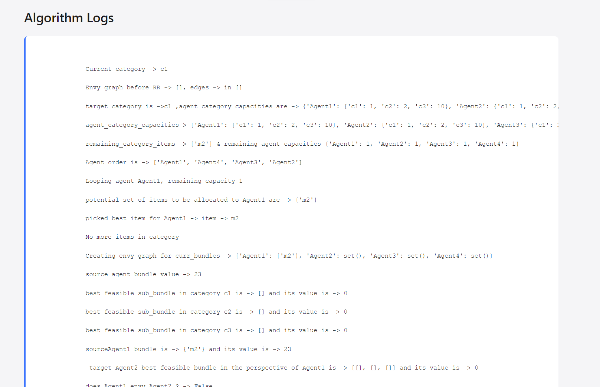
Result page

Slide 35
Final thoughts
This research topic inspired us to delve more into it , we implemented its code contributed to Fairpyx library , built a website showcasing it in an elegant way ! , the fact such algorithms solve daily life scenarios is itself a source of motivation for further research 😊

Slide 36
References
Project Book
our algorithms implementations
Research Papers

Slide 37
THANK YOU ☺

