Slide 1

Sho8lana
Freelancing Platform

Slide 2
Team Members
Abdallah Atya
(Frontend)
Mohamed Abohend
(Backend, Teamleader)
Abdelme3m Khalifa
(Frontend)
Sho8lana
Korolos Sameh
(Ui/Ux)
Mohamed Elsorbagy
(AI)
Omar Elbaz
(Mobile)

Slide 3




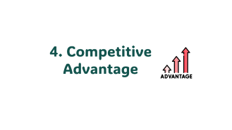
Business Discussion
5 Important Points
Sho8lana

Slide 4

1. Vision

Slide 5
1. Vision
Provide a unique freelancing model that facilitate the connection between freelancer and client and abstract all the details of developing a project from the client decreasing overall headache on client and providing flexibility of work for the freelancing.
Sho8lana

Slide 6

2. Mission

Slide 7
2. Mission
Develop and maintain secure and reliable system to provide:
Strong interaction between clients and freelancers.
Effective collaboration between freelancers with different skills.
Sho8lana

Slide 8

3. Freelancing Websites Market Place

Slide 9
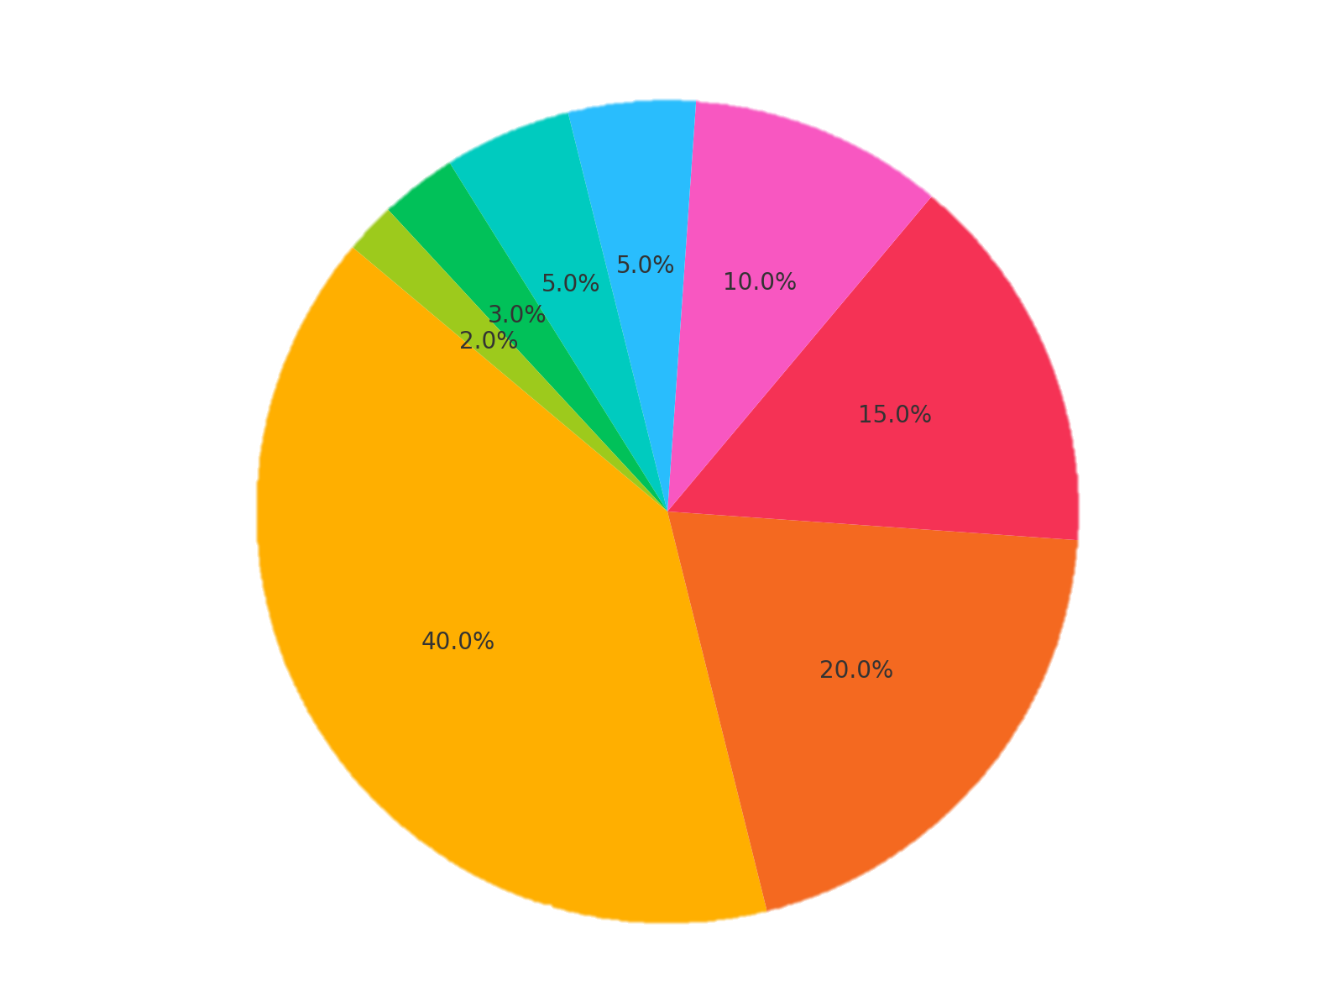




3. Freelancing Websites Market Place
PeoplePerHour
Guru
99designs
Others
Toptal
Sho8lana
Fiverr
Upwork
Freelancer

Slide 10
3. Freelancing Websites Market Place
Year 2022 | Annual Revenue | Total Transactions
 | $618.1 million | $4.5 billion
 | $47.6 million | $5.1 billion
 | $337.4 million | $1.1 billion
Upwork
Sho8lana
Freelancer
Fiverr
Notes:
Enterprise solution
Market position
Fee structure
Investment in platform

Slide 11
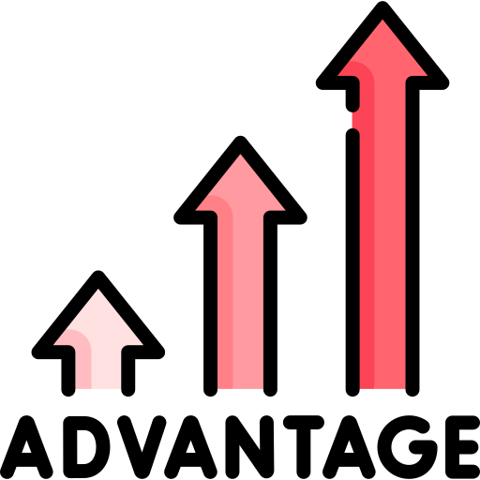
4. Competitive Advantage

Slide 12





4. Competitive Advantage
Problems with large projects
Big businesses struggle to hire entire teams efficiently.
Newcomers struggle to build profiles without big projects.
Sho8lana
Managing multiple roles in business is overwhelming.
Poor communication updates projects without budget awareness.
Isolation and lack of social interactions hinder teamwork.
Notes:
1-Big businesses find it hard to reach to a whole team Or hire complete squads
2-lack of communication updating projects without recognition about the budget
3-new commers find it hard to build up their profiles till they contribute to big projects
4-isolation and lack of social interactions
5-management of multiple roles handling all aspects of business can be overwhelming

Slide 13










4. Competitive Advantage
In Complex large project:
It require whole team to work on.
Dividing the large project to mini small projects
Solution – Client POV
Complete
Sad Client
Payment
Project
Sho8lana
Create
Abstract Process
Happy
Client
Final Product

Slide 14
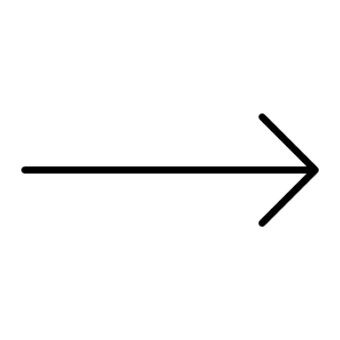


4. Competitive Advantage
Solution – Freelancer POV
Divide
Sho8lana
Assign

Slide 15

5.Revenue Model

Slide 16





5.Revenue Model
Promoted Listing Model
Subscription Revenue Model
Sho8lana
Hybrid
Revenue Model
Commission Revenue Model
Value Added Services Revenue Model
Notes:
1. Ad Revenue model a. freelancer => more jobs
b. Client => more project proposals
2. Commission Revenue model
taking percentage of payment from freelancer
3. Subscription Revenue model
freelancer / user has limited card to post / apply for projects
so subscription will allow them to have more
4. Value Added Services
Ai models will be available on website for instance easy tasks like speech to text service.

Slide 17

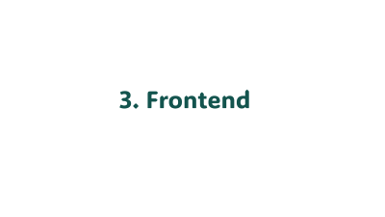
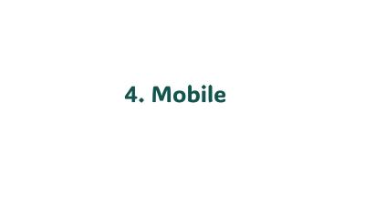
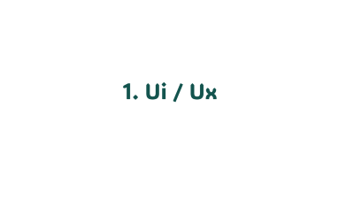
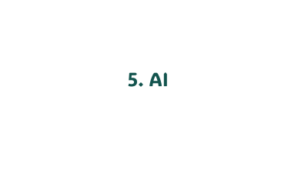
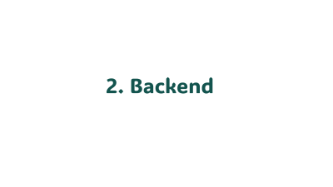
Tech. Discussion
Tech.
Topics
Notes:
Ui / ux
Frontend
Mobile
Backend
Ai

Slide 18
1. Ui / Ux

Slide 19
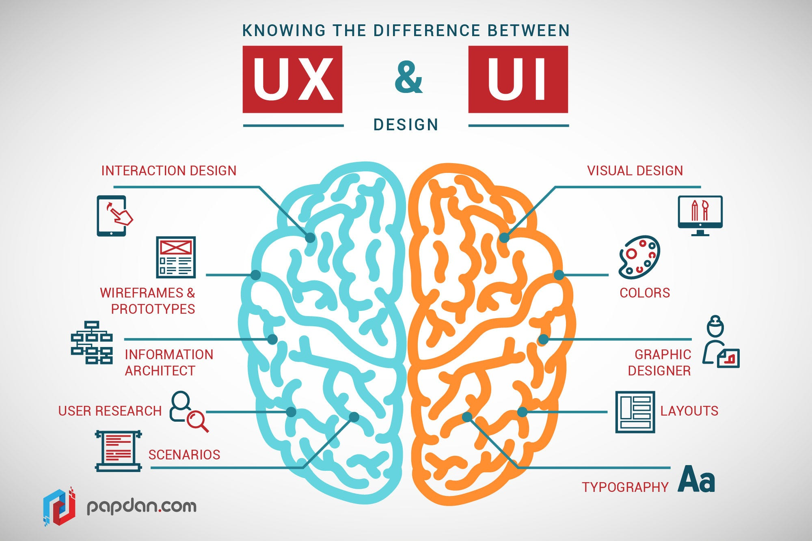
1. Ui / Ux
Sho8lana

Slide 20

1. Ui / Ux
Why Figma?
1 – Cloud storage .
2 – Continuously updates .
3 – Designers community .
4 – Components .
5 – Prototype .
6 – Figma mirror .
7 – Price .
Sho8lana

Slide 21
2. Backend

Slide 22



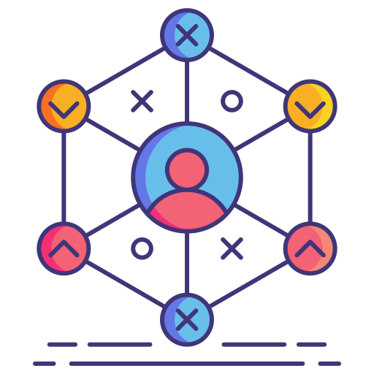



2. Backend
Technology used
Why?
Sho8lana
Cross
platform
Performance and
scalability
Comprehensive
ecosystem
Modern language
support
Security
Notes:
Cross platform:
.net apps can run on windows, mocOs, Linux.
Performance and scalability
High performance.
Provide scalability that is important to our application.
Comprehensive ecosystem:
Support libraries like:
Asp.net core => used to develop web applications.
EFCore => used for database access.
Support tools like:
Visual Studio => adv. Debug, test, deployment capabilities.
Security:
Support Built in security features:
Authentication & Authorization
Encryption
Regular update and patches.
Modern language features
Like c# and f# => which offer powerful features like asynchronous programming and type safety.

Slide 23
2. Backend
How it works internally?
MC
Architecture
MVC Pattern
View
Component
Sho8lana
=
-
Notes:
API depends on MC archeticture
MC is simplified version of mvc pattern without the view component

Slide 24


2. Backend
So, what’s MVC pattern ?
Request Process
Ask model for data
Ask data from DB
Sho8lana
Request
View
Controller
Model
Response
Data
Data
Data
Frontend
Backend
Notes:
API depends on MC archeticture
MC is simplified version of mvc pattern without the view component

Slide 25





2. Backend
Common Packages Used
Sho8lana
Auto Mapper
JWT
Identity
EFCore
SignalR
Notes:
Technology Used Common challenges 3
How it works internally

Slide 26




EF Core
Backend
Database
Class
Table Schema
Sho8lana
Freelancer object
Freelancer column
DB First
2 approaches
To work
Code First
Notes:
Used DB first because schema of database wasn’t clear at first
Will need a lot of updates

Slide 27
Auto Mapper
Freelancer
Id | Name | Birth Date | Email | Role | Password
Sho8lana
FreelancerDto
Name | Age | Email
Notes:
On creating or updating => take different data from user
On getting => take different data from user

Slide 28




Identity
Authentication
User
Management
Sho8lana
Provides
Authorization
Security
Notes:
Authentication : By multiple ways –user passwords –external login. support 2 factor authentication
Authorization: Manage permission and roles ensuring only authorized users can access data,.
User Management: Provide a predefined schema that store user information and role, also provide password recovery.
Security: implement best practices for security such as hashing passwords.

Slide 29

JWT
There is 2 common ways to authenticate a website
Sho8lana
Session cookies
JWT
Notes:
Technology Used Common challenges 3
How it works internally

Slide 30

Session cookies
Client
Server
Post Request (email, password)
Create session
In DB
Session Id as a cookie
Sho8lana
Request session ID cookie
Look up session by
session ID
Response
Notes:
Problems: 1. Session data storage can be bottleneck.
2. Server load due to session lookup for every request.
3. Cause problems with horizontally scaled application.

Slide 31
JWT
Client
Server
Post Request (email, password)
Create JWT with secret key
JWT
Sho8lana
Request JWT
Verify JWT
signature
Response
Notes:
JWT => Header (metadata) + payload (claims) + signature Problems: 1. Could share jwt between multiple users => refresh token + add claim with ip address to the payload

Slide 32


SignalR
Add real-time web functionalities
(Get response without refreshing the page)
Sho8lana
Notes:
Polling
Long polling
ForeverFrames
Server Send Events
Web Sockets

Slide 33
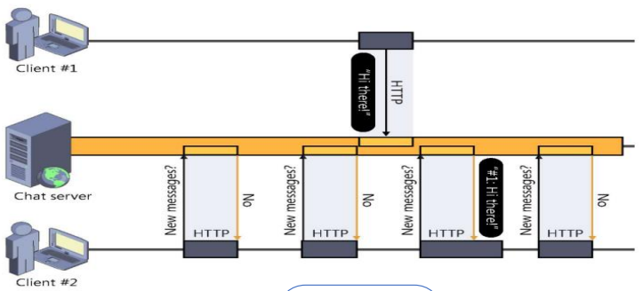
Polling
Sho8lana
Notes:
Why?

Slide 34
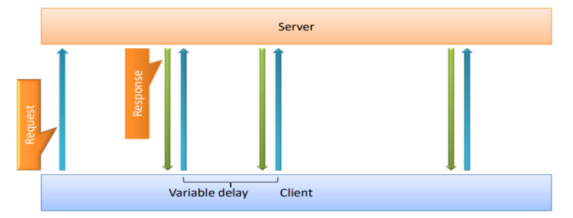
Long Polling
Sho8lana
Notes:
Why?

Slide 35
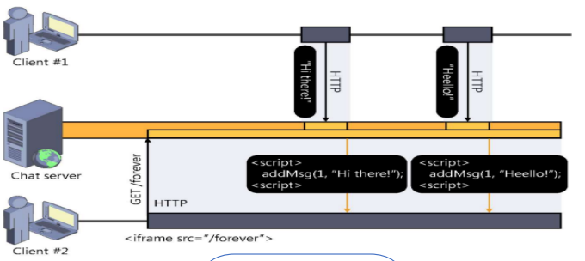
Forever Frames
Sho8lana
Notes:
http request send in chunks
Only supported by IE

Slide 36
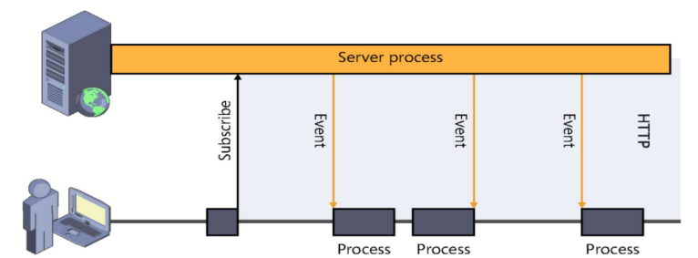
Server Send Events
Sho8lana
Notes:
Only one way communication from server to client

Slide 37
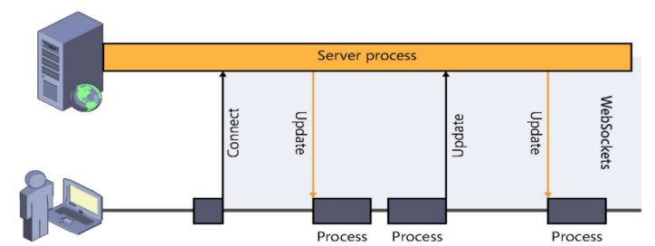
Web Sockets
Sho8lana
Notes:
2 ways of communication between server and client
Polling
Long polling
Forever Frames
Server Send Events
Web Sockets

Slide 38
3. Frontend

Slide 39



3. Frontend
There is 2 common frontend technologies:
Declarative views
JSX advantage
Virtual DOM
One-way data binding
Building blocks flexibility
Sho8lana
But Why react over angular?

Slide 40




3. Frontend
Common Packages Used
Sho8lana
React Query
Bootstrap
Material-UI
React Dropzone

Slide 41
React Query Adv.
Simplified Data Fetching: Abstracts away repetitive code.
Automatic Caching: Improves performance by storing fetched data.
Background Updates: Keeps data fresh without interrupting the user.
Error Handling: Provides tools for managing and displaying errors.
Optimistic Updates: Enhances user experience by showing changes immediately.
Sho8lana

Slide 42




Bootstrap Adv.
Lightweight HTTP Client: Simple and easy to use.
Promises-Based: Familiar API for asynchronous operations.
Sho8lana
Interceptors: Handle requests and responses globally.
Cancelation Support: Gracefully abort requests when needed.

Slide 43
Material-UI Adv.
Consistent UI: Ensures a uniform look and feel across your application
A component library for React
Sho8lana
Implements Google's Material Design guidelines
Offers a wide range of pre-built components

Slide 44
React Dropzone Adv.
Improved User Experience
Sho8lana
Reduced Development Time
Flexibility and Customization

Slide 45

Demo Time

Slide 46
4. Mobile

Slide 47







4. Mobile
Technology Used
Why?
Sho8lana
Cross-Platform Development
Hot Reload
Beautiful and Customizable UIs
Strong Community
Development Efficiency
Notes:
Cross-Platform Development:
Single Codebase: Flutter allows you to write one codebase for both iOS and Android platforms, significantly reducing development time and effort.
Consistency: Ensures consistent UI and performance across different platforms.
Hot Reload:
Fast Iteration: The hot reload feature allows developers to see changes in real-time without restarting the application, speeding up the development process and making it easier to experiment and iterate.
Beautiful and Customizable UIs:
Rich Widgets: Flutter offers a rich set of customizable widgets that make it easy to create attractive and responsive user interfaces.
Custom Designs: The flexibility to create custom designs that match your vision without compromising on performance.
Strong Community
Growing Community: Flutter has a large and active community, providing extensive support, tutorials, and libraries.
Plugins and Packages: A vast collection of plugins and packages available through Pub.dev to extend functionality and integrate with other services.
Development Efficiency:
Productivity: Flutter's comprehensive development tools and libraries boost productivity and help deliver applications faster.
Reduced Costs: By developing for multiple platforms simultaneously, Flutter reduces the overall cost and time to market.

Slide 48
4. Mobile
Common Packages
Image picker:
Purpose: Allows users to pick images from their device gallery or capture images using the camera.
Usage: Facilitates image selection and uploading features in your app.
Sho8lana
Carousel slider:
Purpose: Provides a carousel slider widget.
Usage: Displays images, content, or any other widget in a carousel fashion, enhancing the UI/UX.

Slide 49
4. Mobile
Common Packages
Http:
Purpose: Handles HTTP requests.
Usage: Facilitates communication with web services and APIs to fetch or send data.
Sho8lana
Provider:
Purpose: Manages state in your Flutter application.
Usage: Provides a reactive state management solution, making it easier to manage and share application state across different parts of the app.
Another_flushbar:
Purpose: Displays flush bar notifications.
Usage: Shows temporary and customizable in-app notifications for user feedback or alerts.

Slide 50



4. Mobile
Common Challenges
Sho8lana
State Management
Ui/Ux
Desing
Testing &
Debuging
Network &
API handling
Notes:
State Management:
Using the provider package to manage the state across different screens and components.
UI/UX Design:
Custom Design Implementation: Implementing a user-friendly and attractive UI for the freelance platform.
Testing and Debugging:
Testing: Making sure the application works fine and smoothly.
Debugging: Identifying and fixing bugs, especially those that are platform-specific or occur in production.
Network and API Handling:
Error Handling: Properly handling network errors, timeouts, and retries.
Data Parsing: Efficiently parsing and managing data from APIs.

Slide 51
Demo Time

Slide 52
5. AI

Slide 53


5. AI
2 Models
Team matching
recommendation system
CV Parser

Slide 54

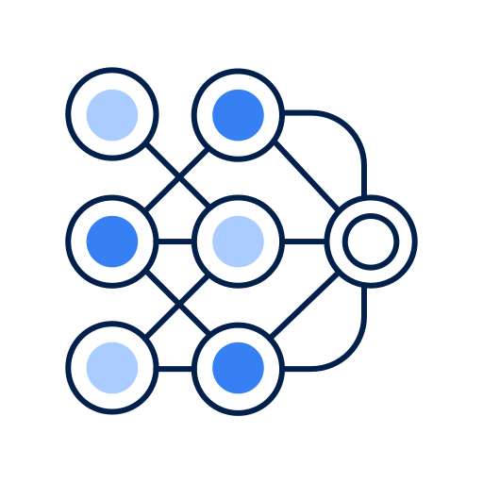


5. AI
CV Parser
Importance
Dalvan model
Challenges
Deployment

Slide 55

5. AI
Team matching recommendation system
Recommendation System for Matching Freelancers Using Graph Neural Networks (GNNs)
Importance
GNN architecture
(message passing _ polling and readout)
Challenges
Graph representation
Notes:
1-importance of recom sys 2--graph representation 2-GNN architecture (message passing _ polling and readout) 3- challenges

Slide 56
Future Work

Slide 57


Future Work (V2)
Freelancer-Project Recommendation
System
Rating system for Freelancer and clients
Sho8lana
Future Work
Stripe Payment service Integration
Ai Value added services
Recommendation system for team matching.
Integrate with payment service (Stripe).
Rating system for freelancers and clients.
AI value added services.

Slide 58
﴿ وَقُلْ رَبِّ زِدْنِي عِلْمًا ﴾

Slide 59

إتخرجنا يا رجالة

