Slide 1
Control Systems in a Nutshell
A PowerPoint2Beamer demo

Slide 2
Feedback control
A controller compares the output with the reference
  Proportional, integral and derivative actions
  Tuned from a model or from experiments
Too much gain makes the loop unstable!
A well-tuned loop is fast and stable

Slide 3
Transfer functions
The Laplace transform turns differential equations into algebra:
$$F(s)=\int_{0}^{∞}{f(t)e^{−st}dt}$$
First-order and second-order systems:
$$G(s)=\frac{K}{τs+1}$$
$$H(s)=\frac{ω_{n}^{2}}{s^{2}+2ζω_{n}s+ω_{n}^{2}}$$

Slide 4
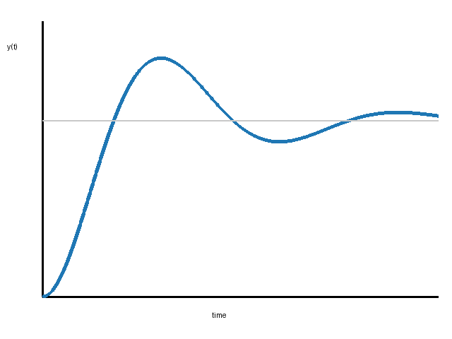
Step response
The output after a sudden change of the input
  Rise time
  Overshoot
  Settling time
  Steady-state error

Slide 5
Ziegler–Nichols tuning
Controller | Kp | Ti | Td
P | 0.5 Ku | — | —
PI | 0.45 Ku | Tu / 1.2 | —
PID | 0.6 Ku | Tu / 2 | Tu / 8

Slide 6
Closed-loop block diagram
+
C(s)
G(s)
R(s)
Y(s)
−

Slide 7
Response to a step input

Slide 8
Designing a controller
1. Model the system
2. Choose the specifications
3. Tune the controller
4. Simulate and verify

