Slide 1


AIRBNB-Paris(Ile De France)
Presentation by:
Sojasingarayar Abonia
M2-IA

Slide 2
Dataset
I was perform an analysis of the detailed Paris listings data, sourced from the Inside Airbnb website, in order to understand the rental landscape and try to recommend a price for a newbie entering the market. The dataset is named listings.csv.gz and was scraped on March 15th 2020

Slide 3
Key concept in the Project:
Data Exploration
Visualization
Preprocessing
Cross validation
Hyperparameter optimization
Building the estimator
Prediction
Scoring
Data interpretation

Slide 4
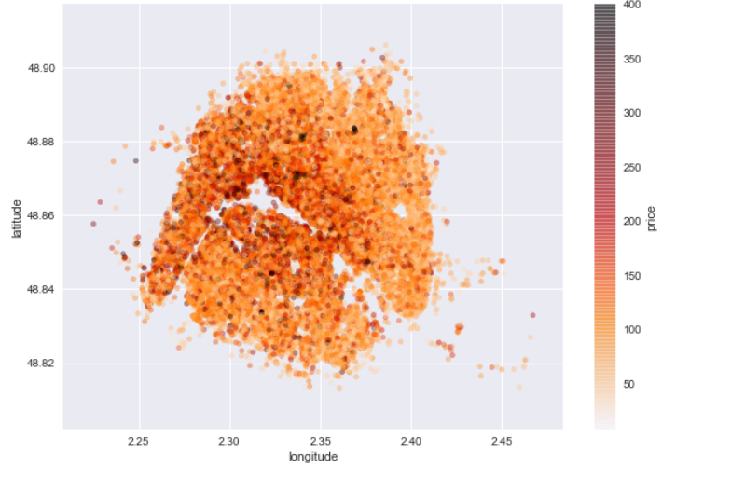
Price distribution - Paris(Ile de France)

Slide 5
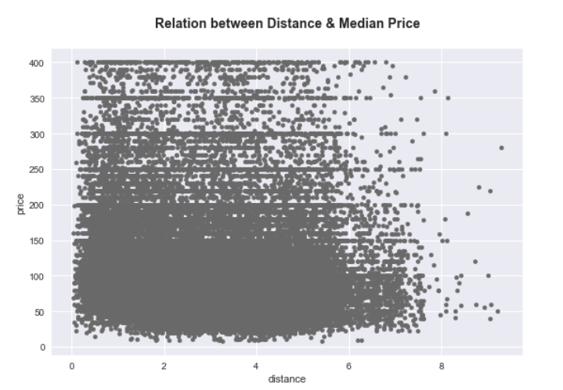
Price Differences by Accommodation Distance to Center of Paris

Slide 6
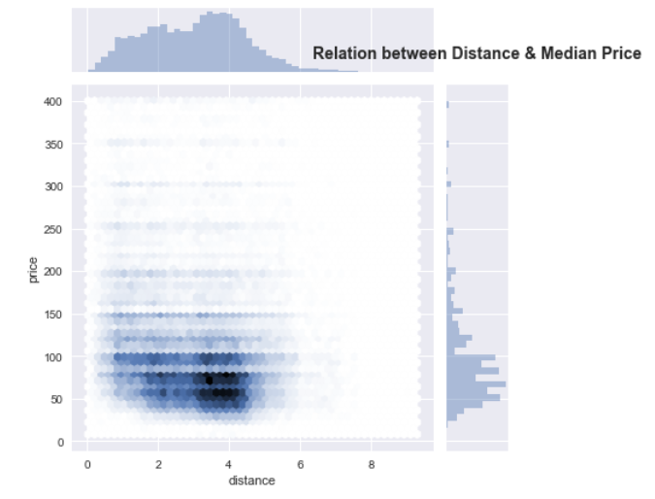
Joint plot(Hex Graph):

Slide 7
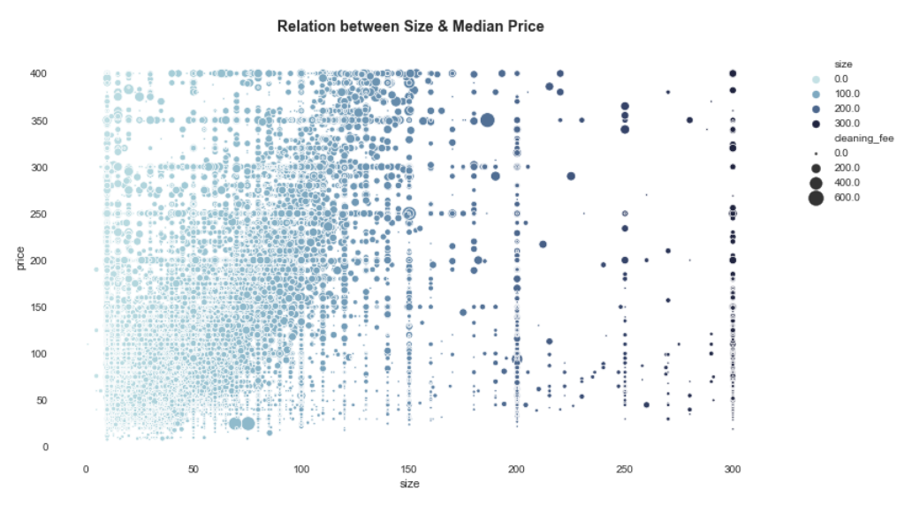
Price Differences by Accommodation Size

Slide 8
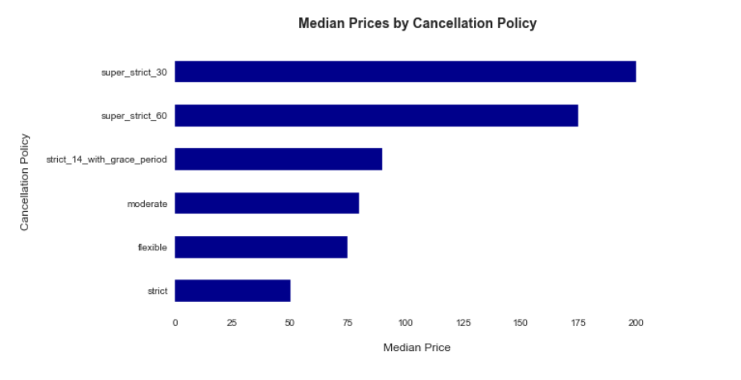
Price Differences by Cancellation Policy

Slide 9
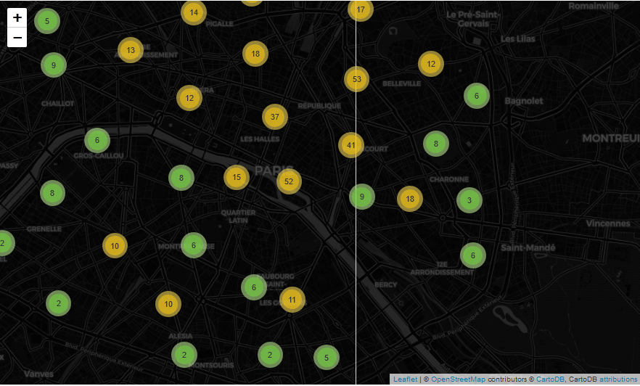
Number of listing per city

Slide 10
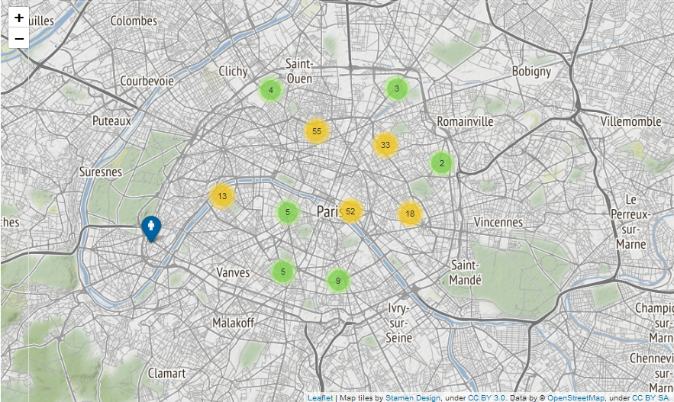
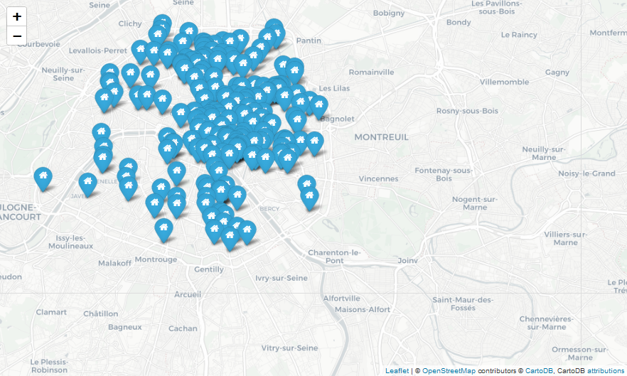
Mapdata visualisation for Number of listing:

Slide 11
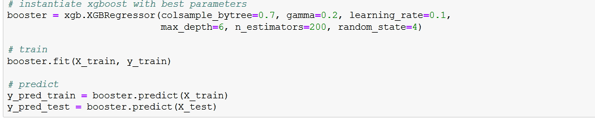
Model

Slide 12
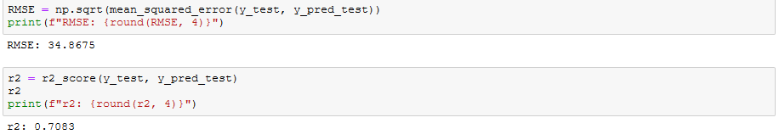
R2 score and RMSE

Slide 13
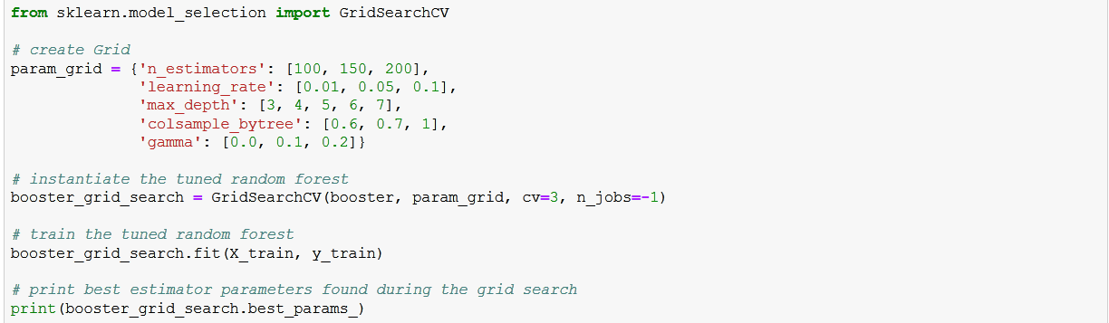
Hyperparameter Optimization

Slide 14
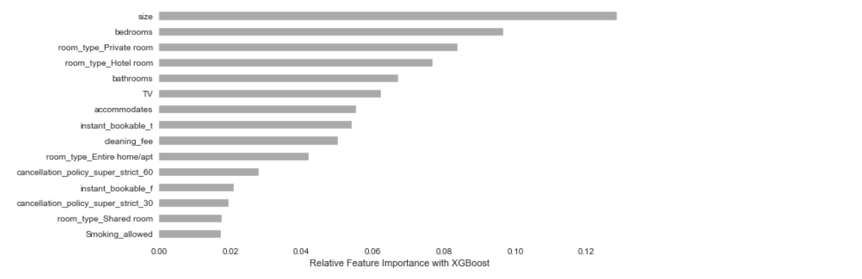
Data Interpretation:

