Slide 1


Project Water Scout
Project Black is an innovative project aimed at securing
healthy drinking water for individuals and communities through comprehensive monitoring and
analysis of water quality. It focuses on efficient water use and the search for fresh water
supplies, utilizing integrated water resources management and advanced technological
solutions.
By CODE BLACK
Sa
Notes:
1

Slide 2
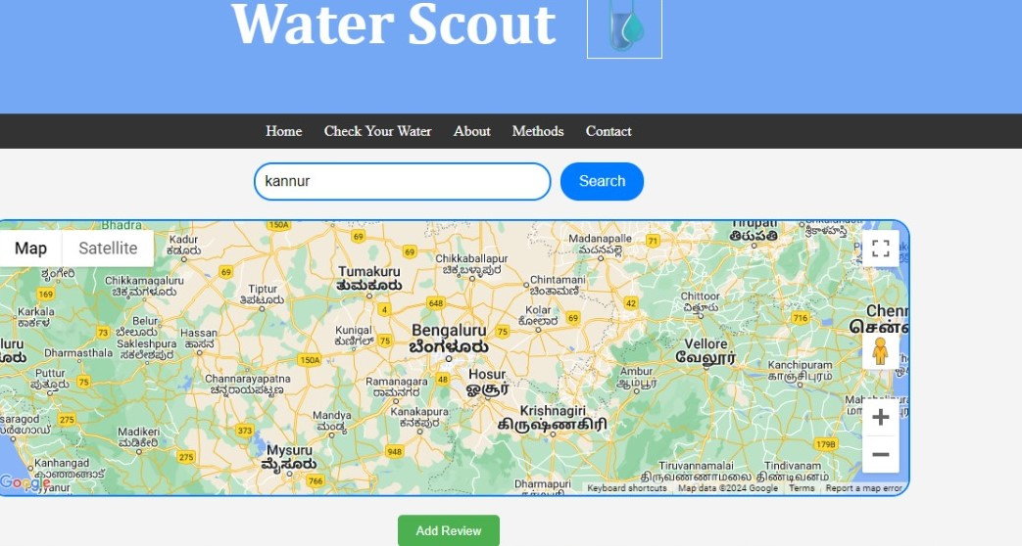
What is Water Scout?
Water Scout is a comprehensive platform that leverages advanced data analytics and predictive modeling to provide real-time insights into water quality, condition and purification solutions. Its mission is to empower communities, and individuals by ensuring they are getting the best of quality water.
Notes:
2

Slide 3
Key Features:
Real-Time Monitoring
Predictive Analytics
Water Scout's search option provides facility for users to access water sources in a locality showcasing its quality ,rating and availability.
By leveraging scientific and user input data it ensures the credibility and genuinity of the ratings provided
Water quality in locality
Community driven Ecosystem
Water scout provides users with non-scientific knowledge the data thet require in a much easy to understand manner.
Water Scout fosters a colmmunity driven ecosystem where everyone has a role to play whether inputting data or obtaining data.
Notes:
3

Slide 4
Applications
User Relocation
Water Quality checking
New users shifting to a location can access tthe water availability in an area allowing them a preferable choice.
Allows people with scientific as well as non-scientific knowledge to equally analyse the data provided.
Disater Relocation
Community Engagement
Incase of any disaster relocation,water scout can tie up with government providing data to ensure a safe environment with quality wtaer for people to live.
Water Scout empowers citizens to track local water quality andreport issues.
Notes:
4

Slide 5
Tech Stack:
Software:
HTML
Javascript
CSS
Notes:
5

Slide 6
Possibilities
worldwide scaling
Colab with Google maps/Govt Organisations
Water Scout requires 0 hardware and less people involved in backend ensuring a worldwide scalability.
On collaborating with government organisations and other services the level of application of waer scout may increase tremendously.
Purifier System Ad generation
On providing branded purifiers for purification,collaborating with such multinational companies providing them space for promotion,revenue generation gets easier ensuring smooth operation of the software.
Notes:
6

Slide 7
THANK YOU
Notes:
8

