Slide 1
Using Open Source Software to Project Renewable Energy
Abed Ayyad, MSc Energy Science
...but see my papers:

Slide 2
Acknowledgements: Up front
Big thanks to you, VanLUG, for showing up, but especially to Nestor for making this happen
Props to my friends and colleagues at Utrecht University, especially Sara Mirbagheri
The open source communities for R, Python PVLIB and GenX
Books and media credited on the slides
I love the BPL!

Slide 3
What do I get out of it?
It’s kind of fun to see how an understanding of some basic concepts, together with openly accessible to data, allows you to get a grasp of how renewables work
You get a link to some GitHub codes at the end
Contributing to informed citizenship (I hope)

Slide 4
Ground Rules
All you need to know:
Some basic math and physics (quick review)
Some idea of how programming and APIs work
Willingness to have a discussion
Tolerance has limits:
The earth is round (more or less)
Vaccines really do work!
Climate change is real and happening

Slide 5
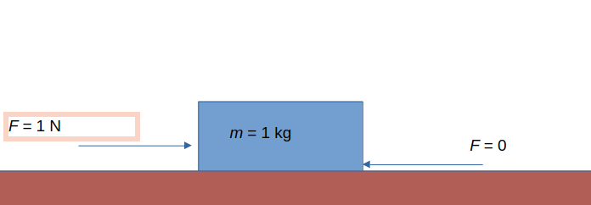
What is Energy?
If you can push a 1 kg box so that it accelerates 1 m/s/s on a flat surface: 1 N, “force”
1 J = 1 Newton of force pushed for 1 m, “energy”
If I do 1 J of “work” in 1 second = 1 Watt, “power”
A cup of coffee: 50 kJ; in 5 minutes = 1 kW
My laptop for: 11.4 W (typical)
Going back: 1 W for 3600 seconds = 1 kWh
“Average” BC household | 11,000 kWh/year (~40 000 MJ)
Typical peak power in BC
Electricity is not the whole picture: Electricity is 258 PJ out of 1,187 PJ end-use in BC. Within households, it is 40%.

Slide 6

I need a cup of coffee... (Whiteboard exercise)
To heat a cup of coffee:
Say you need 250 ml of water: this is 250 g = 0.25 kg
Say you need to start at 15 ° Celsius and go up to 70° (no, you do not want coffee at 100 C)
For each 1° increase in the temperature of 1 kg of water, you need 4.2 kJ (actually, 4.184); this is called “specific heat”
We’ll get to why tea is actually a better example ...
Cup of coffee (Wikimedia)

Slide 7
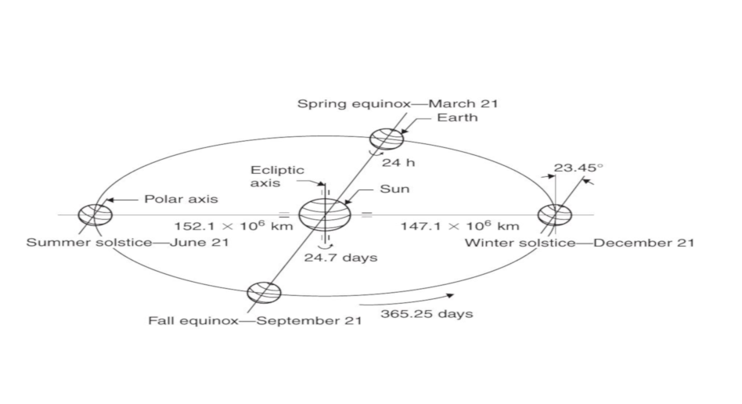
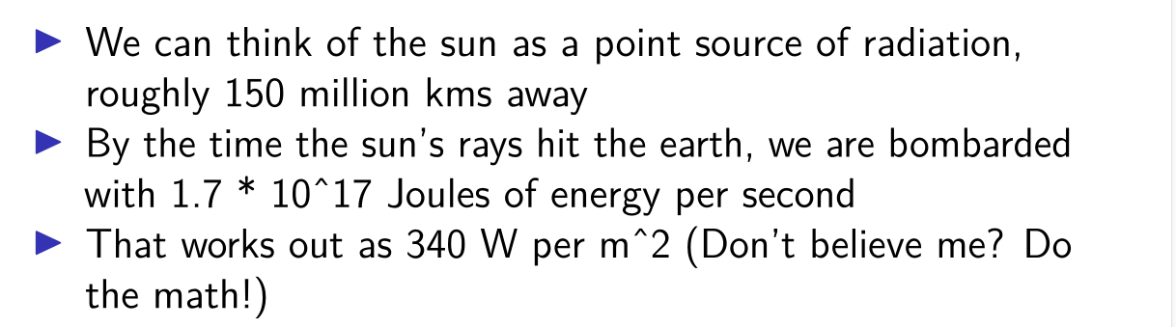
How much could come from the Sun?
Image from Kaligorou, Solar Energy Engineering, 2013

Slide 8
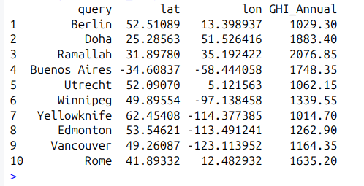
Querying NASA POWER
#Pretty arbitrary choice of cities
vanlug.cities = c("Rome", "Vancouver", "Edmonton", "Yellowknife", "Winnipeg", "Utrecht", "Buenos Aires", "Ramallah", "Doha", "Berlin")
#Get it started and then build from there: we want a dataframe with the long/lat coordinates
vldf = data.frame(nominatimlite::geo_lite(vanlug.cities[1]))
downloaded_data = data.frame(nasapower::get_power(community = "RE", pars = "ALLSKY_SFC_SW_DWN",
temporal_api = "CLIMATOLOGY",lonlat = c(vldf[i,3], vldf[i,2])))

Slide 9
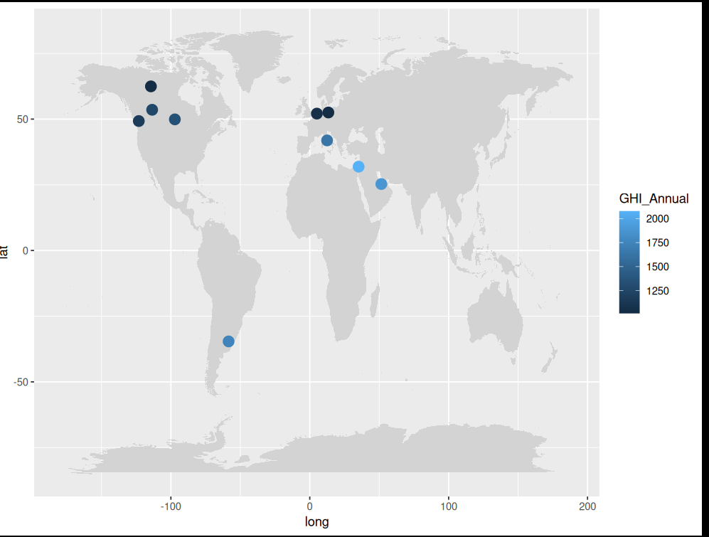
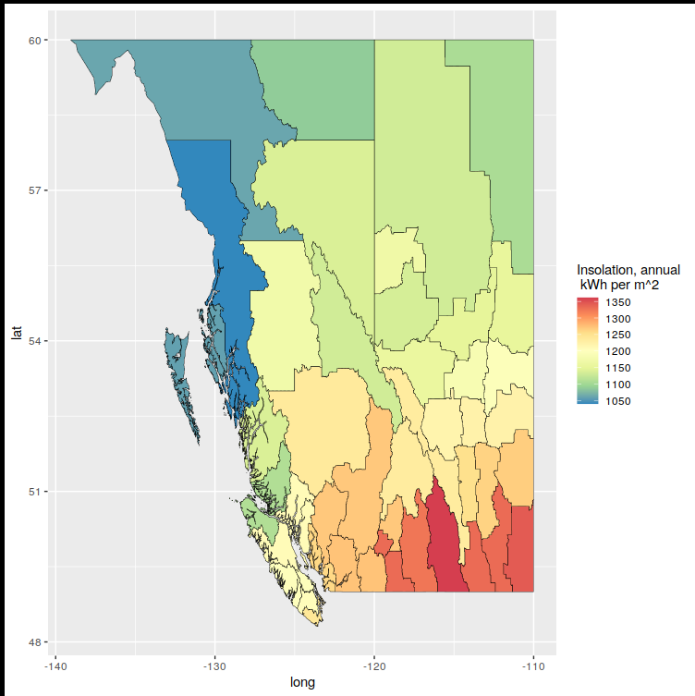

Slide 10
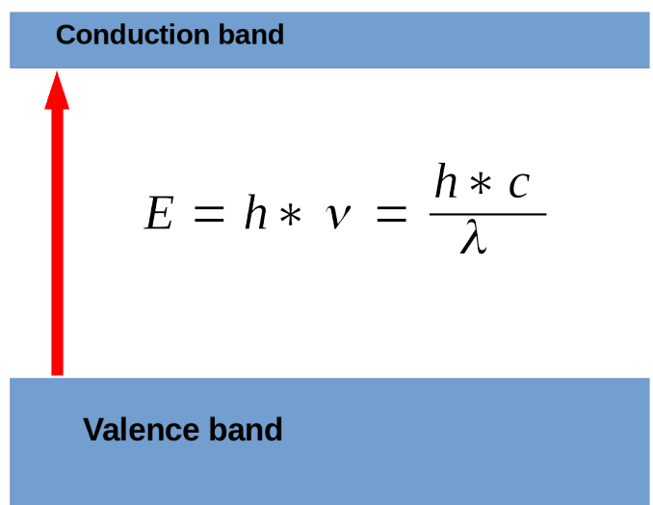
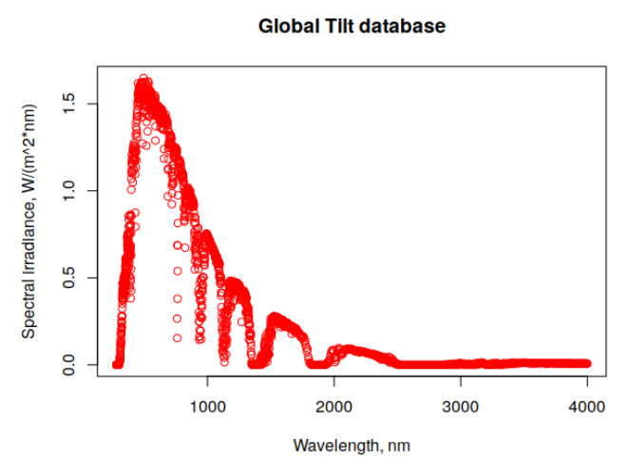
How do we harness that?
PV cells are semiconductors
Temperature dependence
Not all photons created equal
DC current is generated, but the grid needs AC

Slide 11
Some important equations
$T_{cell}=T_{amb}+\frac{G_{POA}}{U_{0}+U_{1}∗v_{air}}$
$E_{yield}\left(DC\right)=\frac{η∗G_{POA}∗P_{rated}}{G_{standard}}$
$η_{module}=F\left(T_{cell}\right)$

Slide 12
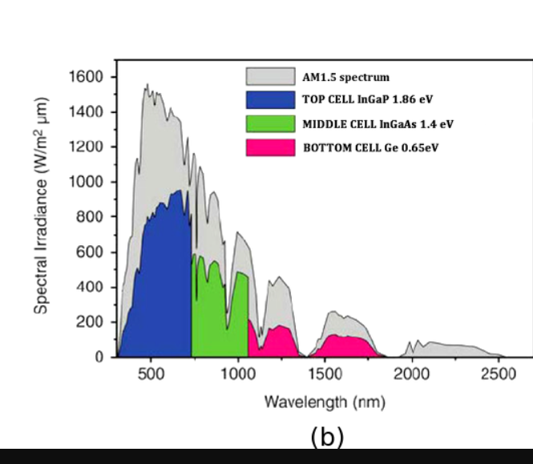
More on conversion efficiency
Physical limit: the “Schockley-Quisser Limit” : ~ 34%
I’m lying because:
Multijunction cells
Accelerating downward trend of costs
Non-silicon technologies becoming more stable
We are actually improving a lot in our ability to approach that
Wikimedia

Slide 13
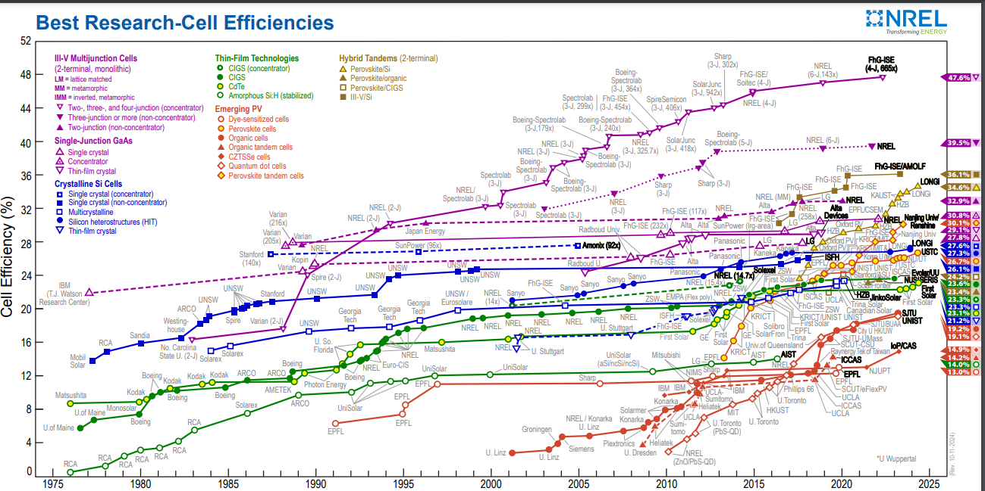

Slide 14
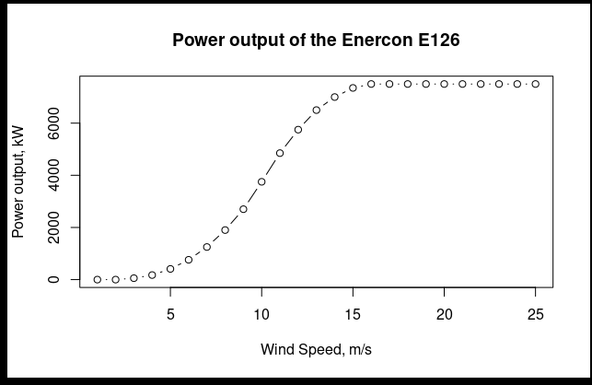
Anything else?
Wind power actually comes from the Sun!
The energy in the wind is proportional to:
The swept area (of the turbine)
The wind speed
The density of the air
Wind speed measured at hub height, and the roughness of the ground is a factor!

Slide 15
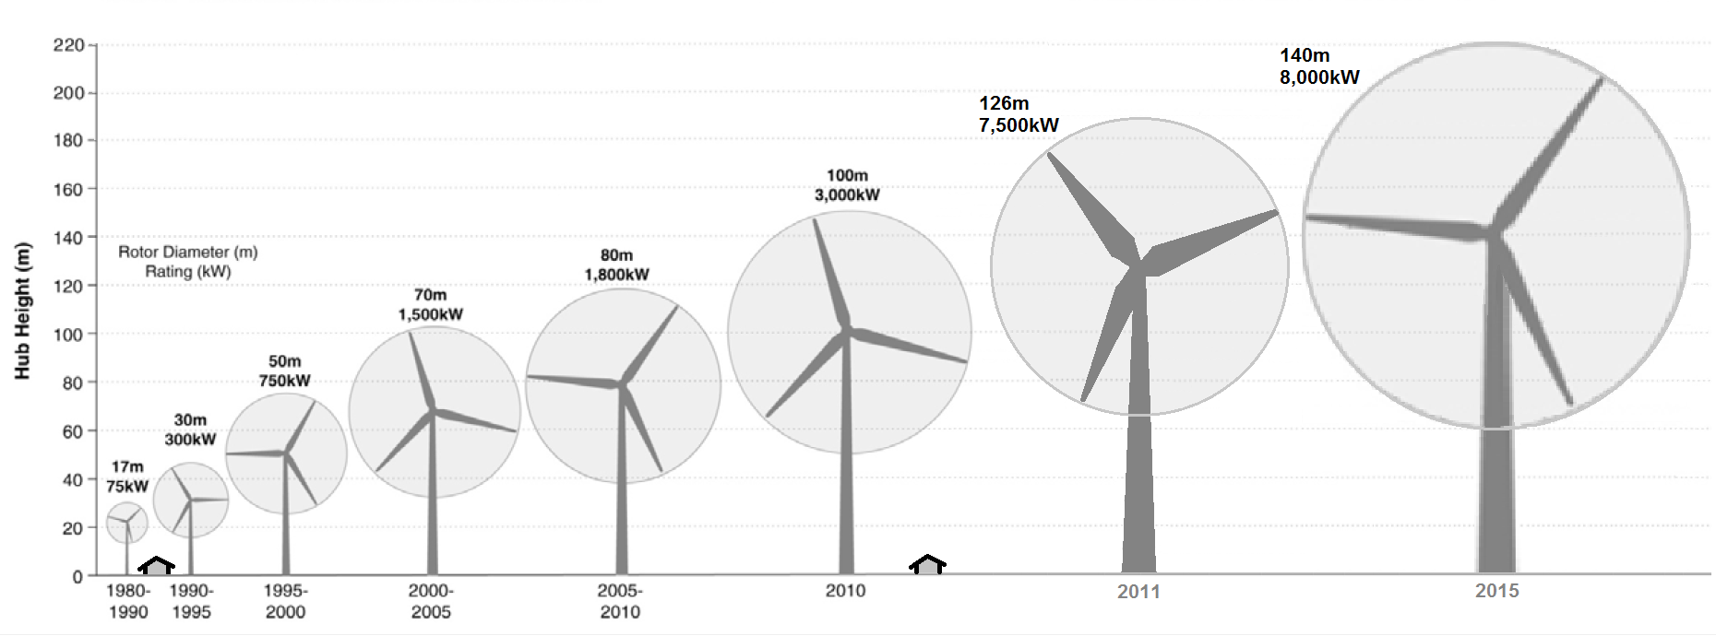
Wind turbines
Wikimedia

Slide 16
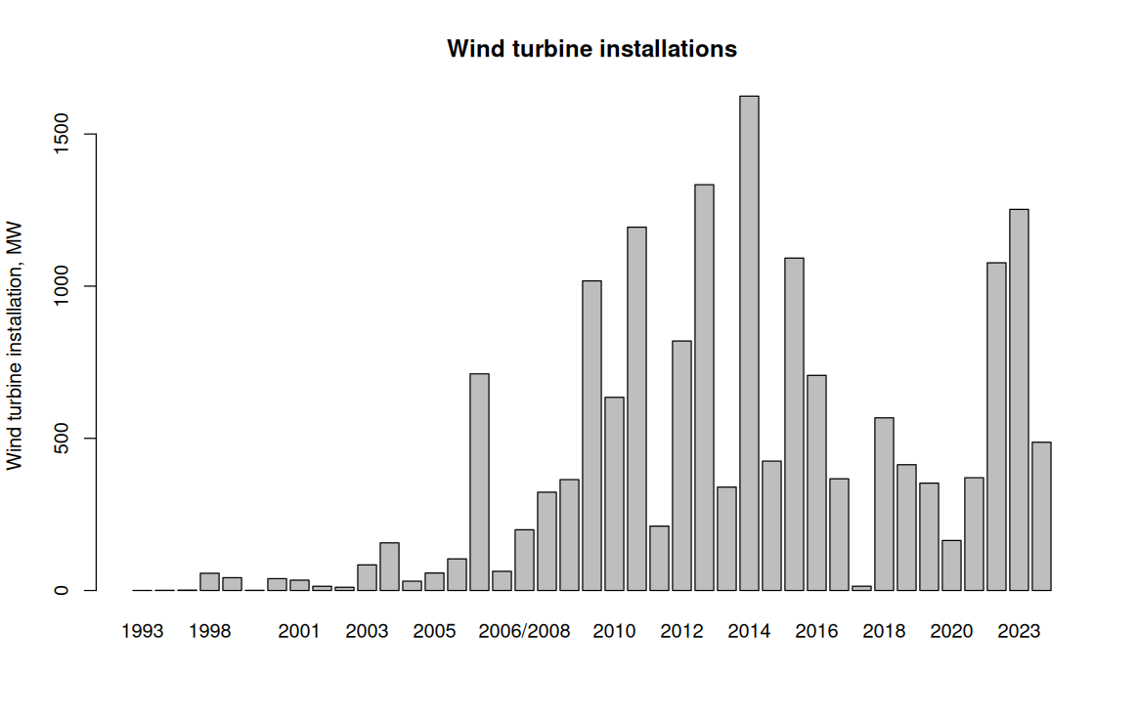
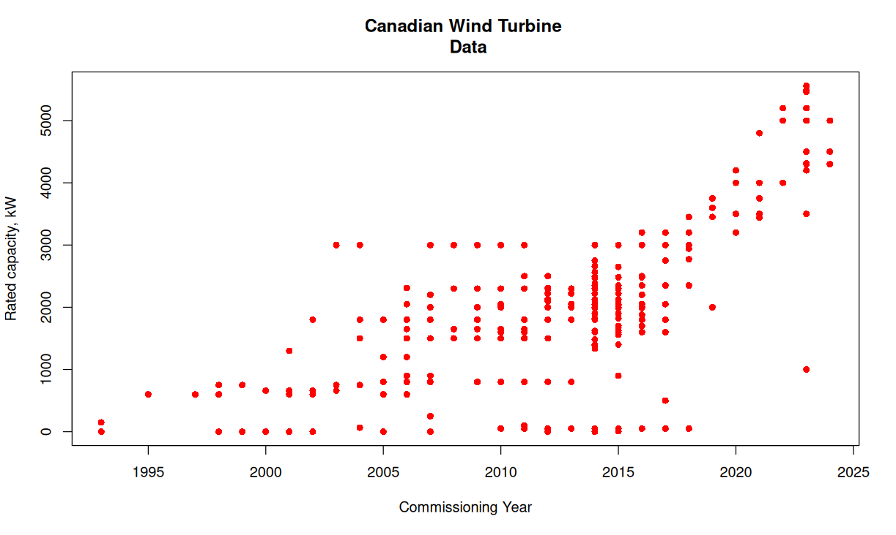
Trends in Canada

Slide 17
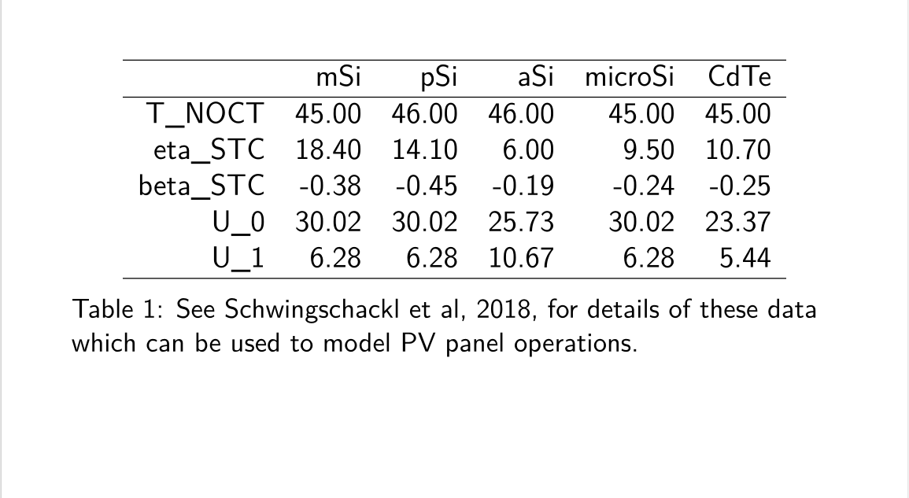
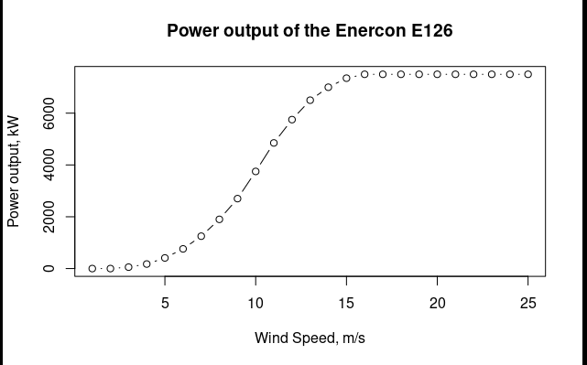
Try it at home

Slide 18
Downloading Weather Data
Solar insolation is important to me: we will focus on GHI only
Wind speed is important to us—we are going to make an assumption about surface roughness
If we wanted to talk about

Slide 19
Show me the codes!
Python-PVLIB:
Read in weather data
Compute the hourly cell temps
Compute hourly efficiencies
Compute AC yields
Wind power from scratch: find wind power, and determine which bucket it falls into!

Slide 20
A (Partial) List of MASSIVE Simplifications
I probably should have said more about inverters: making DC-to-AC possible
Shading is a real issue, for solar PV and for wind turbines: impact on cost
Solid state physics: a lot left out
MPP tracking
Left out the building energy modelling, for now
Better understanding of the wind energy profile

Slide 21
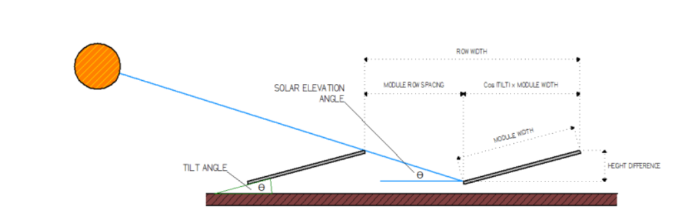
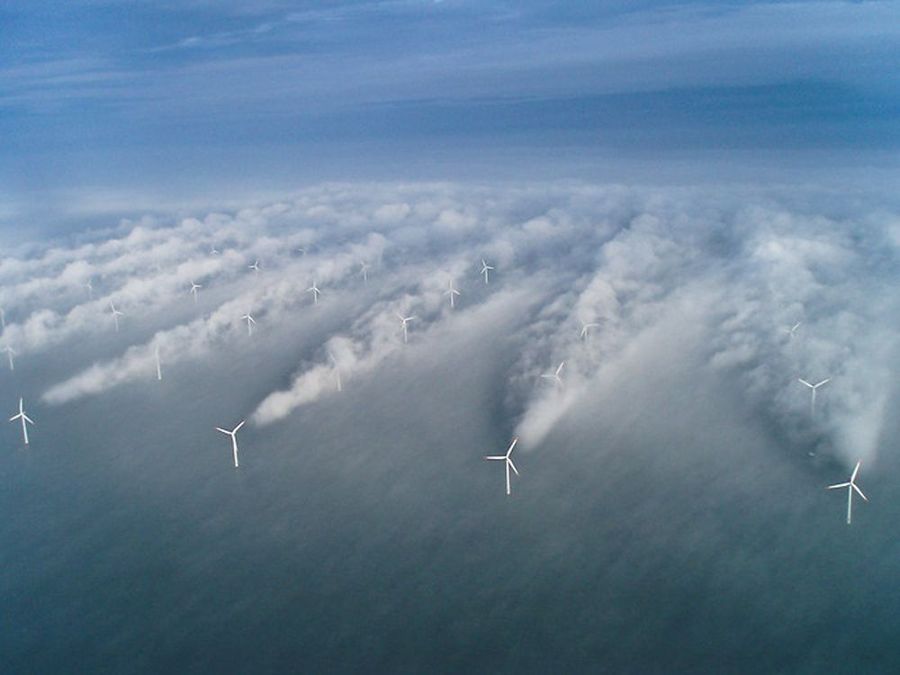
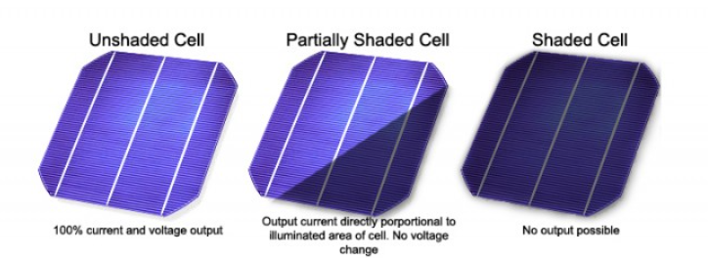
Photo copied from GreenTech Renewables
...also shading here!
Photo copied from Gavin Mooney on LinkedIn
Photo copied from MCI Solutions

Slide 22
What’s stopping us?
The so-called “Duck Curve” (for solar)
Scaling/costs/difficulties of storage
Grid interconnection costs

Slide 23
Bringing it to the Grid ... with FLOSS!
In a system, we have to consider constraints, not always in harmony:
Minimize the total cost
Meet all demand
Cap (total) emissions
Apply max/min operating hours to a given generator
Anything else?
The industry standard has been GAMS
GenX: released by the US’ NREL: implemented in Julia
PyPAS: a Python model for electricity systems

Slide 24
We start out knowing:
How much electricity demand do we have? How does it evolve?
Bonus: trades
How much does (will) it cost to build a generator of type X?
How much does it cost to run each type?
How much do they emit?
We would like to know:
How much electricity do we generate?
Do we need to trade?
How much have we spent to meet our demand?
Carbon emissions?
How have the generation/transmission costs evolved?

Slide 25
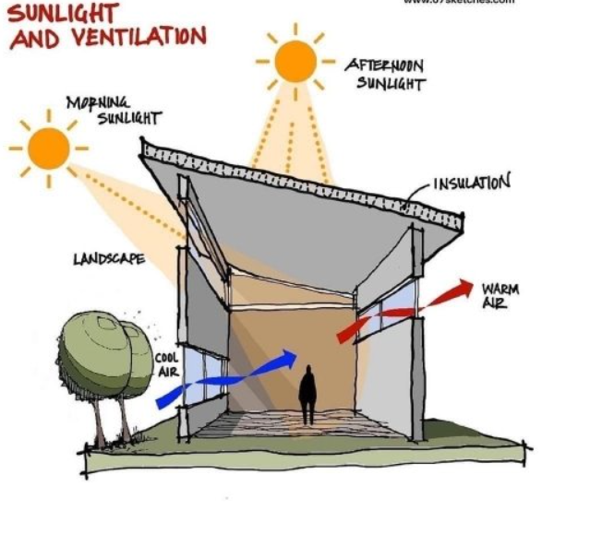
Honourable Mentions from NREL
OpenStudio, “Building Energy Management”
Surfaces/Windows
Area/footprint
Time of day
Location, needs
SAM:
Consumer-side renewable resource
“Techno-economic”: not the same level of granularity as Open Studio
Also open source!
Image courtesy of the US Department of Energy

