Slide 1




Team
OUR MEMBERS
Amjad Awad
Yahya Dalbah
Ahmad Iyrot
Abood Jbr

Slide 2
Project
Description
The Tweet Analysis Pipeline is designed to process live Twitter streams for sentiment analysis, trending hashtag identification, and data visualization.

Slide 3


Real-Time Twitter Data Analysis
Our Problem:
Extract meaningful insights from the vast amount of Twitter data in real time. With millions of tweets generated daily, organizations face challenges in efficiently processing, analyzing, and visualizing this high-volume data
Target Audience:
Data Scientists: For developing predictive models and analyzing sentiment trends.
Social Media Analysts: For monitoring brand sentiment, tracking viral trends, and understanding audience behavior.
Researchers: For studying public opinion, social movements, or market trends.

Slide 4
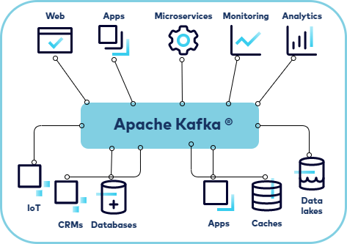
Apache Kafka

Slide 5



Data Processing
Hashtag Extraction
Sentiment Analysis
Searchability

Slide 6



Data Storage in Twitter Data Pipeline
Key Considerations for Storage:
Scalability: The storage system must handle high-velocity Twitter data efficiently.
Real-Time Access: Supports near-instantaneous querying for analytics and visualization.
Reliability: Ensures no data loss during ingestion and processing.
Storage Solutions:
Apache Kafka: Acts as a distributed message broker, buffering real-time data streams.
Elasticsearch: Indexes and stores data for fast search and analytics.
Distributed File Systems (e.g., HDFS): Optional for long-term batch processing and archiving.
Why It Matters: Proper storage ensures the pipeline’s ability to scale, process, and retrieve meaningful insights efficiently. Elastic search is the slide

Slide 7
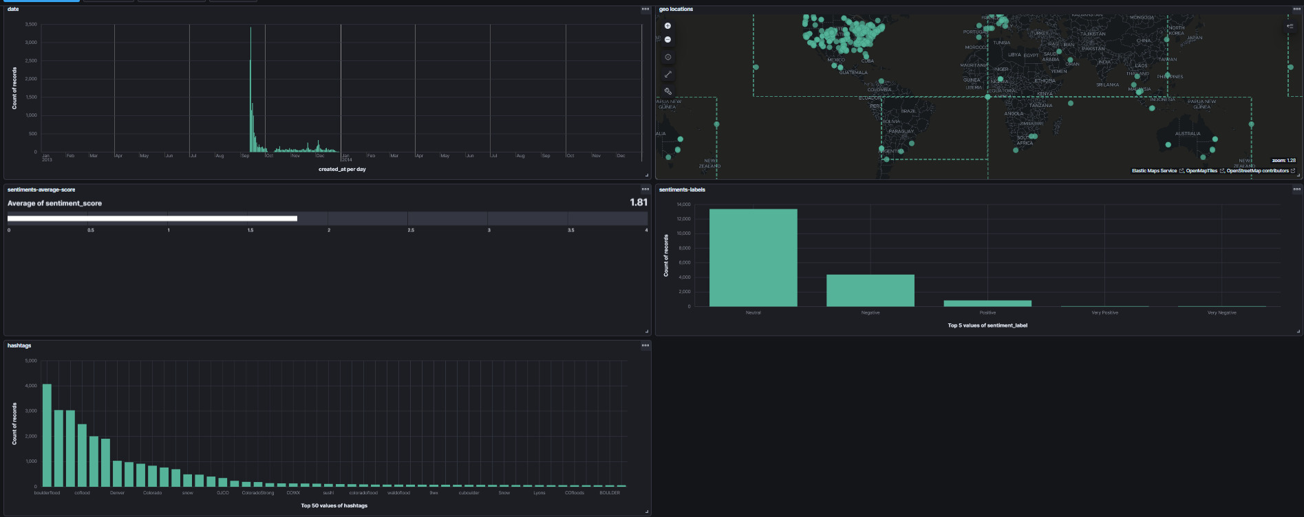
Kibana visualization

