Slide 1




Team
OUR MEMBERS
Amjad Awad
Yahya Dalbah
Ahmad Iyrot
Abood Jbr

Slide 2

Project
Description
The Tweet Analysis Pipeline is designed to process live Twitter streams for sentiment analysis, trending hashtag identification, and data visualization.

Slide 3


Real-Time Twitter Data Analysis
Our Problem:
Extract meaningful insights from the vast amount of Twitter data in real time. With millions of tweets generated daily, organizations face challenges in efficiently processing, analyzing, and visualizing this high-volume data
Target Audience:
Data Scientists: For developing predictive models and analyzing sentiment trends.
Social Media Analysts: For monitoring brand sentiment, tracking viral trends, and understanding audience behavior.
Researchers: For studying public opinion, social movements, or market trends.

Slide 4


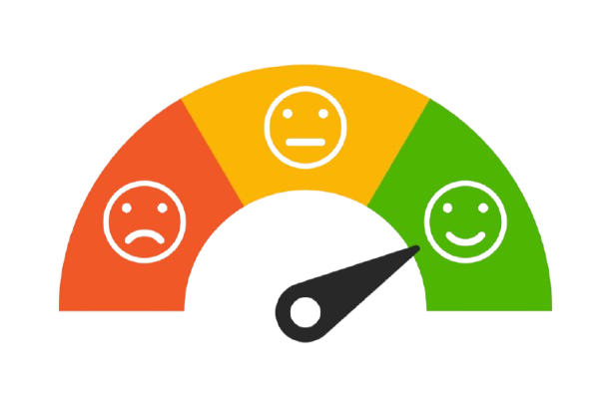
Data Processing
Processing
Hashtag Extraction
Sentiment Analysis

Slide 5



Data Storage in Twitter Data Pipeline
Key Considerations for Storage:
Scalability: The storage system must handle high-velocity Twitter data efficiently.
Real-Time Access: Supports near-instantaneous querying for analytics and visualization.
Reliability: Ensures no data loss during ingestion and processing.
Storage Solutions:
Apache Kafka: Acts as a distributed message broker, buffering real-time data streams.
Elasticsearch: Indexes and stores data for fast search and analytics.
Why It Matters: Proper storage ensures the pipeline’s ability to scale, process, and retrieve meaningful insights efficiently.

Slide 6
Technologies used
Stream Processing: Apache Kafka
Data Storage: Elasticsearch
Visualization: Kibana
Machine Learning: Stanford corenlp

Slide 7
Pipeline
Pipeline Stages
Ingestion
Tweets are fetched in real-time using Kafka.
Data is pushed to a Kafka topic named tweets-stream.
Processing
Extract the important features from the data.
Scala scripts perform sentiment analysis.
Machine learning models classify tweet text into sentiment categories.
Storage
Processed data is stored in Elasticsearch for querying.
Visualization
Kibana dashboards visualize sentiment trends, top hashtags, and tweet statistics.

Slide 8
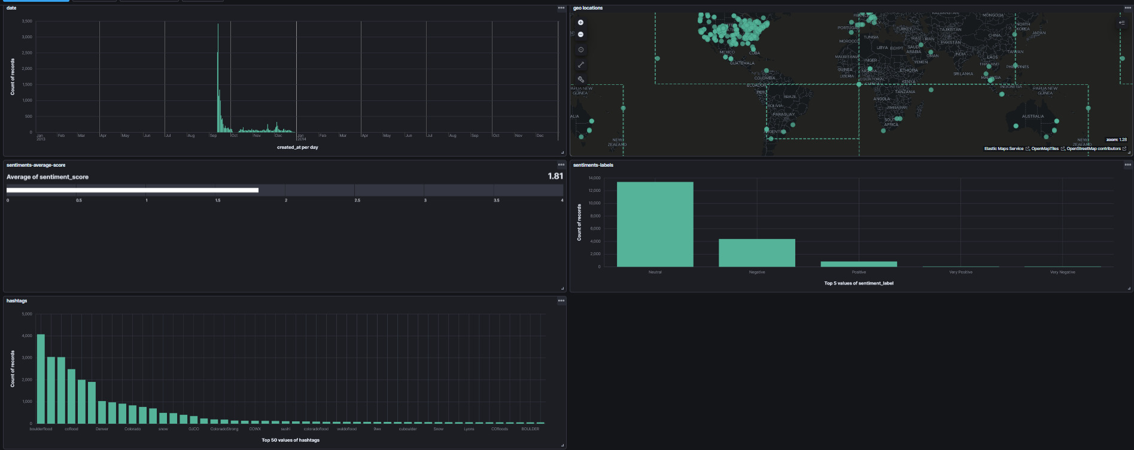
Kibana visualization

