Slide 1
Name: Ashwini.K
Reg No: 410121104006
Department: Computer Science
College Name : Adhi College of Engineering and Technology
Final Project

Slide 2
PROJECT TITLE
FACE DETECTION USING CNN ALGORITHM
In this project, we will explore the application of CNNs for face
detection. We will start by discussing the architecture and
components of CNNs, including convolutional layers, pooling layers,
and activation functions. Then, we will delve into popular CNN
architectures used for face detection, such as the Viola-Jones
algorithm, Haar cascades, and more recent deep learning-based
approaches like Single Shot MultiBox Detector (SSD) and You Only
Look Once (YOLO)

Slide 3


AGENDA
1.Introduction to Face Detection
Definition and importance of face detection
Overview of traditional methods vs. CNN-based methods
2. Fundamentals of Convolutional Neural Networks (CNNs)
Basics of neural networks
Introduction to CNN architecture
Key components: convolutional layers, pooling layers, activation functions
3. Case Studies and Applications
Face detection in security and surveillance
Facial recognition in social media
Healthcare applications
Ethical implications and privacy concerns
4. Future Directions
Emerging trends and research areas in face detection
Potential advancements in CNN-based approaches
5.Conclusion
Summary of key learnings
Final thoughts on the significance of face detection and CNNs in computer
vision.
3/21/2024 Annual Review

Slide 4

PROBLEM STATEMENT
Problem Statement :
The problem statement of face detection
involves accurately locating and identifying human faces within images or videos. Specifically, the task is to develop a system or algorithm that can automatically detect the presence and location of faces in visual data, regardless of factors such as variations in lighting conditions, poses, facial expressions, occlusions, and scale
Objective :
The objective of a face detection project is to develop an accurate, efficient, and robust system or algorithm that can automatically detect and localize human faces within images or video frames.

Slide 5

PROJECT OVERVIEW
Objective: Develop an accurate and efficient face detection system using CNNs to locate and identify human faces in images or video frames, addressing both technical performance and ethical considerations. Key Steps:
1. Data Collection and Preprocessing:
Collect a diverse dataset of face images from various sources, ensuring representation across different demographics, poses, expressions, and lighting conditions.
2. Exploratory Data Analysis (EDA):
Analyze the characteristics of the face image dataset, including distribution of poses, expressions, and other factors.
3. Model Development: Build a CNN model architecture for face classification. 4. Model Training: Train the CNN model on the dataset, optimizing for accuracy. 5. Model Evaluation: Assess the model’s performance on a separate test dataset. 6. Results Visualization: Visualize model predictions and performance metrics.

Slide 6
WHO ARE THE END USERS?
End users for face detection include security and law enforcement agencies for surveillance and identification purposes, as well as industries such as retail, social media, and healthcare for personalized services and enhanced user experiences.

Slide 7

YOUR SOLUTION AND ITS VALUE PROPOSITION
Our face detection solution employs cutting-edge CNN technology to accurately identify and locate human faces, ensuring enhanced security, personalized experiences, and streamlined processes across various industries.

Slide 8

THE WOW IN YOUR SOLUTION
Our face detection solution revolutionizes the field with state-of-the-art CNN technology, boasting unparalleled accuracy and speed in identifying and localizing human faces. Its real-time capabilities enable swift responses in security and surveillance, while its seamless integration enhances user experiences in applications such as social media tagging and biometric authentication. With robust performance across diverse environments and lighting conditions, our solution sets a new standard for efficiency and reliability, offering a versatile tool for industries ranging from retail analytics to healthcare diagnostics.
3/21/2024 Annual Review

Slide 9
MODELLING
In our face detection modeling approach, we leverage convolutional neural networks (CNNs) for their ability to extract intricate facial features from raw image data. We fine-tune pre-trained CNN architectures, optimizing them for high accuracy and real-time performance in face detection tasks. Data augmentation techniques are employed to enhance model generalization, while transfer learning enables efficient utilization of limited training data. Hyperparameter optimization ensures optimal model configuration, resulting in robust and adaptable face detection solutions across various scenarios and applications.

Slide 10
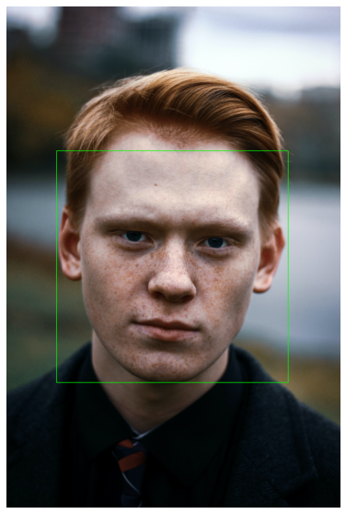
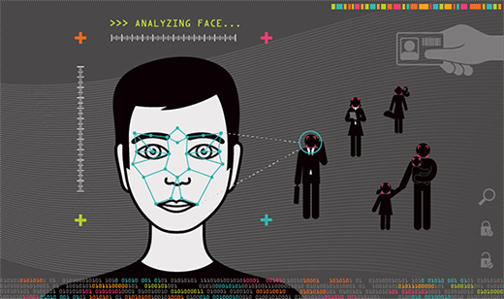
RESULTS

