Slide 1
AI Bootcamp – Meeting 2
Sit next others with the same operating system (Mac or Windows).
Help each other if you get stuck.
Open www.aboottogo.github.io/ai-bootcamp. Keep this open.
You should have completed:
Node.js installed (Exercise 7 on Our Tools)
An account on InstantDB.com
An account on Vercel.com
No pizza or soda in the classroom.
Please sign in

Slide 2
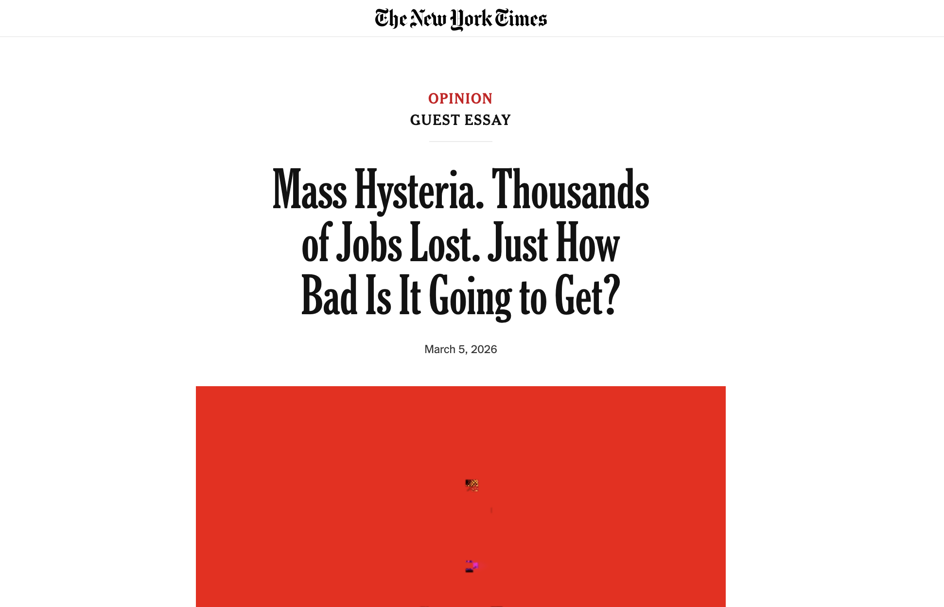

Slide 3
Second Meeting (Tuesday, March 10th)
All exercises are online: aboottogo.github.io/ai-bootcamp
Part 1: I will demonstrate exercises on the Dynamic Web Apps page; try to follow along.
Will be too slow for some, too fast for others.
Don’t stress if you fall behind.
Ask your neighbor for help but keep conversations relevant.
Part 2: Work at your own pace through the exercises on the Build Yor Own Web App page; If you fell behind in Part 1, this will be the chance to get help.

Slide 5





The Problem With Static
Step 1: You type in your data
Step 2: You refresh the page
Coffee — $4.50
(empty)
Saved!
Gone.
Static sites have no memory. Close the tab, lose the data.
Notes:
PRESENTER NOTES — Slide 1: The Problem With Static This slide sets up the core motivation for everything we're about to learn tonight. Walk through the two panels like a story: • LEFT PANEL: "Last week, you built a static website and put it on the internet using GitHub Pages. That was a huge accomplishment. But imagine you built an expense tracker. You type in 'Coffee — $4.50.' It shows up on the screen. Looks great." • RIGHT PANEL: "Now you close the tab. Or refresh the page. And... it's gone. The data just disappears. That's because GitHub Pages serves the exact same HTML file every time — it's like a photocopy machine. It doesn't know who you are or what you did." Key point to emphasize: This isn't a bug. It's a fundamental limitation. Static sites can't store or retrieve data. They're read-only experiences. The question to pose: "So how do we build something that actually remembers? That's what tonight is about." Transition: "To understand how we fix this, let's look at what a dynamic app actually looks like under the hood."

Slide 6




What Makes an App Dynamic?
FRONTEND
HOSTING
DATABASE
What users see
and interact with
Puts your app
on the internet
What remembers
your data
A dynamic app is a conversation — the frontend asks, the database answers and stores.
Notes:
PRESENTER NOTES — Slide 2: What Makes an App Dynamic? This is the foundational mental model for the entire night. Take your time with it. Walk through the three columns: • FRONTEND: "This is the part users actually see — the buttons, the forms, the layout. Last week, this was all we built. HTML and CSS living in your browser." • HOSTING: "This is the service that takes your code and puts it on the internet so anyone can visit it. Last week, GitHub Pages did this for our static site. Tonight, we'll use a tool called Vercel." • DATABASE: "This is the new piece. This is what remembers. When you type in an expense, the frontend sends it to the database. When you come back later, the database sends it back. This is why your data doesn't disappear." Key analogy: "Think of a restaurant. The frontend is the dining room — it's what the customer sees. The database is the kitchen — it's where the actual work gets stored and prepared. Hosting is the building itself — it's what makes the whole thing accessible to people walking by on the street." Important: Emphasize the TWO-WAY arrows. Static sites are one-way (server sends files to browser, end of story). Dynamic apps have a back-and-forth conversation. Transition: "So now that we know the three pieces, let me show you the specific tools that fill each role tonight."

Slide 7



Meet the New Tools
FRONTEND
HOSTING
DATABASE
React
Vercel
InstantDB
Builds the interface
from reusable pieces
Deploys your app live
on the internet
Stores your data and
syncs it in real time
Same three roles — now you know which tool fills each one.
Notes:
PRESENTER NOTES — Slide 3: Meet the New Tools This is the payoff of the previous slide. Point out that the layout is identical — you're just filling in the blanks. Walk through each tool: • REACT (Frontend): "React is what Cursor will use to build the visible part of your app — the buttons, forms, and pages. It was created by Facebook and is the most popular way to build web interfaces today. You don't need to learn React — Cursor writes it for you. But you'll hear the word a lot, so now you know what it means." • VERCEL (Hosting): "Vercel is a hosting platform. It replaces GitHub Pages for tonight. The big difference: Vercel can host dynamic apps, not just static files. And it has a killer feature — every time you push code to GitHub, Vercel automatically re-deploys your site. Push code, site updates. That's it." • INSTANTDB (Database): "InstantDB is the database service we'll use. Think of it as a cloud spreadsheet that your app can read from and write to. The special thing about InstantDB is that it's real-time — when data changes, your app updates instantly. No refresh needed. You'll set up an InstantDB account tonight and connect it to your app." Key emphasis: "Notice that none of these tools require you to manage a server. That's the beauty of modern web development — you plug these services together and they handle the heavy lifting." Transition: "Let's zoom in on React for a moment, since that's what Cursor is going to generate for you."

Slide 8

What Is React?
React apps are built from reusable building blocks called components.
My Expense Tracker
Header
Component
Add Expense: [ description ] [ $0.00 ] [ Add ]
Form
Component
Coffee $4.50 Mar 9
Lunch $12.00 Mar 9
Uber $8.75 Mar 8
List
Component
Total: $25.25
Total
Component
Cursor writes React for you — you just need to know it builds apps from snap-together pieces.
Notes:
PRESENTER NOTES — Slide 4: What Is React? This slide demystifies React for people who have never coded. The goal is NOT to teach React — it's to give students enough of a mental model that they aren't confused when they see the word. Walk through the mockup: • Point to the dashed outlines: "See how the app is broken into sections? The header, the form, the list, the total? In React, each of those is called a component. A component is just a reusable building block." • "The powerful thing is that each component manages its own little world. The form component knows how to accept input. The list component knows how to display items. They can talk to each other, but they're independent pieces." • "If you wanted to add a second page to your app — say, a settings page — you'd just add new components. You don't have to rewrite everything." Key reassurance: "You do NOT need to learn React. Cursor writes all of this for you. When you tell Cursor 'I want an expense tracker with a form and a list,' it generates these components automatically. I'm showing you this so that when you look at the code Cursor produces, you'll have some idea what you're looking at." Analogy if helpful: "Think of LEGO bricks. Each component is a brick. Your app is the assembled set. You can rearrange the bricks without breaking the whole thing." Transition: "Now, you might hear three terms used together — React, Node.js, and Next.js. Let me quickly explain how they relate to each other."

Slide 9





React, Node.js, and Next.js (JavaScript)
Three names you'll hear together — they're layers, not alternatives.
Next.js
Think of it as...
The framework — adds routing, deployment, etc.
Node.js
builds on ↑
is the engine
React
The library — builds UI from components
React
is the steering wheel
builds on ↑
Node.js
Next.js
The engine — runs JavaScript outside the browser
is the whole car
Notes:
PRESENTER NOTES — Slide 5: React, Node.js, and Next.js This slide exists because students WILL see all three of these terms — in Cursor's output, in error messages, in documentation — and confusing them is a common source of anxiety. The goal is a 60-second explanation, not a deep dive. Walk through the stack from bottom to top: • NODE.JS (bottom, widest): "Node.js is a runtime — it lets JavaScript, the programming language of the web, run outside of a browser. Normally JavaScript only runs in Chrome or Firefox. Node.js is what lets it run on your laptop, on a server, in build tools. It's the foundation everything else sits on." • REACT (middle): "React is a library built on top of Node.js. It's specifically designed for building user interfaces — the visual part of your app. We just talked about this: components, building blocks, etc." • NEXT.JS (top, narrowest): "Next.js is a framework built on top of React. It adds structure — things like page routing (so you can have /home and /settings), server-side features, and easy deployment to Vercel. When Cursor generates a project for you tonight, it will almost certainly generate a Next.js project." Use the car analogy on the right: "Node.js is the engine — it powers everything. React is the steering wheel — it's how you control what the user sees. Next.js is the whole car — it packages everything together into something you can actually drive." Key reassurance: "You don't need to memorize this. Just know that these three terms are layers that build on each other. They're not competing tools — they're a stack." Transition: "OK, so we know the tools. Now let's see how data actually flows through your app when a user does something."

Slide 10




How Data Flows
The lifecycle of a single user action
User clicks
"Add Expense”
In browser
React sends data
to InstantDB
1
→
2
←
↓
InstantDB
Updates database
InstantDB pushes
update back
3
4
↓
This loop is what makes your app feel "alive" — data persists and updates in real time.
Notes:
PRESENTER NOTES — Slide 6: How Data Flows This is the most important conceptual slide. Walk through each step deliberately, pointing at the screen. Narrate a concrete example: • STEP 1: "You're using your expense tracker. You type 'Coffee — $4.50' and hit the Add button. That's a user action." • STEP 2: "Your React app takes that data and sends it to InstantDB over the internet. This happens automatically — the code Cursor wrote handles it." • STEP 3: "InstantDB receives the data and saves it in your database. It's now stored permanently. Close the tab, come back tomorrow — it's still there." • STEP 4: "Here's the magic: InstantDB doesn't just save it — it pushes the update back to your app in real time. And not just to you — if someone else is looking at the same data, they see the update too." • STEP 5: "Your screen updates instantly. The new expense appears in your list. No refresh needed." Key emphasis: "This is a LOOP, not a one-time event. Every time a user does something — adds an item, edits a record, deletes something — this cycle repeats. That's what makes the app feel alive and responsive." Connect back to Slide 1: "Remember the static site problem? Data disappeared when you refreshed. This loop is the solution. Step 3 — 'InstantDB saves it' — is the key difference. Your data now lives somewhere permanent." Transition: "So that's what happens at runtime — when a user is actually using your app. But what about right now? What is Cursor actually building?"

Slide 11


What Cursor Is Building Right Now
Behind the scenes: the pieces Cursor is generating for you
Your Pages
& Buttons
Database
Connection
Deploy
Config
React components that
make up the visible
interface — forms, lists,
navigation, layout.
Code that talks to
InstantDB — reads data,
writes data, listens for
real-time updates.
Settings that tell Vercel
how to build and host
your app, plus where
to find your database.
You'll need an API key — a unique ID from InstantDB that tells your app where its database lives.
Notes:
PRESENTER NOTES — Slide 7: What Cursor Is Building Right Now This slide serves a dual purpose: it fills time while Cursor works, and it demystifies what's happening so students aren't just staring at a wall of code. Walk through the three cards: • YOUR PAGES & BUTTONS: "The first thing Cursor generates is the visual layer — all the React components we just talked about. The header, the forms, the lists, the buttons. This is the biggest chunk of code, and it's what determines what your app looks like." • DATABASE CONNECTION: "Next, Cursor writes the 'glue' code — the parts that connect your React components to InstantDB. This is the code that says 'when the user clicks Add, send this data to the database' and 'when data changes, update the screen.' This is the data flow loop we just looked at." • DEPLOY CONFIG: "Finally, Cursor generates configuration files. These tell Vercel how to build your app, where to find your code, and how to serve it. Think of it as the instruction manual that Vercel reads." API KEY CALLOUT: "One thing you'll need to do manually: get an API key from InstantDB. This is like a mailing address — it tells your app which database to talk to. You'll copy it from the InstantDB dashboard and paste it into a file called .env (short for 'environment variables'). The reason we use .env is that it keeps the key private — it won't get uploaded to GitHub where anyone could see it." If students ask about .env: "The .env file is like a sticky note on the inside of your locker door. Your app can read it, but nobody walking down the hall can see it. If you put your API key directly in your code and pushed it to GitHub, it would be like writing your locker combination on the outside of the door." Transition: "Let's zoom all the way out and see the complete picture — every piece and how they connect."

Slide 12




The Full Picture
Your complete workflow — from prompt to live app
1
2
3
→
→
You write
a prompt
Cursor
generates
Code pushed
to GitHub
in Cursor
Next.js app
repository
↓
4
5
6
→
→
Vercel
auto-deploys
User visits
live URL
App reads/
writes data
from GitHub
your-app.vercel.app
via InstantDB
From idea to live app — this is the workflow you're learning tonight.
Notes:
PRESENTER NOTES — Slide 8: The Full Picture This is the culmination slide — the zoom-out moment. Walk through the flow left to right, top to bottom. Step by step: • STEP 1 — YOU WRITE A PROMPT: "Everything starts with you telling Cursor what you want. Something like 'Build me an expense tracker where users can add expenses, categorize them, and see monthly totals. Use InstantDB for the database.' That's it. That's your starting point." • STEP 2 — CURSOR GENERATES A NEXT.JS APP: "Cursor takes your prompt and writes a complete application — React components, database connection code, configuration files. It creates a whole project folder on your computer." • STEP 3 — CODE PUSHED TO GITHUB: "You push that code to GitHub, just like you did last week with your static site. Same commands: git add, git commit, git push. The code is now stored in your repository." • STEP 4 — VERCEL AUTO-DEPLOYS: "Here's where the magic happens. Vercel is connected to your GitHub repo. Every time you push code, Vercel automatically detects it, builds your app, and deploys it. No manual steps." • STEP 5 — USER VISITS LIVE URL: "Your app is now live at a URL like your-app.vercel.app. Anyone in the world can visit it." • STEP 6 — APP READS/WRITES VIA INSTANTDB: "When a user interacts with your app — adding an expense, deleting a record — the app communicates with InstantDB behind the scenes. That's the data flow loop from Slide 6." The big-picture point: "Look at what you're doing tonight. You're going from a blank prompt to a live, data-driven web application. Last week you built a static site. Tonight you're building something that remembers, responds, and works like a real product." Close with energy: "This is the exact same architecture behind apps you use every day — just simpler. The tools are different, but the pattern is identical. And now you know how it works." After this slide, transition to hands-on work: "OK, let's check in on Cursor and see how your apps are coming along."

Slide 13
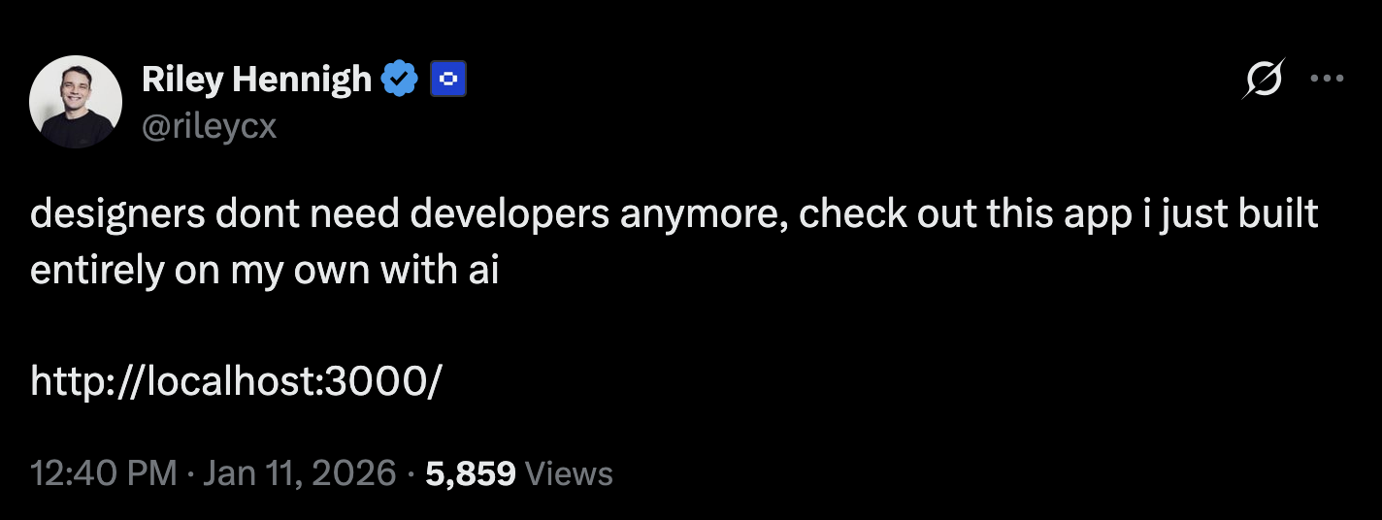

Slide 14
Part 2: Build Your Own Web App
Work with your neighbors at your own pace
Follow the steps on the Build Your Own Web App page:
aboottogo.github.io/ai-bootcamp
You’re going to build a how-to tutorial website for your app idea – not the app itself – and publish it to GitHub Pages
Plan and Build the website in Cursor
Copy the prompt exactly as it is given; attach my-app-idea.md
Examples of my-app-idea.md can be downloaded from Project Ideas page
Push to a new repository on GitHub.com
Publish your website to GitHub Pages
You can work anywhere on the 3rd floor, just be back by 7:50.
Please sign-in if not already.

