Slide 1


Slide 2
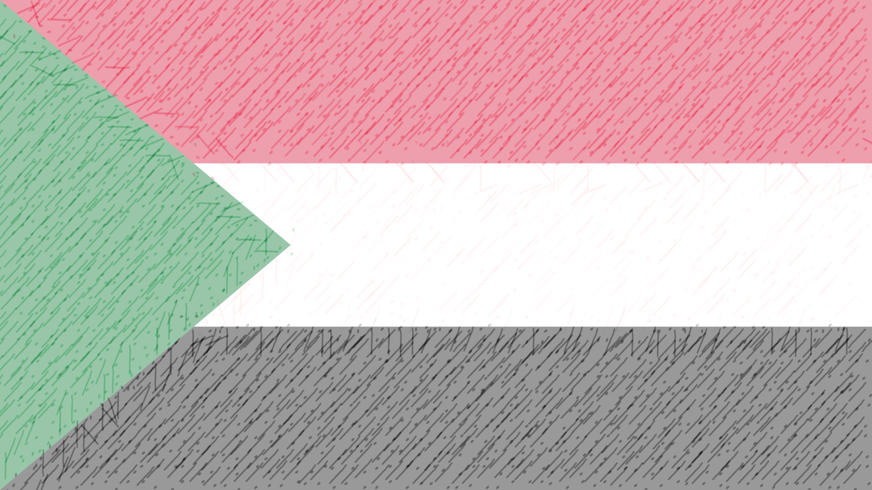
Brief
Sudan, country located in northeastern Africa. The name Sudan derives from the Arabic expression bilād al-sūdān (“land of the blacks”), by which medieval Arab geographers referred to the settled African countries that began at the southern edge of the Sahara. For more than a century, Sudan—first as a colonial holding, then as an independent country—included its neighbour South Sudan, home to many sub-Saharan African ethnic groups. Prior to the secession of the south in 2011, Sudan was the largest African country, with an area that represented more than 8 percent of the African continent and almost 2 percent of the world’s total land area.

Slide 3
History
Since ancient times the Sudan region has been an arena for interaction between the cultural traditions of Africa and those of the Mediterranean world. Islam and the Arabic language achieved ascendancy in many northern parts of the region, while older African languages and cultures predominated in the south.
The country became independent in 1956 and has had numerous changes in government since then. Successive regimes found it difficult to win general acceptance from the diverse political constituencies. An early conflict arose between those northern leaders who hoped to impose unity upon the nation through the vigorous extension of Islamic law and culture to all parts of the country and those who opposed this policy; the latter included the majority of southerners and those northerners who favored a secular government.

Slide 4
Capital
Sudan’s capital, Khartoum, is located roughly in the center of the country, at the junction of the Blue Nile and White Nile rivers. It is part of the largest urban area in Sudan and is a center of commerce as well as of government.

Slide 5
Land
Sudan is bounded on the north by Egypt, on the east by the Red Sea, Eritrea, and Ethiopia, on the south by South Sudan, on the west by the Central African Republic and Chad, and on the northwest by Libya.

Slide 6
Climate
In northernmost Sudan, northerly winds prevail for most of the year, and rainfall is rare. To the south of this the seasons are characterized by the north-south oscillation of the boundary between moist southerly air and dry northerly air. In winter the north winds of the tropical air mass blow across Sudan. These winds are relatively cool and dry and usually bring no rain. Sometime around May, the moist southerly air of the southern maritime air mass moves northward across the country. Because of this, central and southern Sudan have rainy seasons, the total lengths of which vary according to their latitude.

Slide 7
Plant and animal life
Sudan has five main vegetation belts in succession from north to south, more or less in coincidence with rainfall patterns. The desert region in the north is followed southeastward by semi desert, low-rainfall and high-rainfall savanna (grassland) with inland floodplains, and mountain vegetation regions. The desert region, with hardly any rainfall, supports permanent vegetation only near watercourses. The semi desert, with minimal rainfall, supports a mixture of grasses and acacia scrub. Farther south appear low-rainfall savannas that consist of grasses, thorny trees, and baobab trees. Acacia trees dominate these savannas, with one species, Acacia senegal, yielding the gum Arabic which was long one of Sudan’s principal exports. The high-rainfall savannas of southern Sudan are more lush, with rich grasses along the Nile that support a large number of cattle. There are intermittent woodlands that dot this belt.

Slide 8
Languages
As alluded to above, there are many languages spoken in Sudan. Arabic is the primary language of much of the population and is the most common medium for the conduct of government, commerce, and urban life throughout the country. Both Arabic and English are official working languages of the country and were designated as such by the 2005 interim constitution.

Slide 9
Religion of Sudan
The majority of Sudan’s population is Muslim, belonging overwhelmingly to the Sunni branch. Sunni Islam in Sudan, as in much of the rest of Africa, has been characterized by the formation of tarīqahs, or Muslim religious brotherhoods. The oldest of these tarīqahs is the Qādiriyyah, which was introduced to the Sudan region from the Middle East in the 16th century. Another major tarīqah is the Khatmiyyah, or Mīrghaniyyah, which was founded by Muḥammad ʿUthmān al-Mīrghanī in the early 19th century. Perhaps the most-powerful and best-organized tarīqah is the Mahdiyyah; its followers led a successful revolt against the Turco-Egyptian regime (1821–85) and established an independent state in the Sudan that lasted from 1884 to 1898. The Mahdiyyah and Khatmiyyah tarīqahs formed the basis for the political parties that emerged in the Sudan in the 1940s and have continued to play a dominant role in the nation’s politics in the postindependence period.

Slide 10
Demographic trends
The country has a young population, with some two-fifths under age 15; more than one-fourth of the population is between ages 15 and 29.
Sudan has a rather low population density as a whole, but, due to the lack of adequate water supplies in many parts of the country, half of the population lives on just over 15 percent of the land. By contrast, one-quarter of Sudan is virtually uninhabited, including the deserts of the north and northwest.

Slide 11
Economy
Sudan is one of the poorest and least-developed countries in the world, with about one-third of its inhabitants dependent on farming and animal husbandry for their livelihoods. Though its role in the economy has declined in the decades since independence, agriculture still accounts for about one-third of Sudan’s gross domestic product (GDP). Oil production began in the late 1990s, and petroleum quickly became the country’s most important export.

Slide 12
Resources and power
Oil is a lucrative natural resource. It was first discovered in southwestern Sudan in 1977, and a commercially viable find was made in 1980, but the civil war in the south prevented any exploitation of the oil deposits until the late 20th century. Sudan’s recoverable oil reserves, estimated at 500 million barrels in the early 1990s, were thought to be between five and seven billion barrels in the early 2010s. Upon the secession of the south in 2011, the majority of the oil reserves fell within the borders of newly independent South Sudan.

Slide 13
Justice
Civil justice is administered through the Supreme Court, appeals courts, and courts of first instance. There is also a Constitutional Court.

Slide 14
Political process
Multiparty politics, banned after the 1989 coup, was reintroduced in 1999. The National Congress Party (formerly the Islamic National Front; NIF), long the only legal party, continued to dominate the political scene in the years immediately following, until the April 2019 coup; it was disbanded later that year. Other political associations active in Sudan include the Ummah Party and the Democratic Unionist Party.

Slide 15
Health and welfare
Beginning in the mid-1970s, the Ministry of Health initiated a national program intended to provide primary health care throughout the country with an emphasis on preventive medicine. A lack of funds severely affected the plan’s implementation, as it would the government’s establishment in the early 1990s of three tiers of health care at the federal, state, and local levels. At the beginning of the 21st century, roughly half of all Sudanese had access to health services, but accessibility greatly depended upon geographic location. Most of the country’s small number of physicians are concentrated in the urban areas, as are the major hospitals.

Slide 16
Education
A modern educational system was established in Sudan in the 1970s, when the government reorganized a haphazard system of schools inherited from the British colonial government. In the Muslim areas of the north, boys were long instructed in religious subjects according to traditional methods. Primary education was begun by the British in the Sudan after 1898, and secondary education began in 1913. The University of Khartoum was formally established in 1956 from the University College of Khartoum, which itself dated from the merger in 1951 of two smaller colleges founded by the British.

Slide 17
The arts
One of the most important forms of cultural expression among nonliterate groups is oral tradition. The linguistic diversity of the country provides the basis for a richly varied written and oral literature. The major language with a written literature in traditional Sudanese society is Arabic. The most widely known Sudanese literary works in this language are associated with Islam and its scholarship and include a large body of literature describing the lives and virtue of holy men. These works are best known through recitations on special anniversaries associated with pious persons. The combination of oral and written literature remains of major importance to both traditional and Westernized segments of Sudanese society. Perhaps the best-known Sudanese novelist is al-Ṭayyib Ṣāliḥ, whose books Mawsim al-hijrah ilā al-shamāl (1966; Season of Migration to the North) and ʿUrs al-Zayn (1967; The Wedding of Zein & Other Stories) have been translated into various languages.

Slide 18
The arts
One of the most important forms of cultural expression among nonliterate groups is oral tradition. The linguistic diversity of the country provides the basis for a richly varied written and oral literature. The major language with a written literature in traditional Sudanese society is Arabic. The most widely known Sudanese literary works in this language are associated with Islam and its scholarship and include a large body of literature describing the lives and virtue of holy men. These works are best known through recitations on special anniversaries associated with pious persons. The combination of oral and written literature remains of major importance to both traditional and Westernized segments of Sudanese society. Perhaps the best-known Sudanese novelist is al-Ṭayyib Ṣāliḥ, whose books Mawsim al-hijrah ilā al-shamāl (1966; Season of Migration to the North) and ʿUrs al-Zayn (1967; The Wedding of Zein & Other Stories) have been translated into various languages.

Slide 19
Thank You!

