Slide 1
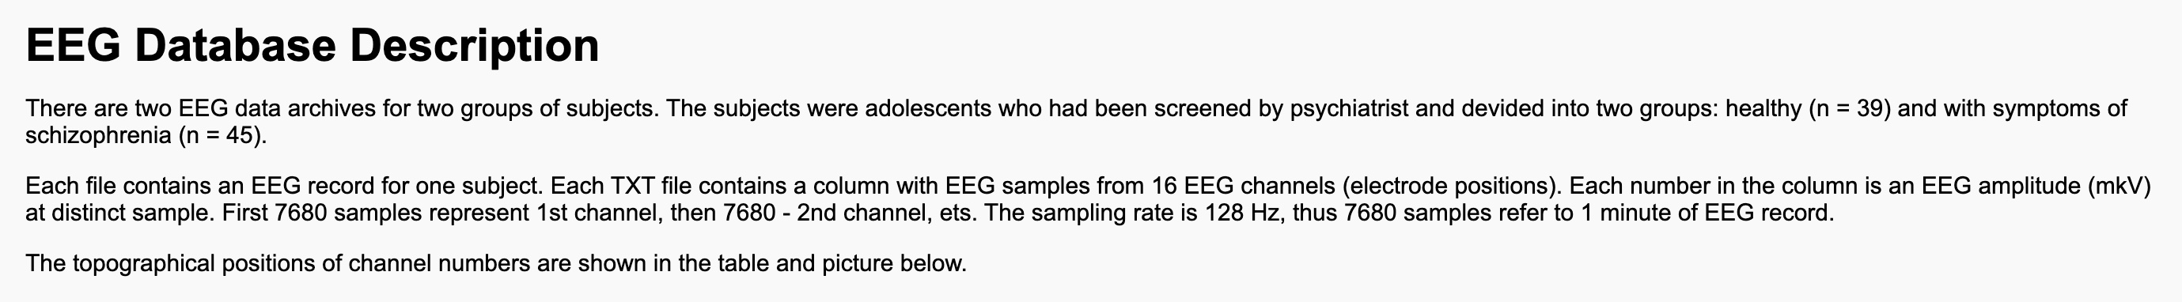
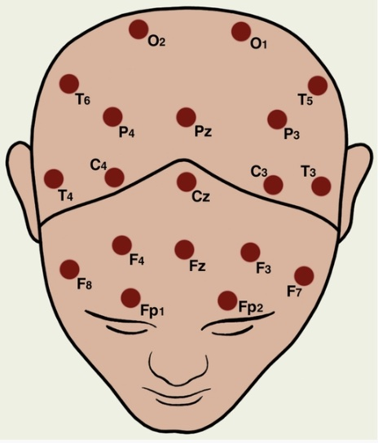
EEG (Electroencephalography) Dataset
Assumptions
Closed-Eye Test
Accurate Screening
Accurate Measurements
Environmental Conditions
16 Brain Regions
7680 Measurements/Region
84 Patients
10 321 920 Data Points !

Slide 2
Null Hypothesis
"There are no differences between the connectivity of brain regions between healthy and schizophrenic patients"

Slide 3
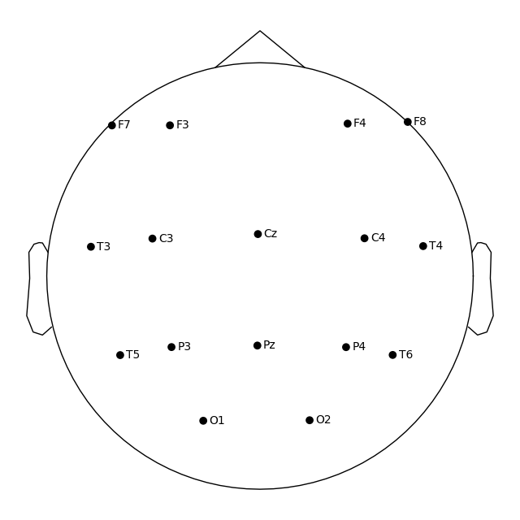
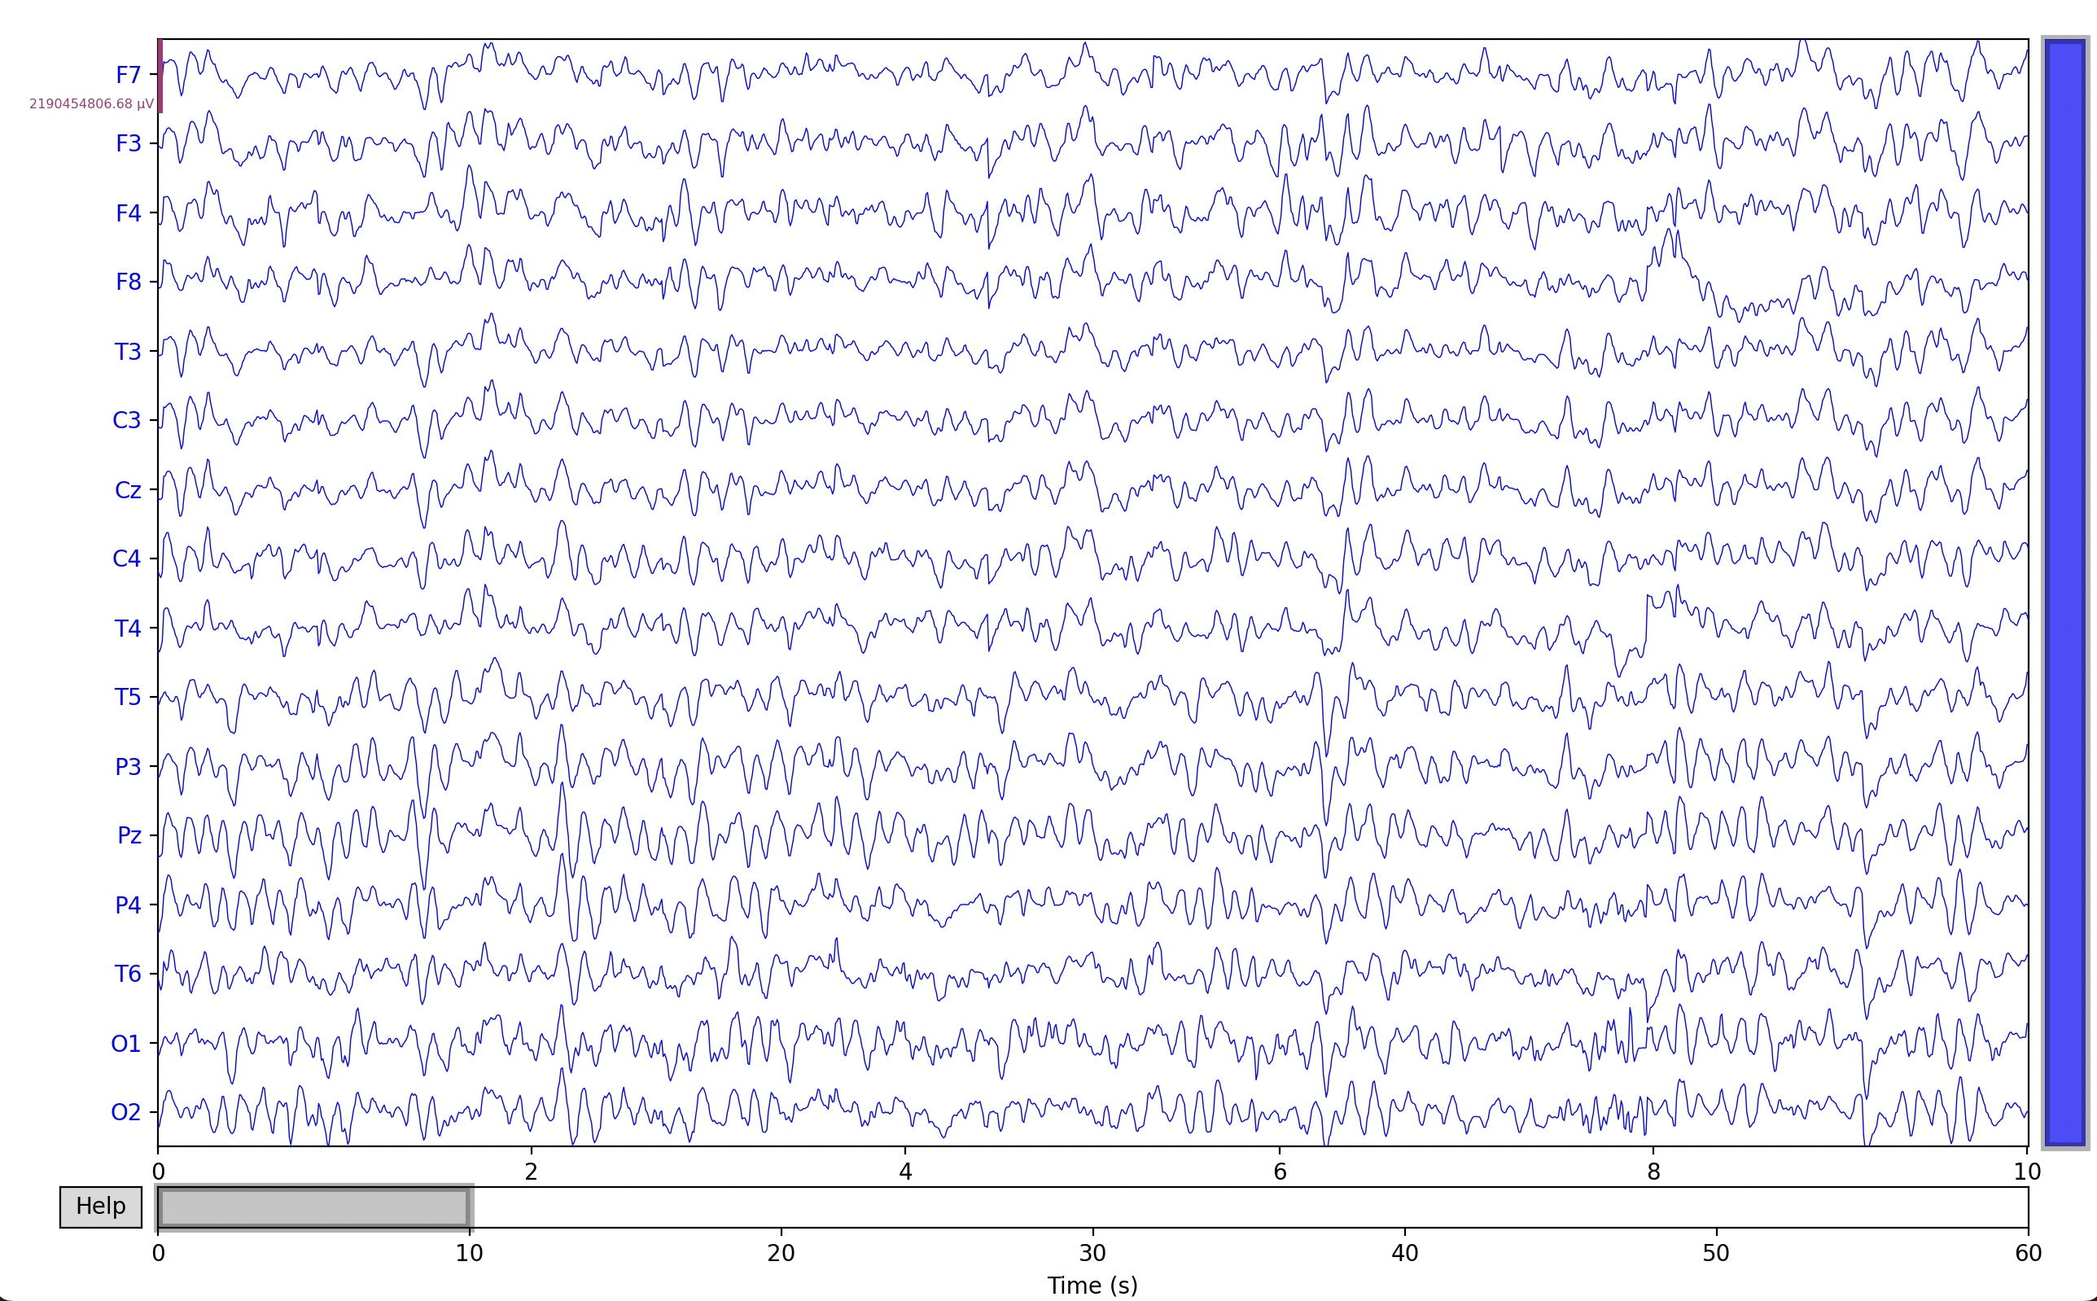

Slide 4
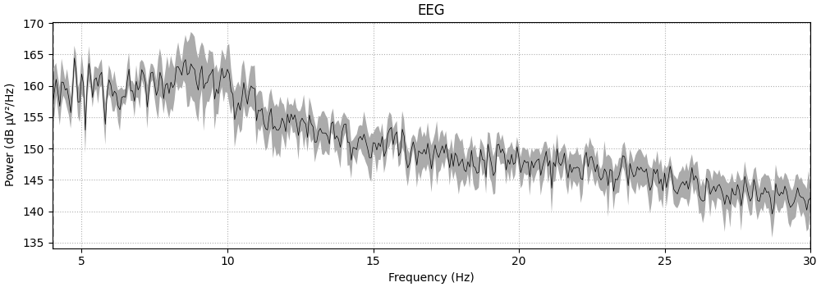
Power Spectral Density (Power Vs Frequency)
Theta
Alpha
Beta

Slide 5
Computing Power Spectral Density (PSD)
How much of the signal's power is present for different frequency values
Fast Fourier Transform (FFT), converts a signal from the Time Domain, to the Frequency Domain
BE ABLE TO EXPLAIN IT VERBALLY

Slide 6
Computing Correlations Across Brain Regions (Dimensional Reduction)
Diagnosed Healthy Patients
Computed 39 different correlation matrices
Reduced to one correlation matrix for healthy patients
Diagnosed Schizophrenic Patients
Computed 45 different correlation matrices
Reduced to one correlation matrix for Schizophrenic patients
Finally, we were able to compute a difference matrix

Slide 7
SHOW PEARSON CORRELATION MATRICES HERE

Slide 8
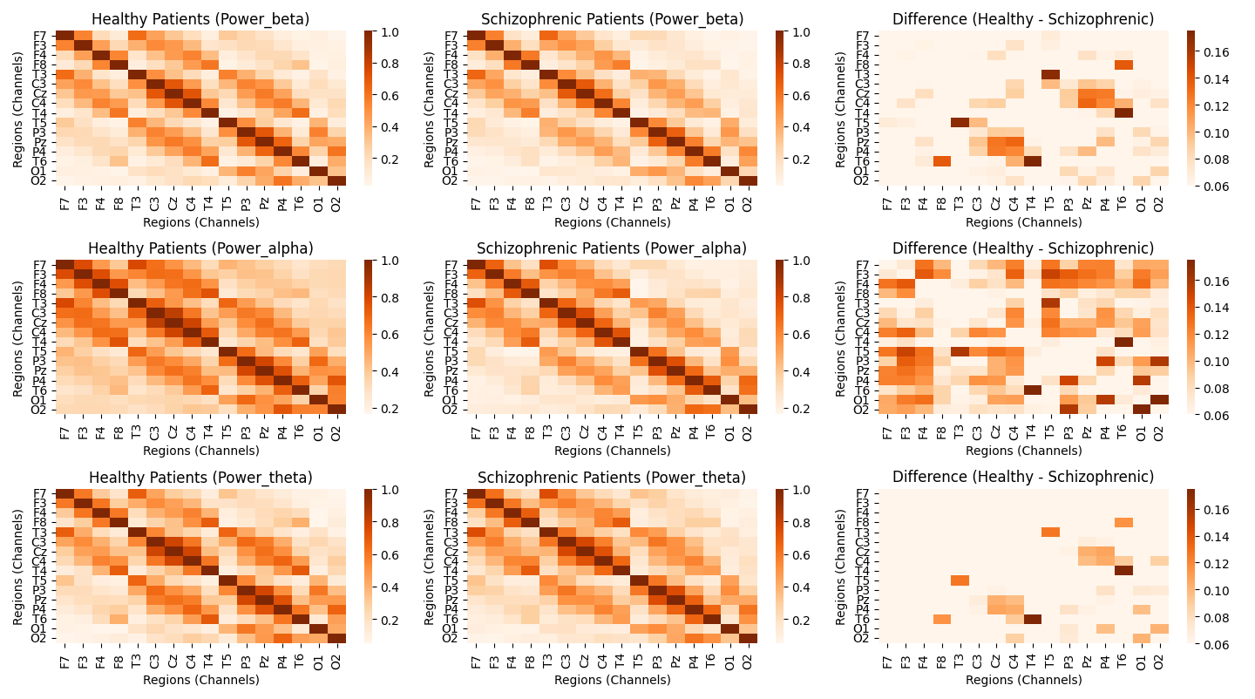

Slide 9
Cross Spectral Density (CSD)
Statistic used for pairs of signals
Put simply, CSD shows how two signals are correlated by either comparing their Magnitudes or their Phases.

Slide 11
Significance Testing
Logic:
Generate an Auto-Regression (AR) model which obeys the Null Hypothesis
By generating new time series datasets for all 84 patients
Derive new PSD Values & then new CSD correlations from Null model (Surrogate dataset)
Perform statistical tests to compare CSD values from Observed & Surrogate datasets

Slide 12
Autoregression Model (Surrogate Dataset)
Procedure for generating our Surrogate Dataset:
Fit an AR model for every patient across all brain regions, and across both groups (Schizophrenic & Healthy)
Retrieve the AR coefficients for both groups (average), and generate "shared" AR coefficients that will be used to create the surrogate (Null) dataset
Using the same AR coefficients for all patients across all 16 channels, obviously yielded the exact same time series everywhere. This was avoided by adding random noise.

Slide 13
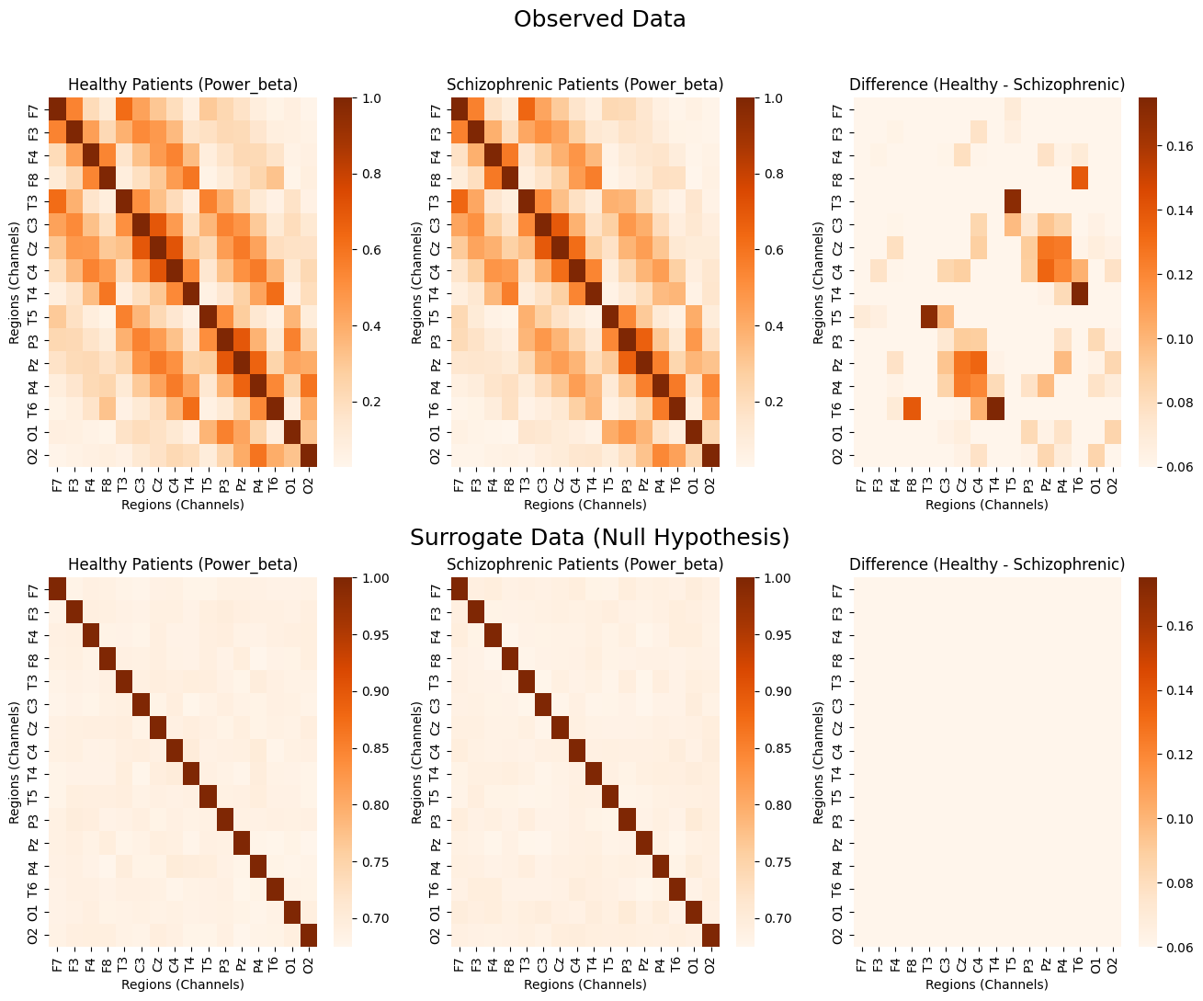
Visual validation of lost correlations

Slide 14
Are Surrogate & Observed datasets normally distributed ?

Slide 15
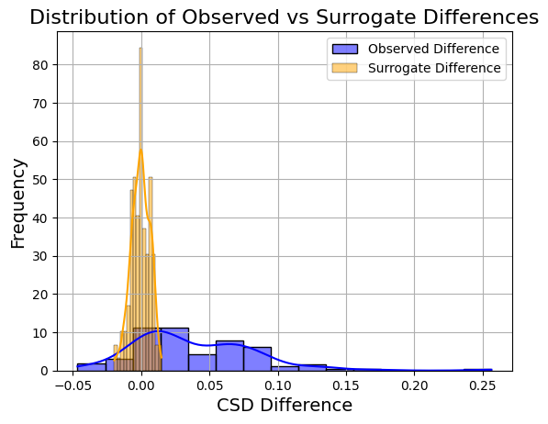
Before looking into Normality Tests, we wanted to visualize the distribution of both datasets
Observed:
does not appear Normal (twin peaks)
Surrogate: expectedly appears somehow normal

