Slide 1
Mains outage detector
1
Presentator:
Abousoufian El Ghourri

Slide 2
Index
2
PCB design
Main blocks
Way of detecting
Working principle
Discussion

Slide 3
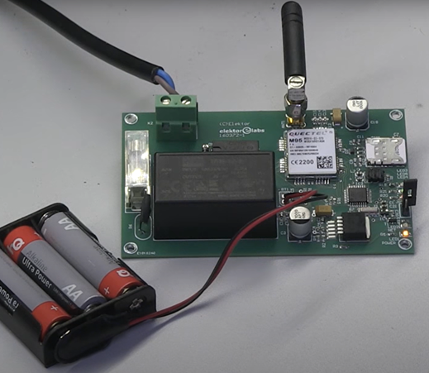
1. PCB design
3

Slide 4
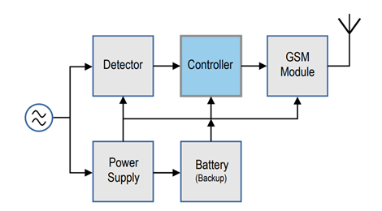
2. Main blocks
4

Slide 5
3. Way of detecting
5
monitored every 250ms for zero crossing
wait another 250ms
power failure
no false alarm

Slide 6
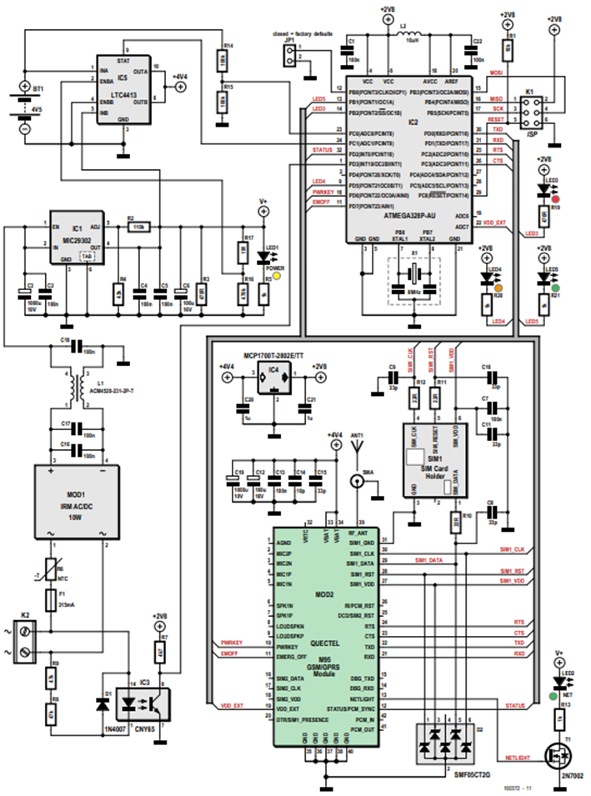
4. Working principle
6

Slide 7
5. Discussion and conclusion
7
Electrical scheme and PCB scheme
A wide choice of footprints in internal library
specifications of the circuit board manufacturer
Mechanical design
Various recesses had to be provided as well as space for the designed logo.
Overall experience
age of the project - corona pandemic - technical complexity
Focus on Altium program
Time lost for obtaining components.

Slide 8
Questions?
8

