Slide 1
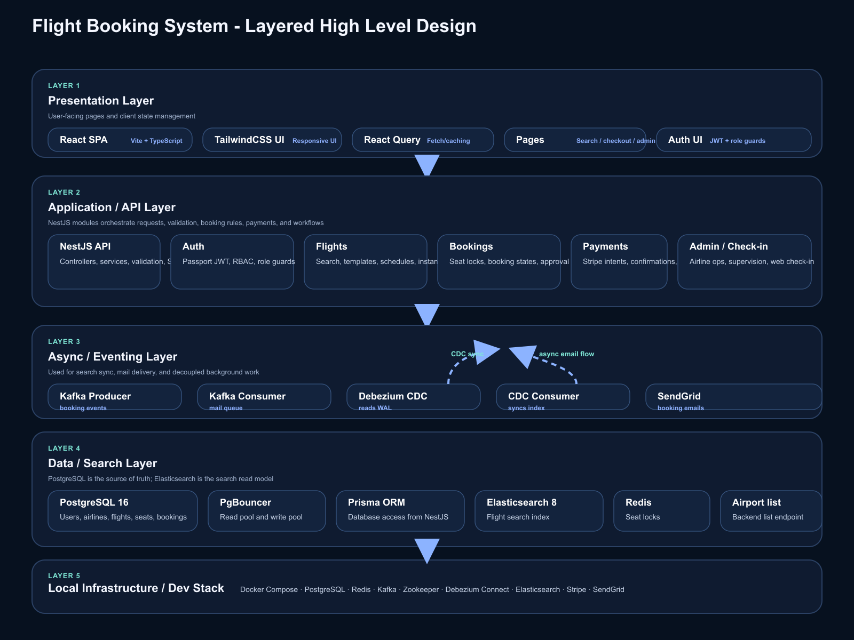
FLIGHT BOOKING SYSTEM
Scalable Flight Booking Platform
React frontend · NestJS API · PostgreSQL source of truth · Elasticsearch search · Kafka/Debezium sync · Redis seat locking
Search
Booking
Admin
Source of truth
Search layer
Safety layer
PostgreSQL holds users, airlines, flights, seats, bookings, and approval state.
Elasticsearch serves flight search so reads do not compete with booking writes.
Redis seat locks and Stripe payment flow prevent double booking and stale holds.
Notes:
Opening slide for the flight booking platform. Emphasize the source-of-truth database, search separation, and the operational safety layers.

Slide 2
WHY THIS PLATFORM
What the system is designed to do
The app is built for search, booking safety, role-based approval, and easy local execution.
Fast search
Safe booking
Operational control
Scalable delivery
Search one-way and round-trip flights with date and route filtering. Elasticsearch keeps the search path fast.
Seat locks, payment flow, and booking state transitions reduce double-booking risk.
Associate and Senior Associate roles separate validation from approval.
Docker Compose, Kafka, Debezium, and PgBouncer keep the stack practical to run and scale.
User journeys
Public users search and book flights, check in, and view bookings. Airline staff manage schedules and review bookings. Superadmin handles airlines and staff lifecycle.
02 / 08
Notes:
Use this slide to frame the product capabilities before jumping into implementation details.

Slide 3
STACK BY LAYER
What is used under which part of the system
This slide answers the architecture question in the most direct way: layer, technology, and purpose.
Presentation
Application / API
Data / Search
Local Infra
• React 18
• NestJS
• PostgreSQL 16
• Docker Compose
• Vite
• Prisma
• PgBouncer write pool
• Redis
• TypeScript
• JWT auth
• PgBouncer read pool
• Kafka
• Tailwind CSS
• RBAC guards
• Elasticsearch 8
• Zookeeper
• React Query / TanStack Query
• Redis seat locks
• Debezium CDC
• Debezium Connect
• Axios
• Stripe
• Kafka CDC topics
• Elasticsearch
• SendGrid
• PostgreSQL
• Kafka producer/consumer
03 / 08
Notes:
This is the main technology breakdown slide. Keep the wording simple and emphasize the boundary between app, data, and infrastructure.

Slide 4
HLD
System architecture overview
How the frontend, API, search, data, and event stream work together.
04 / 08
Notes:
Architecture slide. Use it to walk left-to-right: presentation, API, data/search, and infra.

Slide 5
FLOW
Booking and approval lifecycle
The booking path separates payment, initial validation, and final approval so operational control stays clear.
1
2
3
4
5
6
Search
Lock seat
Pay
Associate review
Senior decision
Notify
User filters flights by route, date, and trip type.
→
Redis reserves the seat for a short TTL window.
→
Stripe captures payment before booking moves forward.
→
Associate passes the booking to senior approval.
→
Senior Associate approves or rejects the booking.
→
Kafka drives confirmation or rejection email delivery.
Failure handling
Payment failures keep the booking from progressing, expired seat locks release inventory automatically, and approval rejection still produces a controlled outcome with email notification.
05 / 08
Notes:
This slide is useful for explaining the business process and how responsibilities split across roles and services.

Slide 6
DATA FLOW
Source of truth, search, and event sync
PostgreSQL remains the system of record while Debezium and Kafka keep search and notifications up to date.
PostgreSQL 16
NestJS CDC consumer
Users, airlines, flights, schedules, seats, bookings, and approval status live here.
Debezium Connect
Consumes CDC events and syncs flight data into Elasticsearch.
Redis
Reads PostgreSQL WAL and publishes change events to Kafka.
Atomic seat locks with TTL.
PgBouncer
Elasticsearch 8
Write and read pools keep database access practical under concurrency.
Kafka topics
Search index powers route/date queries and should stay search-only.
SendGrid
CDC topic plus booking.confirmed and booking.rejected event streams.
Async booking emails.
PostgreSQL is the source of truth; Elasticsearch is a read model; Redis is temporary lock state.
06 / 08
Notes:
The main architectural idea is that writes go to PostgreSQL, while search and notifications are fed by events.

Slide 7
ACCESS
Roles and permissions
The system has one public role and three operational roles with increasing authority.
Action
USER
ASSOCIATE
SENIOR ASSOCIATE
SUPERADMIN
Search and book flights
✓
✓
✓
✓
Web check-in
✓
✓
✓
✓
View own bookings
✓
✓
✓
✓
Approve or reject
—
—
✓
✓
Manage airline/staff
—
Own airline
Own airline
All
07 / 08
Notes:
Use this matrix to explain who can do what. The approval chain is the most important distinction between roles.

Slide 8
RUN IT
How to start the project
Run commands
Default endpoints
Seeded access
1. docker-compose up -d
2. cd backend && npm run start:dev
3. cd frontend && npm run dev
4. cd backend && npx prisma migrate dev && npm run prisma:seed
Frontend: http://localhost:5173
Backend: http://localhost:3001
Health: http://localhost:3001/health
Elastic: http://localhost:9200
superadmin@flightbooking.com / Admin@123456
user@flightbooking.com / User@123456
associate@flightbooking.com / Associate@123456
senior@flightbooking.com / Senior@123456
Next: booking webhooks
Next: admin workflows
08 / 08
Notes:
Final slide. Keep it practical: how to run, what is already seeded, and the next sensible implementation steps.

