Slide 1


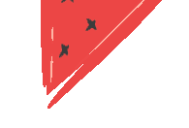





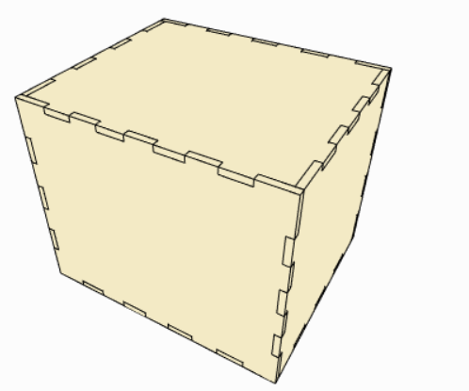
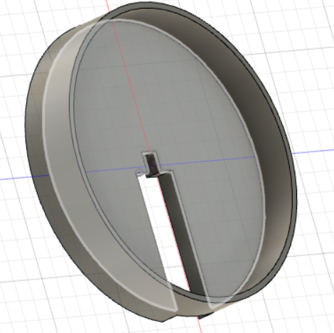
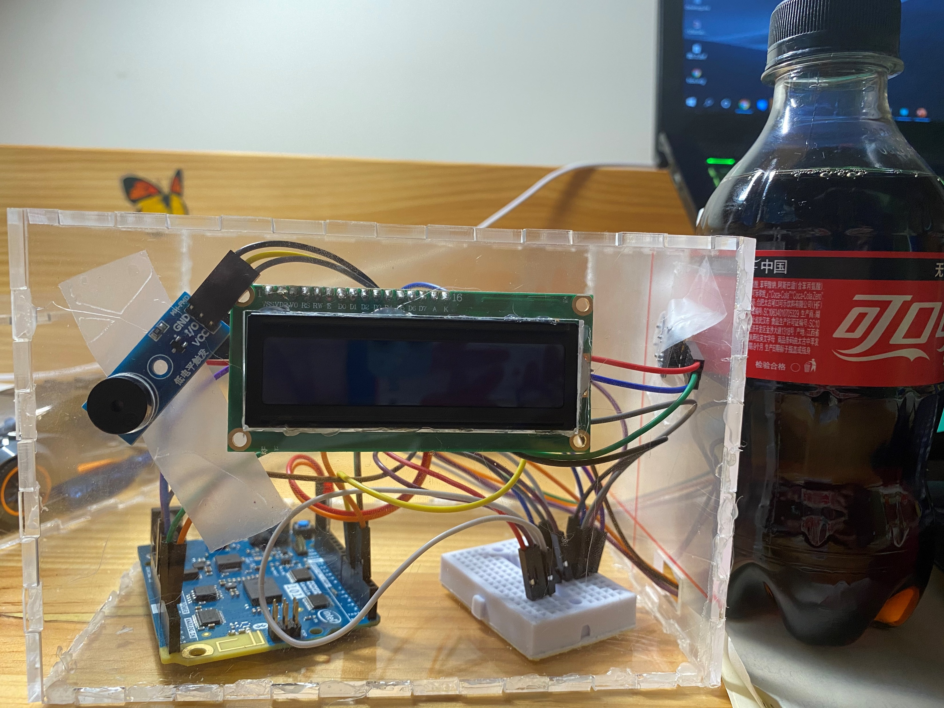







FABLAB Final Project ： A Special Alarm Clock
Wei ZHANG (张伟)
Shape：Laser Cutter
Small Parts：3D Printer
Prototype
Show UTC +8 Standard Time and date precisely.
Alarm clock function.
Measure the temperature.
Special Function : Remind and motivate me to take my medicine in time. You can take away your coke only if you have already taken away your pills. Otherwise, it will alert and make a noise, and red led will be turned on!
FABLAB O SHANGHAI “FABO ACADEMY X CHINA” 2020

