Slide 1
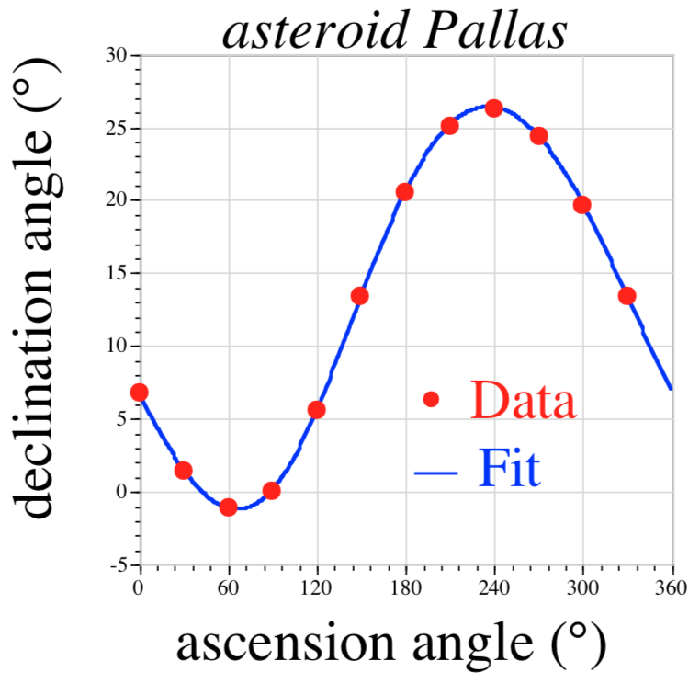
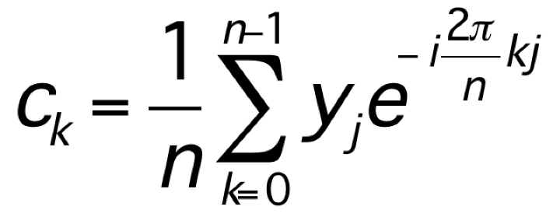
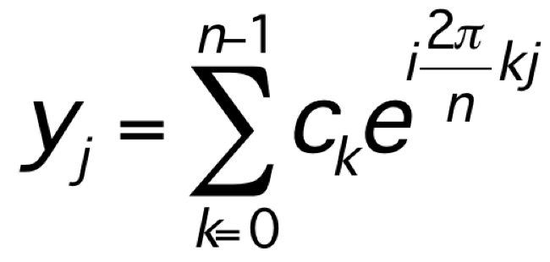
In the beginning (c. 1805): Carl Friedrich Gauss
trigonometric interpolation:
generalizing work
of Clairaut (1754)
and Lagrange (1762)
discrete Fourier transform (DFT):
(before Fourier)

Slide 2
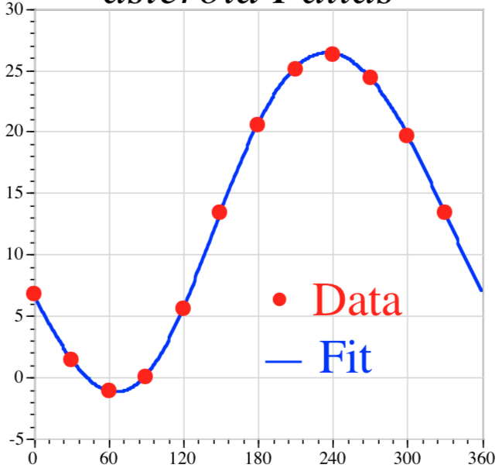
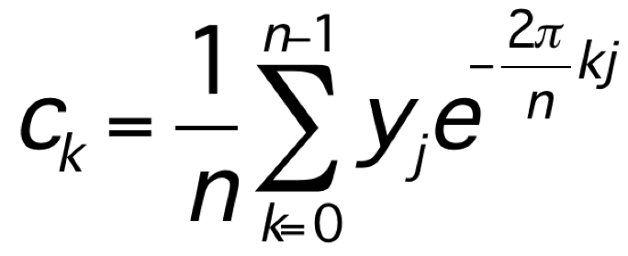
Gauss’ fast Fourier transform (FFT)
?
how do we compute:
— not directly: O(n²) operations … for Gauss, n=12
Gauss’ insight: “Distribuamus hanc periodum primo in tres periodos quaternorum terminorum.”
= We first distribute this period
[n=12] into 3 periods of length 4 …
Divide and conquer.
(any composite n)

Slide 3
But how fast was it?
“illam vero methodum calculi mechanici taedium magis minuere”
= “truly, this method greatly reduces
the tedium of mechanical calculation”
(For Gauss, being less boring was good enough.)

Slide 4
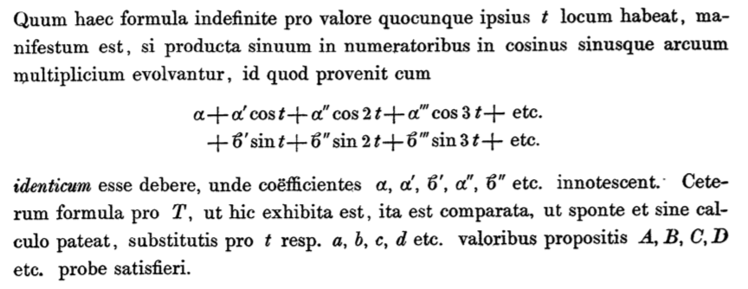
Gauss’ DFT notation:
From “Theoria interpolationis methodo nova tractata”
Kids: don’t try this at home!

Slide 5
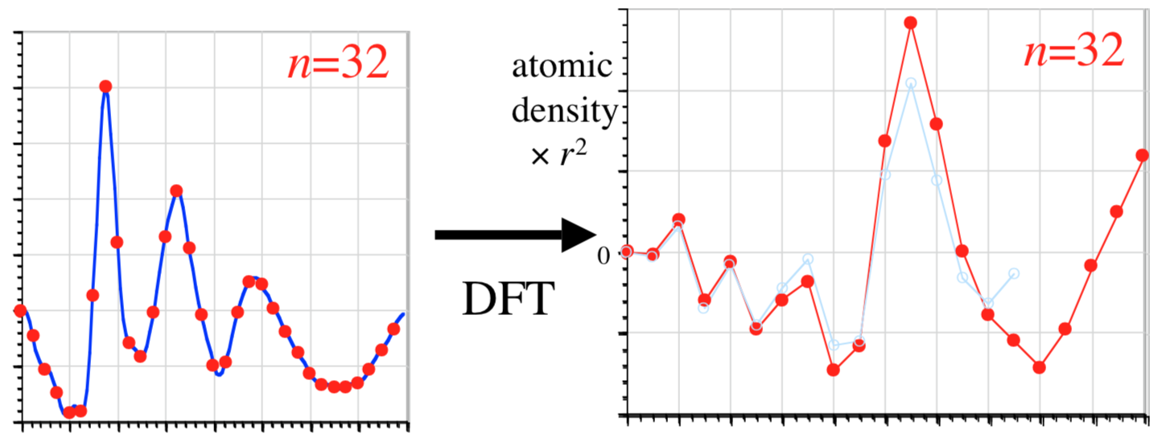
two (of many) re-inventors: Danielson and Lanczos (1942)
[ J. Franklin Inst. 233, 365–380 and 435–452]
Given Fourier transform of density (X-ray scattering) find density:
discrete sine transform (DST-1) = DFT of real, odd-symmetry
sample
the spectrum
at n points:
radius r
…double sampling until density (DFT) converges…

Slide 6
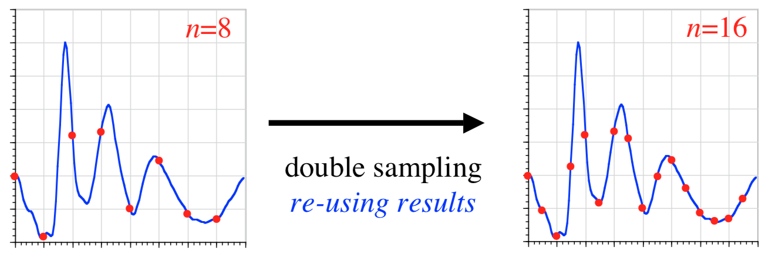
Gauss’ FFT in reverse: Danielson and Lanczos (1942)
[ J. Franklin Inst. 233, 365–380 and 435–452]
“By a certain transformation process, it is possible to double the number of ordinates with only slightly more than double the labor.”
from
O(n²) to ???
64-point DST in only 140 minutes!

Slide 7
re-inventing Gauss (for the last time) Cooley and Tukey (1965)
[ Math. Comp. 19,
297–301 ]
N = N₁N₂
1d DFT of size N:
= ~2d DFT of size N₁ × N₂
(+ phase rotation by twiddle factors)
= Recursive DFTs of sizes N₁ and N₂
O(N²)
O(N log N)
n=2048, IBM 7094, 36-bit float: 1.2 seconds
(~10⁶ speedup vs. Dan./Lanc.)

Slide 8
The “Cooley-Tukey” FFT Algorithm
N = N₁N₂
1d DFT of size N:
₀
₁
₂
₃
₄
…
n
= ~2d DFT of size N₁ × N₂
input re-indexing
n = n₁ + N₁n₂
N₁
output re-indexing
n₁
k = N₂k₁ + k₂
₀
₁
₂
multiply by n
“twiddle factors”
n₂
₃
₄
…
N₂
N₂
k₂
transpose
k₁
₀
₁
₂
₃
₄
…
N₁
= contiguous
first DFT columns, size N₂
(non-contiguous)
finally, DFT columns, size N₁
(non-contiguous)

Slide 9
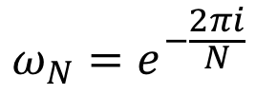
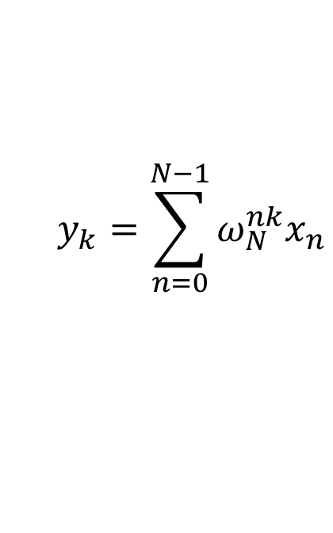

“Cooley-Tukey” FFT, in math
Recall the definition of the DFT:
$$y_{k}=\sum_{n=0}^{N−1}{ω_{N}^{nk}x_{n}}$$
$$ω_{N}=e^{−\frac{2πi}{N}}$$
where
Trick: if $N=N_{1}N_{2}$, re-index $n=n_{1}+N_{1}n_{2}$ and $k=N_{2}k_{1}+k_{2}$:
$$y_{N_{2}k_{1}+k_{2}}=\sum_{n_{1}=0}^{N_{1}−1}{\sum_{n_{2}=0}^{N_{2}−1}{ω_{N}^{n_{1}N_{2}k_{1}}ω_{N}^{n_{1}k_{2}}ω_{N}^{{N_{1}n}_{2}N_{2}k_{1}}ω_{N}^{{N_{1}n}_{2}k_{2}}x_{n_{1}+N_{1}n_{2}}}}$$
= $\sum_{n_{1}=0}^{N_{1}−1}{ω_{N}^{n_{1}N_{2}k_{1}}ω_{N}^{n_{1}k_{2}}\left(\sum_{n_{2}=0}^{N_{2}−1}{ω_{N_{2}}^{n_{2}k_{2}}x_{n_{1}+N_{1}n_{2}}}\right)}$
size-N₁ DFTs
twiddles
size-N₂ DFTs
… repeat recursively.

Slide 10
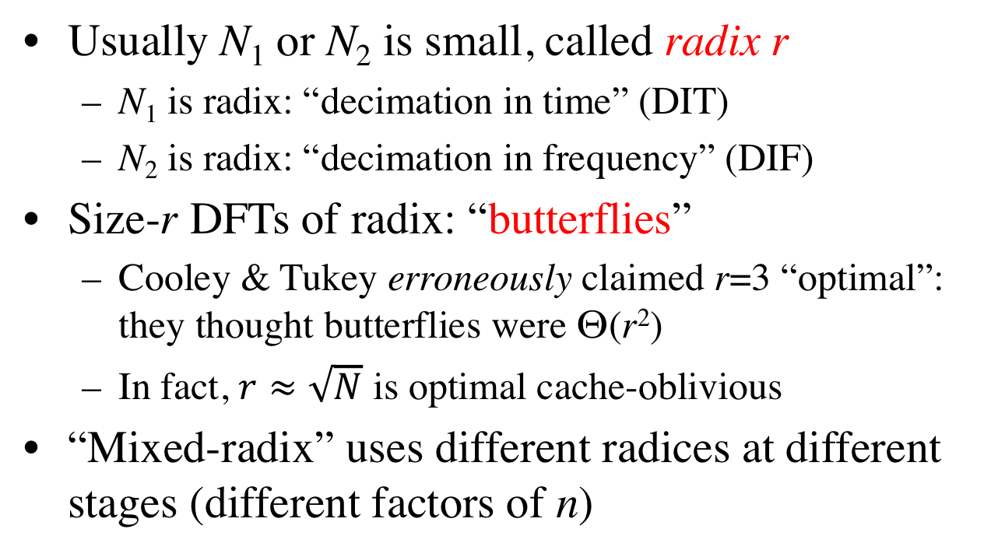
Cooley–Tukey terminology
Usually N₁ or N₂ is small, called radix r
N₁ is radix: “decimation in time” (DIT)
N₂ is radix: “decimation in frequency” (DIF)
Size-r DFTs of radix: “butterflies”
Cooley & Tukey erroneously claimed r=3 “optimal”: they thought butterflies were Θ(r²)
In fact, $r≈\sqrt{N}$ is optimal cache-oblivious
“Mixed-radix” uses different radices at different stages (different factors of n)

Slide 11
…but how do we make it faster?
We (probably) cannot do better than Θ(n log n).
(the proof of this remains an open problem)
[ unless we give up exactness ]
We’re left with the “constant” factor…

Slide 12
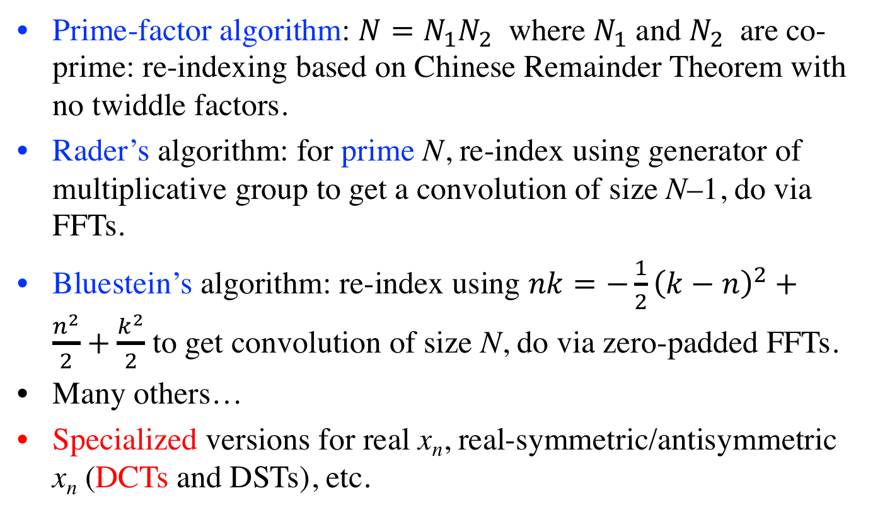
Many other FFT algorithms
Prime-factor algorithm: $N=N_{1}N_{2}$ where $N_{1}$ and $N_{2}$ are co-prime: re-indexing based on Chinese Remainder Theorem with no twiddle factors.
Rader’s algorithm: for prime N, re-index using generator of multiplicative group to get a convolution of size N–1, do via FFTs.
Bluestein’s algorithm: re-index using $nk=−\frac{1}{2}{\left(k−n\right)}^{2}+\frac{n^{2}}{2}+\frac{k^{2}}{2}$ to get convolution of size N, do via zero-padded FFTs.
Many others…
Specialized versions for real x_{n}, real-symmetric/antisymmetric x_{n} (DCTs and DSTs), etc.

Slide 13
The Next 30 Years…
Assume “time”
= # multiplications
# multiplications + # additions (= flops)
Winograd (1979): # multiplications = Θ(n)
(…realizable bound! … but costs too many additions)
Yavne (1968): split-radix FFT, saves 20% over radix-2 flops
[ unsurpassed until last 2007, another ~6% saved
by Lundy/Van Buskirk and Johnson/Frigo ]

Slide 14
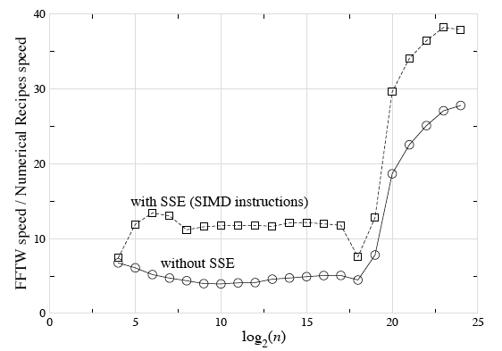
Are arithmetic counts so important?

Slide 15
The Next 30 Years…
Assume “time”
= # multiplications
# multiplications + # additions (= flops)
Winograd (1979): # multiplications = Θ(n)
(…realizable bound! … but costs too many additions)
Yavne (1968): split-radix FFT, saves 20% over radix-2 flops
[ unsurpassed until last 2007, another ~6% saved]
last 15+ years: flop count (varies by ~20%)
no longer determines speed (varies by factor of ~10+)

Slide 16
a basic question: If arithmetic no longer dominates, what does?

Slide 17
The Memory Hierarchy (not to scale)
disk (out of core) / remote memory (parallel)
(terabytes)
…what matters is not
how much work you
do, but when and where
you do it.
RAM (gigabytes)
L2 cache (megabytes)
the name of the game:
• do as much work as
possible before
going out of cache
L1 cache (10s of kilobytes)
registers (~100)
…difficult for FFTs
…many complications
…continually changing

Slide 18

The “Fastest Fourier Transform in the West”
:
Steven G. Johnson, MIT Applied Mathematics
Matteo Frigo, Oracle; formerly MIT LCS (CSAIL)

Slide 19
What’s the fastest algorithm for _____? (computer science = math + time = math + $)
1
Find best asymptotic complexity
naïve DFT to FFT: O(n²) to O(n log n)
2
Find best exact operation count?
3
Find variant/implementation that runs fastest
hardware-dependent — unstable answer!
Better to change the question…

Slide 20
What’s the smallest set of “simple” algorithmic steps whose compositions ~always span the ~fastest algorithm?
A question with a more stable answer?

Slide 21

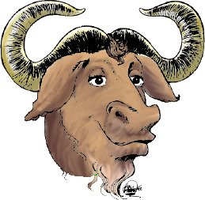
FFTW
the “Fastest
Fourier Tranform
in the West”
• C library for real & complex FFTs (arbitrary size/dimensionality)
(+ parallel versions for threads & MPI)
• Computational kernels (80% of code) automatically generated
• Self-optimizes for your hardware (picks best composition of steps)
= portability + performance
free software: http://www.fftw.org/

Slide 22
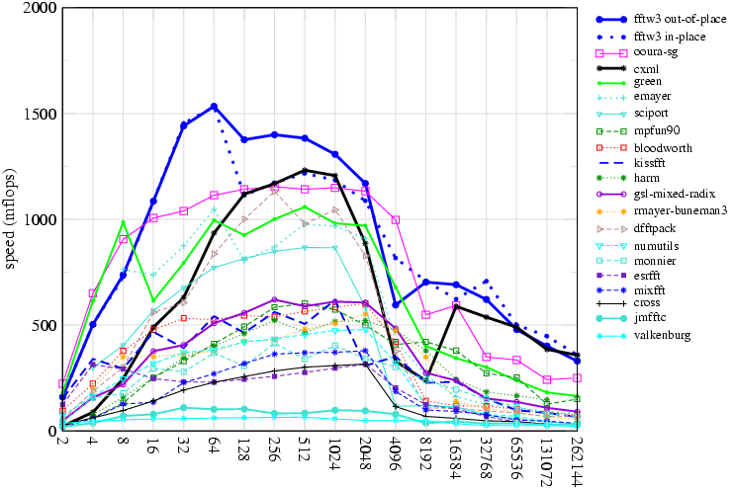
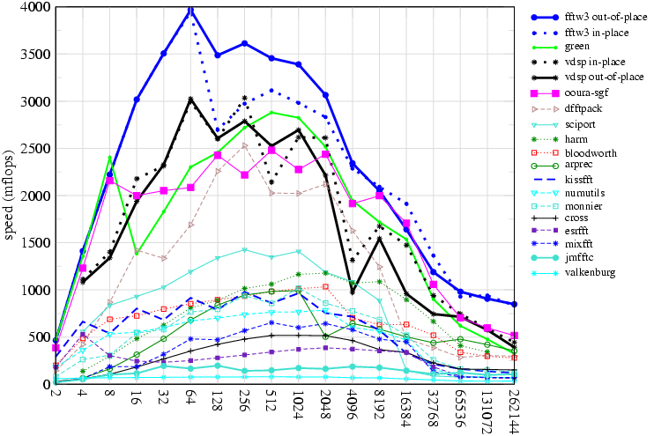
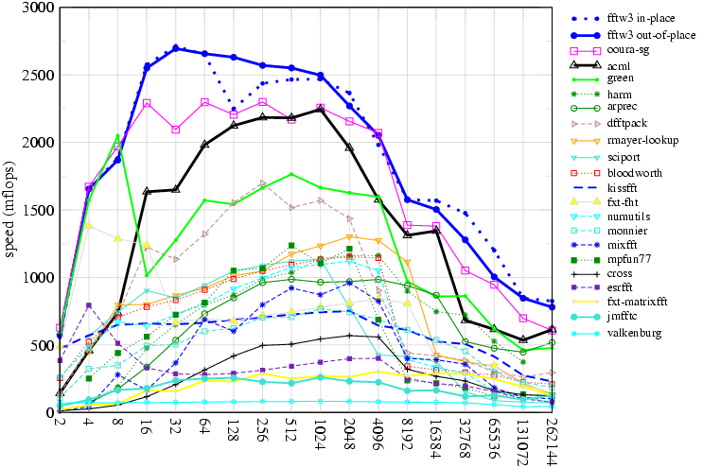
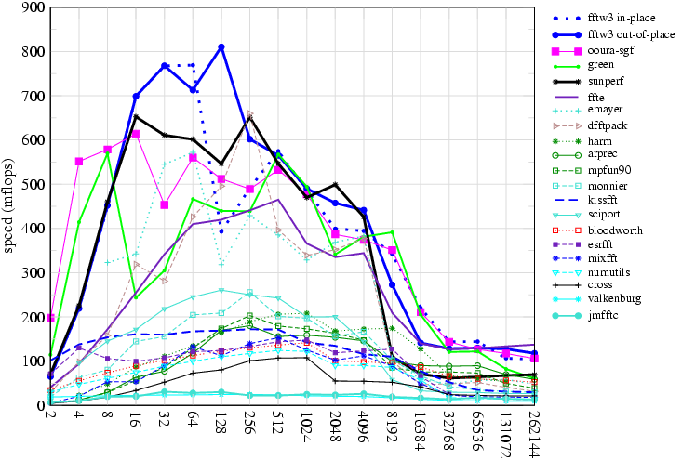
FFTW performance power-of-two sizes, double precision
833 MHz Alpha EV6
2 GHz PowerPC G5
2 GHz AMD Opteron
500 MHz Ultrasparc IIe

Slide 23
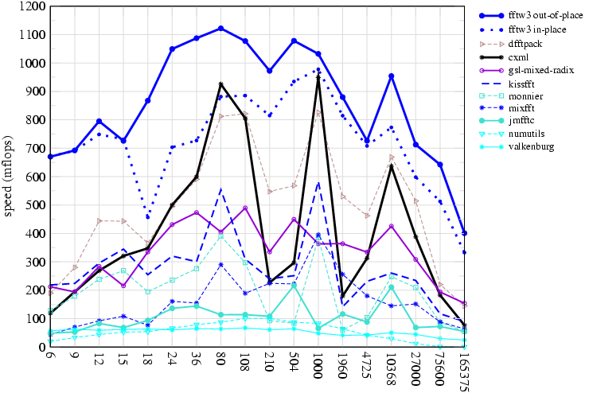
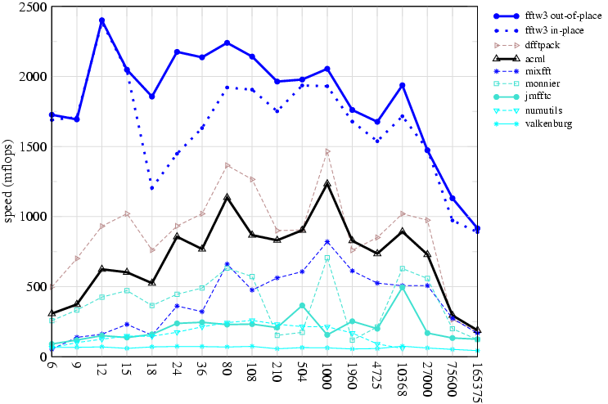
FFTW performance non-power-of-two sizes, double precision
unusual: non-power-of-two sizes
receive as much optimization
as powers of two
833 MHz Alpha EV6
2 GHz AMD Opteron
…because we
let the code do the optimizing

Slide 24
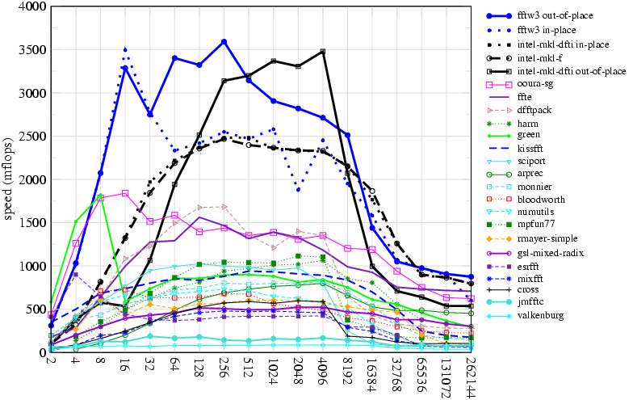
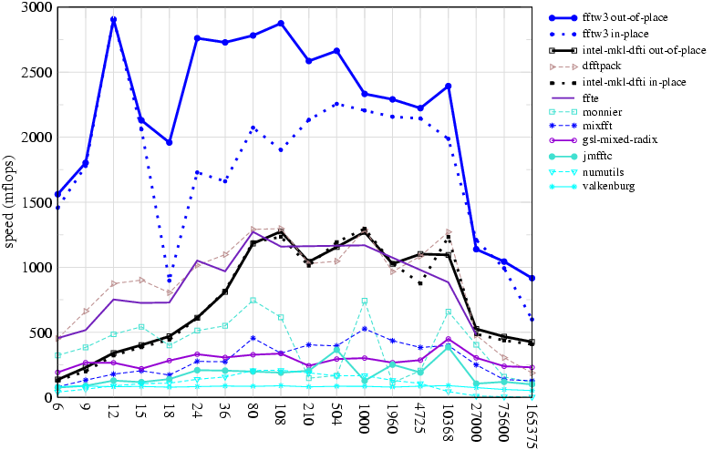
FFTW performance double precision, 2.8GHz Pentium IV: 2-way SIMD (SSE2)
powers of two
exploiting CPU-specific
SIMD instructions
(rewriting the code)
is easy
non-powers-of-two
…because we
let the code write itself

Slide 25
Why is FFTW fast?
FFTW implements many FFT algorithms:
A planner picks the best composition (plan)
by measuring the speed of different combinations.
Three ideas:
1
A recursive framework enhances locality.
2
Computational kernels (codelets)
should be automatically generated.
3
Determining the unit of composition is critical.

Slide 26
FFTW is easy to use
{
complex x[n];
plan p;
p = plan_dft_1d(n, x, x, FORWARD, MEASURE);
...
execute(p); /* repeat as needed */
...
destroy_plan(p);
}
Key fact: usually,
many transforms of same size are required.

Slide 27
Why is FFTW fast?
FFTW implements many FFT algorithms:
A planner picks the best composition (plan)
by measuring the speed of different combinations.
Three ideas:
1
A recursive framework enhances locality.
2
Computational kernels (codelets)
should be automatically generated.
3
Determining the unit of composition is critical.

Slide 28
Why is FFTW slow?
1965 Cooley & Tukey, IBM 7094, 36-bit single precision:
size 2048 DFT in 1.2 seconds
2003 FFTW3+SIMD, 2GHz Pentium-IV 64-bit double precision:
size 2048 DFT in 50 microseconds (24,000x speedup)
(= 30% improvement per year)
(
Moore’s prediction:
30 nanoseconds
)
(= doubles every ~30 months)
FFTs are hard:
don’t get “peak” CPU speed
especially for large n,
unlike e.g. dense matrix multiply

Slide 29
Discontiguous Memory Access
n = pq
1d DFT of size n:
= ~2d DFT of size p x q
p
multiply by n “twiddle factors”
q
transpose
q
p
= contiguous
first DFT columns, size q
(non-contiguous)
finally, DFT columns, size p
(non-contiguous)

Slide 30
Cooley-Tukey is Naturally Recursive
Size 8 DFT
p = 2 (radix 2)
Size 4 DFT
Size 4 DFT
Size 2 DFT
Size 2 DFT
Size 2 DFT
Size 2 DFT
But traditional implementation is non-recursive,
breadth-first traversal:
log₂ n passes over whole array

Slide 31
Traditional cache solution: Blocking
Size 8 DFT
p = 2 (radix 2)
Size 4 DFT
Size 4 DFT
Size 2 DFT
Size 2 DFT
Size 2 DFT
Size 2 DFT
breadth-first, but with blocks of size = cache
optimal choice: radix = cache size
radix >> 2
…requires program specialized for cache size
…multiple levels of cache = multilevel blocking

Slide 32
Recursive Divide & Conquer is Good
(depth-first traversal)
[Singleton, 1967]
Size 8 DFT
p = 2 (radix 2)
Size 4 DFT
Size 4 DFT
Size 2 DFT
Size 2 DFT
Size 2 DFT
Size 2 DFT
eventually small enough to fit in cache
…no matter what size the cache is

Slide 33
Cache Obliviousness
• A cache-oblivious algorithm does not know the cache size
— for many algorithms [Frigo 1999],
can be provably “big-O” optimal for any machine
& for all levels of cache simultaneously
… but this ignores e.g. constant factors, associativity, …
cache-obliviousness is a good beginning,
but is not the end of optimization
we’ll see: FFTW combines both styles
(breadth- and depth-first) with self-optimization

Slide 34
Why is FFTW fast?
FFTW implements many FFT algorithms:
A planner picks the best composition (plan)
by measuring the speed of different combinations.
Three ideas:
1
A recursive framework enhances locality.
2
Computational kernels (codelets)
should be automatically generated.
3
Determining the unit of composition is critical.

Slide 35
The Codelet Generator
a domain-specific FFT “compiler”
• Generates fast hard-coded C for FFT of a given size
Necessary to give the planner a large space of codelets to experiment with (any factorization).
Exploits modern CPU
deep pipelines & large register sets.
Allows easy experimentation with different optimizations & algorithms.
…CPU-specific hacks (SIMD) feasible
(& negates recursion overhead)

Slide 36
The Codelet Generator
written in Objective Caml [Leroy, 1998], an ML dialect
Abstract FFT algorithm
n
Cooley-Tukey: n=pq,
Prime-Factor: gcd(p,q) = 1,
Rader: n prime, …
Symbolic graph (dag)
Simplifications
powerful enough
to e.g. derive real-input FFT
from complex FFT algorithm
and even find “new” algorithms
Optimal cache-oblivious
scheduling
(cache .EQ. registers)
Optimized C code (or other language)

Slide 37
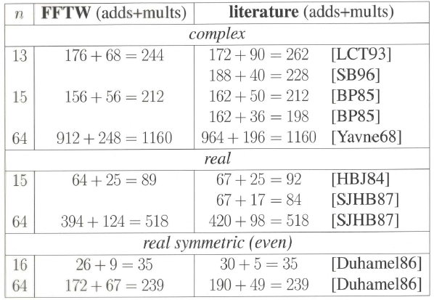
The Generator Finds Good/New FFTs

Slide 38
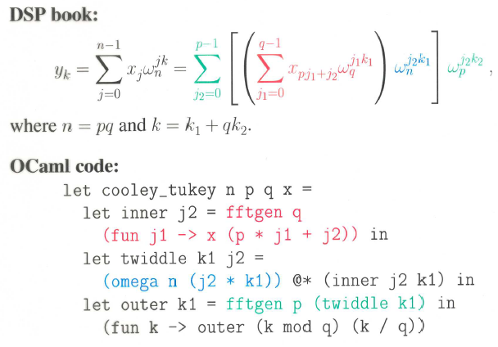
Symbolic Algorithms are Easy Cooley-Tukey in OCaml

Slide 39
Simple Simplifications
Well-known optimizations:
Algebraic simplification, e.g. a + 0 = a
Constant folding
Common-subexpression elimination

Slide 40
Symbolic Pattern Matching in OCaml
The following actual code fragment is
solely responsible for simplifying multiplications:
stimesM = function
| (Uminus a, b) -> stimesM (a, b) >>= suminusM
| (a, Uminus b) -> stimesM (a, b) >>= suminusM
| (Num a, Num b) -> snumM (Number.mul a b)
| (Num a, Times (Num b, c)) ->
snumM (Number.mul a b) >>= fun x -> stimesM (x, c)
| (Num a, b) when Number.is_zero a -> snumM Number.zero
| (Num a, b) when Number.is_one a -> makeNode b
| (Num a, b) when Number.is_mone a -> suminusM b
| (a, b) when is_known_constant b && not (is_known_constant a) ->
stimesM (b, a)
| (a, b) -> makeNode (Times (a, b))
(Common-subexpression elimination is implicit
via “memoization” and monadic programming style.)

Slide 41
Simple Simplifications
Well-known optimizations:
Algebraic simplification, e.g. a + 0 = a
Constant folding
Common-subexpression elimination
FFT-specific optimizations:
Network transposition (transpose + simplify + transpose)
_________________ negative constants…

Slide 42
A Quiz: Is One Faster?
Both compute the same thing, and
have the same number of arithmetic operations:
a = 0.5 * b;
c = 0.5 * d;
e = 1.0 + a;
f = 1.0 - c;
a = 0.5 * b;
c = -0.5 * d;
e = 1.0 + a;
f = 1.0 + c;
Faster because no separate load for -0.5
10–15% speedup

Slide 43
Non-obvious transformations require experimentation

Slide 44
Quiz 2: Which is Faster?
accessing strided array
inside codelet (amid dense numeric code), nonsequential
array[stride * i]
array[strides[i]]
using precomputed stride array:
strides[i] = stride * i
This is faster, of course!
Except on brain-dead architectures…
…namely, Intel Pentia:
integer multiplication conflicts with floating-point
up to ~10–20% speedup
(even better to bloat:
pregenerate various constant strides)

Slide 45
Machine-specific hacks are feasible if you just generate special code
stride precomputation
SIMD instructions (SSE, Altivec, 3dNow!)
fused multiply-add instructions…

Slide 46
The Generator Finds Good/New FFTs

Slide 47
Why is FFTW fast?
FFTW implements many FFT algorithms:
A planner picks the best composition (plan)
by measuring the speed of different combinations.
Three ideas:
1
A recursive framework enhances locality.
2
Computational kernels (codelets)
should be automatically generated.
3
Determining the unit of composition is critical.

Slide 48
What does the planner compose?
• The Cooley-Tukey algorithm presents many choices:
— which factorization? what order? memory reshuffling?
Find simple steps that combine without restriction
to form many different algorithms.
… steps to do WHAT?
FFTW 1 (1997):
steps solve out-of-place DFT of size n

Slide 49
“Composable” Steps in FFTW 1
SOLVE — Directly solve a small DFT by a codelet
CT-FACTOR[r] — Radix-r Cooley-Tukey step =
execute loop of r sub-problems of size n/r
✗
Many algorithms difficult to express via simple steps.
— e.g. expresses only depth-first recursion (loop is outside of sub-problem)
— e.g. in-place without bit-reversal requires combining
two CT steps (DIT + DIF) + transpose

Slide 50
What does the planner compose?
• The Cooley-Tukey algorithm presents many choices:
— which factorization? what order? memory reshuffling?
Find simple steps that combine without restriction
to form many different algorithms.
… steps to do WHAT?
FFTW 1 (1997):
steps solve out-of-place DFT of size n
Steps cannot solve problems that cannot be expressed.

Slide 51
What does the planner compose?
• The Cooley-Tukey algorithm presents many choices:
— which factorization? what order? memory reshuffling?
Find simple steps that combine without restriction
to form many different algorithms.
… steps to do WHAT?
FFTW 3 (2003):
steps solve a problem, specified as a DFT(input/output, v,n):
multi-dimensional “vector loops” v of multi-dimensional transforms n
{sets of (size, input/output strides)}

Slide 52
Some Composable Steps (out of ~16)
SOLVE — Directly solve a small DFT by a codelet
CT-FACTOR[r] — Radix-r Cooley-Tukey step =
r (loop) sub-problems of size n/r
(& recombine with size-r twiddle codelet)
VECLOOP — Perform one vector loop
(can choose any loop, i.e. loop reordering)
INDIRECT — DFT = copy + in-place DFT
(separates copy/reordering from DFT)
TRANSPOSE — solve in-place m × n transpose

Slide 53
Many Resulting “Algorithms”
• INDIRECT + TRANSPOSE gives in-place DFTs,
— bit-reversal = product of transpositions
… no separate bit-reversal “pass”
[ Johnson (unrelated) & Burrus (1984) ]
• VECLOOP can push topmost loop to “leaves”
— “vector” FFT algorithm [ Swarztrauber (1987) ]
• CT-FACTOR then VECLOOP(s) gives “breadth-first” FFT,
— erases iterative/recursive distinction

Slide 54
Many Resulting “Algorithms”
• INDIRECT + TRANSPOSE gives in-place DFTs,
— bit-reversal = product of transpositions
… no separate bit-reversal “pass”
[ Johnson (unrelated) & Burrus (1984) ]
• VECLOOP can push topmost loop to “leaves”
— “vector” FFT algorithm [ Swarztrauber (1987) ]
• CT-FACTOR then VECLOOP(s) gives “breadth-first” FFT,
— erases iterative/recursive distinction

Slide 55
Depth- vs. Breadth- First for size n = 30 = 3 × 5 × 2
A “depth-first” plan:
30
CT-FACTOR[3]
VECLOOP x3
10
10
10
CT-FACTOR[2]
SOLVE[2, 5]
5
5
5
5
5
5
A “breadth-first” plan:
30
CT-FACTOR[3]
CT-FACTOR[2]
10
10
10
VECLOOP x3
SOLVE[2, 5]
5
5
5
5
5
5
(Note: both are executed by explicit recursion.)

Slide 56
Many Resulting “Algorithms”
• INDIRECT + TRANSPOSE gives in-place DFTs,
— bit-reversal = product of transpositions
… no separate bit-reversal “pass”
[ Johnson (unrelated) & Burrus (1984) ]
• VECLOOP can push topmost loop to “leaves”
— “vector” FFT algorithm [ Swarztrauber (1987) ]
• CT-FACTOR then VECLOOP(s) gives “breadth-first” FFT,
— erases iterative/recursive distinction

Slide 57
In-place plan for size 2¹⁴ = 16384 (2 GHz PowerPC G5, double precision)
CT-FACTOR[32]
CT-FACTOR[16]
INDIRECT
TRANSPOSE[32 × 32] x16
SOLVE[512, 32]
Radix-32 DIT + Radix-32 DIF = 2 loops = transpose
… where leaf SOLVE ~ “radix” 32 x 1

Slide 58
Out-of-place plan for size 2¹⁹=524288 (2GHz Pentium IV, double precision)
CT-FACTOR[4] (buffered variant)
CT-FACTOR[32] (buffered variant)
VECLOOP (reorder) x32
~2000 lines
hard-coded C!
CT-FACTOR[64]
INDIRECT
+ VECLOOP (reorder)
(+ …)
=
huge improvements
for large 1d sizes
INDIRECT
VECLOOP (reorder) x64
VECLOOP x4
COPY[64]
VECLOOP x4
SOLVE[64, 64]
Unpredictable: (automated) experimentation is the only solution.

Slide 59
Dynamic Programming the assumption of “optimal substructure”
Try all applicable steps:
CT-FACTOR[2]: 2 DFT(8)
CT-FACTOR[4]: 4 DFT(4)
DFT(16) = fastest of:
CT-FACTOR[2]: 2 DFT(4)
CT-FACTOR[4]: 4 DFT(2)
SOLVE[1,8]
DFT(8) = fastest of:
If exactly the same problem appears twice,
assume that we can re-use the plan.
— i.e. ordering of plan speeds is assumed independent of context

Slide 60
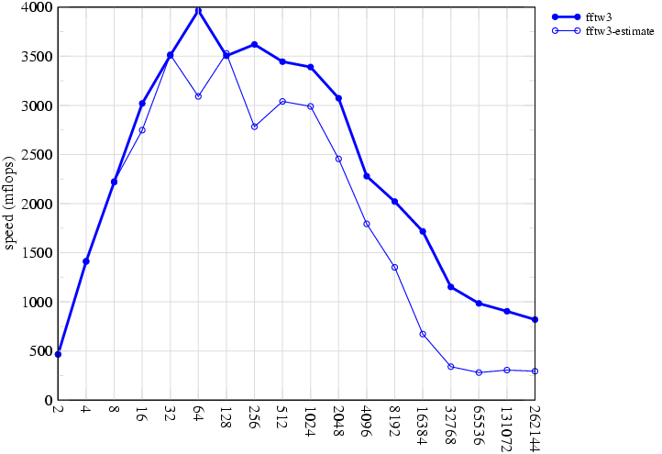
Planner Unpredictability
double-precision, power-of-two sizes, 2GHz PowerPC G5
FFTW 3
Classic strategy:
minimize op’s
fails badly
another test:
Use plan from:
another machine?
e.g. Pentium-IV?
… lose 20–40%
heuristic: pick plan
with fewest
adds + multiplies + loads/stores

Slide 61
We’ve Come a Long Way?
•
In the name of performance, computers have become
complex & unpredictable.
•
Optimization is hard: simple heuristics (e.g. fewest flops)
no longer work.
•
One solution is to avoid the details, not embrace them:
(Recursive) composition of simple modules
+ feedback (self-optimization)
High-level languages (not C) & code generation
are a powerful tool for high performance.

