Slide 1
Experimental study on the anaphora resolution model
Mohammed Abraar Asif
Supervisors:
Dr. Sona Taheri
Dr. Estrid He
Notes:
Good afternoon, everyone, I am Mohammed Abraar Asif, a final year master of analytics student and in today’s presentation I will be walking through my thesis – an experimental study on the anaphora resolution model

Slide 2
Contents
What is chemical information extraction?
Motivation
Background
Dataset
Anaphora resolution model
Problem statement
Loss functions
Results
Conclusion
References
Notes:
This will be the contents of today’s presentation, we’ll start off by a quick background on the chemical information extraction and the existing anaphora resolution model, followed by the class imbalance problem and the results of the thesis.

Slide 3

What is chemical information extraction?
Notes:
So, what Is chemical information extraction?

Slide 4

What is chemical information extraction?
Named Entity Recognition
Machine learning comprehension
Part-of-Speech Tagging
Notes:
Chemical information extraction is the automated NLP process of retrieving valuable information from chemical text for important tasks like Named Entity Recognition, machine reading comprehension etc.

Slide 5

Applications
Drug discovery
Event extraction
Document summarization
Notes:
Also extracting chemical information from patent text can be useful in several applications like drug discovery, document summarization etc. Bio medicine and pharmaceutical industry are the major fields which will benefit from chemical data mining, inorder to understand important characteristics of a drug.

Slide 6

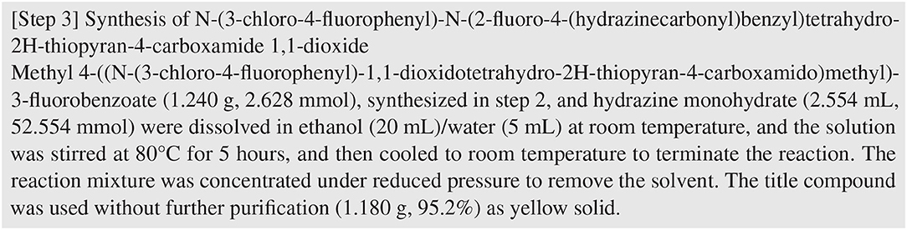
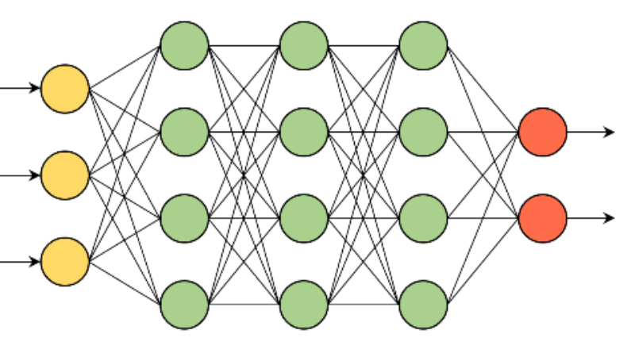

Motivation
Entities
Entities
Entity 1
Relationship
Entity 2
Notes:
The main motivation of the thesis comes from the challenges faced in extracting information from the texts taken from chemical patents like the example shown here. Because of their complex structure and linguistic properties, it becomes really difficult to train a model which can extract information’s like entities and relation between the entities from a document text, and thus the baseline model which is the anaphora resolution helps in resolving such issues. But even with such a complex nlp model there can be a lot of flaws and the main focus of this thesis is to study, analyze and optimize the issues caused by the anaphora resolution model.

Slide 7
Background
ChEMU-Ref: A Corpus for Modeling Anaphora Resolution in the Chemical Domain
Developed by The Cheminformatics Elsevier Melbourne University (ChEMU) evaluation lab 2020, in collaboration with RMIT University and University of Melbourne
ChEMU-Ref dataset is created from the reaction description in English chemical patents.
The data is annotated in BRAT standoff format.
Notes:
Let me give you guys a quick background on the focus of our thesis which is the anaphora resolution model Chemuref. The model ChemuRef was developed by the ChemU lab in collaboration with the RMIT University and the University of Melbourne. The chemuref dataset is created from the reaction descriptions taken from English chemical patents and is annotated in BRAT standoff format. Before talking about the brat standoff annotations, let me give you guys a quick walkthrough on the entities used for annotations.

Slide 8
Background (contd..)
Reaction description
Mention
Relation
  Coreference
  Bridging
    Transformed
    Reaction-associated
    Work-up
    Contained
Mention
Relation
Coreference
Bridging
Transformed
Reaction-associated
Work-up
Contained
Notes:
So basically, a reaction description such as the example shown below, has two entities, one is the mention and the other one is the relation. The mentions are the nouns and the noun phrases in the reaction description and the relation is the relationship between those mentions. The relations are further categorized into two one is the coreference and the other one is the bridging relations which are further subdivided into transformed, reaction-associated, work-up and contained bridgings.

Slide 9
Background (contd..)
Mention
Mentions
Proper noun
Noun Phrases
Identifiers
Proper Noun
Noun phrases
Identifiers
Notes:
For mentions, all the proper nouns, noun phrases and identifiers in a document text are considered as a potential candidate for mention entities.

Slide 10

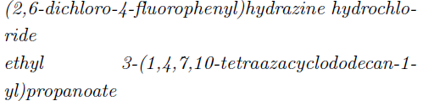
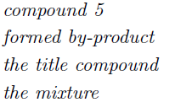



Background (contd..)
Mentions | Example 1 | Example 2
Proper noun
Noun phrases
Identifiers
Notes:
These are some of the examples of mentions, chemical names such as the ones shown in the picture are proper nouns and they contribute to a mention candidate in a reaction text. Similarly phrases such as “the mixture”, “compound 5” etc along with identifiers such as “5g”, “4ml” also add up to mention entities in a reaction description.

Slide 11

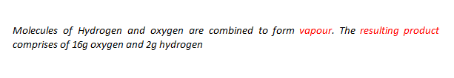
Background (contd..)
Coreference
Notes:
This is a small example of coreference in English text. So, in the example, queen Elizabeth 2 and her refers to the same person and thus there is a coreference between these two entities. Similarly, “her sister” and “princess Margaret” refers to the same person and therefore there is a coreference.
With chemical examples like the one shown here. In this example both vapor and the resulting product refers to the same entity and thus there is a coreference.

Slide 12

Background (contd..)
Bridging relation
Transformed
Two chemical compound entities that are initially based on the same chemical components and have undergone possible changes through various conditions
Reaction-associated
The relationship between a chemical compound and its immediate sources via a mixing process. The immediate sources do need to be reagents, but they need to end up in the corresponding product. The source compounds retain their original chemical structure
Notes:
Next are the bridging relations. The first in the list is a transformed relation, for instance lets say “______read the example_____” so the mixture 1 before stirring and mixture 2 after stirring are not the same. Hence there is a transformed relation between the two entities.
Next comes the reaction associated entity. When two or more chemical compounds are combined to form a mixture, then there is a bridging relation between the underlying mention entities.

Slide 13

Background (contd..)
Work-up
The relationship between chemical compounds that were used for isolation or purification purposes, and their corresponding output products.
Contained
The association holding between chemical compounds and the related equipment in which they are placed. The direction of the relation is from the related equipment to the previous chemical compound.
Notes:
The third one is the workup relation. When a chemical compound is used to isolate or purify a chemical product, then there is a workup relation between the product and the compound.
And finally if a substance like flask is used to store the solution, then there is a contained relationship between the flask and the solution which is being stored.

Slide 14


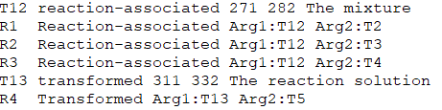

Dataset
Mention Annotation
Relation Annotation
Notes:
These are the brat standoff annotations used for our model training and testing. The first field is the unique entity ID, the second is the entity of the reaction which is followed by the start and the end of a span and the relation annotations have arguments which specifies which two mentions are involved in a relation.

Slide 15
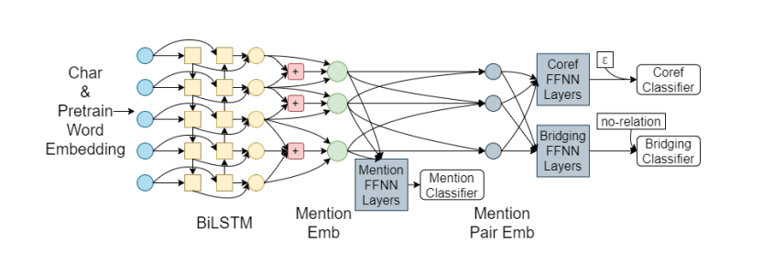
Anaphora resolution model
F1- Score
Mention Classifier: 0.875
Relation Classifier: 0.780
Notes:
This is the overall anaphora resolution model under study. It is a joint neural network with a language model for providing the attention mechanism. Initially the input texts are tokenized using GloVe’s pretrained word embeddings. The embeddings are then passed through an ELMO language model for providing attention to the highly regarded span. It is assumed that continuous tokens can act as a potential span and the span score for each possible span is computed. These are then passed through a mention classifier for mention candidate detection. Once mention candidates are detected, the next step will be to extract the relationships between the candidates. So, for that we have two relation classifiers, the first one is the coref and the second one is the bridging classifier. The coref classifier helps in extracting the reference of the same mention in previous instances and the bridging classifier helps in classifying the four bridging classes.
The baseline model has an overall f1-score of 0.875 for the mention classifier and 0.78 for the relation classifier. The focus of the thesis is to study the anaphora resolution model and spot out ways in which the performance can be improved.

Slide 16
Performance enhancement
Notes:
So, while thinking about the ways in which we can enhance the model performance, we found that there is a severe class imbalance in the input text data

Slide 17
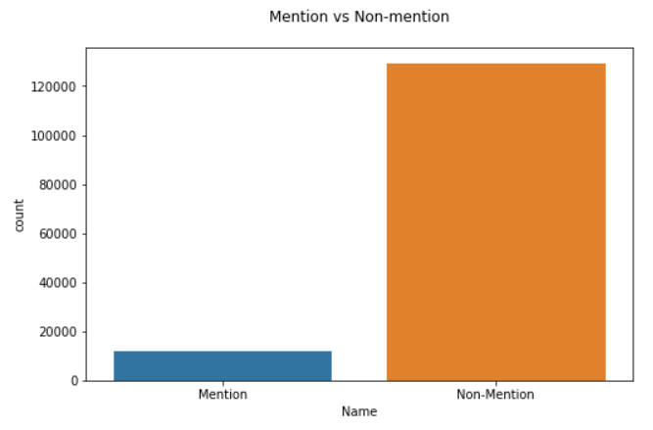
Class Imbalance in ChEMU-Ref Dataset
Notes:
This plot clearly shows that the number of negative mentions outnumber the number of positive mentions with a huge number.

Slide 18

Class imbalance problem
Distribution of the class examples is not equal
The model gives more importance to the dominant classes
Notes:
Class imbalance occurs when the distribution of the positive and negative examples is not equal and when such data are fed into the model, the model tends to learn more with the dominant class examples

Slide 19
Class imbalance in text
Task | # Negative examples | # Positive examples | Ratio
CoNLL03 NER | 170K | 34K | 4.98
OntoNotest5.0 NER | 1.96M | 239K | 8.18
SQuAD 1.1 | 10.3M | 175K | 55.9
SQuAD 2.0 | 15.4M | 188K | 82.0
QUOREF | 6.52M | 38.6K | 169
Notes:
These are some of the other textual datasets with the class imbalance issue.

Slide 20
Methods to resolve data imbalance Problem
Up-sampling minority classes
Down-sampling majority classes
Loss function
Notes:
There are several ways to solve the class imbalance issue, and these are some of the methods. We focus on the loss function used for the anaphora resolution model and have run experiments using other loss functions that help in solving the class imbalance issue.

Slide 21
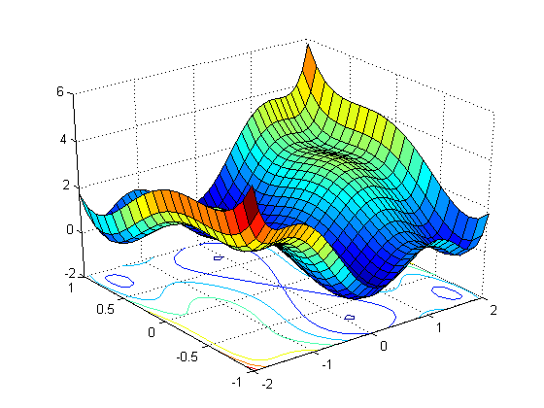
Loss Functions
Cross entropy (baseline)
Focal loss
Dice loss
Adaptive dice loss
Tversky loss
Focal Tversky loss
Notes:
These are the loss functions used in the experiments. Except cross entropy, all the other loss functions displayed in the slide have shown capability of resolving the class imbalance problem.

Slide 22



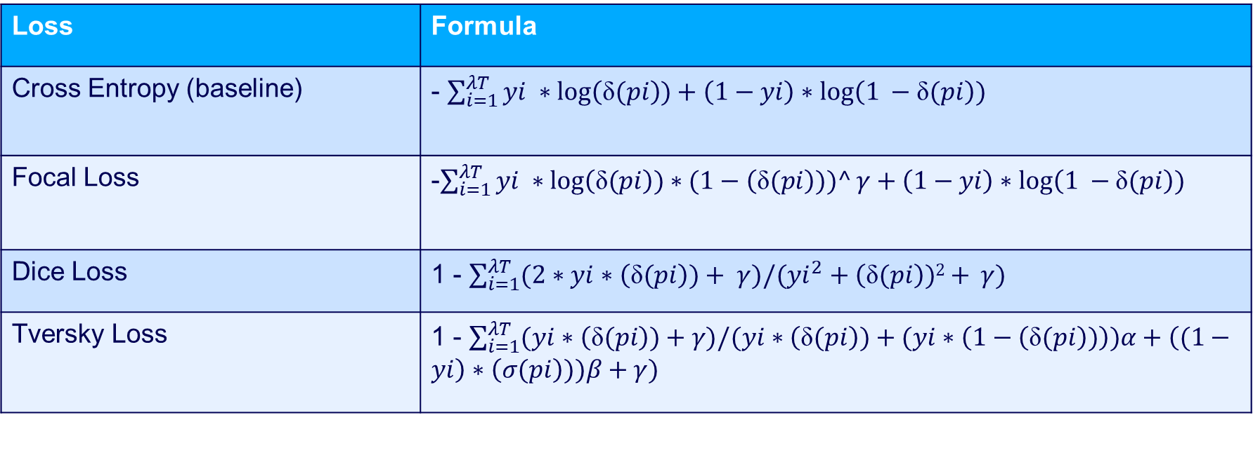
Loss Formulas
Loss | Formula
Cross Entropy (baseline) | - $\sum_{i=1}^{λT}{yi ∗\log\left(\text{δ}(pi\right))+\left(1−yi\right)∗log⁡\left(1 −\text{δ}(pi\right))}$
Focal Loss | -$\sum_{i=1}^{λT}{yi ∗\log\left(\text{δ}(pi\right))∗(1−\left(\text{δ}(pi\right)))^γ+\left(1−yi\right)∗log⁡\left(1 −\text{δ}(pi\right))}$
Dice Loss | 1 - $\sum_{i=1}^{λT}{(2∗yi∗\left(\text{δ}(pi\right))+ γ)/(yi^{2}+\left(\text{δ}(pi\right))2+ }γ)$
Tversky Loss | 1 - $\sum_{i=1}^{λT}{(yi∗\left(\text{δ}(pi\right))+γ)/(yi∗\left(\text{δ}(pi\right))+(yi∗\left(1−\left(\text{δ}(pi\right))\right))α+\left((1−yi\right)∗\left(σ(pi\right)))β+γ)}$
Legends
Loss | Standard Formula
Focal Loss
Dice Loss
Tversky Loss
yi – Ground truth labels
pi – Predicted logits
δ – Sigmoid function
α – Alpha value
β – Beta value
ϒ - Gamma value
Notes:
These are the formulas for the loss functions used in the experiments. We see that the cross entropy is accuracy oriented and focuses more on the true positives and true negatives.
To establish focus on the hard examples, focal loss introduces a term (1-pred) which adds an importance to the hard examples. Gamma is a variable which is used to specify the degree of importance.
Dice loss in another loss function which is used to solve the class imbalance problem. Here, the false negatives and false positives are given equal importance, so instead of the accuracy, the model will be trained based on precision and recall.
Tversky loss is just a modified version of dice loss with parameters provided to weight the false positives and false negatives.

Slide 23
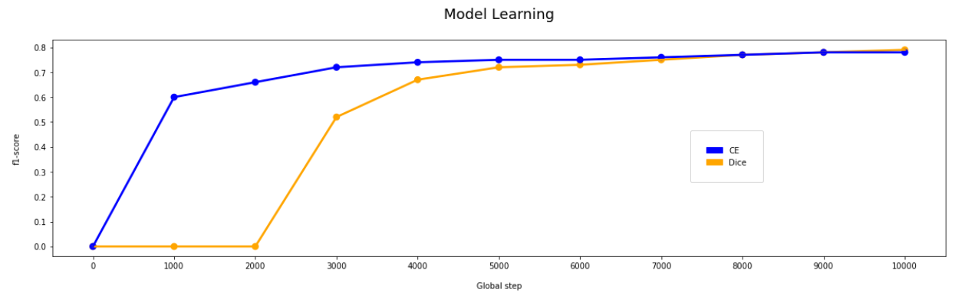
Model Learning using dice vs cross entropy
Notes:
While performing experiments on the anaphora resolution model, the model learning of various loss was analyzed. It is found that the f1-score of dice loss is 0 for the first 2000 global steps after which the model performance increases, explaining the slow learning characteristics of the model using dice loss as the cost function.

Slide 24
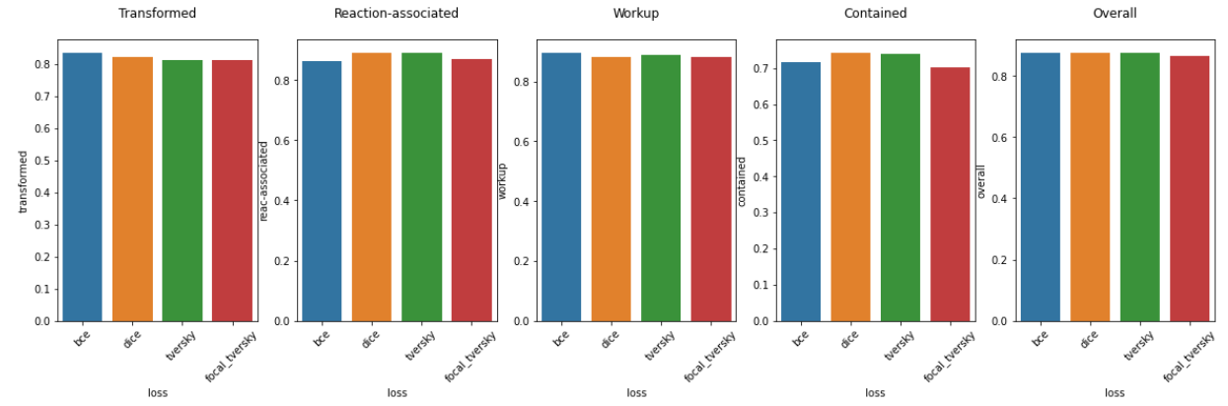
Results – F1 Score
Notes:
The f1-score of the models has been pretty much the same when running experiments with multiple loss functions, with a sligh improvement in the reaction associated and contained relations.

Slide 25
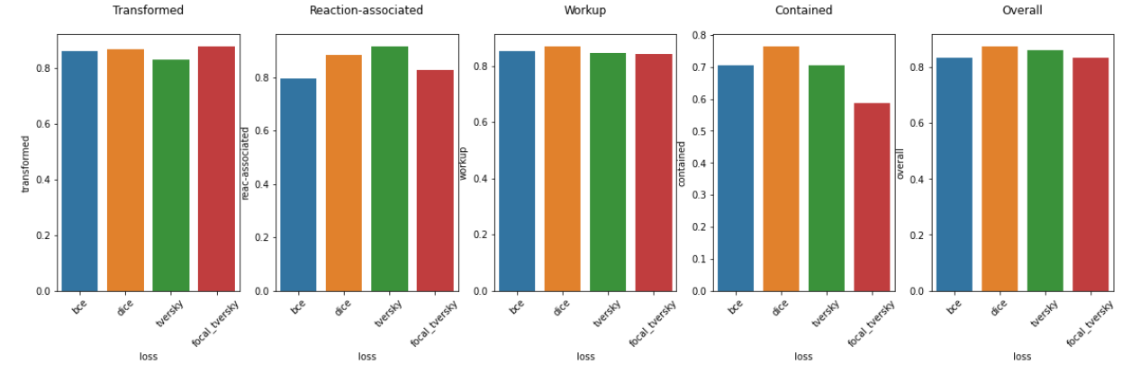
Results – Recall
Notes:
However, while checking out the recall for the loss functions such as dice, Tversky and focal. It shows that the recall has gone up, thus denoting that more positive examples are being predicted. But however, with the increase in recall, the precision has gone down a bit, so there is always a tradeoff between the precision and recall when modelling the anaphora resolution with different loss functions.

Slide 26
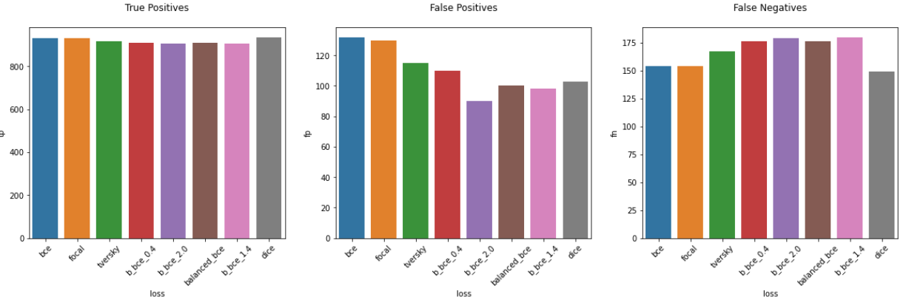
Results – TP, FP & FN
Notes:
This tradeoff is clearly depicted in the plot for TP, FP and FN. We can see that as the number of false negatives decreases, the false positive increases. But using dice loss, a balance between the precision and recall is achieved. Thus, the model performs the best with the dice loss as its cost function for model training.
But why has the precision gone down?

Slide 27
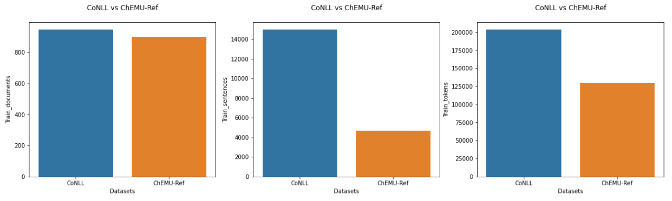
Comparing ChEMU-Ref dataset with baseline datasets
Notes:
When comparing the chemuref dataset with other standard textual datasets we found that both CoNLL and ChEMU-Ref have almost equal number of documents but the number of sentences in the chemuref dataset is 4k while standard datasets like ConLL have about 15k sentences. Also there is significant difference in the number of tokens used in the training dataset.

Slide 28
Conclusion
Dice loss provides a balance between precision and recall
The baseline model has a recall value of 0.833 and with dice loss as a cost function the recall value is 0.874
There is always a tradeoff between precision and recall when using focal, Tversky and other cost functions that have shown improvement in class imbalance.
Learning rate is quite slow for Tversky and dice loss, so training them with high global step can improve the performance of the model

Slide 29
Future work
Increasing the number of sentences in the dataset
Running the model using dice and Tversky loss for a greater number of global steps
Developing a multiclass model which can detect the NER and events along with the anaphora in a chemical text.

Slide 30
References
Fang, B., Druckenbrodt, C., Akhondi, S. A., He, J., Baldwin, T., & Verspoor, K. (2021, April 1). ChEMU-Ref: A Corpus for Modeling Anaphora Resolution in the Chemical Domain. ACLWeb; Association for Computational Linguistics. https://doi.org/10.18653/v1/2021.eacl-main.116
Li, X., Sun, X., Meng, Y., Liang, J., Wu, F., & Li, J. (2020). Dice Loss for Data-imbalanced NLP Tasks. ArXiv:1911.02855 [Cs]. https://arxiv.org/abs/1911.02855
Lin, T.-Y., Goyal, P., Girshick, R., He, K., & Dollár, P. (2018). Focal Loss for Dense Object Detection. ArXiv:1708.02002 [Cs]. https://arxiv.org/abs/1708.02002
‌
Abraham, N., & Khan, N. M. (2018). A Novel Focal Tversky loss function with improved Attention U-Net for lesion segmentation. ArXiv:1810.07842 [Cs]. https://arxiv.org/abs/1810.07842
‌
Loss Function Library - Keras & PyTorch. (n.d.). Kaggle.com. https://www.kaggle.com/code/bigironsphere/loss-function-library-keras-pytorch/notebook
‌
‌
‌

Slide 31
Thank You!!

