Slide 1
Python, Data Science Indtroduction

Slide 2
Features of Python
It is a general purpose programming language
Python is dynamically typed
Python follows OOPC (Object Oriented Programming Concepts)
It is interpreted

Slide 3
Why Python?
Easy to grasp, understand and code.
Widely used and finds application in mostly all domains.
Amazing job/career opportunities in India and abroad.
Job Sustainability.
High paying Jobs
Huge Research and Development Potential

Slide 4
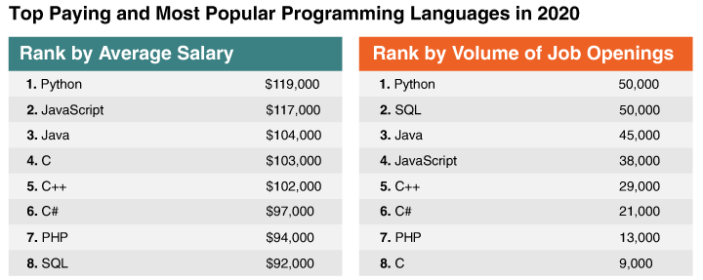

Slide 5
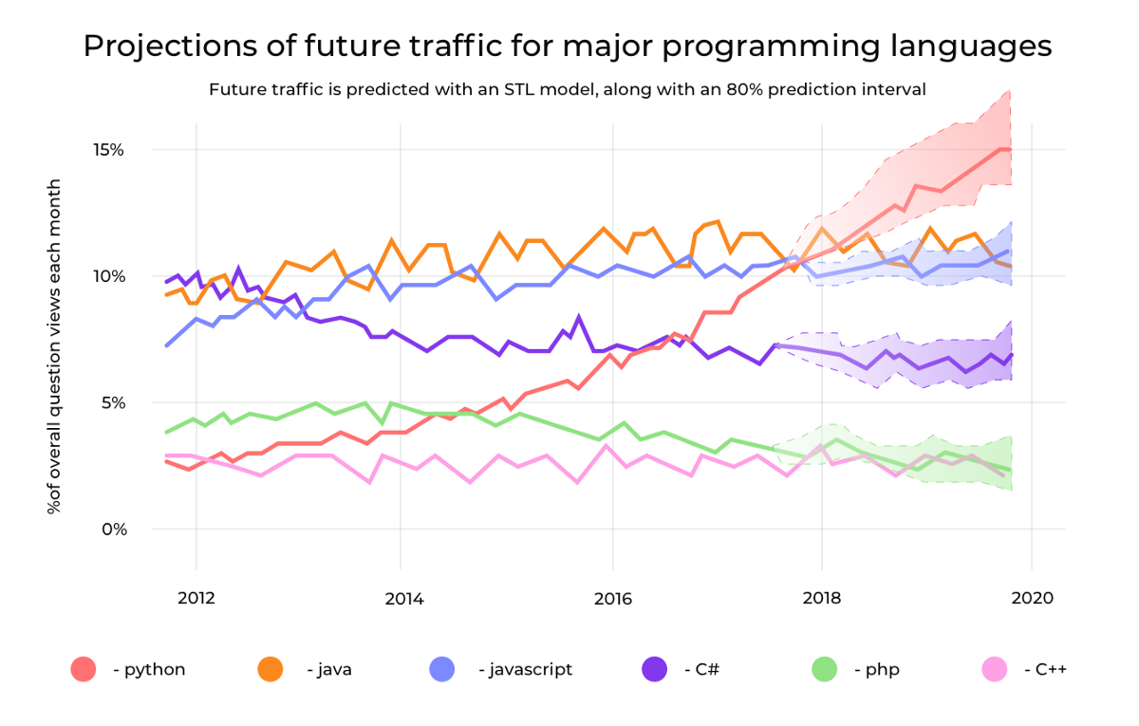

Slide 6
Applications of Python
Data Science
Machine Learning
AI/ Deep Learning/ Neural Network
Web Scraping
Web Development – Django/Flask
Automation
Image Processing
Audio/Video Processing
Natural Language Processing

Slide 7
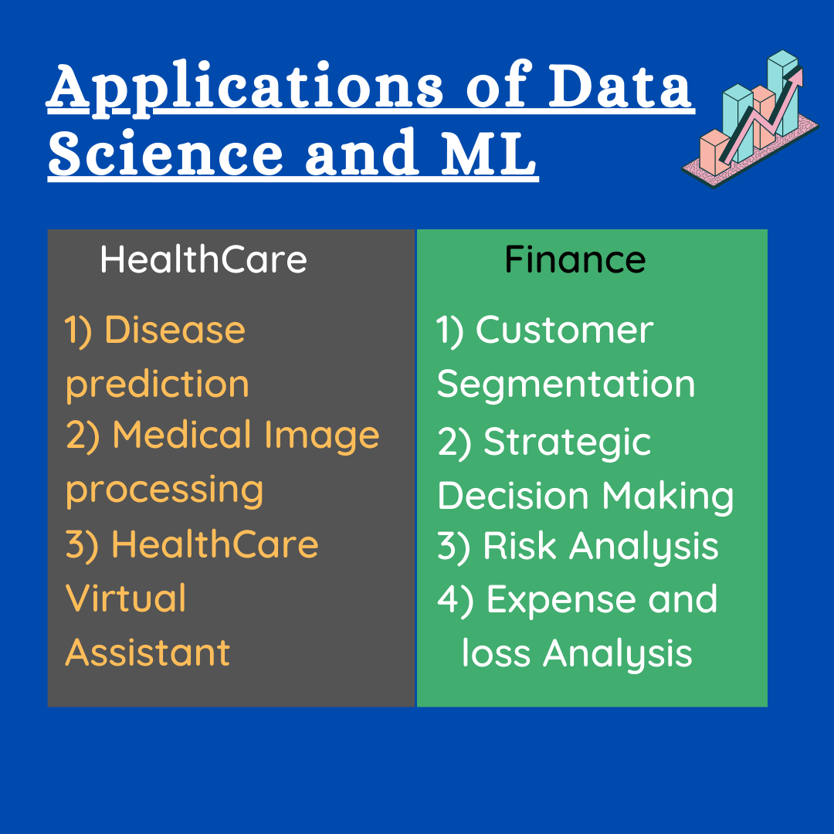

Slide 8
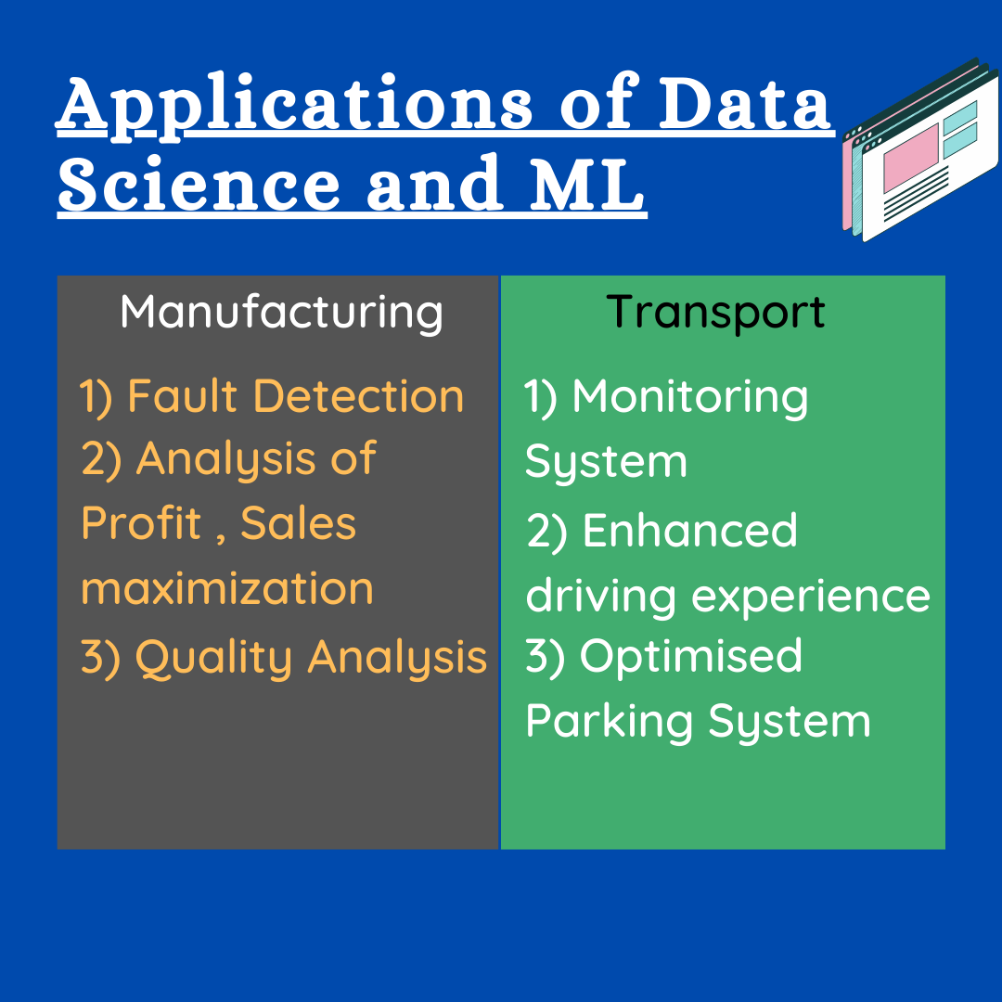

Slide 9
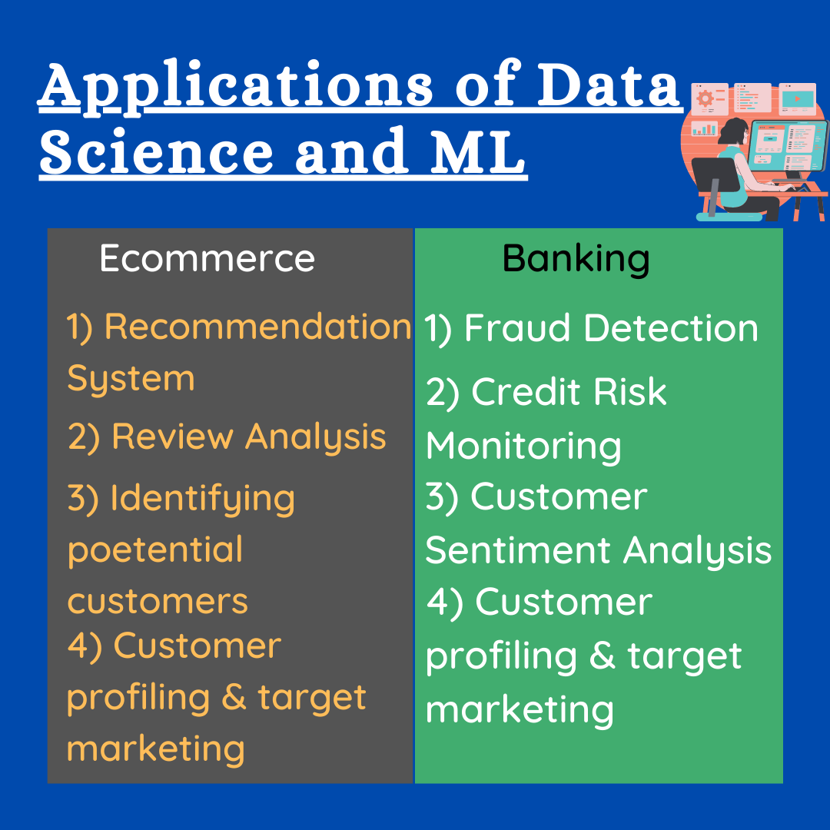

Slide 10
