Slide 1
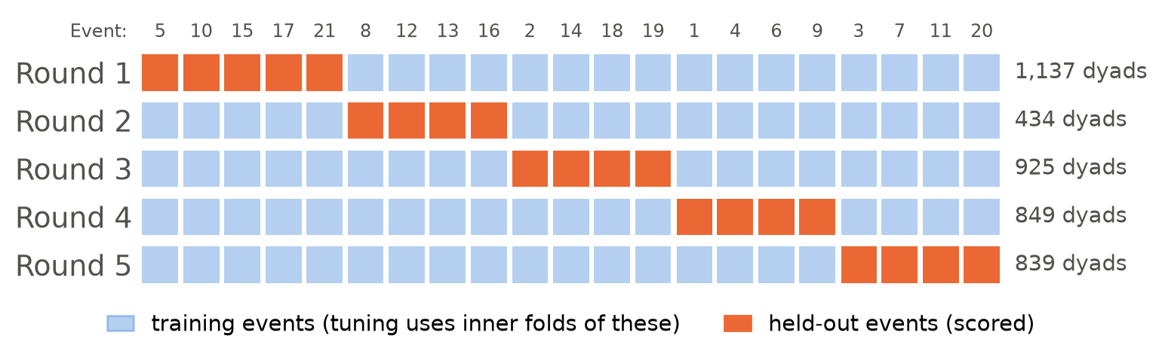
Technical implementation: hold out whole events
Each person dates up to 22 partners, so a random split puts the same person in training and test, and the scores look better than they would for new people.
So each round of 5-fold cross-validation holds out whole events; each of the 21 events is held out once.
Tuning (an inner cross-validation) and data preparation (medians, log transforms, standardizing) use the training events only.
Grouped cross-validation: Roberts et al. (2017), Ecography 40(8):913-929. Nested cross-validation: Varma & Simon (2006), BMC Bioinformatics 7:91; Hastie, Tibshirani & Friedman (2009), The Elements of Statistical Learning, 2nd ed., Section 7.10.2.
Notes:
Now how we actually ran the models. The key fact about this data is that people repeat: each person dates up to 22 partners, so the 4,184 pairs share people. If we split pairs at random, the same person would be in both the training and the test set, and the model could partly recognize them. That makes the scores look better than they would be for a matchmaker meeting new people. So we split by event instead. The picture shows the five rounds: in each round the orange events are held out and scored, and the model is fitted on the blue ones. Every event is held out exactly once. When a model has a setting to tune, we tune it with a second cross-validation inside the blue events only, and all data preparation, like filling in missing values with medians, is learned from the training events too. Nothing about the test events leaks into the fit.

Slide 2
How each model was fitted
Model | What it chooses | How it chooses
Logistic regression | a curve (spline) for age, age gap, interests, preference fit | only if BIC improves (it never did)
Stepwise logistic | which predictors enter | BIC: forward, backward, both
LDA | nothing to tune | priors from the training match rate
QDA (regularized) | shrinkage r from 0.1 to 0.9 | best AUC on inner event folds (chose 0.9)
Random forest | minimum leaf size 1, 5, 20 or 50; 500 trees, √p predictors per split | best AUC on inner event folds (chose 50 before the date)
Lasso (L1 logistic)* | penalty strength, 30 values | best AUC on inner event folds
Each model is fitted twice: pre (before the date) and pre+date (adds the in-date ratings).
A yes/no call uses the training match rate (about 0.165) as the cutoff, not 0.5: only 1 pair in 6 matches.
* Added after the pre-registered comparisons.
Splines, BIC, stepwise selection and the lasso: James et al. (2023), ISLP, Sections 6.1, 6.2.2 and 7.4. Regularized QDA: Friedman (1989), JASA 84:165-175. Random forests: Breiman (2001), Machine Learning 45:5-32.
Notes:
Each model has choices to make, and every choice is made inside the training events. Logistic regression may bend a few continuous predictors into a curve, but only when the Bayesian information criterion says the curve helps, and it never did. Stepwise selection adds or removes whole predictors by the same criterion. QDA's shrinkage, the forest's leaf size and the lasso's penalty are tuned on the inner folds, again grouped by event. Because only one pair in six matches, we call a pair a match when its predicted probability beats the training match rate, about 0.165, rather than 0.5. One telling detail: in every fold QDA chose the strongest shrinkage, the forest chose the largest leaves, and no curve beat a straight line. Before the date, the signal is too weak to support flexible fits.

Slide 3
Beyond the textbook: what we added, and why
Method | Why we used it | Source
Event-grouped cross-validation | People repeat across pairs; a random split lets the model recognize them | Roberts et al. 2017
Nested cross-validation | Tuning and scoring on the same folds makes the score optimistic | Varma & Simon 2006
Regularized QDA | About 550 matches per training fold is too few to estimate a full covariance matrix, so we shrink it toward a simpler one | Friedman 1989
Lasso for logistic regression | The textbook's lasso penalty on the logistic likelihood; drops weak predictors automatically | Friedman, Hastie & Tibshirani 2010
Standard errors clustered by event | Pairs from one evening do well or badly together, so the usual standard error is too small | Liang & Zeger 1986; Cameron & Miller 2015
Clustered standard error of the AUC | The AUC is the chance a random match outranks a random non-match; its standard error is also added up by event | Hanley & McNeil 1982; Obuchowski 1997
Pre-registration | Every hypothesis and threshold committed before its test: no moving the goalposts | Nosek et al. 2018
Roberts et al. (2017) Ecography 40:913-929. Varma & Simon (2006) BMC Bioinformatics 7:91. Friedman (1989) JASA 84:165-175. Friedman et al. (2010) J. Stat. Softw. 33(1). Liang & Zeger (1986) Biometrika 73:13-22. Cameron & Miller (2015) J. Human Resources 50:317-372. Hanley & McNeil (1982) Radiology 143:29-36. Obuchowski (1997) Biometrics 53:567-578. Nosek et al. (2018) PNAS 115:2600-2606.
Notes:
These are the tools we used that go a little beyond the course textbook, each for a specific reason. Event-grouped and nested cross-validation are what I just described. Regularized QDA exists because QDA needs a separate covariance matrix for the matches, and with only about 550 matches in a training fold that matrix is estimated poorly, so we shrink it toward a simpler one. The lasso for logistic regression is the same penalty as in the textbook, applied to the logistic likelihood. Our standard errors are clustered by event, because pairs from the same evening tend to be predicted well or badly together, so treating them as independent would make our error bars too small. The AUC's standard error is clustered the same way. Finally, every hypothesis and its threshold was committed to our repository before we ran its test, so the results Jenna showed are not tuned after the fact.

Slide 4
Next steps
When | What
Weeks 6-7 | Honest error bars. Pairs share people and events, so the usual cross-validation error bars may be too narrow. By how much, and which ones can we trust? Checked on simulated data built like ours.
Week 7 | Two follow-up questions. Who is most desirable? Rank participants within each event, with honest uncertainty about each rank. Do people know who likes them? Score participants' own guesses that a partner would say yes.
Week 7 | More models and checks: single trees, bagging and boosting; does the order of the evening matter (recency)?
Week 8 | Freeze the results, robustness checks, first draft of the poster.
Weeks 9-10 | Final report, poster and presentation.
Cross-validation error bars: Bates, Hastie & Tibshirani (2024), JASA 119:1434-1445. Trees, bagging and boosting: James et al. (2023), ISLP, Chapter 8.
Notes:
Here is the plan for the second half. First, honest error bars. Because the same people appear in many pairs, the usual error bars on a cross-validated result may be too narrow. We want to know by how much, and which error bars can be trusted, and we check that on simulated data built to look like ours. Second, two follow-up questions: who is most desirable, ranked within each event with honest uncertainty about each rank, and whether people know who likes them, which we can score because participants guessed whether each partner would say yes. In week 7 we also add single trees, bagging and boosting, and check whether the order of the evening matters. Week 8 we freeze the results and draft the poster, and weeks 9 and 10 are the final report, poster and presentation.

