Slide 1

MATH 195 CAPSTONE · MIDTERM PRESENTATION
Can we predict a match before two strangers meet?
Sophia Qin · Jenna Yang · Abraham Yeung
Columbia speed-dating experiment · October 2026
Notes:
Sophia opens. Our project asks whether a mutual match can be predicted from what two people wrote down before they met. That is the problem every dating app and matchmaking service faces. Sophia covers the question and the data, Jenna the statistical ideas and the results, and Abraham how we built it and what comes next.

Slide 2
OUTLINE
What we will cover
1
The research question and why it matters for dating apps
Sophia
2
The dataset: the study, the raw data, cleaning and indicators
Sophia
3
Statistical concepts: models, validation, trees, evaluation
Jenna
4
Technical implementation: how we applied them to our data
Abraham
5
Results and what they mean
Jenna
6
Next steps for the coming weeks
Abraham
Math 195 · Speed dating · 2

Slide 3

1 · THE QUESTION
Main question
Using only what is known before they meet, how well can we predict whether two people will both say yes to meeting again?
Compatibility
Do pair-level compatibility measures improve predictions beyond each person's own characteristics?
After meeting
How much more predictive information appears once the two people have actually met?
Math 195 · Speed dating · 3
Notes:
(After reading main question) Even if one person is interested in the other, the feeling is not necessarily mutual. We are interested in whether both people want to see each other again. We call that a match if both participants said yes.

Slide 4



1 · WHY IT MATTERS
Prior research
Our contribution
Why it matters
Fisman et al.: gender differences in choosing partners
Joel et al.: pre-date info not necessarily informed pair match
We predict the pair: will both say yes?
Dating apps and matchmakers rely on users’ profiles: potential and limitations?
Math 195 · Speed dating · 4 · Fisman et al. (2006), Quarterly Journal of Economics · Joel, Eastwick & Finkel (2017), Psychological Science
Notes:
The Columbia speed-dating data were first studied by Fisman and colleagues, who focused on gender differences in how people choose partners. They found that men weighted looks more and women weighted intelligence and same race. But even if we know which traits people generally prefer, does that let us predict whether two specific people will choose each other? Two people might look like a good match on paper, but have a conversation where one of them is not interested.
A later study by Joel et al. found that what people reported before speed dating predicted how much they liked others in general, but not which particular pairs clicked. This matters for matchmaking and recommendation systems, which rely on what users put in their profiles; we want to understand both the potential and the extent of that information. One clarification: we measure whether both people wanted another date, not whether they would have had a successful long-term relationship.

Slide 5




2 · THE DATASET
Where does our data come from?
21 speed-dating events (waves) at Columbia University, 2002 to 2004
Before the event
During
After each date
A sign-up questionnaire: age, field, career, goals, dating habits, 17 interests, self-ratings, and what they want in a partner
A four-minute date with each participant of the opposite sex at the event
A private yes or no, ratings of the partner on six traits, overall liking, and a guess of whether the partner would say yes
Math 195 · Speed dating · 5 · Fisman, Iyengar, Kamenica & Simonson (2006), Quarterly Journal of Economics
Notes:
The data come from 21 speed-dating events run at Columbia between 2002 and 2004; most participants were graduate and professional students. Before attending, participants completed a questionnaire about their demographics, education and career plans, their interests, how they see themselves, and what they value in a potential partner.
At the event they met each participant of the opposite sex for a four-minute conversation.
After each one, they privately answered whether they wanted to see that person again, and rated the partner on traits such as attractiveness, intelligence and fun, along with an overall liking score and a guess of whether the partner would say yes. Because we have information from both before and after each date, we can build models that use only the pre-date questionnaire and compare them with models that also use the post-date ratings. One limitation: these are mostly Columbia graduate students, so we should be careful about generalizing.

Slide 6
2 · THE DATASET
What the raw data look like
8,378 rows, 195 columns: one row per date, from one person's side.
iid | pid | wave | gender | age | field | attr1_1 | attr | like | dec | dec_o | match
1 | 11 | 1 | 0 | 21 | Law | 15 | 6 | 7 | 1 | 0 | 0
1 | 12 | 1 | 0 | 21 | Law | 15 | 7 | 7 | 1 | 0 | 0
1 | 13 | 1 | 0 | 21 | Law | 15 | 5 | 7 | 1 | 1 | 1
1 | 14 | 1 | 0 | 21 | Law | 15 | 7 | 7 | 1 | 1 | 1
1 | 15 | 1 | 0 | 21 | Law | 15 | 5 | 6 | 1 | 1 | 1
1 | 16 | 1 | 0 | 21 | Law | 15 | 4 | 6 | 0 | 1 | 0
Who (grey): iid the rater, pid the partner, wave the event. Before the date (pink): gender (0 = woman), age, field, attr1_1 = points out of 100 rater gave attractiveness. After the date (blue): attr = rating of partner’s looks, like = overall liking (both 1 to 10), dec = rater’s decision, dec_o = partner’s decision. Outcome (green): match = both said yes.
Math 195 · Speed dating · 6 · Kaggle release of the Columbia data (speed_dating.csv) and its codebook
Notes:
Each row is one date seen from one person's side, so every date appears twice
Identifiers matter when we restructure the data

Slide 7
QUICK GUESS
Out of 100 speed dates, how many ended with both people saying yes?
Take a guess.
Each dot is one date
Notes:
Before showing any numbers, ask the room: out of 100 four-minute dates in this experiment, how many ended with both people saying yes?
Take two or three guesses from the audience, then click to the next slide.

Slide 8
THE ANSWER
Only 16 of every 100 dates ended in a match
16
both people said yes: a match
51
only one person said yes: about half of all dates
33
neither person said yes
Math 195 · Speed dating · 4,184 dates from 21 events at Columbia, 2002–2004 · match = both people said yes

Slide 9
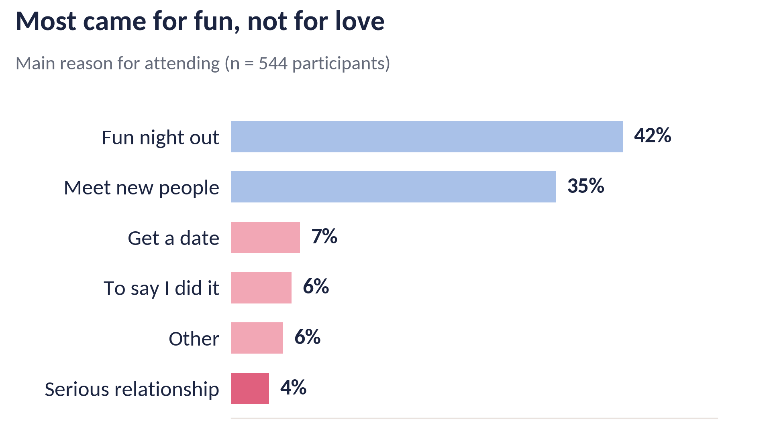
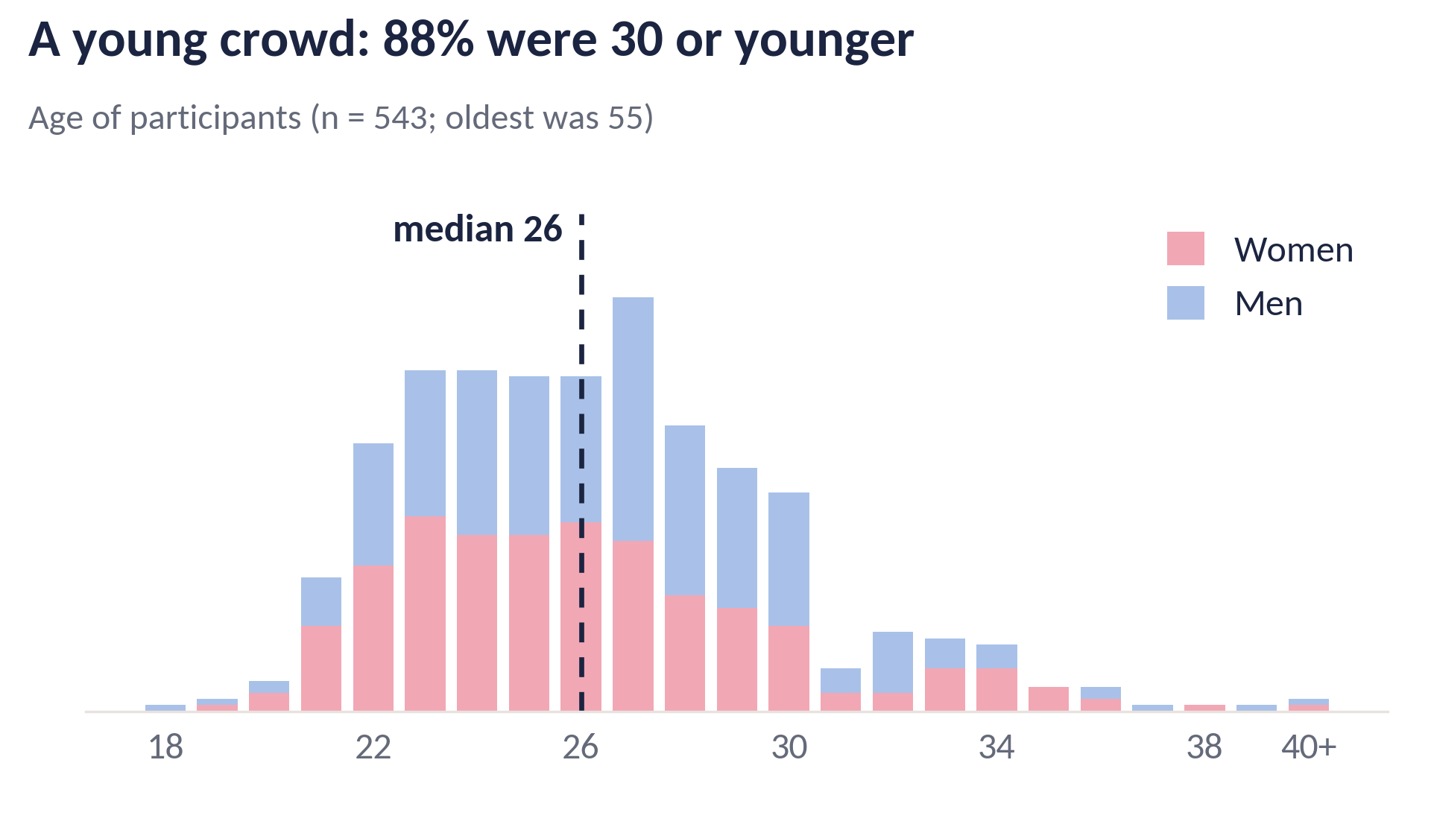
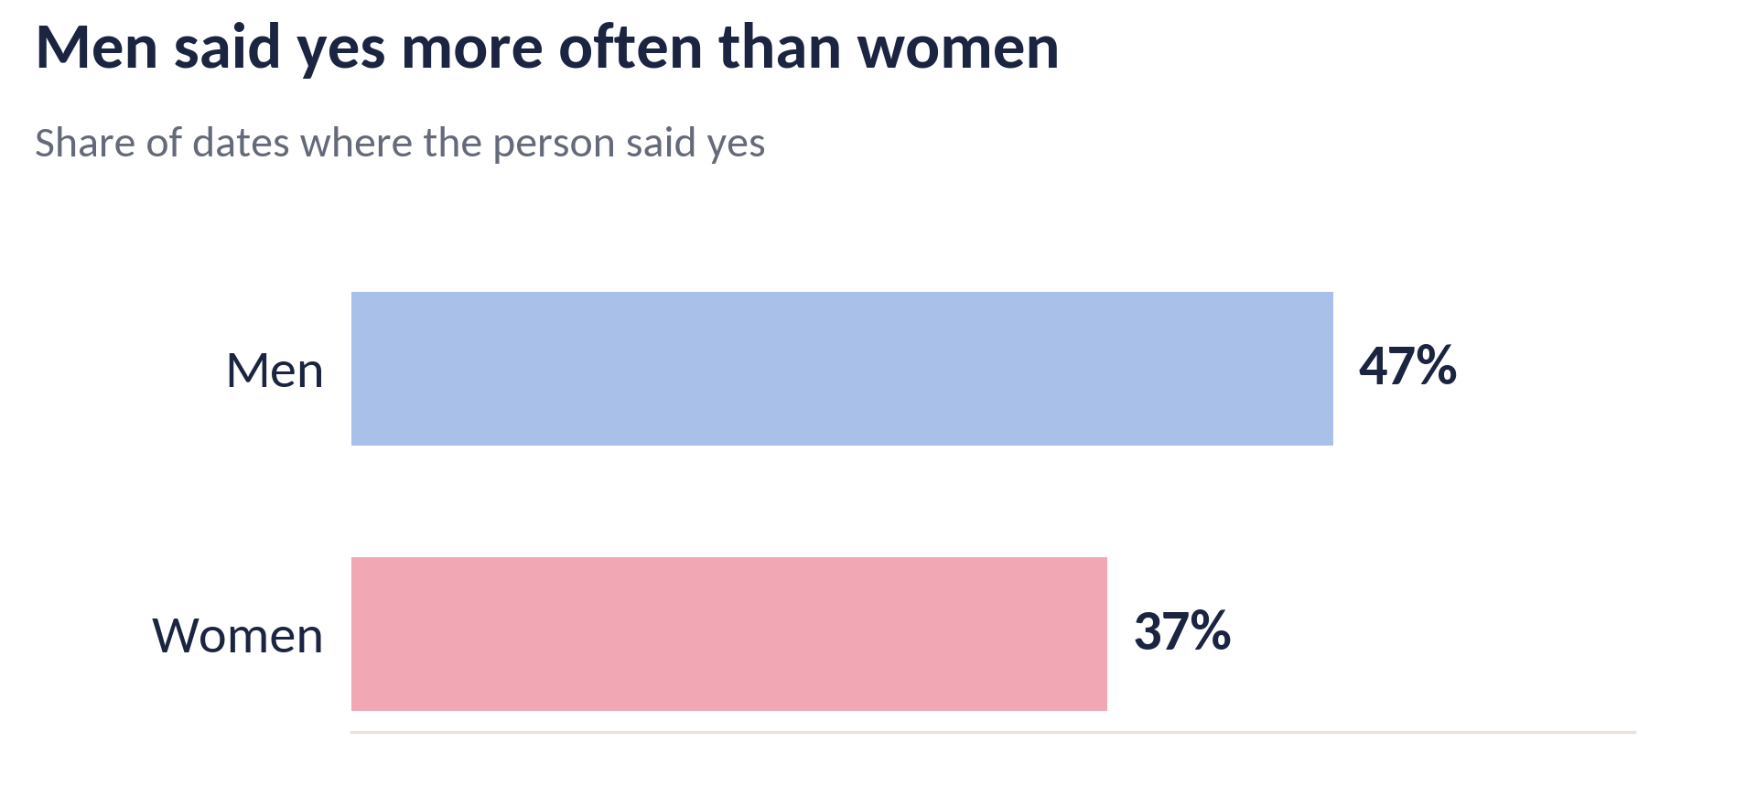
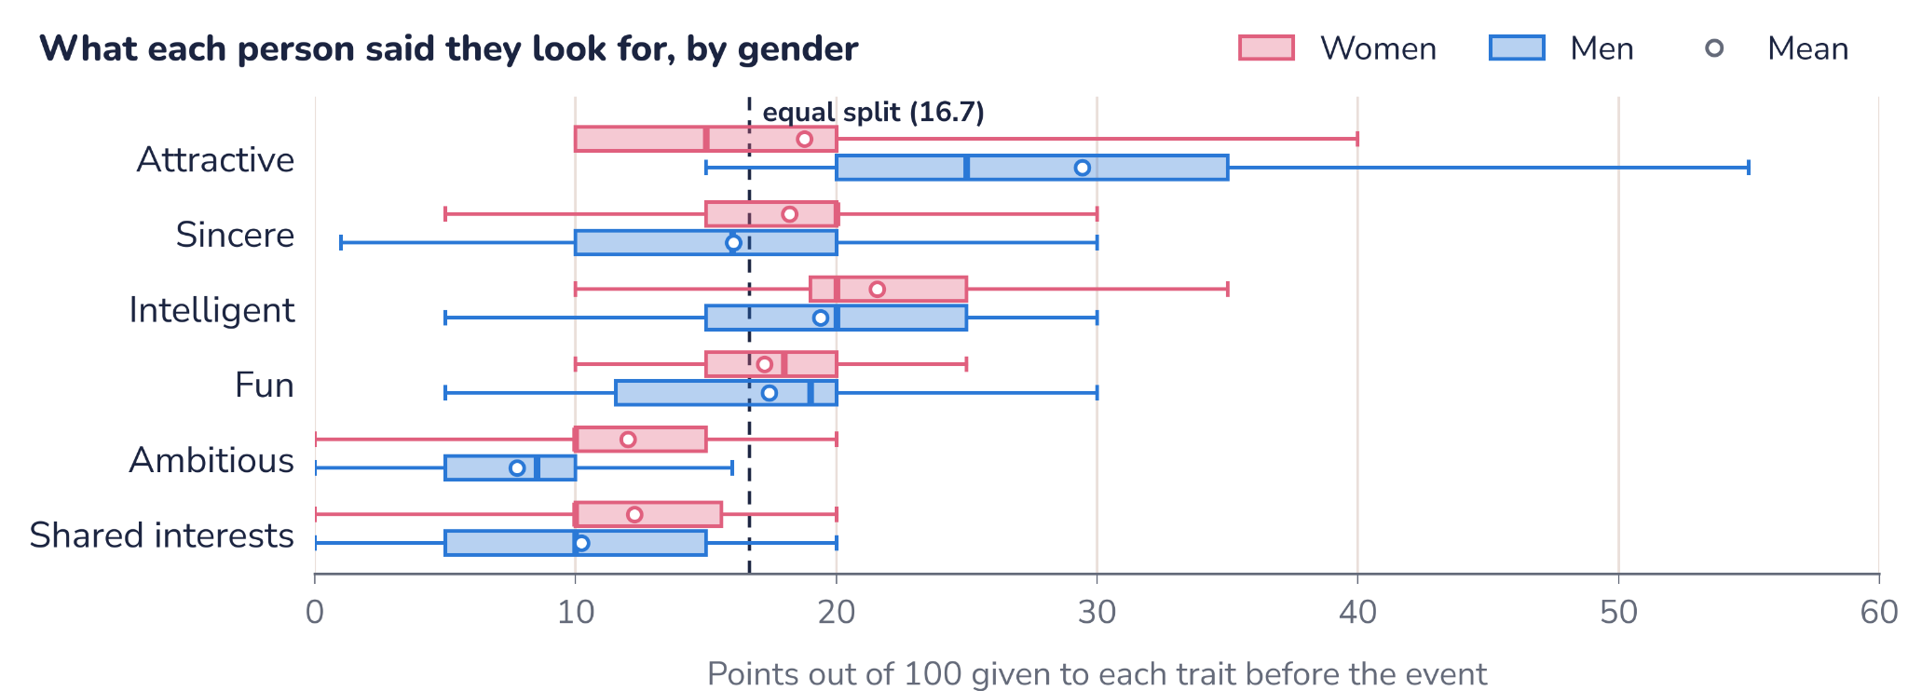

Slide 10
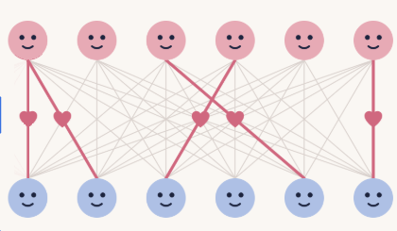
2 · THE DATASET
At each event, everyone meets everyone
551
people: 274 women, 277 men
21
events of 10 to 44 people
4,184
woman–man pairs
16.5%
of pairs were a match
women
men
both said yes: a match
Math 195 · Speed dating · 10

Slide 11

2 · DATA CLEANING
From 8,378 date records to 4,184 pairs
Remove
Pair up
Check
Dropped 10 date records with no partner id
Each date is recorded twice: A rates B, and B rates A. We join them into one row per pair
No date is duplicated, every recorded match is two yeses
Math 195 · Speed dating · 11
Notes:
We first removed 10 records with missing partner identifiers. Since date appears twice in the raw file, we combined the two records into one row per woman–man pair
First, our classes are imbalanced: only 16.5% of pairs resulted in a mutual match. This means a model that predicts “no match” for everyone would already be 83.5% accurate, despite failing to identify any actual matches. So accuracy alone can be misleading. Instead, we focus on AUC, which measures how well a model distinguishes matches from non-matches across different classification thresholds. An AUC of 0.5 is equivalent to random guessing
Second, our observations are not fully independent, because each participant met multiple partners. Normally, we evaluate predictive models by splitting the data into a training set, which the model learns from, and a test set, which evaluates how well it performs on unseen data.
But if we randomly split individual pairs, the same participant could appear in both sets. The model might then benefit from information about people it has already encountered, making its performance look better than it actually is on new participants. To avoid this, we group by event

Slide 12
2 · DATA CLEANING
Making survey answers comparable
Example answers, made up for illustration
Trait | Person A: points of 100 (waves 1–5, 10–21) | Person B: rating 1–10 (waves 6–9) | Person B: share of 100
Attractive | 30 | 9 | 19.6
Sincere | 15 | 8 | 17.4
Intelligent | 20 | 9 | 19.6
Fun | 15 | 7 | 15.2
Ambitious | 10 | 6 | 13.0
Shared interests | 10 | 7 | 15.2
Total | 100 | 46 | 100
Convert into shares of 100
Standardized
Six shares always sum to 100 -> drop one in the models
Math 195 · Speed dating · 12
Notes:
Stated preferences were collected in two formats. In some, participants split 100 points across six traits. In others, they rated each trait from 1 to 10. We converted each person's answers into shares that sum to 100. This keeps the relative importance of each trait. However, preferences from the 1 to 10 format were less spread out, so our main analysis also standardized preference-related variables within each questionnaire format. And because the six shares always sum to 100, including all six would make one an exact combination of the others, so we left one, shared interests, out of the models.

Slide 13
2 · COMPATIBILITY MEASURES
Six additional compatibility measures
Age gap
Interest similarity
Pearson correlation of their ratings of 16 activities (sports, reading, tv): high when they like and dislike the same things.
The absolute difference in their ages: the size of the gap, not its direction.
Shared field and goal
Preference fit
Yes/no indicators: same field of study, and same main goal for coming to the event
Are the traits he rates himself highest on the ones she weighs most?
Math 195 · Speed dating · 13
Notes:
Our models start from each person's own pre-date survey responses, but compatibility is about the pair, so we constructed additional pair-level features
These features broadly measure: similarity in background and lifestyle, such as age gaps, shared fields or goals; second, similarity in interests, based on how closely participants rated different activities; and third, preference alignment—whether the characteristics one person values in a partner align with the other's self-perceived strengths.
We also explored more complex relationships, such as whether interest similarity matters more when someone explicitly values having shared interests.
To evaluate their predictive value, we first only include the original individual responses. Then we add our six core compatibility measures (shown on this slide). For logistic regression only, we also try adding further measures (dating frequency, going out frequency) and nonlinear effects and interactions.
Additional notes: Pearson correlation asks whether their deviations from their personal averages follow the same pattern. Cosine similarity asks whether their raw rating vectors have similar directions.
Interactions: interest similarity x man/woman’s preference for shared interests (does it change depending on how much person values shared interest?) / effect of age difference may not change linearly

Slide 14






4 · TECHNICAL IMPLEMENTATION
The same pre-processing pipeline for each model
Raw survey
Clean, pair
Two feature sets
Event CV
Score
8,378 rows
4,184 pairs
pre: 74 · pre+date: 90
5 folds
AUC with error bars
No peeking at test events
A Fair Comparison
Inside each training fold: log-transform skewed columns, fill medians, one-hot categories, standardize. Everything is learned from training events only.
Every model gets the same folds, the same preparation and the same scoring, so differences come from the model, not the setup.
Math 195 · Speed dating · 14
Notes:
Thanks, Jenna. I'll explain how we put these ideas to work on our data. Every model goes through the same pipeline. We start from the raw survey, 8,378 rows, one per date from one person's side. Sophia showed how we clean it and pair it up into 4,184 woman–man pairs. Each pair then gets two feature sets: “pre”, 74 variables known before the date, and “pre plus date”, 90 variables, which adds the ratings the two people gave each other after the date. Every model is then trained and tested with cross-validation by event, which I'll show on the next slide, and scored with the AUC and its error bars. Two rules keep us honest. First, no peeking at the test events: every data-preparation step, like log-transforming skewed variables, filling missing values with medians, making dummy variables, and standardizing, is learned from the training events only, and then applied unchanged to the test events. Second, no moving the goalposts: before running each test, we wrote down the hypothesis and the threshold that would count as support, and committed it to our GitHub repository. That's called pre-registration. And every number on these slides is produced by our code, not typed in by hand.

Slide 15
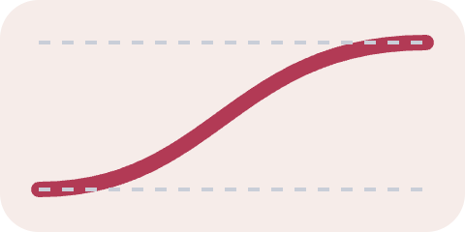
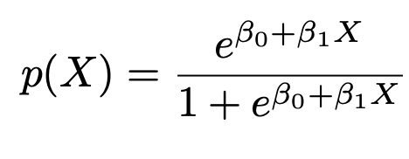
3 · STATISTICAL CONCEPTS
Classification Models and Logistic Regression
Logistic regression
Predicts categorical binary outcome based on predictor variables
Logistic equation and maximum likelihood
Math 195 · Speed dating · 15 · James et al. (2023), An Introduction to Statistical Learning, Sections 4.3–4.4
Notes:
Classification models are relevant to our study, because we want to measure a match or not, which is a qualitative variable (as opposed to regression, which measure qualitative outcomes).
Logistic regression: say we want to predict a categorical binary outcome (yes/no) based on predictor variables.
In logistic regression, we generally try to do this by measuring the probability that a certain outcome variable occurs.
In the method of maximum likelihood, we find the coefficient values that allow the model to give a probability close to 1 for the outcomes that we observed to be yes, and close to 0 otherwise.
But we, like many other datasets, have so many possible predictors to include in our model. How do we go about selecting the group of predictors that gives us the most accurate model?

Slide 16


3 · STATISTICAL CONCEPTS
BIC and Stepwise Logistic Regression
BIC
Stepwise Logistic Regression
Model-selection criterion
Lower BIC is better
Add/remove predictors as we go
Forward, backwards, mixed
Math 195 · Speed dating · 16 · James et al. (2023), An Introduction to Statistical Learning, Sections 4.3–4.4
Notes:
We will use BIC, which is the Bayesian Information Criterion. The math behind it is very complicated but essentially it is a model-selection criterion, and particularly for us it can be used for predictor selection by comparing models with different sets of predictors. A lower BIC is better.
BIC is important for a form of logistic regression called Stepwise Logistic Regression, which is essentially adding and removing predictors to minimize BIC.
So for example, there is forward stepwise logistic regression, where we start with only the intercept then add predictors iteratively based on which lowers BIC the most.
Then there’s backwards, where we start with all the predictors and remove predictors to reduce BIC the most.
And there’s also the mixed, where we can add or remove at each step.

Slide 17
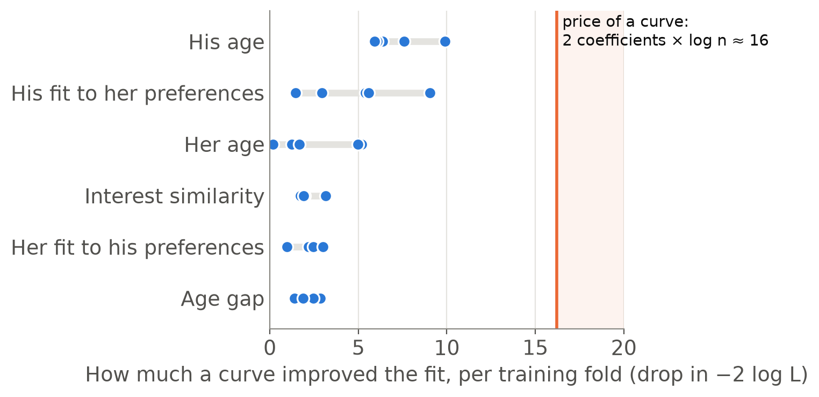

4 · TECHNICAL IMPLEMENTATION
Logistic regression on our data
What goes in
Her answers, his answers and the pair features, such as the age gap: 74 pre-date predictors. Categories become yes/no columns, so about 125 columns in all.
Straight line or curve?
For six predictors we also tried a curve (a spline), kept only if it lowered BIC:
A straight line won every time. Full logistic regression, held-out AUC: 0.542 before the date, 0.780 with the date ratings.
Math 195 · Speed dating · 17 · BIC: James et al. (2023), ISL §6.1.3 · Splines: ISL §7.4 · Dots: the five pre-date training folds; no curve was chosen with the date ratings either
Notes:
Jenna introduced logistic regression and BIC; here's how we ran them on our data. Each row is one pair. The predictors are her answers, his answers, and the pair features from earlier, such as the age gap and interest similarity: 74 in all before the date. Categories like field of study become yes-or-no dummy columns, so the model has about 125 columns. For six of the numeric predictors a straight-line effect might be too simple, so we also tried a curve, called a spline, for each one, and let BIC decide whether it stays. A curve adds two coefficients, and BIC charges log n for each, about 8 with roughly 3,300 training pairs, so about 16 in all. The chart shows how much each curve actually improved the fit in each of the five training folds. His age came closest, at about 10, but no curve ever paid its price, so the model stayed linear everywhere. This full model reached a held-out AUC of 0.542 before the date and 0.780 with the date ratings.

Slide 18
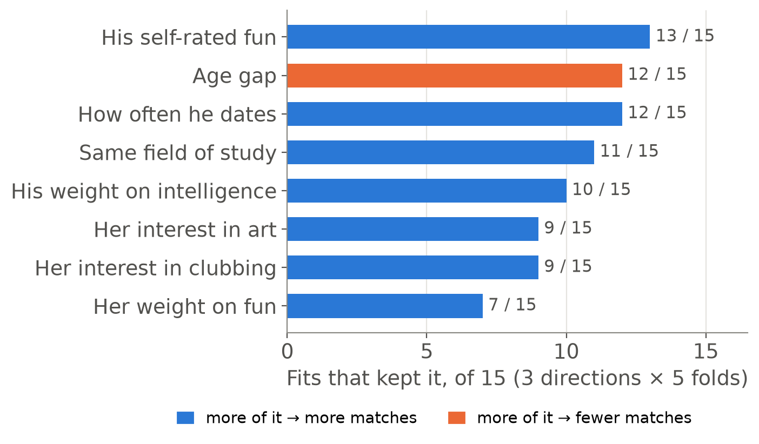
4 · TECHNICAL IMPLEMENTATION
Stepwise selection and the lasso on our data
Stepwise selection by BIC
Add or drop one predictor at a time while BIC goes down, three ways (forward, backward, both). Kept about 8 of 74 predictors per fit; about 15 of 90 with the date ratings.
The lasso
Shrinks every coefficient toward zero and sets the weakest exactly to zero; inner CV picks how strongly. Kept 22 to 76 of about 125 columns.
Fewer predictors predicted better. Before the date: full model 0.542, stepwise 0.559, lasso 0.573. With the date ratings: 0.780, 0.835, 0.838.
Math 195 · Speed dating · 18 · Stepwise: ISL §6.1.2 · Lasso: ISL §6.2.2; Friedman et al. (2010) · Bars: pre-date fits · AUCs on held-out events
Notes:
Next we asked whether fewer predictors would do better. Stepwise selection adds or drops one predictor at a time, keeping a change only if it lowers BIC. We ran it three ways, forward, backward and both, in each of the five folds, so 15 fits, and it kept only about 8 of the 74 predictors each time. The chart shows the ones it kept most often. His self-rated fun, the age gap, how often he dates, sharing a field of study, and how much he values intelligence came up in most fits. Blue means more of it goes with more matches; orange, with fewer. We also ran the lasso, which you'll see in our results. It's logistic regression with a penalty that shrinks every coefficient toward zero and sets the weakest ones exactly to zero, and an inner cross-validation picks how strong the penalty is. It kept between 22 and 76 of the roughly 125 columns. Both beat the full model on new events: before the date, 0.559 for stepwise and 0.573 for the lasso, against 0.542; with the date ratings, 0.835 and 0.838, against 0.780.

Slide 19
3 · STATISTICAL CONCEPTS
Generative Models
Before: predicting the class based on its predictors
Now: predict the observation’s predictors based on the class
Bayes’ Theorem flips it back around
Place each observation in the class with the greatest probability
P(X | Y) · P(Y)
P(Y | X) =
P(X)
Math 195 · Speed dating · 19 · James et al. (2023), An Introduction to Statistical Learning, Sections 4.3–4.4
Notes:
So previously, we calculated the probability that the outcome of a datapoint is a particular class (yes or no) based on the predictors. It’s the direct path. But we now turn to generative models, which take an alternative method.
Instead of trying to predict the outcome using predictors, we swap it: we try to predict what predictors an outcome variable likely had, and then use Bayes’ theorem to flip it around to get us which probability we wanted.
[Point] So we want to find P(Y|X).
[Point] To do so, we need to find P(Y) which is easy, we get the proportion of values observed with that outcome.
[Point] And P(X) can also be taken from the training data.
[Point] What we’re interested in is this, P(X|Y). In practice, calculating this is hard. It calculates for a fixed outcome class, the distribution of the predictor variables in it.
So after finding P(Y|X) for every possible Y=k (k class), we place X into the class that has the highest probability.
We are interested in two main ways to find this value.

Slide 20
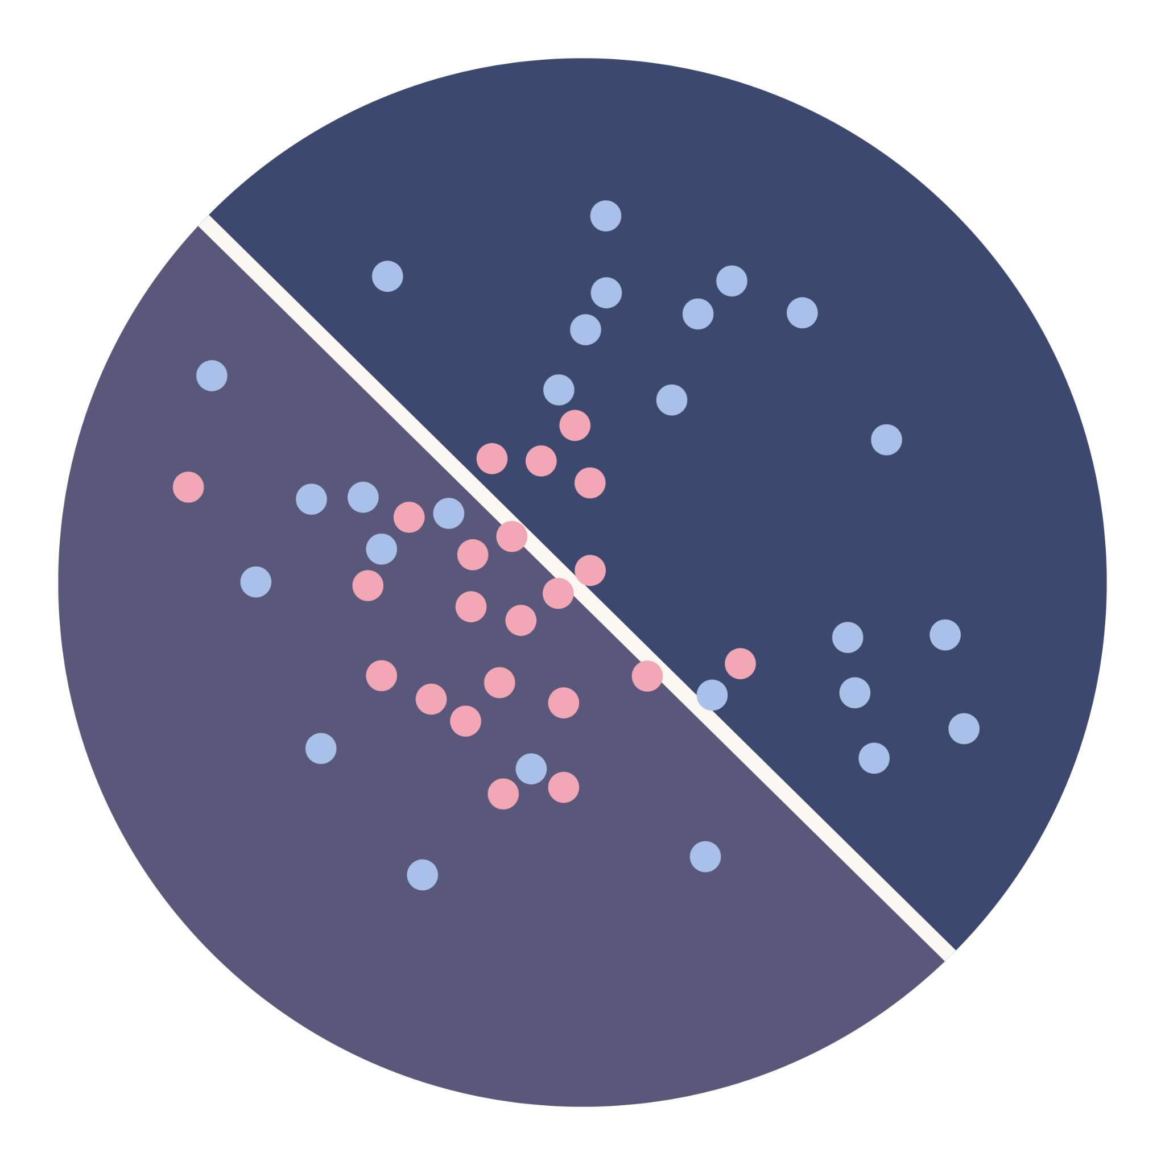
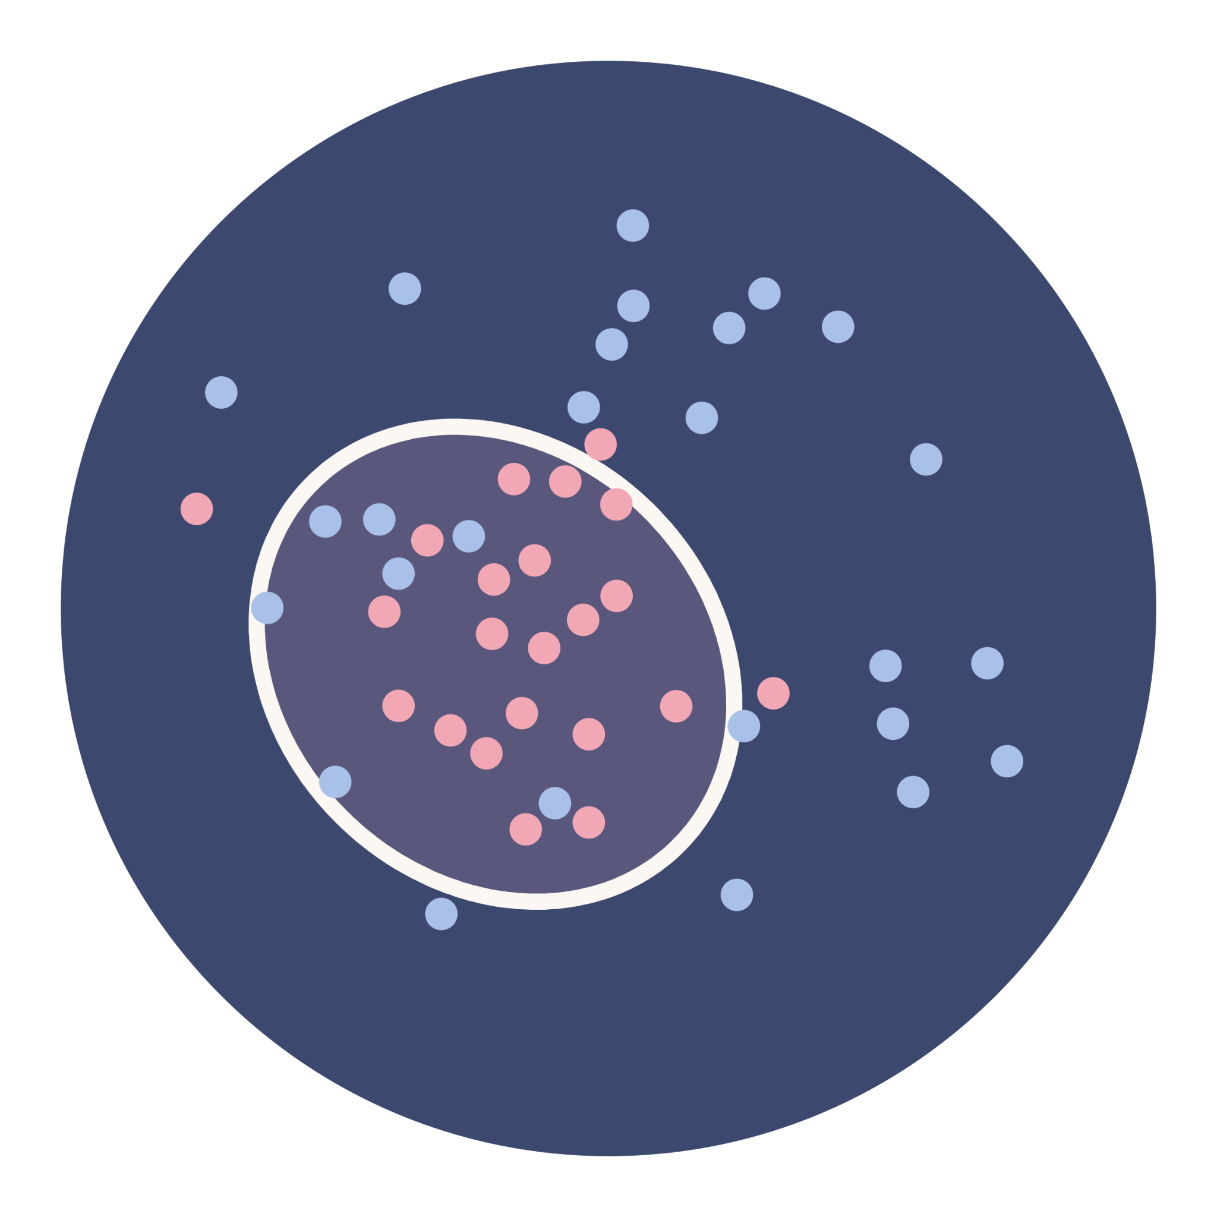
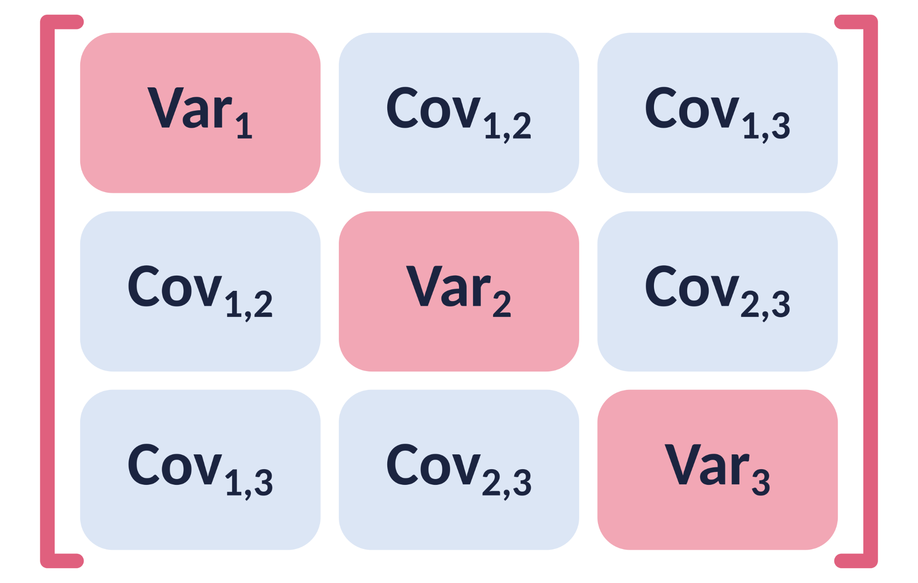
3 · STATISTICAL CONCEPTS
LDA and QDA
LDA
QDA
Covariance Matrices
Linear decision boundary
Same covariance matrix across classes
Curvy decision boundary
Different covariance matrices by class
Encodes relationship between pairs of predictors
Math 195 · Speed dating · 20 · James et al. (2023), An Introduction to Statistical Learning, Sections 4.3–4.4
Notes:
We are interested in two main ways to find this value.
Linear Discriminant Analysis (LDA): produces a linear decision boundary by which we split our classes. It’s a very simple model but as you can see, a straight line is usually nowhere near accurate enough to split the data.
Quadratic Discriminant Analysis (QDA): produces a quadratic, curvy, decision boundary by which we split our classes. It’s more flexible, but has higher variance and generally needs more data to be accurate.
One more difference between the two has to do with a important thing we use to calculate this probability P(X | Y). It’s called the covariance matrix of each class, which essentially encodes the relationship between each unique pair of predictor values in the class.
So if the data is a cluster, like a cloud of dots, the covariance matrix describes the shape of that cloud.
[Point diagonal] These values, the variance of each variable, numbers say how wide the cloud is along each variable.
[Point others] These take into account the relationship between each pair of variables, and it would determine how the cloud is tilted.
So the difference between LDA and QDA is that LDA assumes the same covariance matrix for each class, which is obviously simpler. But QDA uses a different one for each class (so in our case the match and no-match groups have different covariances), which gives more flexibility.

Slide 21
4 · TECHNICAL IMPLEMENTATION
LDA and QDA on our data
LDA
8,000
550
One covariance matrix, shared by matches and non-matches, estimated from all of the about 3,300 training pairs. Nothing to tune.
numbers, roughly, in the matches' covariance matrix: 125 × 126 / 2 for 125 columns
matches, on average, in a training fold to estimate them from
QDA
A separate covariance matrix for each class, so the matches' matrix has to come from the matches alone.
Too many numbers, too few matches: plain QDA's matrix is mostly noise. LDA's held-out AUC: 0.553 before the date, 0.790 with the date ratings.
Math 195 · Speed dating · 21 · LDA and QDA: James et al. (2023), ISL §4.4 · Counts from our training folds (event 5-fold CV): 124 to 128 columns, 3,047 to 3,750 pairs
Notes:
Now LDA and QDA. Both describe each class, match and no match, by its average and its covariance matrix, the table of how every pair of predictors varies together. LDA uses one covariance matrix for both classes, estimated from all of the roughly 3,300 training pairs, with the training match rate, about 0.165, as the prior. It has nothing to tune. QDA gives each class its own covariance matrix, so the matches' matrix has to be estimated from the matches alone, and that's the problem. With about 125 columns the matrix has about 8,000 separate numbers, 125 times 126 over 2, and a training fold has only about 550 matches to estimate them from. So most of those numbers are noise. LDA reached a held-out AUC of 0.553 before the date and 0.790 with the date ratings.

Slide 22
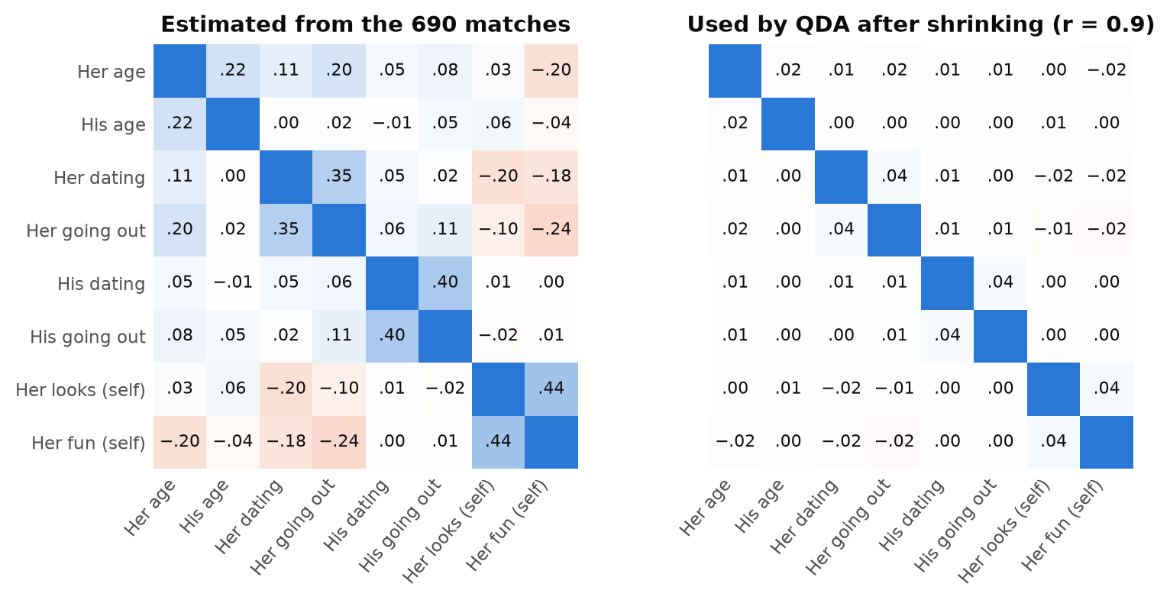

4 · TECHNICAL IMPLEMENTATION
Shrinking QDA's covariance matrix
Shrink toward no correlation
Average the estimate with the identity matrix (no correlations), using weight r:
r = 0 is plain QDA; r = 1 drops every correlation. Inner CV chose r from 0.1, 0.3, 0.5, 0.7, 0.9, and picked 0.9 in all 10 fits.
Shrinking paid off. Before the date: LDA 0.553, regularized QDA 0.579. With the date ratings: 0.790 and 0.836.
Math 195 · Speed dating · 22 · Regularized QDA: Friedman (1989); Hastie et al. (2009) §4.3.1 · Heatmaps: 8 of our predictors, 690 matched pairs
Notes:
Our fix is called regularized QDA. We shrink the matches' covariance matrix toward the identity matrix, which means no correlations at all, using a weighted average with weight r. With r equal to 0 it's plain QDA; with r equal to 1 every correlation is dropped. An inner cross-validation inside the training events chose r from 0.1, 0.3, 0.5, 0.7 and 0.9. The heatmaps show what shrinking does, for 8 of our predictors among the matched pairs. On the left are the correlations we estimate; for example, women who rate themselves as more attractive also rate themselves as more fun, a correlation of 0.44. On the right is what QDA uses after shrinking with r equal to 0.9: every correlation is about a tenth as big, so 0.44 becomes 0.04. The inner cross-validation picked 0.9, the strongest option, in all ten fits. And regularized QDA ended up one of our best models: 0.579 before the date against 0.553 for LDA, and 0.836 against 0.790 with the date ratings.

Slide 23
3 · STATISTICAL CONCEPTS
Validation
k-Fold Cross-Validation
The Bootstrap
Data
1
2
3
4
5
6
Resample 1
2
2
4
5
5
6
Resample 2
1
1
3
3
4
6
Resample 3
1
2
2
5
6
6
Math 195 · Speed dating · 23 · James et al. (2023), ISL Sections 5.1.3 and 5.2 · Our folds are whole events: slide 24
Notes:
As you may imagine, have their limitations, most notably by the little data that we have. That’s why we have validation methods to test the accuracy and reliability of our models.
Firstly, as mentioned, e’re training our models on data we have, whose outcomes we know. But we don’t necessarily know how well it performs on data it hasn’t seen yet. Validation allows us to measure the accuracy of our models.
k-Fold Cross-Validation is when we split our data into k groups (called folds) and train it on all folds but one, then test it on the last fold, comparing the predictions of the model to the real results.
Sampling is another problem: we can’t be certain that our current data is actually representative of the population we want it to be generalized to.
Bootstrap is a way to simulate repeated sampling just on the data we have. It’s done by taking a random fixed-size subset of our data and computing our statistic, and repeating this by taking different random subsets each time (with replacement). And then we look at the distribution of them all at the end. This is how we estimate the uncertainty of our dataset.

Slide 24
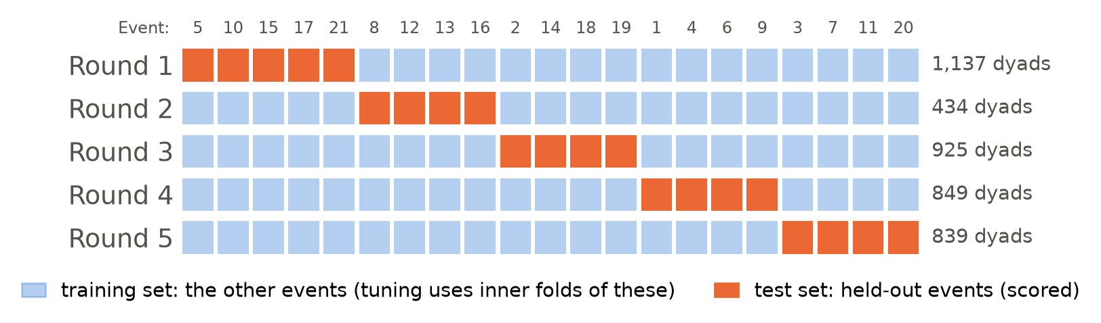
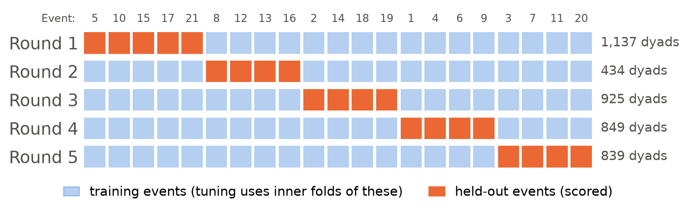
4 · TECHNICAL IMPLEMENTATION
Hold out whole events instead of pairs in CV
Why
Tuning
Preparation
People date up to 22 partners; a random split would test on people already seen.
An inner cross-validation inside the training events picks each model's settings.
Medians, log transforms and scaling are learned from training events only.
Math 195 · Speed dating · 24 · Grouped CV: Roberts et al. (2017) · Nested CV: Varma & Simon (2006); Hastie et al. (2009) §7.10.2
Notes:
Jenna introduced k-fold cross-validation. The usual version splits rows at random, but in our data people repeat: each person dates up to 22 partners, so the 4,184 pairs share people. With a random split, the same person would be in both the training and the test set, and the model could partly recognize them. The score would then describe predictions for people the model has already seen, which overstates how well it would do for a matchmaker meeting new people. So we split by event instead. The picture shows our five rounds. In each round, the orange events are held out and scored, and the model is fitted on the blue ones; every one of the 21 events is held out exactly once. When a model has a setting to tune, like the random forest's leaf size, we choose it with a second cross-validation inside the blue training events only. That's called nested cross-validation, and those inner folds also hold out whole events. And all data preparation is learned from the training events, so nothing about the test events leaks into the fit.

Slide 25
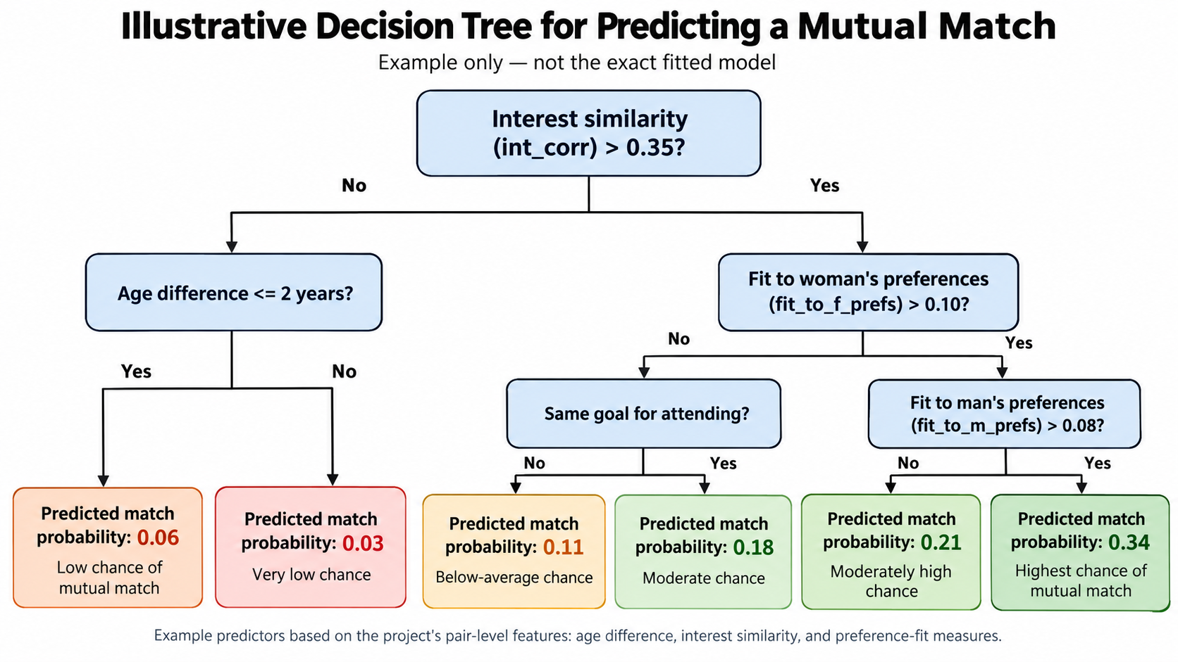
3 · STATISTICAL CONCEPTS
Decision Tree
Tree Methods
Repeatedly split data based on strongest predictor values.
Bagging
Draw several bootstrap samples and fit a tree to each.
Random Forest
Decorrelates trees, reducing variance
Math 195 · Speed dating · 14 · James et al. (2023), ISL Sections 8.1–8.2.2 · Breiman (2001) · The tree is an illustration, not fitted to our data
Notes:
A decision tree is a model that makes predictions by repeatedly splitting the data into different branches based on the strongest predictor values. The way this is chosen is at each node, the tree tries different predictors and cutoff values for them in applicable and chooses the split that best separates the outcome classes. We keep splitting until we reach a terminal node/leaf, which gives the prediction for that value.
Decision trees are easy to interpret but a single one can have very high variance, i.e., small changes in training data can have drastic impacts on the data.
So we turn first to bagging. Bagging reduces variance by creating many bootstrap samples of the training data, fitting a separate deep decision tree to each sample, and then combining their predictions (for classification trees, they’re amalgamated by a majority vote, i.e., which outcome was most common). The idea is that taking an “average” gives us a more stable prediction.
Random forest is similar to bagging, except when a tree is deciding how to make a split, it is not allowed to consider all p predictors. Instead it chooses from a random subset of those predictors, often m = √p.
We do this because if one predictor is particularly strong, then it might be chosen for multiple if not all the trees in bagging, and we would end up with many similar trees. Random forest decorrelates the predictions from one tree to another, which improves the performance of our model.

Slide 26
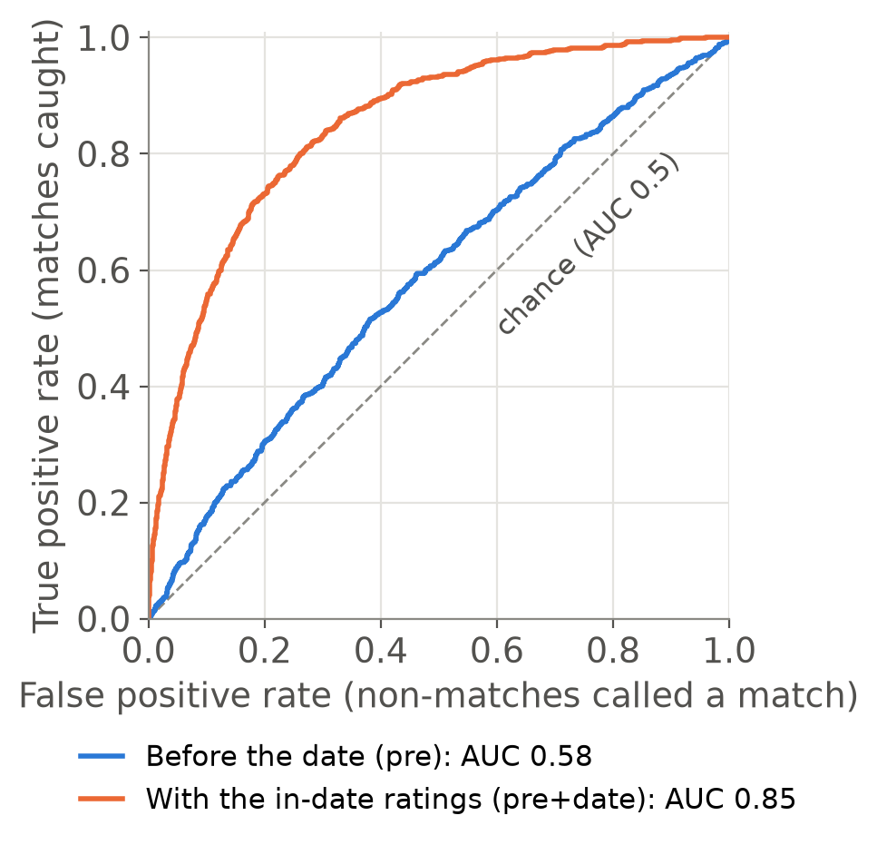
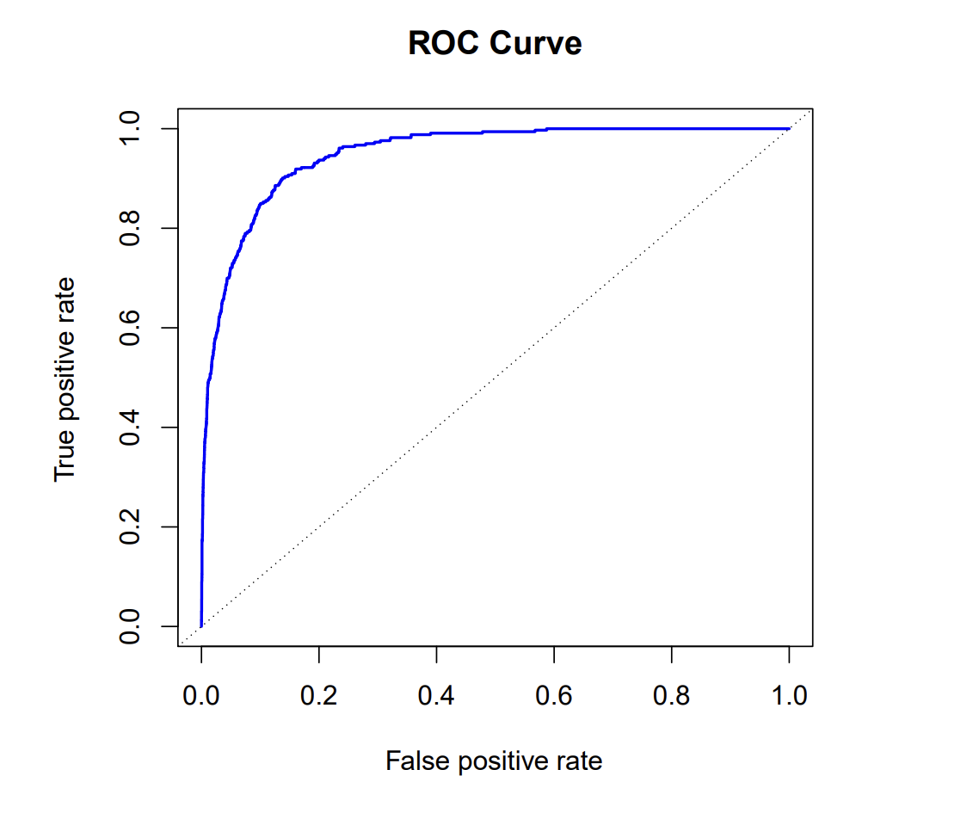
3 · STATISTICAL CONCEPTS
Model evaluation: the ROC curve and AUC
Math 195 · Speed dating · 25 · Random forest on held-out events, 4,184 pairs · James et al. (2023), ISL Chapter 4 · Hanley & McNeil (1982)
Notes:
The last thing I want to introduce as background is how we are interested in evaluating our models.
Since our models give us probabilities that a given observation leads to a certain outcome, we need a threshold for what probability is yes or no (it’s not always above/below 50%).
Broadly, if we increase that threshold, we’re more prone to false negatives, and if we decrease it, we’re more prone to false positives.
The ROC curve gives this relationship. Each point on the ROC curve represents a different probability threshold. Lowering the threshold moves us up and right: we catch more true matches, but also create more false positives.
AUC is the area under the ROC curve and summarizes the model’s overall ability to distinguish matches from non-matches.
AUC of 0.5 means it’s the same as a 50-50 guess.
AUC of 1 means perfect discrimination between match and non-match.

Slide 27
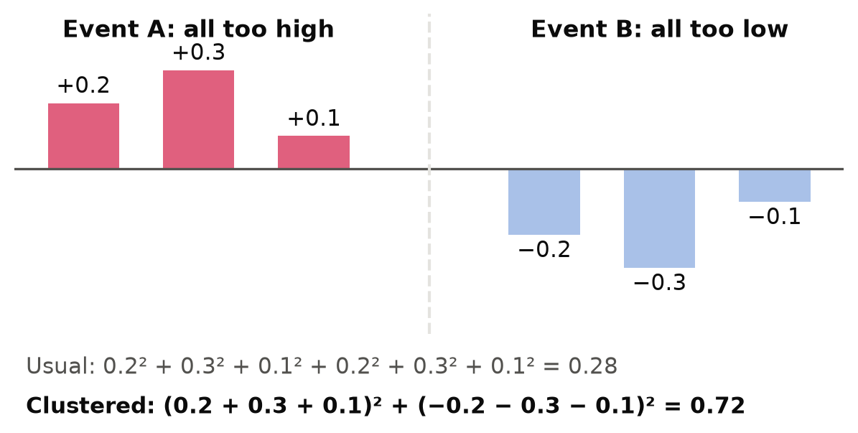
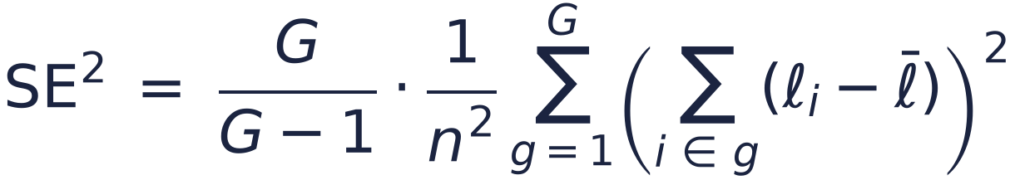
4 · TECHNICAL IMPLEMENTATION
Error bars that respect events
Toy example: six pairs at two events
Add up within each event, then square
Pairs at an event share people and an evening, so errors lean the same way. ℓᵢ is pair i's error; G = 21 events, n = 4,184 pairs:
On our results
90% intervals are AUC ± 1.72 × SE (t with 20 df). The AUC's SE uses the same idea.
Ignoring events makes error bars too narrow whenever errors lean together within an event.
Math 195 · Speed dating · 26 · Cluster-robust SE: Cameron & Miller (2015) · Clustered AUC: Obuchowski (1997) · The toy numbers are made up
Notes:
Every result we show comes with an error bar, so here's how we compute it. The usual standard error assumes all 4,184 pairs are independent. Ours aren't: pairs at the same event share people and the same evening, so a model's errors tend to lean the same way within an event. Here's a toy example with six pairs at two events. At event A the model is too high for every pair; at event B it's too low for every pair. The usual formula squares each pair's error and adds them up, which gives 0.28. The clustered version first adds up each event's errors, then squares, which gives 0.72. Errors that lean together don't cancel within an event, so the variance is more than twice as big and the error bar about 1.6 times as wide. That's the formula on the right: sum within each event, square, add over our 21 events, with a small correction of G over G minus 1. Our intervals are the AUC plus or minus 1.72 standard errors, from a t distribution with 20 degrees of freedom, and the AUC's standard error uses the same idea, due to Obuchowski. Whenever errors lean together within an event, ignoring the events makes the error bars too narrow.

Slide 28

4 · TECHNICAL IMPLEMENTATION
How we fitted each model
Model | Hyperparameters to tune | How we chose these hyperparameters
Logistic regression | a spline for age, age gap, interests, fit | only if BIC improves (it never did)
Stepwise logistic | which predictors are included in the model | BIC: forward, backward, both
LDA | nothing to tune | priors from the training data
QDA (regularized) | shrinkage, 0.1 to 0.9 (chose 0.9, close to no correlation) | best AUC on inner event folds
Random forest | leaf size: 1, 5, 20 or 50 (chose 50) | 500 trees, √p predictors per split
Lasso (L1 logistic) | penalty strength, 30 values | best AUC on inner event folds
Each model is fitted on pre and on pre+date. After getting a score, we consider scores above the training match rate (about 0.165) as the cutoff for yes and scores below that to be no. We don’t use 0.5, because only 1 pair in 6 matches.
Math 195 · Speed dating · 18 · James et al. (2023) · Friedman (1989) · Breiman (2001)
Notes:
These are the models, and the choices each one makes. Every choice is made inside the training events. Logistic regression may bend a few continuous predictors, like age, the age gap, interest similarity and preference fit, into a curve called a spline, but only when the Bayesian information criterion, BIC, says the curve helps. It never did, so our logistic model is linear. Stepwise selection adds or removes whole predictors by the same criterion, going forward, backward or both ways. LDA has nothing to tune. QDA's shrinkage, the random forest's leaf size and the lasso's penalty are tuned on the inner folds, again grouped by event. The lasso was added after we pre-registered the comparisons, so it is reported separately. Every model is fitted twice: once on the pre-date features and once with the in-date ratings added. And because only about one pair in six matches, we call a pair a match when its predicted probability beats the training match rate, about 0.165, rather than 0.5. One telling detail: in every fold QDA chose the strongest shrinkage, the forest chose the largest leaves, and no curve beat a straight line. Before the date, the signal is too weak to support flexible fits.

Slide 29
4 · TECHNICAL IMPLEMENTATION
Methods we used beyond ISL Textbook
Method | Why we needed it here | Source
Grouped cross-validation | A random split lets the model recognize people | Roberts et al. 2017
Nested cross-validation | Tuning on the test folds flatters the score | Varma & Simon 2006
Regularized QDA | Too few matches (~550) for a full covariance (about 8,000 numbers) | Friedman 1989
L1 (lasso) logistic | Lasso penalty for logistic regression | Friedman et al. 2010
Clustered standard errors | Pairs from one evening do well or badly together | Liang & Zeger 1986
AUC standard error | The same idea for the AUC: add up by event | Obuchowski 1997
Each of these are explained in the background section of our written report.
Math 195 · Speed dating · 19 · Also Cameron & Miller (2015); Hanley & McNeil (1982); Hastie, Tibshirani & Friedman (2009)
Notes:
A few of our tools go a little beyond the course textbook, each for a specific reason. Grouped and nested cross-validation are what I just described: grouping by event so the model is never tested on people it has seen, and tuning inside the training events, because tuning and scoring on the same folds makes the score look better than it is. Regularized QDA exists because QDA needs a separate covariance matrix for the matches, and with only about 550 matches in a training fold and 74 variables, that matrix is estimated poorly, so we shrink it part of the way toward a simpler one. The lasso for logistic regression is the same penalty as the textbook's lasso, applied to the logistic likelihood; it sets weak predictors' coefficients exactly to zero. Our standard errors are clustered by event: pairs from the same evening tend to be predicted well or badly together, so treating them as independent would make the error bars too small. We add up the errors within each event before measuring their spread, and because we have only 21 events we use t quantiles with 20 degrees of freedom. The AUC's standard error is clustered the same way, following Obuchowski. Finally, pre-registration: every hypothesis and its threshold was committed before its test ran, so the results Jenna is about to show were not tuned after the fact.

Slide 30
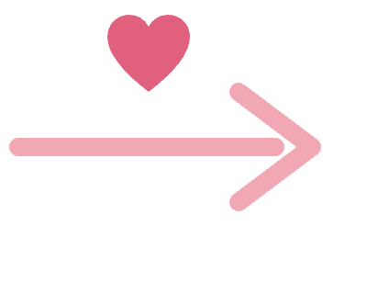
5 · THE MAIN RESULT (SO FAR)
0.58
0.85
best AUC from what is known before the date
with the ratings from the four-minute date
Math 195 · Speed dating · 27 · Held-out events, 4,184 pairs · random forest: 0.583 (SE 0.020) before, 0.846 after
Notes:
Our main result is that pre-date characteristics perform much more poorly on their own than if we added during-date information.
We achieved a max AUC of 0.58 (which, as a reminder,
AUC 0.5 is basically a random guess, so the model was not much better than a random guess.

Slide 31
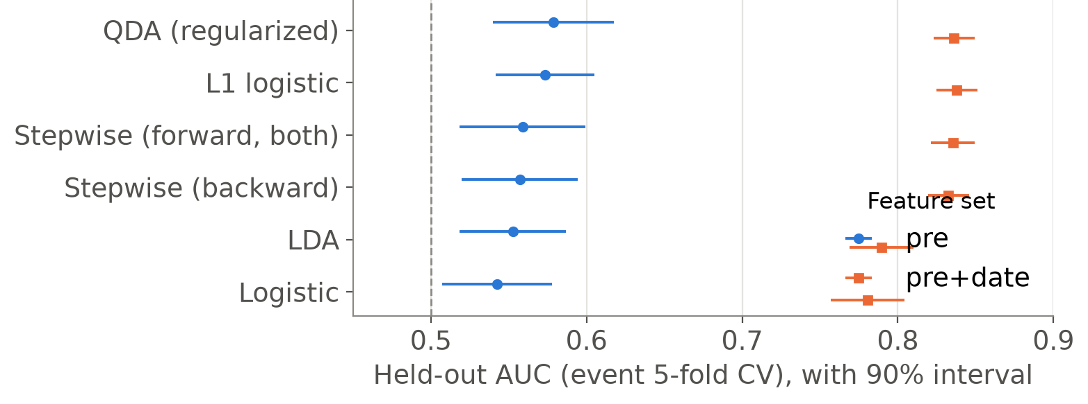
5 · RESULTS
Every model is close to chance before the date
Liking is hard to predict too
Average R^2: -0.003
Our held-out R^2: -0.034
Pair features changed it by only +0.008.
Math 195 · Speed dating · 28 · Held-out events (event 5-fold CV); 90% intervals = AUC ± t(20) × event-clustered SE
Notes:
This chart shows every model we fitted, with 90 percent intervals.
In blue, before the date, all of them, from logistic regression to the random forest, land between 0.54 and 0.58: only a little above chance.
In orange, with the in-date ratings, they land between 0.78 and 0.85.
So the limit is in the information available before the date, not in the choice of model.
We also tried to predict the overall liking score people gave each other after each date, as another measure of matching.
We did so using the R^2 measure, which measures how much better the model does compared with just predicting the average value for everyone.
So our baseline, average value R^2 was -0.003.
Using the rater's characteristics, the partner's characteristics, and the pair features, the model's held-out R^2 was -0.034. A negative R^2 means it did worse on new events than simply predicting the average liking score from the training data, which is evident that this happened here.
Adding the pair-level compatibility features improved the R^2 value by only 0.008. So this supports the fact that relatively little information of how people feel about each other can be recovered from their characteristics before they meet.

Slide 32
5 · RESULTS
Too many predictors, too few matches
≈ 4
QDA: strongest shrinkage
Forest: biggest leaves
r = 0.9 in all 10 fits: the estimated correlations were mostly noise.
Leaf size 50 in every pre-date fit; with the date ratings, mostly 20.
matches per column: about 550 matches in a training fold, but about 125 columns once categories become dummies
Splines: never chosen
Selection: few predictors
Curve is never better than a straight line in any fold.
Stepwise kept about 8 of 74; the lasso 22 to 76 of about 125 columns.
Simpler beat fuller. Before the date: lasso 0.573 and stepwise 0.559, against 0.542 for full logistic regression. With the date: 0.838 and 0.835, against 0.780.
Math 195 · Speed dating · 19 · Choices made inside each training fold; AUCs on held-out events (event 5-fold CV)
Notes:
We also learned something just from what the tuning chose. Our data are thin for this many predictors: a training fold has about 550 matches, but about 125 columns once the categories become dummy variables, so roughly four matches per coefficient. And every tuned model reacted the same way, by picking its most cautious setting. QDA chose the strongest shrinkage in all ten fits, so the estimated correlations were mostly noise. The random forest chose the biggest leaves in every pre-date fit. Interestingly, once the date ratings were added, it chose smaller leaves, because now there was real signal to capture. No spline ever beat a straight line. Stepwise selection kept only about 8 of the 74 predictors, and the lasso dropped many columns. And being cautious paid off: the simpler models beat the full logistic regression, before the date and after. The lesson: before the date, the signal is weak and the data are thin, so the best models are the cautious ones.

Slide 33
5 · RESULTS
Compatibility features add almost nothing
Held-out AUC, step by step (zoomed in)
AUC
change
chance
Each person’s own answers
0.532
+ 6 compatibility features
0.542
+0.010
+ 5 more compatibility features
0.545
+0.003
+ 3 interaction terms
0.546
+0.001
0.50
0.52
0.54
0.56
0.58
0.60
On the full AUC scale
0.5 is chance, 1.0 is perfect
Before the date: 0.53–0.55
With in-date ratings: 0.78–0.85
0.50
0.75
1.00
Math 195 · Speed dating · 29 · Logistic regression rows unless marked; whiskers = ±1 standard error (about 0.02)
Notes:
Next, did our compatibility features help? We added them in steps, using the full logistic regression.
With only the two people's own pre-date answers, the AUC is 0.532.
Adding the six main pair features, the age gap, interest similarity, same field, same goal and the two preference-fit measures, raises it to 0.542, a gain of only 0.0105.
Five more pair features, like same career and differences in how often each goes out, add 0.003, and then the three interaction terms add 0.001, ending at 0.546.
So explicitly modeling compatibility did little beyond each person's own characteristics.

Slide 34
5 · RESULTS
Looks drive choices about twice as much as people say
Women
Stated share of 100 points given to attractiveness before the event
19%
37%
Real share of the weight in their actual decisions
Men
29%
55%
Math 195 · Speed dating · 30 · Logistic model of each yes on the six in-date ratings (3,457 dates by women, 3,574 by men) · Eastwick & Finkel (2008)
Notes:
We took participants’ self-reported importance of attractiveness in the partner, and we also took how attractiveness actually contributed to their decisions based on the standardized coefficients from the decision model. We found that the difference between these ratings of how important attractiveness was increased +18.4 percentage points for women and + 25.3 percentage points for men (on the distribution-of-100-points scale). It’s also interesting how much more it increased for men than women, which had a 35.7% more increase.

Slide 35
6 · NEXT STEPS
The coming weeks
Weeks 6–7
Week 7
Week 7
Weeks 8–10
Honest error bars
Follow-up questions
More models, checks
Finishing Up
The same people appear in many pairs. Which error bars can we trust? Tested on simulated data built like ours.
Who is most desirable, with honest uncertainty? Do people know who likes them back?
Single trees, bagging and boosting. Does the order of the evening matter?
Robustness checks, poster, final report and presentation.
The open question: when the same people appear in many rows, how much should we trust a cross-validated number?
Math 195 · Speed dating · 31 · Cross-validation error bars: Bates, Hastie & Tibshirani (2024) · Trees: James et al. (2023), ISL Chapter 8
Notes:
Here is our plan for the second half. First, honest error bars. Because the same people appear in many pairs, the usual error bars on a cross-validated result may be too narrow. We want to know by how much, and which error bars can be trusted, and we test that on simulated data built to look like ours. Second, two follow-up questions. Who is most desirable? We'll rank participants within each event, with honest uncertainty about each rank. And do people know who likes them? Participants guessed, after each date, whether the partner would say yes, so we can score how accurate those guesses were. In week 7 we also add single trees, bagging and boosting, and check whether the order of the evening matters, for example whether later dates are less likely to get a yes. Weeks 8 to 10 are for freezing the results, robustness checks, the poster, and the final report and presentation. Thank you; we're happy to take questions.

Slide 36

Thank you!
Questions?
Sophia Qin · Jenna Yang · Abraham Yeung
Notes:
Thank you. We are happy to take questions. If someone asks whether apps should use profiles at all: our data say profiles tell you a little, people tell you much more once you have seen them interact, and any accuracy claim needs error bars that respect who appears in which rows.

