Slide 1
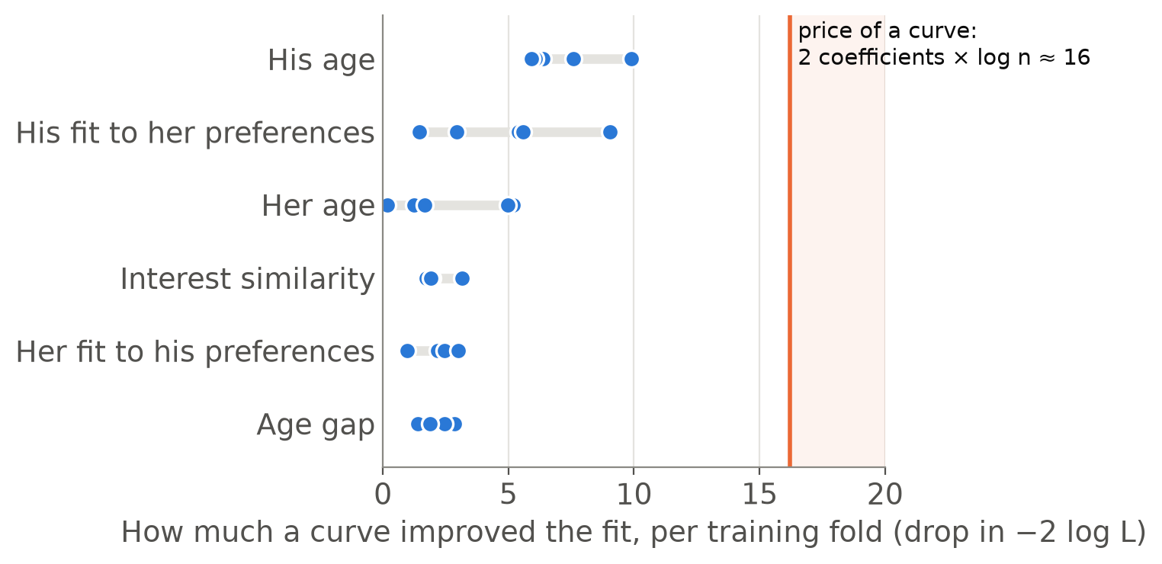

4 · TECHNICAL IMPLEMENTATION
Logistic regression on our data
What goes in
Her answers, his answers and the pair features, such as the age gap: 74 pre-date predictors. Categories become yes/no columns, so about 125 columns in all.
Straight line or curve?
For six predictors we also tried a curve (a spline), kept only if it lowered BIC:
A straight line won every time. Full logistic regression, held-out AUC: 0.542 before the date, 0.780 with the date ratings.
Math 195 · Speed dating · 17 · BIC: James et al. (2023), ISL §6.1.3 · Splines: ISL §7.4 · Dots: the five pre-date training folds; no curve was chosen with the date ratings either
Notes:
Jenna introduced logistic regression and BIC; here's how we ran them on our data. Each row is one pair. The predictors are her answers, his answers, and the pair features from earlier, such as the age gap and interest similarity: 74 in all before the date. Categories like field of study become yes-or-no dummy columns, so the model has about 125 columns. For six of the numeric predictors a straight-line effect might be too simple, so we also tried a curve, called a spline, for each one, and let BIC decide whether it stays. A curve adds two coefficients, and BIC charges log n for each, about 8 with roughly 3,300 training pairs, so about 16 in all. The chart shows how much each curve actually improved the fit in each of the five training folds. His age came closest, at about 10, but no curve ever paid its price, so the model stayed linear everywhere. This full model reached a held-out AUC of 0.542 before the date and 0.780 with the date ratings.

Slide 2
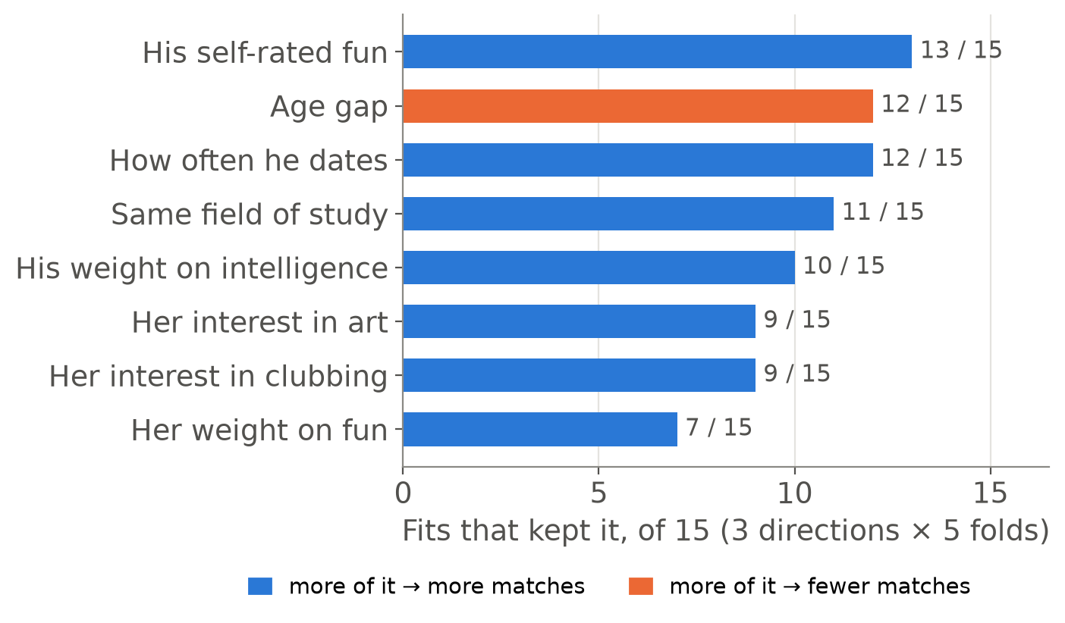
4 · TECHNICAL IMPLEMENTATION
Stepwise selection and the lasso on our data
Stepwise selection by BIC
Add or drop one predictor at a time while BIC goes down, three ways (forward, backward, both). Kept about 8 of 74 predictors per fit; about 15 of 90 with the date ratings.
The lasso
Shrinks every coefficient toward zero and sets the weakest exactly to zero; inner CV picks how strongly. Kept 22 to 76 of about 125 columns.
Fewer predictors predicted better. Before the date: full model 0.542, stepwise 0.559, lasso 0.573. With the date ratings: 0.780, 0.835, 0.838.
Math 195 · Speed dating · 18 · Stepwise: ISL §6.1.2 · Lasso: ISL §6.2.2; Friedman et al. (2010) · Bars: pre-date fits · AUCs on held-out events
Notes:
Next we asked whether fewer predictors would do better. Stepwise selection adds or drops one predictor at a time, keeping a change only if it lowers BIC. We ran it three ways, forward, backward and both, in each of the five folds, so 15 fits, and it kept only about 8 of the 74 predictors each time. The chart shows the ones it kept most often. His self-rated fun, the age gap, how often he dates, sharing a field of study, and how much he values intelligence came up in most fits. Blue means more of it goes with more matches; orange, with fewer. We also ran the lasso, which you'll see in our results. It's logistic regression with a penalty that shrinks every coefficient toward zero and sets the weakest ones exactly to zero, and an inner cross-validation picks how strong the penalty is. It kept between 22 and 76 of the roughly 125 columns. Both beat the full model on new events: before the date, 0.559 for stepwise and 0.573 for the lasso, against 0.542; with the date ratings, 0.835 and 0.838, against 0.780.

Slide 3
4 · TECHNICAL IMPLEMENTATION
LDA and QDA on our data
LDA
8,000
550
One covariance matrix, shared by matches and non-matches, estimated from all of the about 3,300 training pairs. Nothing to tune.
numbers, roughly, in the matches' covariance matrix: 125 × 126 / 2 for 125 columns
matches, on average, in a training fold to estimate them from
QDA
A separate covariance matrix for each class, so the matches' matrix has to come from the matches alone.
Too many numbers, too few matches: plain QDA's matrix is mostly noise. LDA's held-out AUC: 0.553 before the date, 0.790 with the date ratings.
Math 195 · Speed dating · 21 · LDA and QDA: James et al. (2023), ISL §4.4 · Counts from our training folds (event 5-fold CV): 124 to 128 columns, 3,047 to 3,750 pairs
Notes:
Now LDA and QDA. Both describe each class, match and no match, by its average and its covariance matrix, the table of how every pair of predictors varies together. LDA uses one covariance matrix for both classes, estimated from all of the roughly 3,300 training pairs, with the training match rate, about 0.165, as the prior. It has nothing to tune. QDA gives each class its own covariance matrix, so the matches' matrix has to be estimated from the matches alone, and that's the problem. With about 125 columns the matrix has about 8,000 separate numbers, 125 times 126 over 2, and a training fold has only about 550 matches to estimate them from. So most of those numbers are noise. LDA reached a held-out AUC of 0.553 before the date and 0.790 with the date ratings.

Slide 4
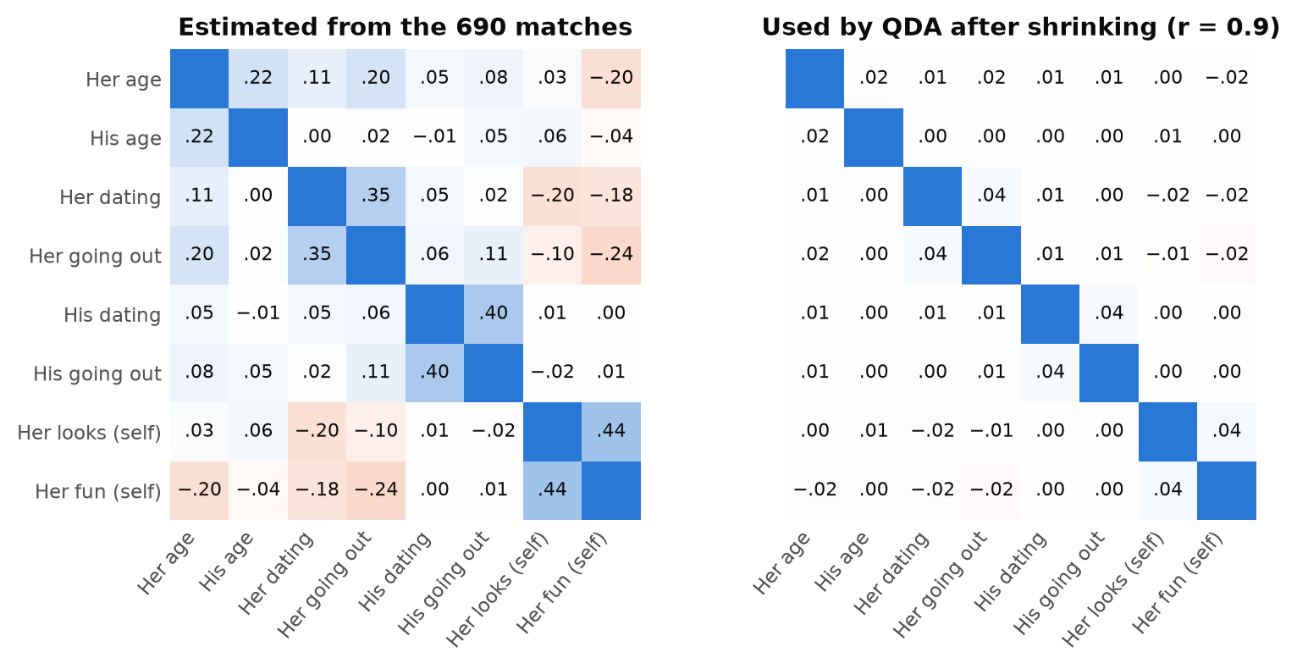
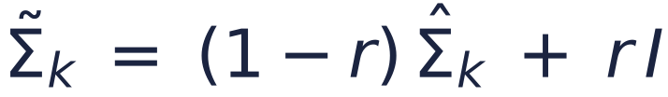
4 · TECHNICAL IMPLEMENTATION
Shrinking QDA's covariance matrix
Shrink toward no correlation
Average the estimate with the identity matrix (no correlations), using weight r:
r = 0 is plain QDA; r = 1 drops every correlation. Inner CV chose r from 0.1, 0.3, 0.5, 0.7, 0.9, and picked 0.9 in all 10 fits.
Shrinking paid off. Before the date: LDA 0.553, regularized QDA 0.579. With the date ratings: 0.790 and 0.836.
Math 195 · Speed dating · 22 · Regularized QDA: Friedman (1989); Hastie et al. (2009) §4.3.1 · Heatmaps: 8 of our predictors, 690 matched pairs
Notes:
Our fix is called regularized QDA. We shrink the matches' covariance matrix toward the identity matrix, which means no correlations at all, using a weighted average with weight r. With r equal to 0 it's plain QDA; with r equal to 1 every correlation is dropped. An inner cross-validation inside the training events chose r from 0.1, 0.3, 0.5, 0.7 and 0.9. The heatmaps show what shrinking does, for 8 of our predictors among the matched pairs. On the left are the correlations we estimate; for example, women who rate themselves as more attractive also rate themselves as more fun, a correlation of 0.44. On the right is what QDA uses after shrinking with r equal to 0.9: every correlation is about a tenth as big, so 0.44 becomes 0.04. The inner cross-validation picked 0.9, the strongest option, in all ten fits. And regularized QDA ended up one of our best models: 0.579 before the date against 0.553 for LDA, and 0.836 against 0.790 with the date ratings.

Slide 5
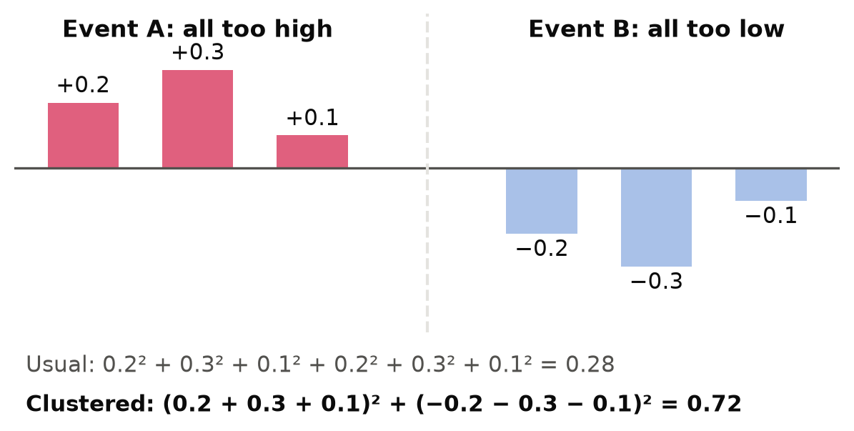
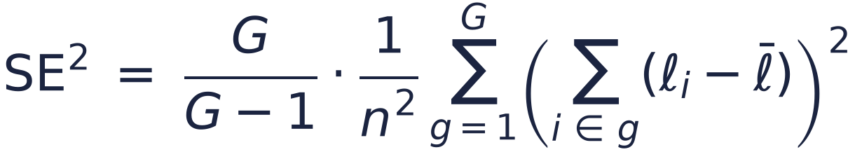
4 · TECHNICAL IMPLEMENTATION
Error bars that respect events
Toy example: six pairs at two events
Add up within each event, then square
Pairs at an event share people and an evening, so errors lean the same way. ℓᵢ is pair i's error; G = 21 events, n = 4,184 pairs:
On our results
90% intervals are AUC ± 1.72 × SE (t with 20 df). The AUC's SE uses the same idea.
Ignoring events makes error bars too narrow whenever errors lean together within an event.
Math 195 · Speed dating · 26 · Cluster-robust SE: Cameron & Miller (2015) · Clustered AUC: Obuchowski (1997) · The toy numbers are made up
Notes:
Every result we show comes with an error bar, so here's how we compute it. The usual standard error assumes all 4,184 pairs are independent. Ours aren't: pairs at the same event share people and the same evening, so a model's errors tend to lean the same way within an event. Here's a toy example with six pairs at two events. At event A the model is too high for every pair; at event B it's too low for every pair. The usual formula squares each pair's error and adds them up, which gives 0.28. The clustered version first adds up each event's errors, then squares, which gives 0.72. Errors that lean together don't cancel within an event, so the variance is more than twice as big and the error bar about 1.6 times as wide. That's the formula on the right: sum within each event, square, add over our 21 events, with a small correction of G over G minus 1. Our intervals are the AUC plus or minus 1.72 standard errors, from a t distribution with 20 degrees of freedom, and the AUC's standard error uses the same idea, due to Obuchowski. Whenever errors lean together within an event, ignoring the events makes the error bars too narrow.

