Slide 1


VISVESVARAYA TECHNOLOGICAL UNIVERSITY
“Jnana Sangama”, Belagavi-590018, Karnataka, India
Impact College of Engineering and Applied Sciences
Department of Computer Science And Engineering
Mini Project Presentation
FLIGHT TO
Submitted by,
Abraham John(1IC22CS002)
Avinash N Shetty(1IC22CS014)
Mahsooq(1IC22CS032)
Rakesh N(1IC23CS401)
Under the guidance of ,
Asst. prof. Vijendra SN
Department of Computer Science and Engineering

Slide 2
CONTENTS
Abstract
Introduction
Literature Survey
Existing System
Proposed System
Description
Problem Statement
System Requirements
Methodology
Implementation

Slide 3
ABSTRACT
This project involves creating a clone of the popular Flappy Bird game, which includes the basic mechanics of bird movement, obstacle generation, collision detection, and scoring. The game has additional features like dynamic themes (e.g., morning, noon, evening, night), soundtracks that change with gameplay intensity. The project uses Python and the Pygame library for graphical rendering and sound management. The goal is to develop an engaging, interactive, and visually appealing game that challenges players to score as high as possible while avoiding obstacles.

Slide 4
INTRODUCTION
Flappy Bird is a simple yet addictive mobile game created by Dong Nguyen in 2013. Despite its minimalistic gameplay, it became a worldwide sensation. In this project, we replicate the core mechanics of Flappy Bird while introducing additional features, such as dynamic themes and dynamic music. The player controls a plane that automatically moves forward, and by tapping the spacebar, the plane fly to avoid incoming pipes. The objective is to navigate through gaps between pipes, score points, and continue for as long as possible.

Slide 5
LITERATURE SURVEY
Flappy Bird’s Influence: Flappy Bird, with its easy-to-understand mechanics, had a significant impact on the gaming community. The simple controls, combined with increasing difficulty, made it both frustrating and addictive, contributing to its viral success.
Game Design and Mechanics: Numerous studies and articles on game design suggest that minimalistic mechanics and repetitive gameplay can captivate players. Games like Flappy Bird demonstrate how straightforward gameplay can engage users.
Game Engines for 2D Games: The Pygame library, a set of Python modules designed for writing video games, is widely used for developing 2D games. It provides capabilities for handling graphics, sound, and events in a relatively simple environment, making it ideal for beginner game developers.
Dynamic Game Music: Studies have also emphasized the use of dynamic music in games to enhance user experience. Changing music based on the game’s intensity or state can increase immersion and engagement, as demonstrated in this project.

Slide 6
EXISTING SYSTEM
Flappy Bird Game: The original game features a simple, minimalist interface. The player controls a bird that must avoid passing through pipes by tapping the spacebar to make the bird "flap." The game ends when the bird collides with an obstacle or the ground.
Flappy Bird Clones: After the success of the original game, many clones emerged with same mechanics but with different objects for example replacing the bird with a superhero etc. These clones often use basic 2D game engines, like Unity or Pygame.

Slide 7
PROPOSED SYSTEM
The proposed system is a clone of the original Flappy Bird game but with enhanced features. Key features include:
Dynamic Themes: The background, pipes, and environmental effects change based on time, including different themes for morning, noon, evening, and night.
Music Transition: The game dynamically switches between intense, and game-over music tracks, depending on the game's state.
Scoring and Difficulty: The game tracks the score and increases the speed of the pipes as the player progresses. High scores are tracked, and the game ends when the plane collides with a pipe or the ground.

Slide 8
DESCRIPTION
Gameplay: The game starts with the plane flying across the screen. The player controls the plane's vertical movement by tapping the spacebar to make the plane fly. The pipes move horizontally toward the plane, and the player must navigate through gaps in the pipes to continue progressing.
Score and Timer: The score increases by 1 every time the plane passes through a gap between pipes. A timer tracks the time since the game started, and the game continues until the plane collides with a pipe or falls to the ground.
Themes: The game features four themes that change every 15 seconds: morning, noon, evening, and night. Each theme has a corresponding background and pipes.
Sound: The game uses different soundtracks based on the game’s intensity. A calm soundtrack is played when the game is progressing normally, while an intense soundtrack plays when pipes are close. The game-over track is played when the game ends.

Slide 9
PROBLEM STATEMENT
The challenge is to create a clone of the Flappy Bird game while enhancing it with dynamic elements such as changing themes, music. The game should be easy to play but challenging enough to keep players engaged. The main difficulty in the project lies in managing game state transitions, implementing dynamic music, and creating a smooth, responsive user interface.

Slide 10
SYSTEM REQUIREMENTS
Software Requirements:
Python (version 3.x)
Pygame library
Image assets for backgrounds, pipes, and plane sprites
Sound files for background music and sound effects
Hardware Requirements:
A computer or device capable of running Python and Pygame
Mouse or keyboard for interaction

Slide 11
METHODOLOGY
The development of the Flight To follows these steps:
Setup: Install Python and the Pygame library. Initialize the game window and set the initial conditions (plane’s position, background, etc.).
Game Loop: Implement the main game loop that continuously updates the game state, handles user input, and updates the screen.
User Input: Capture key events (such as the spacebar) and update the game state accordingly.
Pipe Generation: Randomly generate pipes at set intervals. The pipes move from right to left and are removed once they leave the screen.
Collision Detection: Implement collision detection between the bird and pipes, as well as the ground, to end the game when necessary.

Slide 12
6.Theme and Sound Management: Implement the logic to switch themes every 15 seconds and manage sound transitions based on game state.
7.Game Over and Restart: If the bird collides with an obstacle or falls, the game transitions to a "game over" state, and the player can restart the game.

Slide 13
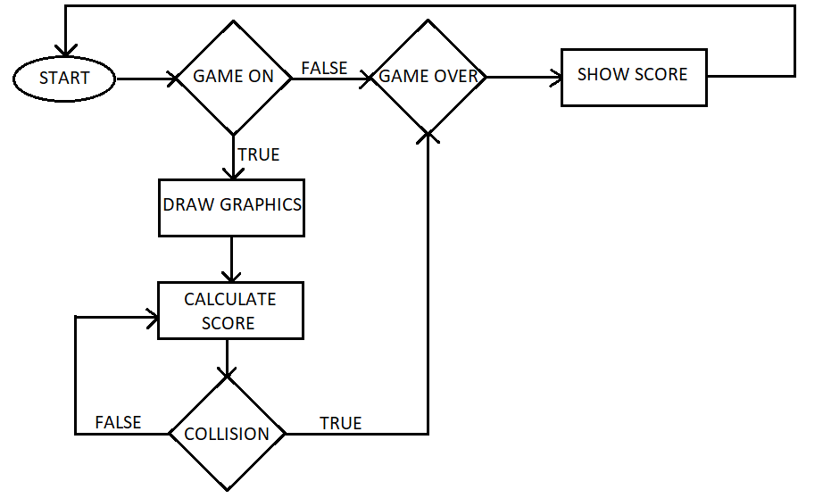

Slide 14
IMPLEMENTATION
The implementation uses the Pygame library for graphical rendering and sound management. Key components of the game include:
Plane Movement: The plane moves automatically, and the player controls its vertical movement by tapping the spacebar.
Pipe Generation: Pipes are created at random heights and move horizontally across the screen. The player must avoid colliding with them.
Sound Management: The game uses dynamic soundtracks that change based on the game’s intensity. A game-over track is played when the game ends and a ping is played when the player passes through an obstacle.

Slide 15
4.Themes: Four dynamic themes are implemented, each with different backgrounds and pipe images and the themes changes every 15 seconds of the game running.
5.Python libraries used: There are some python libraries used to support some functions that are defined in the game. Libraries such as Pygame, sys, time, random, math and mixer is used.

Slide 16
PYTHON LIBRARIES
Pygame: Pygame is a Python library designed for developing video games. It provides functionality for creating 2D games and multimedia applications by offering modules to handle such as graphics, sound, input and game loop management.
Sys: The sys library in Python is a built-in module that provides access to system-specific parameters and functions. It allows interaction with the Python runtime environment and the underlying operating system.
Time: The time library in Python is a built-in module that provides functions for working with time-related tasks. It enables measuring the passage of time, pausing execution, and retrieving system time.
Random: The random library in Python is a built-in module used to generate pseudo-random numbers and perform random operations. It provides a variety of functions to work with randomness, making it useful for simulations, games, and data sampling.

Slide 17
Math: The math library in Python is a built-in module that provides a wide range of mathematical functions and constants. It is primarily used for performing advanced mathematical computations such as trigonometry, logarithms, factorials, and more.
Mixer: The mixer library in Python is part of the Pygame library and is specifically designed for managing and playing audio in multimedia applications and games.

Slide 18
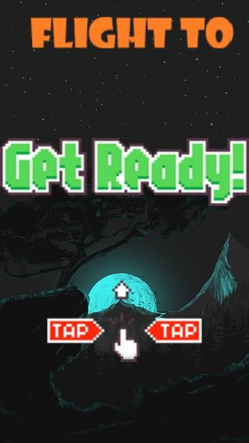
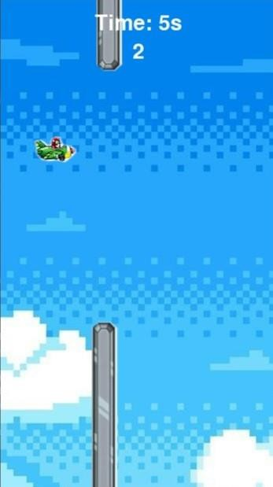
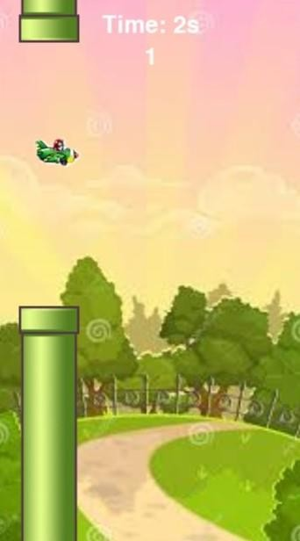
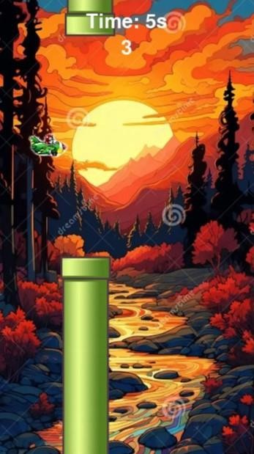
RESULT

Slide 19
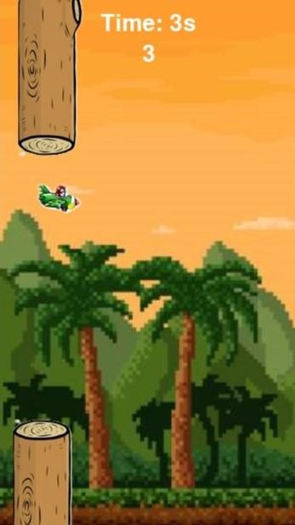
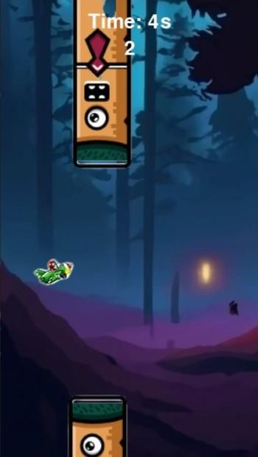
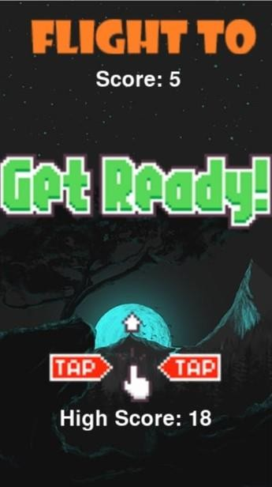

Slide 20
CONCLUSION
The code demonstrates a dynamic and interactive 2D game built using the Pygame library, showcasing several features that create a polished gaming experience. This project is a commendable effort to blend interactive gameplay, visual aesthetics, and responsive sound design into a cohesive experience. It serves as an excellent example of how to use Pygame for game development and encourages further exploration into advanced game mechanics and optimization.

Slide 21
REFERENCES
https://www.w3schools.com/
https://codewithcurious.com/

Slide 22
THANK YOU

