Slide 1
Regression and the World Happiness Report
Abe Eyman Casey

Slide 2
Purpose & Research Question
The purpose of this research is to see how well we can predict the Happiness Index using various regression models and which model is the most effective with these data.
Between Linear Regression, Ridge Regression, Lasso Regression, and Random Forest Regression, which model best predicts the Happiness Index for the countries in the World Happiness Report

Slide 3
World Happiness Report
Each year the World Happiness Report teams up with multiple data sources to aggregate data to attempt to quantify the happiness of 153 countries across the globe. The most important data source for the report is Gallup World Poll.
Using various input variables, they attempt to quantify “happiness” which we will use as our output variable

Slide 4
Input Variables
Variable | Type | Description
Log GDP Per Capita | Numeric | Log of GDP per capita for each country
Social Support | Numeric | The national average of the binary responses (either 0 or 1) to the GWP question “If you were in trouble, do you have relatives or friends you can count on to help you whenever you need them, or not?”
Healthy Life Expectancy | Numeric | Based on data extracted from WHO Global Health Observatory
Generosity | Numeric | the residual of regressing national average of response to the GWP question “Have you donated money to a charity in the past month?” on GDP per capita
Corruption Perception | Numeric | national average of the survey responses to two questions in the GWP: “Is corruption widespread throughout the government or not” and “Is corruption widespread within businesses or not?”
Population | Numeric | Population of country
Freedom Choices | Numeric | national average of responses to the GWP question “Are you satisfied or dissatisfied with your freedom to choose what you do with your life?”
Unemployment | Numeric | Unemployment rate
Region | Categorical | What region of the world the country is in

Slide 5
Preprocessing
Selecting the relevant variables from the data
Pulling in population data and unemployment data from the World Bank
StandardScaler() on all numeric variables
Refactor categorical variable to dummy variables

Slide 6
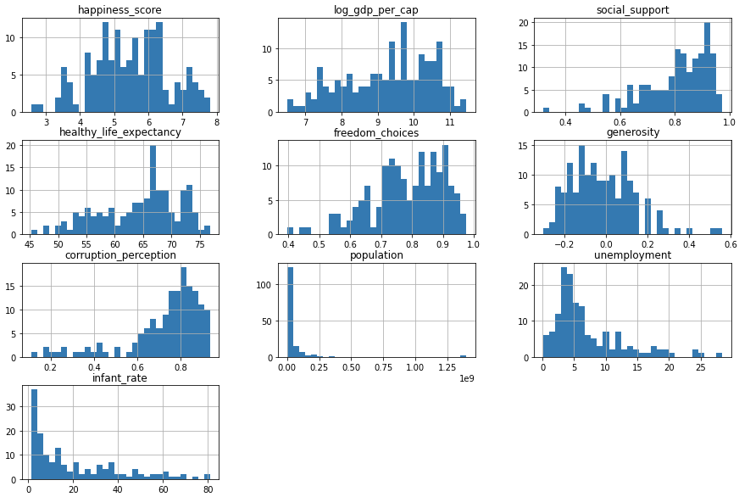
Distribution of Variables

Slide 7
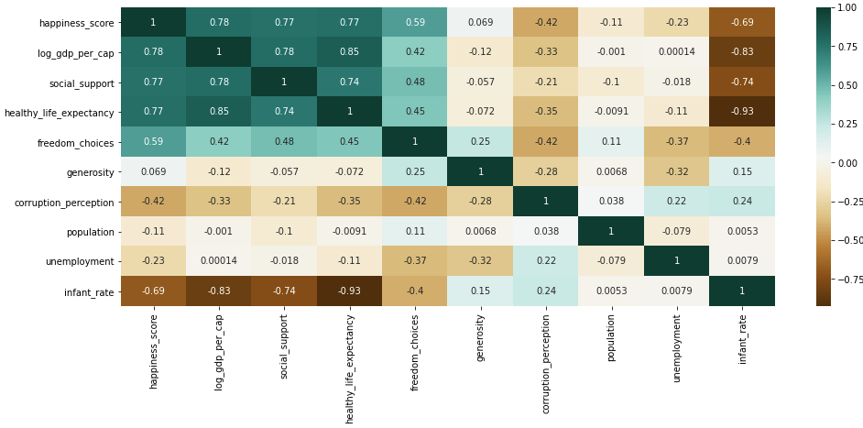

Slide 8
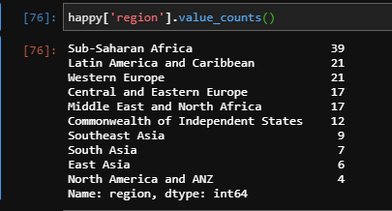
Region Frequency Counts

Slide 9
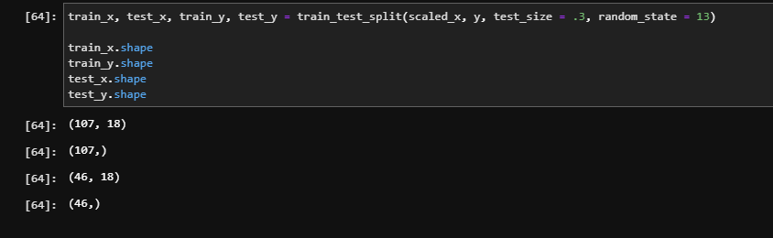
Data splitting or partitioning

Slide 10
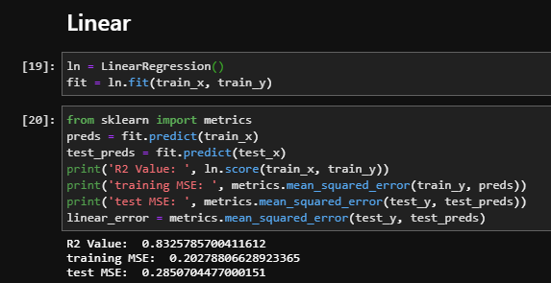
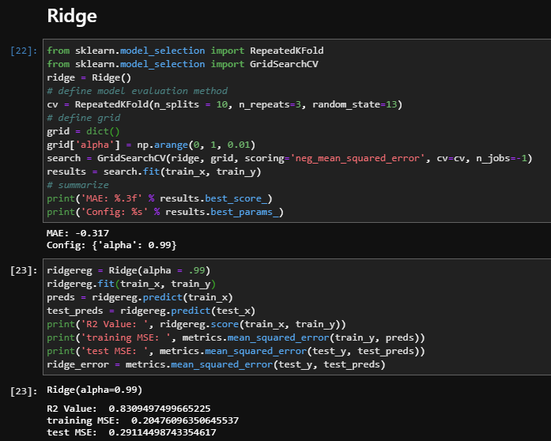
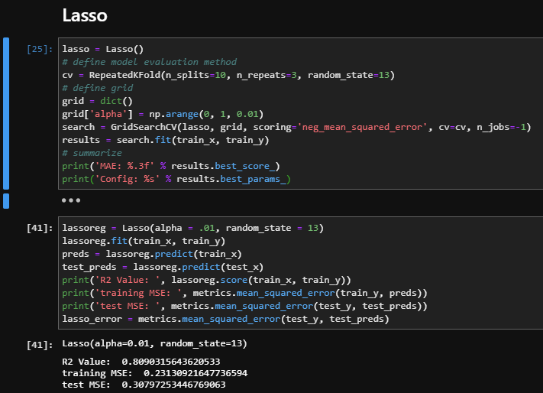
Models

Slide 11
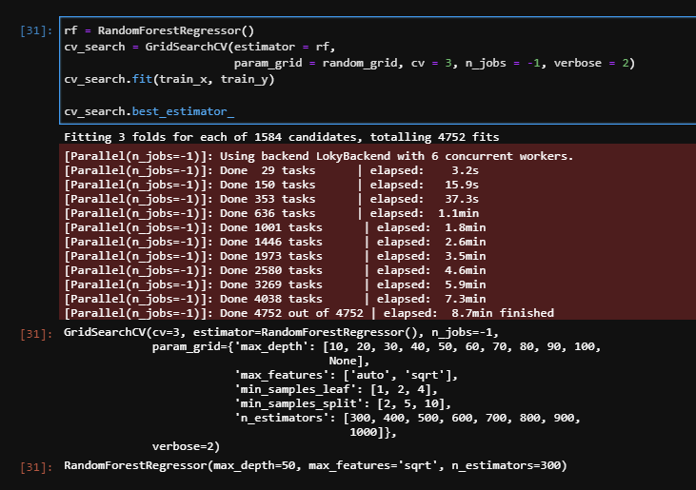
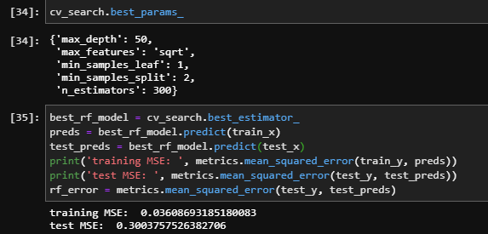
Models

Slide 12
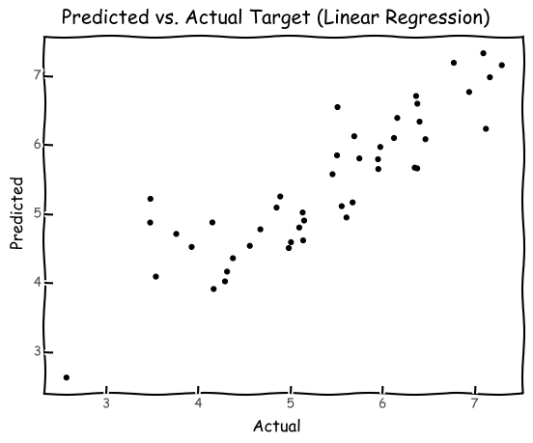
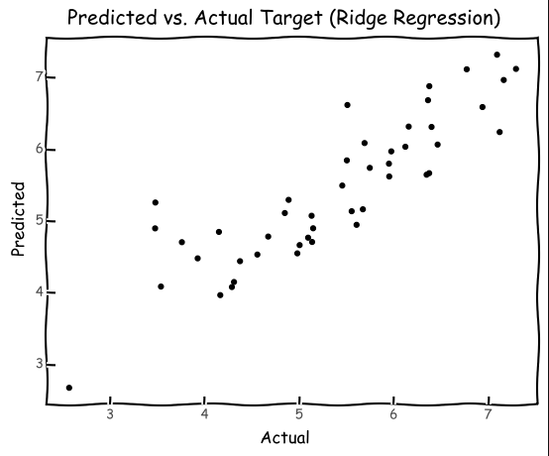
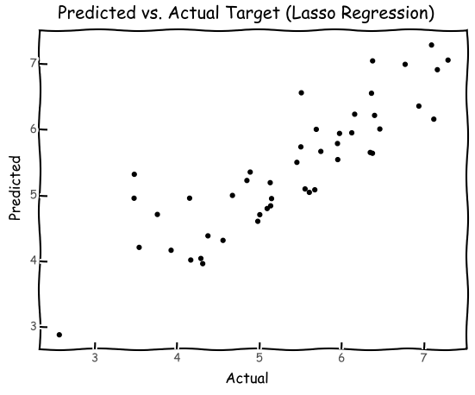
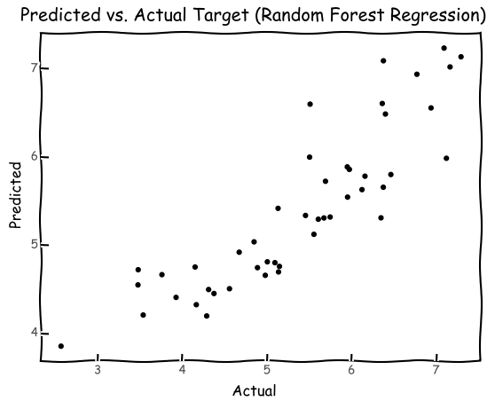

Slide 13
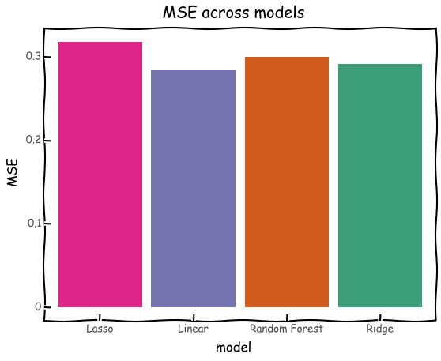

Slide 14
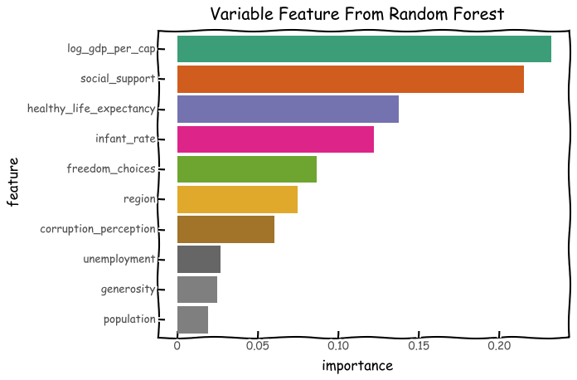

Slide 15
Conclusion
The best performing model was the Linear Regression with a test MSE of .285 and an R2 of .832

