Slide 1
Twitch.Tv A video Player
(Felipe Leon)

Slide 2
Revision History
Version | Date | Description | Author
1.0 | 2018.01.23 | App released | Felipe Leon

Slide 3
Contents
UI Structure
Usage Scenario
Menu & function description
Key policy
How to change languages

Slide 4
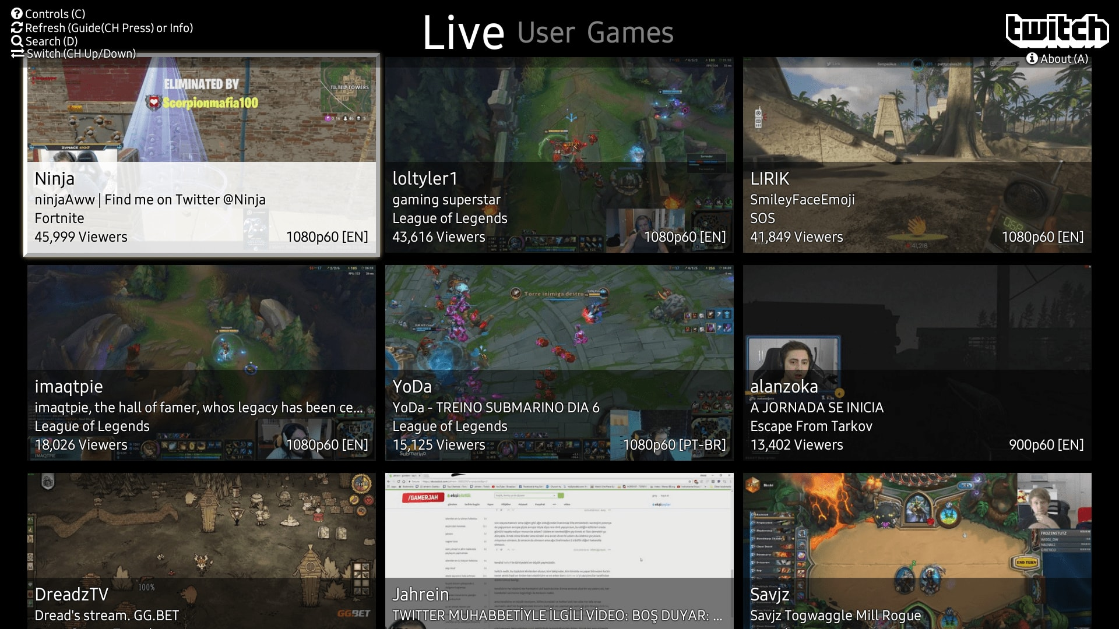
UI Structure

Slide 5
UI Structure – sample2(depth navi.)
1st depth
2nd depth
3rd depth
4th depth
5th depth
Video list
Select video
Play the video
Switch Screen
New Screen select a video
Play the video
Back to previously screen
Refresh current
select a video
Play the video

Slide 6
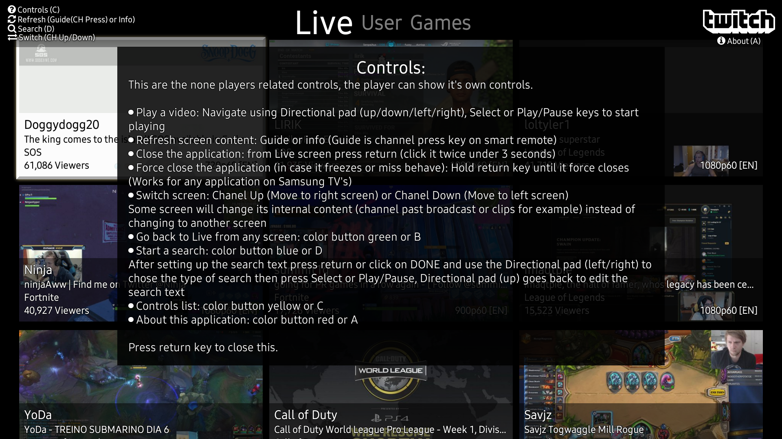
Usage Scenario

Slide 7
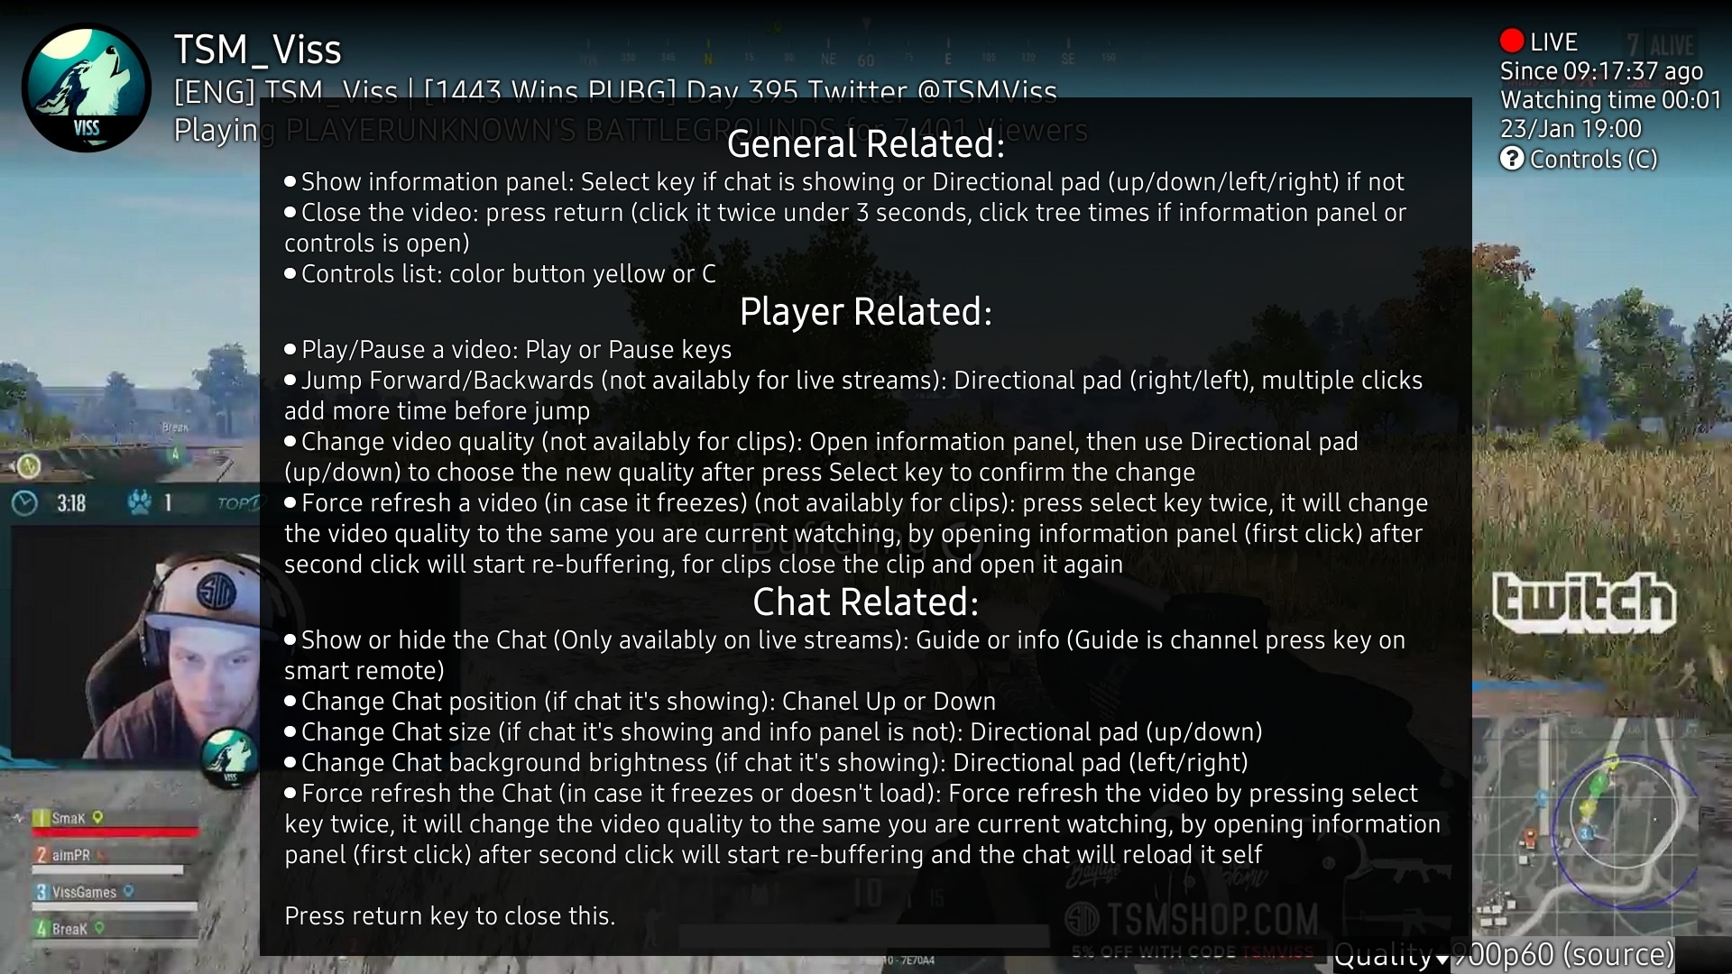
Usage Scenario

Slide 8
How to change languages
Items | Contents
How to change languages | Change langunage on TV settings menu

