Slide 1

Predicting Hospital Readmission for Diabetic Patients
Project overview using diabetic_data.csv — clinical features → readmission prediction

Slide 2
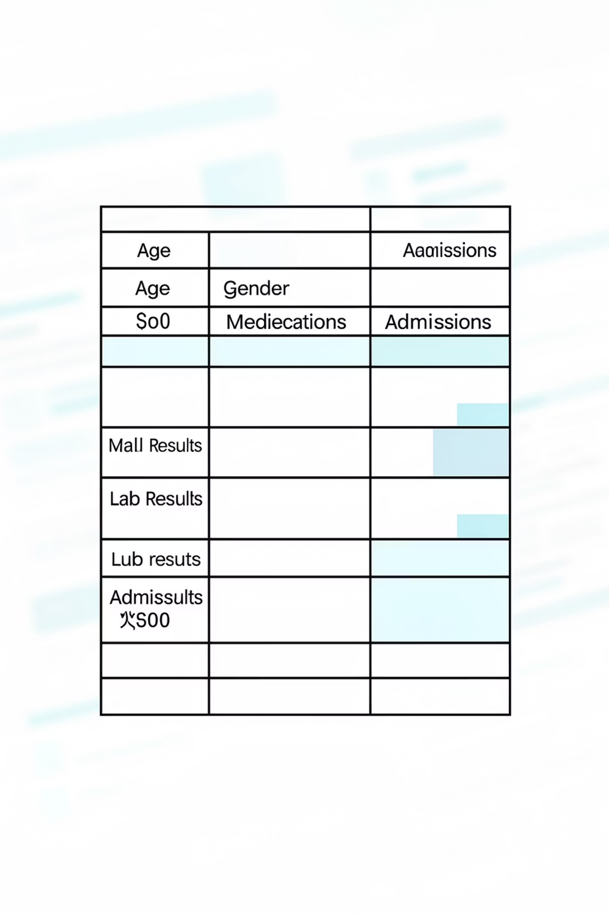
Dataset Snapshot — diabetic_data.csv
Records
Target
~70k hospital visits (de-identified)
readmitted (yes/no / within 30 days)
Sources
EMR fields: demographics, labs, meds, diagnoses

Slide 3

Problem Statement
Goal: Predict whether a diabetic patient will be readmitted (binary classification)
Why it matters: reduce costs, improve care coordination
Use case: early intervention flags at discharge

Slide 4

Key Features
Representative features
Demographics: age, gender, race
Clinical: diagnoses, comorbidities (CHF, hypertension)
Medications: insulin, metformin, number of meds
Labs & vitals: glucose, HbA1c, creatinine
Utilization: # previous admissions, length of stay

Slide 5

Data Preprocessing
01
Missing values
Impute labs (median), flag missing categorical values
02
Encoding
One-hot for nominal; ordinal mapping for age buckets
03
Normalization
Scale lab values (RobustScaler) to reduce outlier impact
04
Split
Train/val/test (70/15/15) with stratification on readmission

Slide 6
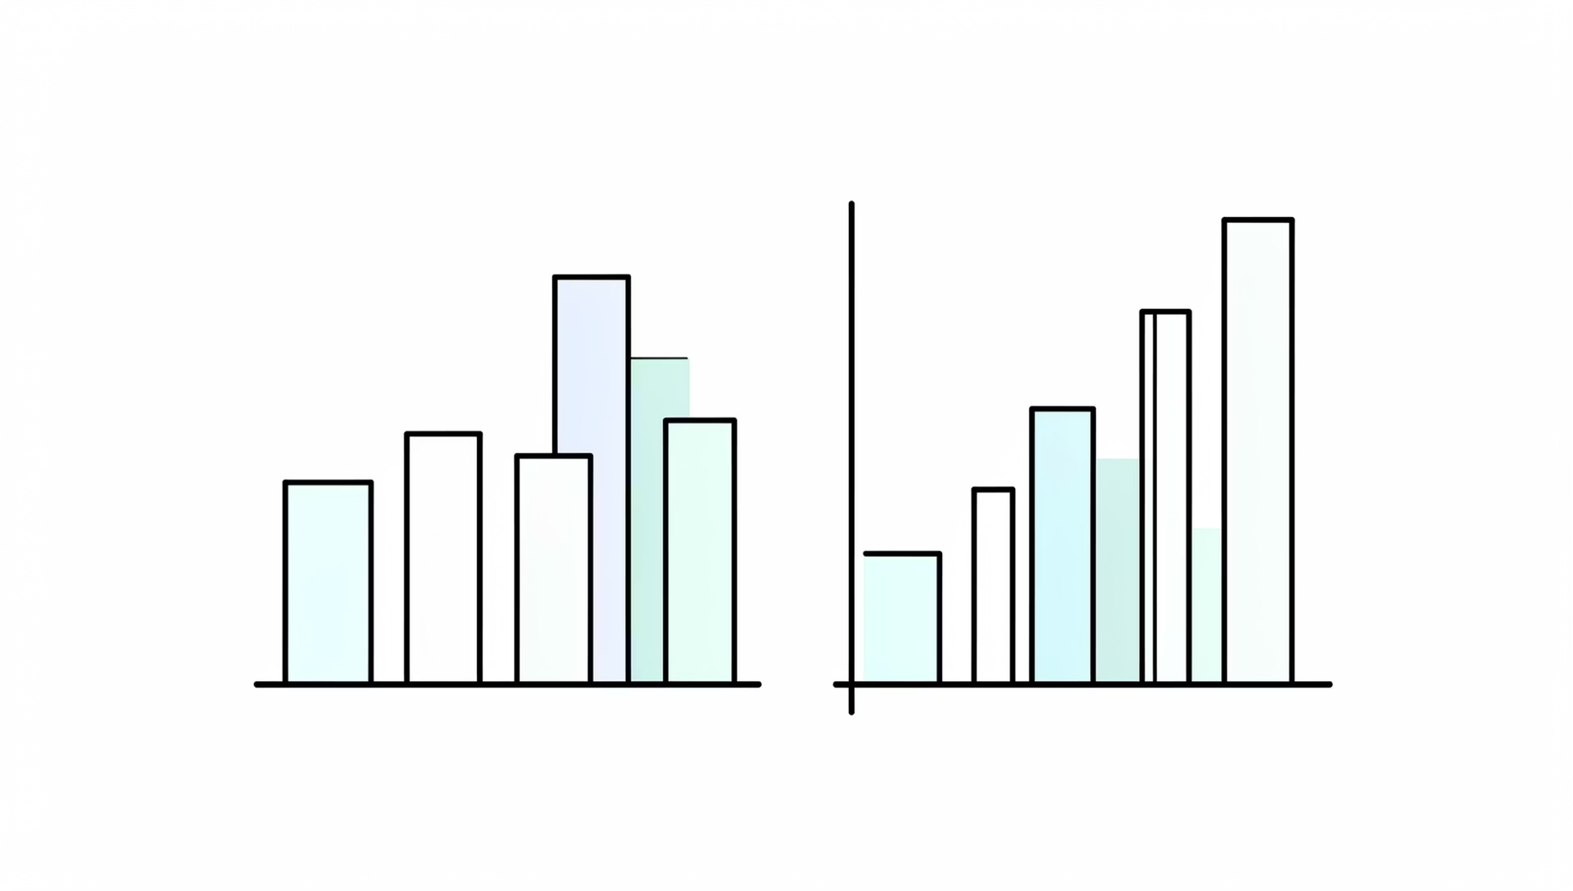
Exploratory Data Analysis — Key Insights
Higher readmission rates for older age groups and multiple comorbidities
Prior admissions strong predictor — clear positive correlation
Certain meds (insulin) associated with higher readmission frequency
Missing labs concentrated in outpatient records → potential bias

Slide 7
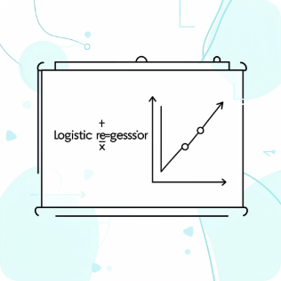

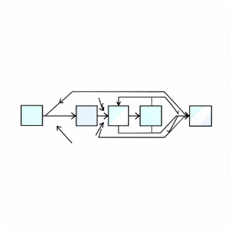
Model Selection & Approach
Logistic Regression
Decision Tree / Random Forest
Gradient Boosting (XGBoost)
Baseline interpretable model; regularization added
Captures non-linearities; feature importance analysis
Higher accuracy candidate; careful tuning to avoid overfit

Slide 8
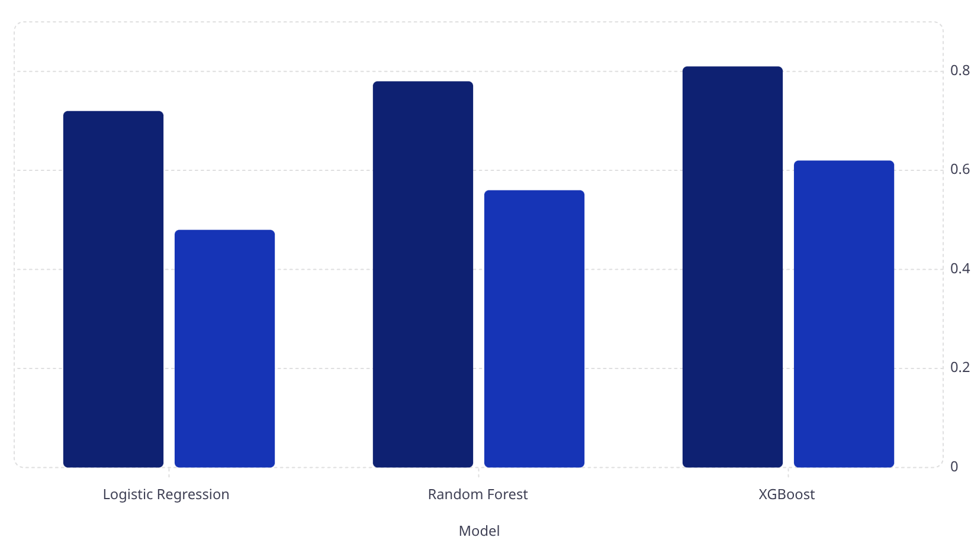

Training & Evaluation
Accuracy
F1 Score
Metrics (validation): accuracy, precision, recall, F1. Use confusion matrix for clinical utility (false negatives risk).
Prioritize recall for safe discharge decisions; tune threshold accordingly.

Slide 9
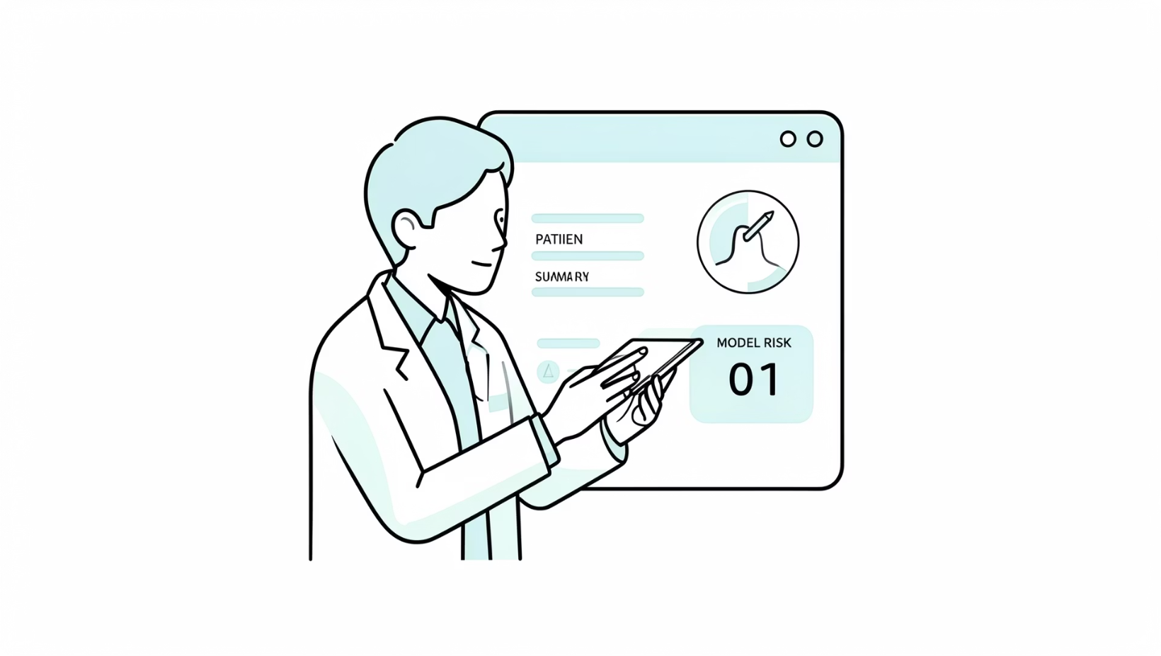
Results, Interpretation & Challenges
Best model: XGBoost — highest accuracy and F1
Top predictors: prior admissions, length of stay, HbA1c, insulin use
Interpretability: SHAP values used to explain individual predictions
Challenges:
Missing and biased lab values
Class imbalance (few early readmissions)
Data drift across hospitals / coding differences

Slide 10

Conclusion & Next Steps
Deploy
Validate
Prototype clinical dashboard with risk alerts; pilot on one ward
Prospective validation and clinician feedback loop
Improve
Ethics & Governance
Address bias, integrate social determinants, expand feature set
Regular fairness audits, clear documentation, patient privacy safeguards
Questions?

