Slide 1

Hystrix isolation strategies
getting them right.

Slide 2
Types of execution strategies
THREAD: command execution is isolated in a separate thread. Maximum parallel threads can be configured as well as execution timeout. Pros: safety, parallelism. Cons: Greater overhead
SEMAPHORE: all command calls are executed on a single thread. Execution timeout can be specified. Pros: lower performance overhead. Cons: Concurrency issues, blocking.

Slide 3
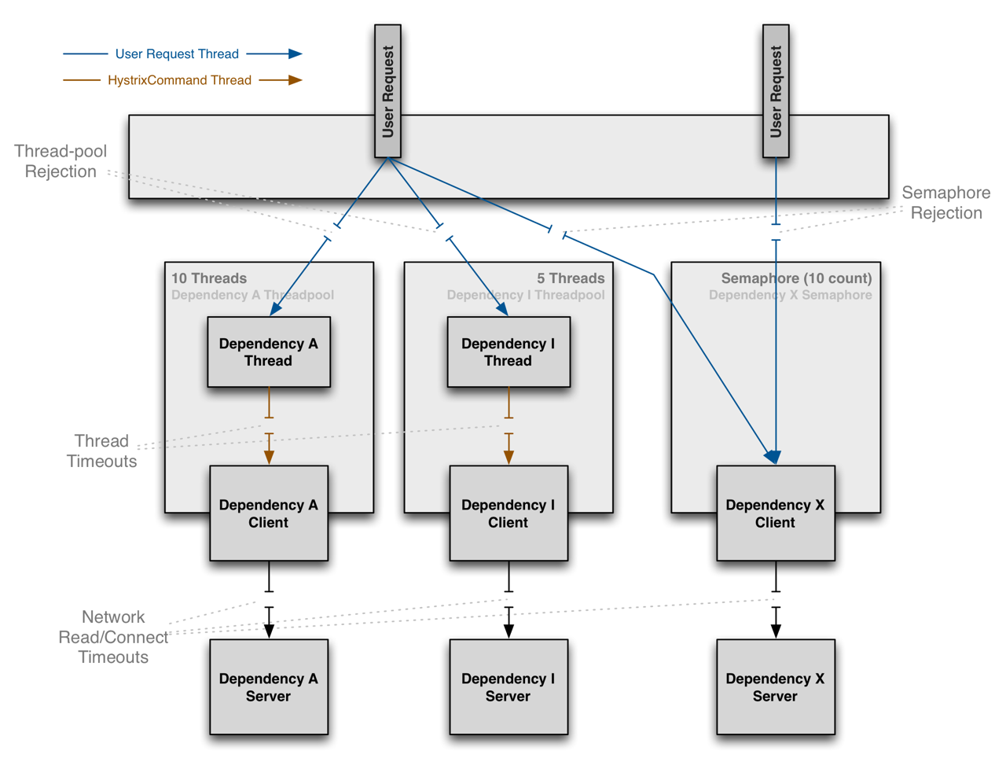
Execution rejection mechanisms

Slide 4
DEMO

Slide 5
Gotcha
With SEMAPHORE isolation strategy the Commands do timeout.
But the thread never gets interrupted - so what fallback returns is available only after calling thread is unblocked.
With THREAD isolation the thread is interrupted and fallback returns instantly.

Slide 6
What Hystrix documentation says
Note: if a dependency is isolated with a semaphore and then becomes latent, the parent threads will remain blocked until the underlying network calls timeout.
Semaphore rejection will start once the limit is hit but the threads filling the semaphore can not walk away. ...
Generally the only time you should use semaphore isolation (SEMAPHORE) is when the call is so high volume (hundreds per second, per instance) that the overhead of separate threads is too high; this typically only applies to non-network calls.

Slide 7
Calculating thread pools
We don’t need as many threads in a pool as concurrent requests (too many!!!)
We can’t have more maximum threads in Hystrix pool than we allow our application to run. Approximately 10 times less is sufficient.
The general formula to calculate thread pool size:
requests per second at peak when healthy × 99th percentile latency in seconds + some breathing room

Slide 8
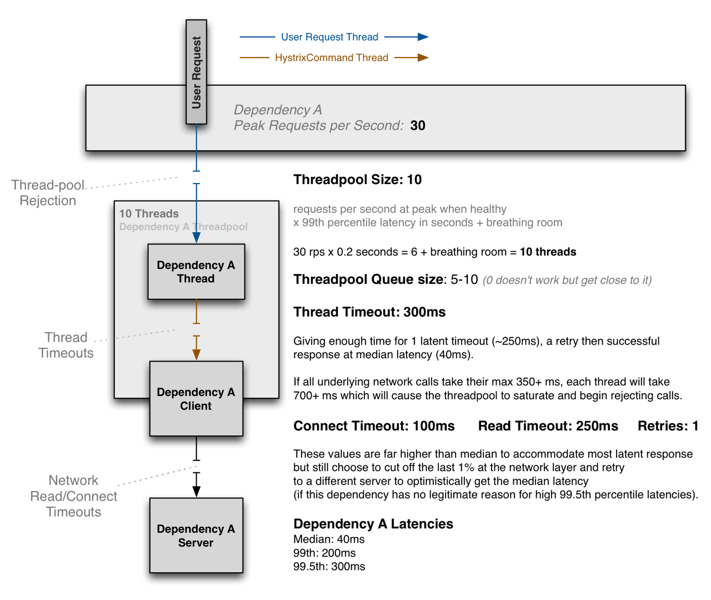
Explained

Slide 9
QUESTIONS?

