Slide 1


Digital Freelancer:
Managing Freelancing Projects
Project: Working with a Mock Client

Slide 2
Part 1
Project Listing

Slide 3
Sample Project Listing #1: Web Development
Web application development support needed for healthcare application.
Posted 2 hours ago
Hourly: $35.00 - $65.00 Based on experience.
Project Time: 3 months, 25 hours a week.
Project Description:
We are a web development company working with a healthcare client looking to connect patients directly with their doctors. We need someone to be able to take PSD mockup files from our designer and convert them into custom code using HTML, CSS, and JavaScript. We have not decided on which JavaScript library to use, but will be open to working with the one you’re most familiar with. We have the designs for 10 pages and will need them to be completed in 3 months. We are open to working with all levels of experience, but the pay will be adjusted based on your experience.

Slide 4
Part 2
Expression of Interest

Slide 5
Expression of Interest (Provided)
Which Sample Project Listing did you select to respond to?
Answer: Web application development support needed for healthcare application.
Please type your initial response to the client below. This should be between 200 - 300 words.
Expression of Interest:
Dear valued customer,
I am thrilled to have reached you and eager to get started on your project, "Web application development support required for healthcare application." I understand you want to use HTML, CSS, and JavaScript to convert your designer's PSD mockup files into custom code.
I have two years of full stack development experience and strongly advise you to use react.js in the project. The use of react.js will have a positive impact on your business. As react.js influences the quality of your application, which is very valuable in terms of revenue gains, your revenue will be high and you will profit greatly.
React.js will save you time because it allows us to quickly build complicated, rigorous products and iterate on them; as a result, I can complete your application in three weeks.
Isomorphic capabilities in React.js speed up the development process, saving you money, so I'd like to assure you that the cost will be low.
React.js is the best choice for your project for all of these reasons, and it will ensure that all requirements are met.
I am Abrar Mohammed. full stack development for two years. working in multinational company in France. I am top rated in Upwork. I will be happy if you contact me again.
Regards,
Abrar Mohammed
Number: 01145971266

Slide 6
Part 3
Project Management Process

Slide 7
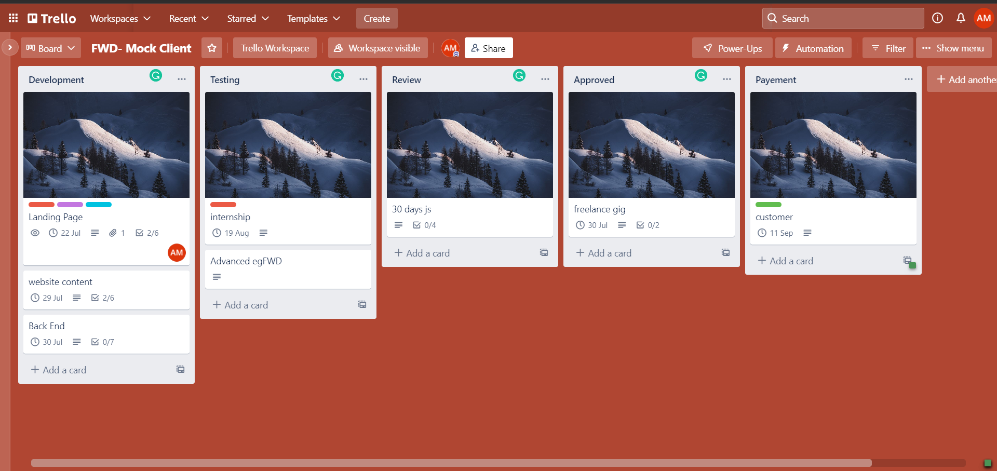
Trello Board
Please include the following information for your Trello board:
A link to your public Trello board should be provided here:
[https://trello.com/b/msrJXlIX]
Include a screenshot of the board below:

Slide 8
Part 4
Invoice and Payment Options

Slide 9
[Abrar Mohammed Abdel Ghani]
[zahraa el maadi,cairo,Egypt]
Invoice
Recipient:
[Udacity company]
[Nasr City, Cairo, Egypt]
Invoice #: [114597]
Date issued: [7/7/2022]
Date due: [7/8/2022l]
Services Rendered (Continue on next page)
Service | Description of Work Done | Hours Spent | Amount Per Hour | Total
[Reviewing CV] | [The company reviewed cv for juniors to increase their skills] | [20 hrs] | [10$] | (20) x (10) = [$200]
[create a dynamic website] | [create website for the company using react and API] | [50hrs] | [$20] | (50) x (20) = [$1000]
[Blog for their start up] | [This blog is dynamic , has advertisements and using control panel] | [80 hrs] | [$30] | (80) x (30) = [$2400]
[chrome extension development] | [social chrome extension using react.js with arrangement and UI] | [70 hrs] | [$40] | (70) x (40) = [$2800]

Slide 10
[Abrar Mohammed Abdel Ghani] [zahraa el maadi,cairo,Egypt]
Invoice
Services Rendered (continued)
Service | Description of Work Done | Hours Spent | Amount Per Hour | Total
[dynamic website for solving problems] | [solving problems using c++ , this website making by API] | [20 hrs] | [10$] | (20) x (10) = [$200]
[Chat APP] | [Chat APP for customers in restaurant for adding their needs and pay the bills from the phone] | [50hrs] | [$20] | (50) x (20) = [$1000]
[platform for students] | [online environment that comes with a modern code editor, a modern language and a set of kid friendly commands] | [80 hrs] | [$30] | (80) x (30) = [$2400]
[Web app doctor] | [Online doctor Consultation App UI in Flutter and delivery option for delivering medicines for homes] | [70 hrs] | [$40] | (70) x (40) = [$2800]
Total Payment Due: [12800 $]
Payment Options:
PayPal: abrarbero2510@gmail.com
Bank account:
zahraa el maadi,cairo,Egypt
Account Number : 2510XXX

