Slide 1

DEPARTMENT OF COMPUTER SCIENCE AND ENGINEERING
NATURAL LANGUAGE PROCESSING [DSA0308]
Campus-Aware Intelligent Lost-and-Found Management System Using NLP
Presented by A. Syed Thoufiq (192424211)
S. Mohammad Abrar (192472185)
B. Praneeth (192472222)
K. Subrahmanya Venkata Sai Manikanta (192472220)
Guided by:
Dr. T Kumaragurubaran

Slide 2







INTRODUCTION
Campus lost-and-found desks receive a large volume of free-text reports every day.
Manual matching is slow, inconsistent, and easy to miss valid matches.
Different people describe the same object using very different words and phrasing.
NLP techniques can normalize, structure, and compare these descriptions automatically.
The project extracts, analyzes, and ranks matches to reunite items with their owners faster.
3

Slide 3
LITERATURE REVIEW
S.No | Focus Area | Technique Reviewed | Advantages | Limitations
1 | Information Extraction | Named Entity Recognition (NER) | Accurately pulls structured fields from free text | Struggles with informal or very short descriptions
2 | Grammatical Analysis | HMM-based POS Tagging | Reliable word-category identification | Accuracy drops on ambiguous or slang wording
3 | Feature Representation | TF-IDF + N-gram Extraction | Simple, interpretable, fast to compute | Misses deeper semantic/contextual meaning
4 | Similarity Matching | Cosine Similarity | Efficient and widely used for text comparison | Sensitive to vocabulary mismatch between reports
5 | Applied Matching Systems | Automated Matching for Classified/Lost-Item Listings | Reduces manual search and turnaround time | Needs reasonably detailed descriptions to work well
4

Slide 4

PROBLEM STATEMENT
Lost-and-found reports on campus are currently matched manually by staff, which is slow and error-prone.
The same item gets described differently by different people, using different words, detail levels, and sentence structures.
There is a need for an NLP-based system that can understand item descriptions, extract key details, and automatically identify and rank likely matches between lost and found reports.
Same Item,
Different Words
5

Slide 5
OBJECTIVES
1
Extract structured information (item, location, time) from free-text reports.
2
Identify grammatical structure and key word categories using POS tagging.
3
Convert descriptions into numerical features using TF-IDF and n-grams.
4
Compute similarity between lost and found reports using cosine similarity.
5
Rank and recommend the most likely matches for each report.
6
Reduce manual effort and improve turnaround time for reuniting owners with items.
6

Slide 6




Core NLP Techniques
The pipeline moves from raw text to a ranked match: entities and structure are extracted first, then descriptions are turned into comparable numeric features, and finally scored for similarity.
Example
"iPhone lost near Block C" → item: iPhone, location: Block C → compared to found report → similarity score 0.87 → match
NER
POS Tagging
TF-IDF
Cosine
Similarity
7

Slide 7









Applications of NLP Techniques in Real World
Spam & text classification
Chatbots & virtual assistants
Search engines & information retrieval
Sentiment analysis
Machine translation
Resume / job matching systems
Plagiarism detection
Speech-to-text & voice assistants
Recommendation systems
Lost-and-found / classified matching (this project)
8

Slide 8




PROJECT MODULES
01
02
03
04
Campus Context &
Item Information
Extraction
Syntactic
Structure
Analysis
Linguistic
Feature
Extraction
Lost-and-Found
Similarity
Matching
9

Slide 9
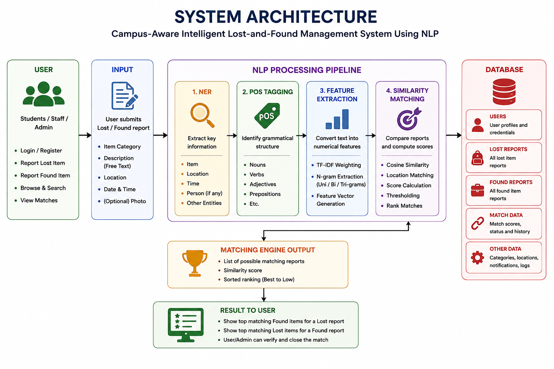

Slide 10
Module 1
Campus Context & Item Information Extraction
Objective: To extract important information such as item, location, and time from user-submitted lost/found descriptions.
Project Components
Tasks
Techniques
Item Identification
Location Extraction
Date / Time Extraction
Parse item name & description
Detect campus block, room, floor
Extract reported date/time
Named Entity Recognition (NER)
Python
NLP libraries, database
10

Slide 11
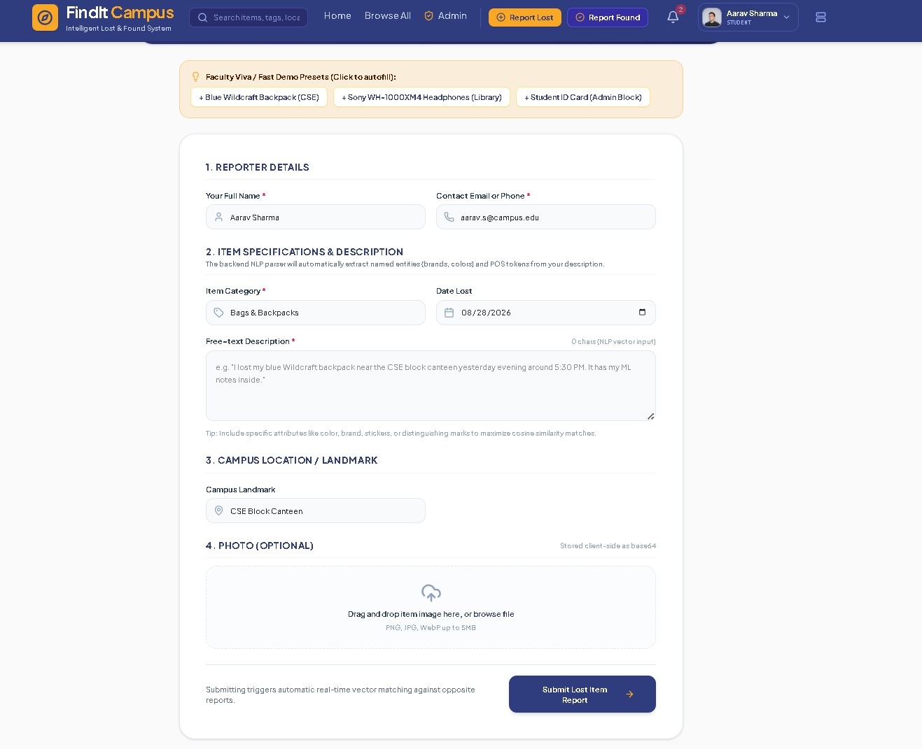
10

Slide 12
Module 2
Syntactic Structure Analysis
Objective: To analyze the grammatical structure of the reported description and identify important word categories.
Project Components
Tasks
Techniques
POS Tagging
Word Category Detection
Grammar Structuring
Tag nouns, verbs, adjectives
Identify prepositions & modifiers
Structure tagged output
HMM-based POS Tagging
Python
NLTK
11

Slide 13
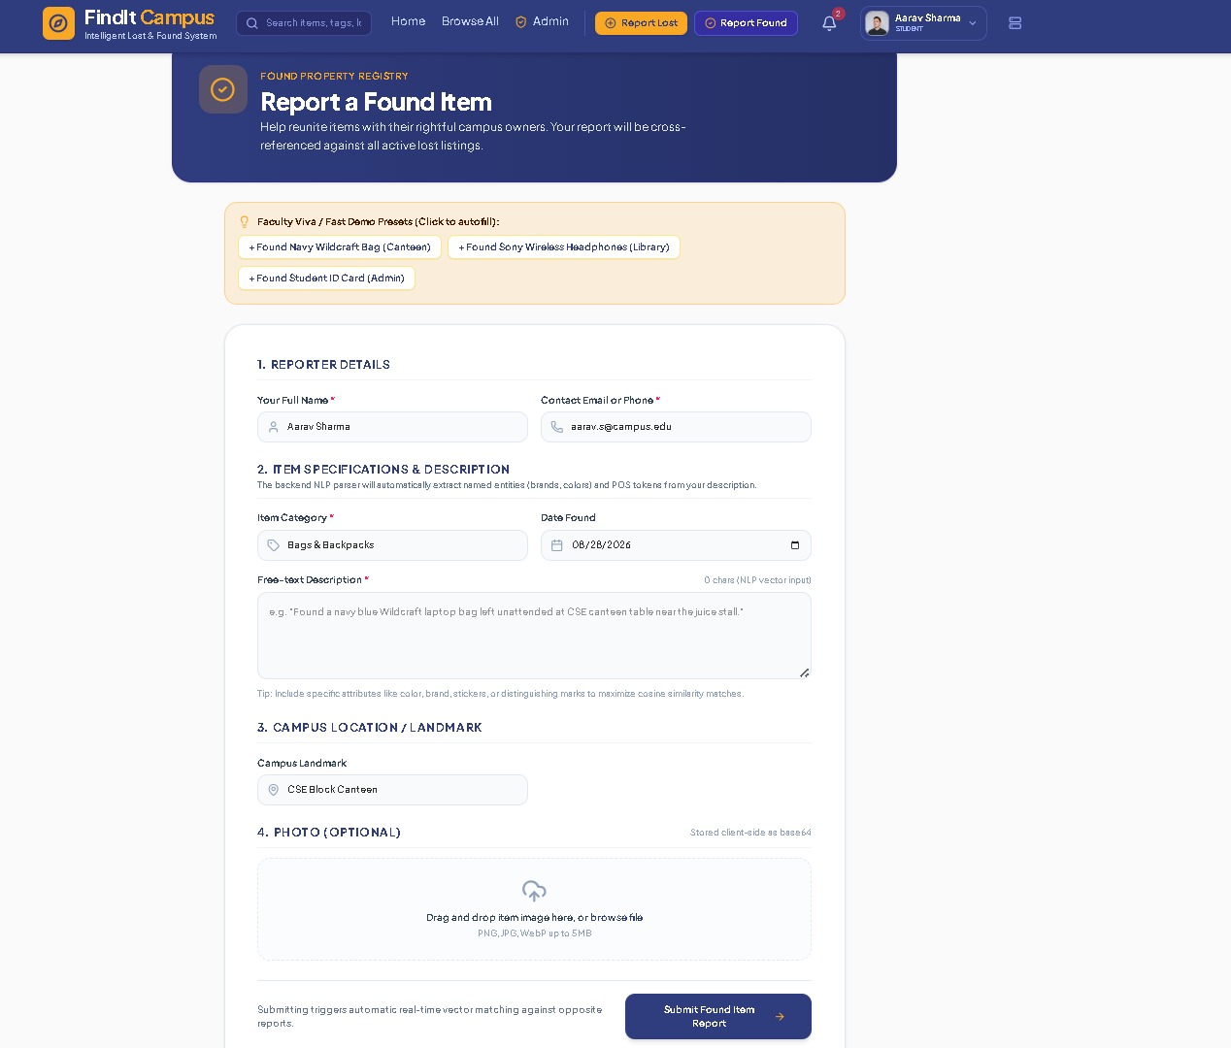

Slide 14
Module 3
Linguistic Feature Extraction
Objective: To convert item descriptions into meaningful numerical/textual features for comparison.
Project Components
Tasks
Techniques
TF-IDF Weighting
N-gram Extraction
Feature Vector Building
Compute TF-IDF weights
Generate unigram/bigram/trigram features
Build comparable vectors
TF-IDF + N-gram Extraction
Python
Scikit-learn, NLTK
12

Slide 15
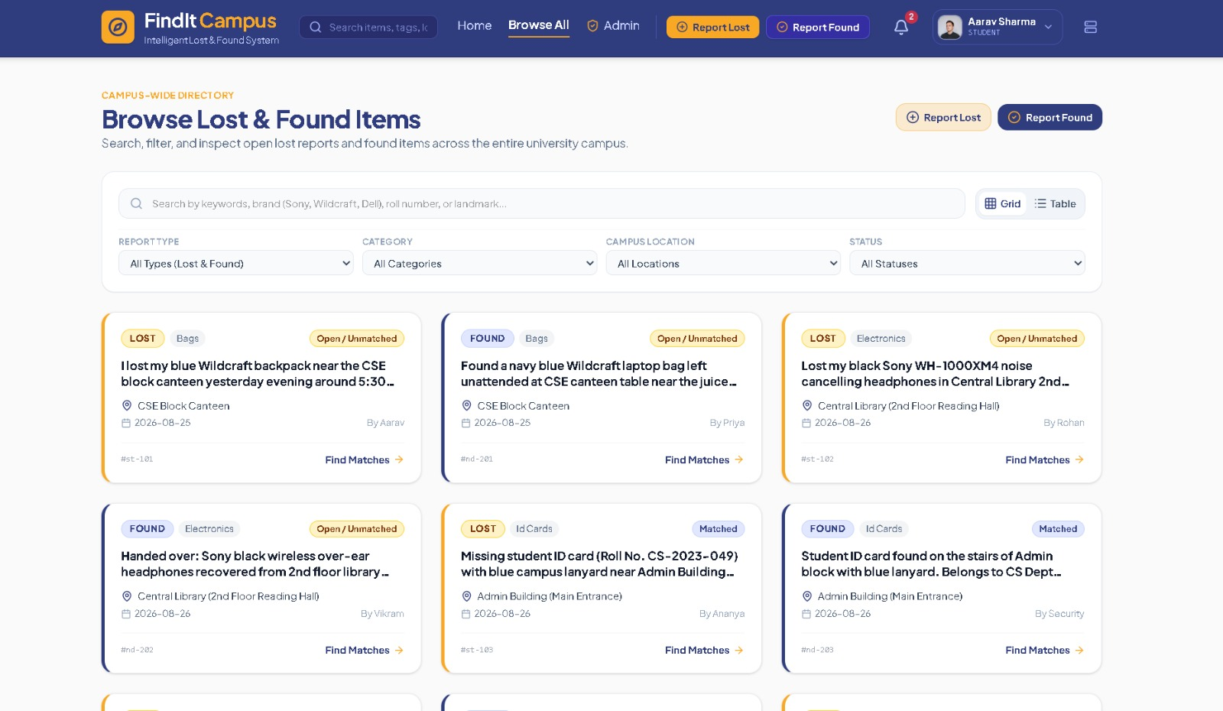

Slide 16
Module 4
Lost-and-Found Similarity Matching
Objective: To compare lost and found reports and rank the most likely matching items.
Project Components
Tasks
Techniques
Text Similarity Scoring
Location Matching
Match Ranking
Compare extracted features
Compute cosine similarity
Rank & threshold matches
Cosine Similarity
Python
Scikit-learn, NumPy, database
13

Slide 17
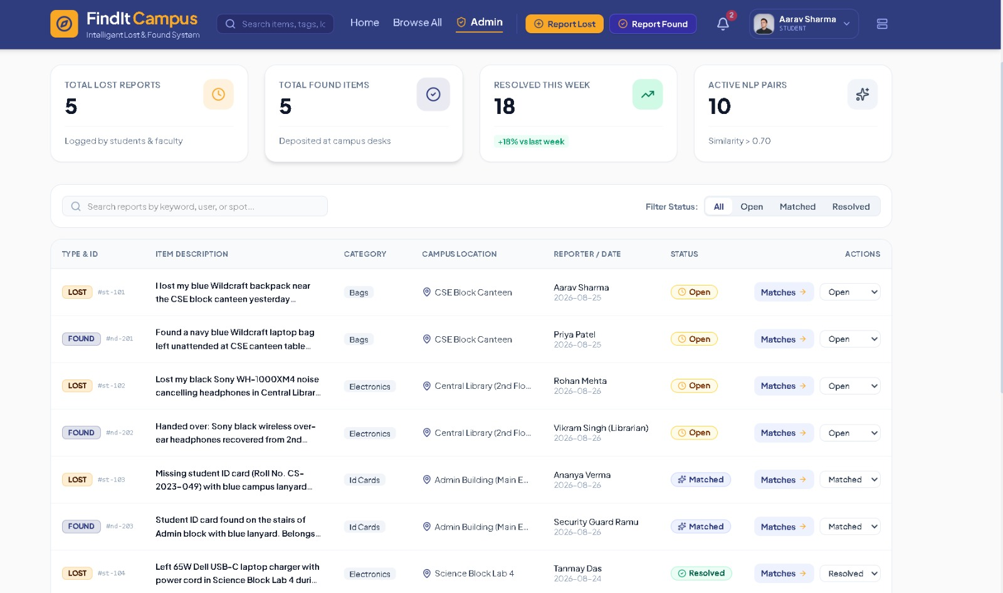

Slide 18
FUTURE SCOPE
Develop a mobile application for easy reporting and tracking.
Improve matching using advanced AI techniques.
Add real-time notifications for potential matches.
Integrate QR codes for quick lost-and-found reporting.
Add campus map and location-based features.
Support multiple languages for easier use.
Faster Reunions,
Less Waste
15

Slide 19
CONCLUSION
Uses NLP (NER, POS tagging, TF-IDF, cosine similarity) to automatically match lost and found campus reports.
Reduces manual effort and speeds up reuniting items with their owners.
Handles varied user descriptions through structured extraction and similarity ranking.
Supports smarter, more responsive campus lost-and-found services.
Contributes to SDG 12: Responsible Consumption and Production by encouraging reuse over replacement.
Faster Reunions,
Less Waste
15

Slide 20
REFERENCES
[1] Jurafsky, D. and Martin, J. H. Speech and Language Processing (3rd ed. draft). Stanford University.
[2] Manning, C. D., Raghavan, P., and Schütze, H. Introduction to Information Retrieval. Cambridge University Press.
[3] Bird, S., Klein, E., and Loper, E. Natural Language Processing with Python (NLTK). O'Reilly Media.
[4] Pedregosa, F. et al. Scikit-learn: Machine Learning in Python. Journal of Machine Learning Research, 12, 2825-2830.
[5] Salton, G. and Buckley, C. Term-weighting approaches in automatic text retrieval. Information Processing & Management, 24(5), 513-523.
15

Slide 21

Thank You

