Slide 1


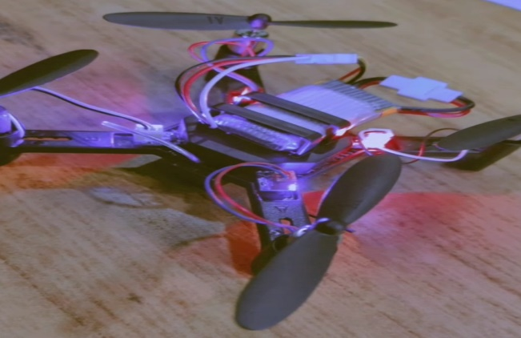
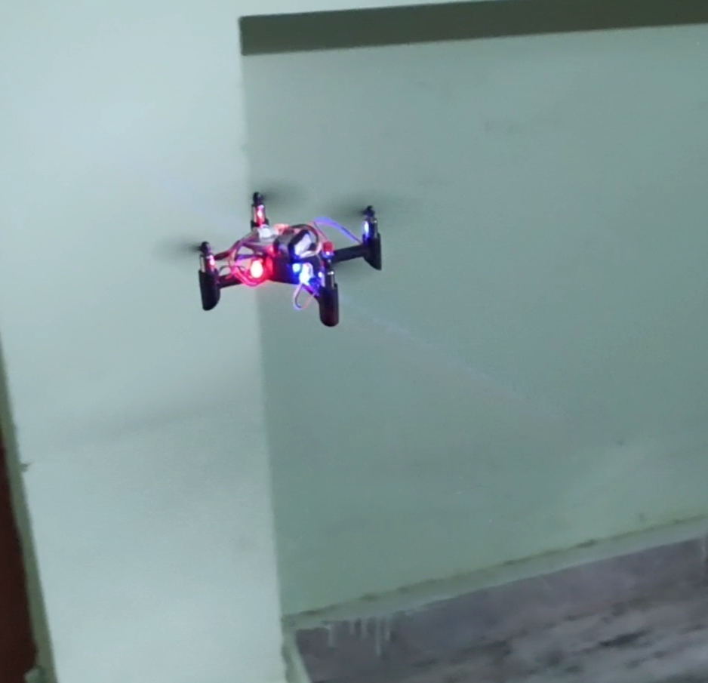
DRONE
M.Chandrashekhar, Director R&D ISLEC ,DR MD Ibrahim Altaf H&S DEPT
Mohd Abdul Aziz , Mohd Abrar , Mohd Noman Shaik , Mohd Saifullah Hussain , Akber Mohd Arshad
ABSTRACT- A drone is a kind of aircraft. A drone is also known as an unmanned aerial vehicle(UAV).It does not need a pilot on board to fly it.
A person on the ground flies a drone by using remote control and range of our drone is around 80 meters.
Drone is successfully flying and it is used for spying . Drones are proof to be a workforce multiplier
MATERIAL REQUIRED:
DC motor
Electrical wires
Lithium Battery
Propellers
Camera
Led lights
Remote control
1.5V cell
To fly drone have a power source , such as battery. The frame of a drone is made of light weight , composite material to reduce weight. First the engine is turned on, it starts up, and the propellers rotate to enable flight. Then, the pilot uses the remote control to direct its flight from the ground. Drones work much like other modes of air transportation, such as helicopters and airplanes .Architects mainly use drones for generating photographic views and developing their projects from particular angles.
Conclusion:
Drones drastically improve responses to natural disasters and can help to rapidly locate survivors, particularly in areas that are difficult to reach on foot, and they can transport aid and supplies to other affected people.
RESULT- They are mostly used for surveillance in areas and terrains

