Slide 1



CSE 4408
System Analysis
and Design Lab
Group : Go With The Flow
Ahmed Samin Yasar
Mahir Labib
Abrar Faiyaz
Ashique Khan
230041113
230041139
230041143
230041153
Notes:
PRESENTER: Ahmed Samin Yasar (230041113)
TIME: 0:00 - 0:30 (30s)
TALKING POINTS:
- Good morning respected teachers and peers. We are Group 'Go With The Flow' from Section 1A.
- Today, we present our final project for CSE 4408 (System Analysis and Design Lab): The 'Disease Spread Prevention System'.
- Team members: Ahmed Samin Yasar, Mahir Labib, Abrar Faiyaz, and Ashique Khan.
- In this 8-minute presentation, we will walk you through our organizational analysis, feasibility, DFD architecture, working input prototypes, and real-time outbreak analytics.

Slide 2



Disease Spread Prevention System
A system designed to prevent the spread of contagious, viral diseases among IUT students and facilitate the recovery of ill students.
Notes:
PRESENTER: Ahmed Samin Yasar (230041113)
TIME: 0:30 - 1:00 (30s)
TALKING POINTS:
- The Disease Spread Prevention System is engineered specifically for university campuses like IUT.
- Its core mission is twofold: proactively prevent contagious viral disease outbreaks among residential students, and provide streamlined digital recovery support for ill students.

Slide 3

Organizational Context & Stakeholders
High-Density Residential Campus
Over 3,000 students live in close proximity across male and female halls with shared dining and amenities.
Centralized Healthcare Hub
The IUT Medical Center manages consultations and triage, but suffers from paper-based record fragmentation.
Multi-Stakeholder Coordination
Viral flu, COVID-19, Dengue, and conjunctivitis spread rapidly through dorms without early detection.
Notes:
PRESENTER: Ahmed Samin Yasar (230041113)
TIME: 1:00 - 1:30 (30s)
TALKING POINTS:
- IUT is a dense residential institution where thousands of students share dormitories, dining halls, and classrooms.
- Currently, medical records and symptom reports are processed manually or offline, creating critical lag between an initial infection and campus-wide isolation.
- Our system bridges the Medical Center, Hall Provosts, and Students into an integrated digital surveillance network.

Slide 4

Identified Operational Problems
Delayed Outbreak Detection
Communication Latency
Communicable illnesses spread across dorm floors before manual records reveal clustering.
01.
02.
Health advisories and quarantine alerts are delivered too late to halt secondary peer infections.
Manual Record Keeping
Unstructured Submissions
Physical registers at the medical center cause lost data and lack longitudinal health tracking.
03.
04.
Students submit external doctor certificates via email/chat without standardized verification.
Notes:
PRESENTER: Ahmed Samin Yasar (230041113)
TIME: 1:30 - 2:00 (30s)
TALKING POINTS:
- Our problem analysis identified 4 major operational bottlenecks:
- 1. Paper-based data fragmentation at the clinic.
- 2. Delayed outbreak detection across dormitory floors.
- 3. Unverified external doctor certificates.
- 4. Slow manual communication between medical staff and hall authorities.

Slide 5
Target System Objectives
01.
02.
03.
04.
Digital Symptom Intake
Doctor Verification Queue
Doctor Verification Queue
Spatial Cluster Detection
Spatial Cluster Detection
Targeted Cohort Alerts
Targeted Cohort Alerts
Digital Symptom Intake
Doctor Verification Queue
Equip medical officers with dual-pane verification tools to audit external tests and approve sick leaves.
Continuously correlate case logs by Hall, Floor, and Batch to automatically flag contagion hot-spots.
Notes:
PRESENTER: Ahmed Samin Yasar (230041113)
TIME: 2:00 - 2:30 (30s)
TALKING POINTS:
- In response, we designed 4 targeted objectives: real-time self-reporting, dual-pane doctor verification, automated spatial cluster detection, and targeted dynamic notifications.
TRANSITION: I now pass the presentation to Mahir Labib to discuss Information Gathering and System Requirements.

Slide 6
Feasibility Study Matrix
01.
02.
03.
04.
Technical Feasibility
Economic Feasibility
Operational Feasibility
Security & Privacy
Built with lightweight web architecture (HTML5/CSS/JS + REST API + PostgreSQL) accessible on all student/clinic devices.
Role-Based Access Control (RBAC) and HIPAA-aligned confidentiality strictly protecting student medical records.
Zero Capex on new hardware; hosted directly on existing IUT infrastructure; prevents costly campus closures.
Dual-pane verification slashes medical triage review time from 10 minutes to under 60 seconds with high adoption.
Notes:
PRESENTER: Mahir Labib (230041139)
TIME: 2:30 - 3:00 (30s)
TALKING POINTS:
- Thank you, Samin. Our feasibility study confirmed that the system is technically lightweight, economically high-ROI, and operationally effortless for students and medical staff.

Slide 7
Information Gathering Methods
Student Body Surveys
Sick-Leave Document Review
Student Body Surveys
01.
02.
Inspected past medical leave applications to map required verification fields, leave criteria, and fraud risks.
Stakeholder Interviews
Clinical Log Sampling
03.
04.
Conducted semi-structured interviews with the Chief Medical Officer, duty doctors, and hall provosts on daily bottlenecks.
Audited 6 months of historical paper registers at the IUT Medical Center to extract primary viral symptom taxonomies.
the system
Notes:
PRESENTER: Mahir Labib (230041139)
TIME: 3:00 - 3:30 (30s)
TALKING POINTS:
- In Labs 5 and 6, we combined interactive stakeholder interviews and student surveys with unobtrusive sampling of 6 months of clinic logbooks and leave applications.

Slide 8




Non-Functional Requirements (NFR)
System Requirements (FR & NFR)
NFR-1: HIPAA-Aligned Medical Data Privacy | NFR-2: Sub-200ms Validation Latency | NFR-3: 99.9% High Availability | NFR-4: Full Device Responsiveness.
Functional Requirements (FR)
FR-1: Student Profile & Dorm Registration | FR-2: External Symptom Ingestion | FR-3: Medical Verification Queue | FR-4: Dynamic Cohort Alerts | FR-5: Outbreak Heatmaps.
Stakeholder Alignment
Eliminates clinic walking fatigue for students, provides verified patient histories for doctors, and delivers real-time cluster visibility for provosts.
Notes:
PRESENTER: Mahir Labib (230041139)
TIME: 3:30 - 4:00 (30s)
TALKING POINTS:
- We established 5 core functional requirements covering profile registration, symptom ingestion, doctor verification, notification generation, and outbreak analytics, bounded by HIPAA-aligned privacy and sub-200ms validation.
TRANSITION: I will now hand over to Abrar Faiyaz to present our System Modeling and Architectural Designs.

Slide 9
Context Diagram (DFD Level 0)
Entity: Student
Entity: Authorities
Submits profile updates, symptom logs, and medical certificates; receives verified advice, leave status, and advisories.
01.
02.
Hall Provosts & University Leadership receive spatial outbreak heatmaps, statistical trends, and issue quarantine directives.
Process 0.0 System Core
Entity: Medical Staff
03.
04.
Central Disease Spread Prevention System mediating all clinical workflows, data storage, and alert generation.
Receives unverified student symptom triage queue; inputs clinical diagnoses, verification decisions, and prescribed actions.
Notes:
PRESENTER: Abrar Faiyaz (230041143)
TIME: 4:00 - 4:35 (35s)
TALKING POINTS:
- Thank you, Mahir. In Level 0 DFD (Context Diagram), Process 0.0 establishes the system boundary interacting with 4 key external entities: Students, Medical Staff, Dorm Authorities, and University Authorities.
- Data captured from students is processed into verified clinical records and strategic outbreak telemetry for campus administration.

Slide 10
Logical DFD Level 1 & Data Stores
D1: Student Information Store
1.0 Manage User Profiles captures credentials, department, and room-level residence coordinates into D1.
D2: Medical Record Store
2.0 Ingest Symptoms captures fever logs and prescriptions; 3.0 Medical Verification seals doctor approval notes into D2.
D3: Analyzed Outbreak Store
4.0 Outbreak Analytics aggregates spatial metrics into D3; 5.0 Notification Dispatch broadcasts targeted cohort alerts.
Notes:
PRESENTER: Abrar Faiyaz (230041143)
TIME: 4:35 - 5:10 (35s)
TALKING POINTS:
- In Level 1 DFD, we decomposed the architecture into 5 sub-processes and 3 decoupled data stores: D1 (Student Info), D2 (Medical Records), and D3 (Analyzed Outbreak Data).
- This segregation ensures strict medical privacy while enabling high-throughput dashboard analytics.
TRANSITION: I will now hand over to Ashique Khan to present our Working UI Prototypes and System Outputs.

Slide 11
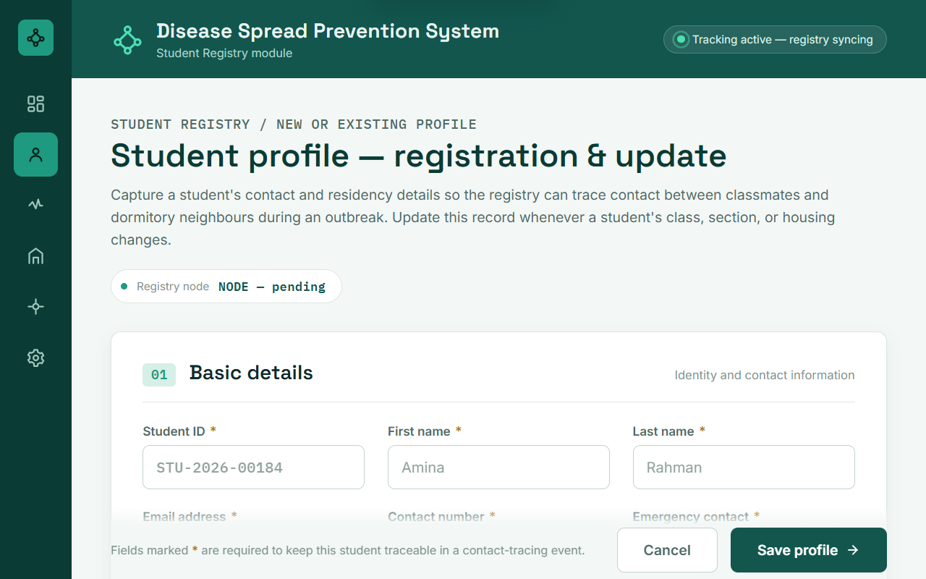
Prototype: Student Profile Registration
01.
02.
03.
Dynamic UI Controls
Regex Validation
Error Recovery
Selecting 'Resident' dynamically reveals Dorm Building & Room fields; 'Non-Resident' hides them.
Enforces institutional email format (@iut-dhaka.edu) and phone formatting at point of capture.
Form auto-shakes and focuses the first invalid field upon failed submission.
Notes:
PRESENTER: Ashique Khan (230041153)
TIME: 5:10 - 5:45 (35s)
TALKING POINTS:
- Thank you, Abrar. In Lab 12, our team implemented 4 working interactive prototypes.
- Screen 1 handles Student Registration. It dynamically displays dormitory and room fields only when 'Resident' is toggled, and enforces sub-second regex validation on student email and contact information.

Slide 12



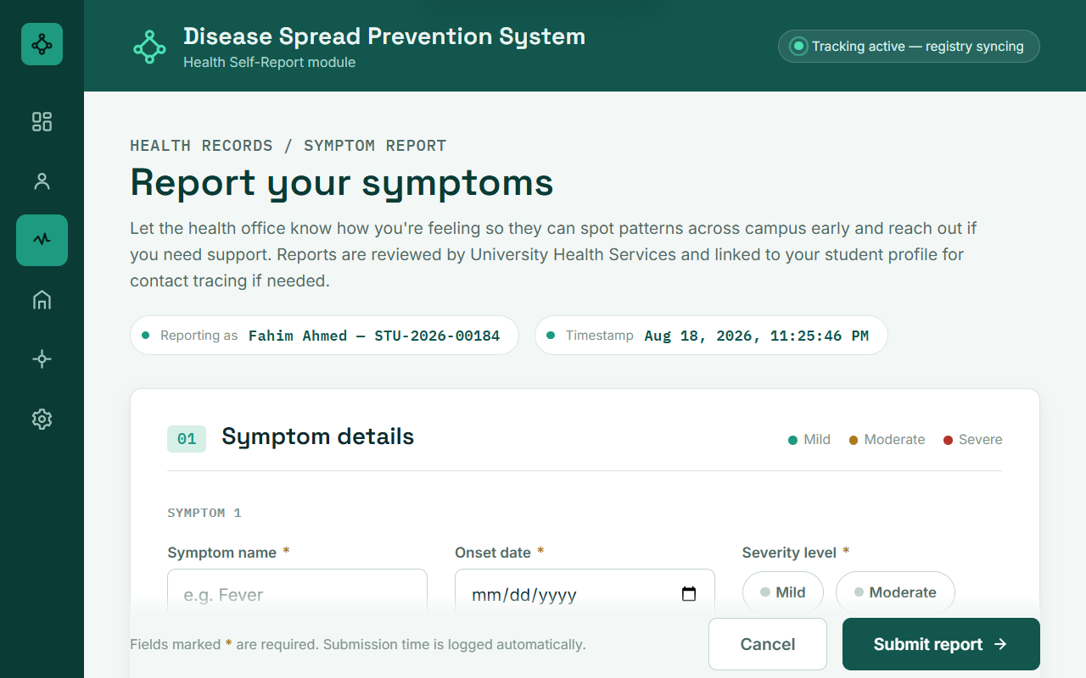



Prototype: External Symptom Submission
Severity Slider
Symptom Chips
1-10 pain/severity slider allowing students to rate illness dynamically.
Multi-select chips (Fever, Cough, Rash, Fatigue) for standardized clinical taxonomy.
Dropzone Upload
Instant Token
Drag-and-drop uploader for PDF/JPG medical slips (<5MB) with mandatory upload on severe cases.
Immediate submission tracking token generated upon successful symptom ingest.
Notes:
PRESENTER: Ashique Khan (230041153)
TIME: 5:45 - 6:20 (35s)
TALKING POINTS:
- Screen 2 is our External Symptom Submission form. It features multi-select symptom chips, a 1-10 severity slider, and a drag-and-drop file uploader that dynamically becomes mandatory when symptoms are marked severe.

Slide 13
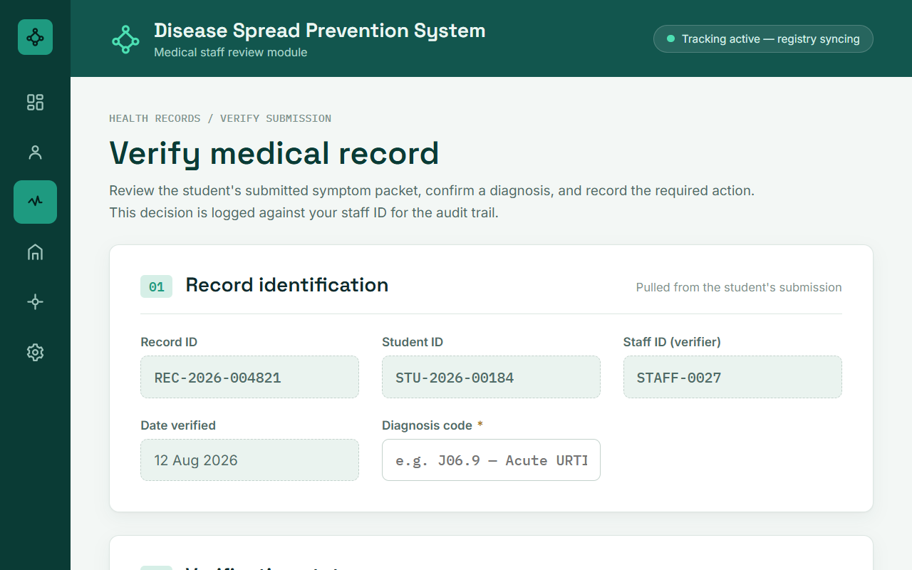
Prototype: Medical Record Verification
Doctor Triage Efficiency: Reduces verification time from 10 minutes of manual paperwork to under 60 seconds.
Put more emphasis on their health and
Ensure the safety of all students in the campus
01.
02.
03.
Dual-Pane Triage: Left pane lists pending student cases; right pane displays prescription viewer and student history.
Decision Triggers: One-click actions for 'Approve & Grant Leave', 'Needs Info', or 'Reject' with mandatory notes.
Audit Logging: Verified decisions are permanently sealed into D2 with physician digital signature and timestamps.
Notes:
PRESENTER: Ashique Khan (230041153)
TIME: 6:20 - 6:55 (35s)
TALKING POINTS:
- Screen 3 provides medical officers with a dual-pane verification workspace.
- Doctors can inspect unverified student prescription slips side-by-side with historical medical logs, and authorize sick leave with digital audit logging in under 60 seconds.

Slide 14
Thank You For Being With Us
Feel Free to Ask Any Questions
Notes:
PRESENTER: Ahmed Samin Yasar & Team
TIME: 7:30 - 8:00 (30s + Q&A)
TALKING POINTS:
- That concludes our final project presentation for CSE 4408.
- We have systematically fulfilled all SDA lifecycle requirements across Labs 5 through 12.
- Our entire team is now ready to answer any questions from the faculty panel. Thank you!

