Slide 1
Arrays
Array is a collection of variables belonging to the same data type.
You can store group of data of same data type in an array.
Array might be belonging to any of the data types Array size must be a constant value.
Always, Contiguous (adjacent) memory locations are used to store array elements in memory.

Slide 2
Example for C Arrays:
int a[10]; // integer array
char b[10]; // character array i.e. string
Types of C arrays:
There are 2 types of C arrays. They are,
One dimensional array
Multi dimensional array
Two dimensional array
Three dimensional array, four dimensional array etc.
1. One dimensional array in C:
Syntax : data-type arr_name[array_size];

Slide 3
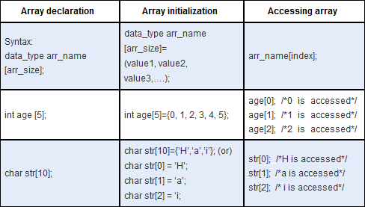

Slide 4
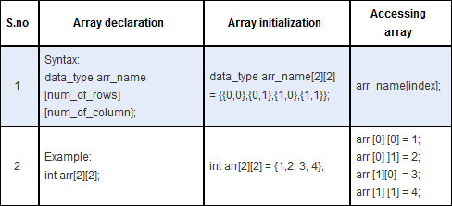
Two dimensional array in C:
Two dimensional array is nothing but array of array.
syntax : data_type array_name[num_of_rows][num_of_column]

Slide 5
// declare the array like any other variable before using it.
// When we declare an array in C, the compiler allocates the memory block of the specified size to the array name.
// The C arrays are static in nature, i.e., they are allocated memory at the compile time.
#define SIZE 5
int main( )
{
int size=15;
float sal[SIZE] ; /*Valid*/
int marks[size] ; / *Not valid*/
}

Slide 6
Array Initialization
#include <stdio.h>
int main()
{
// array initialization using initialier list
int arr[5] = { 10, 20, 30, 40, 50 };
int arr1[5] = { 10, 20};
int arr1[5] = { 0};
// array initialization using initializer list without
// specifying size
int arr1[] = { 1, 2, 3, 4, 5 };
// array initialization using for loop
int arr2[5];
for (int i = 0; i < 5; i++) {
arr2[i] = i;
}
return 0;
}

Slide 7
Access Array Elements
#include <stdio.h>
int main()
{
// array declaration and initialization
int arr[5] = { 15, 25, 35, 45, 55 };
// accessing element at index 0 i.e 1st element
printf("Element at arr[0]: %d\n", arr[0]);
// accessing element at index 4 i.e last element
printf("Element at arr[4]: %d\n", arr[4]);
// accessing element at index 2 i.e third element
printf("Element at arr[2]: %d", arr[2]);
return 0;
}

Slide 8
Traversing Array:
#include <stdio.h>
int main()
{
// array declaration and initialization
int arr[5] = { 10, 20, 30, 40, 50 };
// modifying element at index 2
arr[2] = 100;
// traversing array using for loop
printf("Elements in Array: ");
for (int i = 0; i < 5; i++) {
printf("%d ", arr[i]);
}
return 0;
}

Slide 9
Taking inputs into an Array:
#include <stdio.h>
int main()
{
// declaring an integer array
int arr[5];
// taking input to array elements one by one
for (int i = 0; i < 5; i++) {
scanf("%d", &arr[i]);
}
// printing array elements
printf("Array Elements: ");
for (int i = 0; i < 5; i++) {
printf("%d ", arr[i]);
}
return 0;
}

Slide 10
int arr[5]={0};
float sal [10] ={1,2,3,4,5};
int i=0;
scanf("%d",&arr[i]); /*input value into arr[i]*/
printf("%f",sal[3]); /*print value of sal[3]*/
arr[4]=25; /*assign a value to arr[4] */
// Int y = arr[4]++; /*Increment the value of arr[4] by
arr[4]++
sal[5]+=200; /*Add 200 to sal[5]*/
sum=arr[0]+arr[l]+arr[2]+arr[3]+arr[4]; /*Add all the values of arr[5]*/
i=2;
scanf("%f",&sal[i]) ; /*input val into sal[2]*/
printf("%f",sal[i++]);
/* print value of sal[2] and the increment the value of i

Slide 11
Suppose arr[10] is an array of int type-
(i) Reading values in arr[10]
for (int i = 0; i < 10; i++)
scanf("%d", &arr[i]);
(ii) Displaying values of arr[ 10]
for (int i = 0; i < 10; i++)
printf(%d ", arr[i]);
(iii) Adding all the elements of arr[ 10]
int sum = 0;
for(int i = 0; i < 10; i++)
sum=sum+arr[i];

Slide 12
Advantages of Array in C
Random and fast access of elements using the array index.
Use of fewer lines of code as it creates a single array of multiple elements.
Traversal through the array becomes easy using a single loop.
Disadvantages of Array in C
Allows a fixed number of elements to be entered which is decided at the time of declaration. Unlike a linked list, an array in C is not dynamic. It is static.
Insertion and deletion of elements can be costly since the elements are needed to be rearranged after insertion and deletion.

Slide 13
Passing array into a function:
#include<stdio.h>
void func(int val[]);
int main(void)
{
int i,arr[6]={1,2,3,4,5,6};
func(arr);
printf("Contents of array are : ");
for(i=0; i<6; i++)
printf("%d ",arr[i]);
printf("\n");
return 0;
}
void func(int val[])
{
int sum=0,i;
for(i=0; i<6; i++)
{
val[i]=val[i]*val[i];
sum=sum+val[i];
}
printf("Sum of squares=%d\n",sum);
}

Slide 14
Passing array into a function of different sizes:
#include<stdio.h>
int add(int arr[],int n);
int main(void)
{
int a[5]={2,4,6,8,10};
int b[8]={1,3,5,7,9,11,13,15};
int c[10]={1,2,3,4,5,6,7,8,9,10};
printf("Sum of elements of array a : %d\n",add(a,5));
printf("Sum of elements of array b : %d\n",add(b,8));
printf("Sum of elements of array c : %d\n",add(c,10));
return 0;
}
int add(int arr[],int n)
{
int i,sum=0;
for(i=0; i<n; i++)
sum+=arr[i];
return sum;
}

Slide 15
Relationship Between Pointers and Arrays
Element b[3]
Value can be accessed by *(b+3) , Address by (b+3)
Called pointer notation
Can be accessed by b[3] , Address by &b[3]
called subscript notation

Slide 16
Pointers and 1-D arrays
#include<stdio.h>
int main(void)
{
int arr[5]={5,10,15,20,25};
int i;
for(i=0; i<5; i++)
{
printf("Value of arr[%d] = %d\t",i,*(arr+i));
printf("Address of arr[%d] = %p\n",i,arr+i);
}
return 0;
}

Slide 17
Access array elements via a pointer variable:
#include<stdio.h>
int main(void)
{
int arr[5]={5,10,15,20,25};
int i,*p;
p=arr;
for(i=0; i<5; i++)
{
printf("Address of arr[%d]= %p %p \n",i,(p+i), &p[i]);
printf("Value of arr[%d]= %d %d \n",i,*(p+i),p[i]);
}
return 0;
}

Slide 18
2-D Array
#define ROW 3
#define COL 4
#include<stdio.h>
int main(void)
{
int mat[ROW][COL],i,j;
printf("Enter the elements of the matrix(%d x %d) row-wise :\n",ROW,COL);
for(i=0; i<ROW; i++){
for(j=0; j<COL; j++){
scanf("%d", &mat[i][j]);
}
}
printf("The matrix that you have entered is :\n");
for(i=0; i<ROW; i++){
for(j=0; j<COL; j++){
printf("%d\t", mat[i][j]);
}
printf("\n");
}
printf("\n");
return 0;
}

