Slide 1
Strings
C Strings are nothing but array of characters ended with null character (‘\0’).
This null character indicates the end of the string. Strings are always enclosed by double quotes. Whereas, character is enclosed by single quotes in C.
Example for C string:
char string [] = “Welcome”;
Null character (‘\0’) used to indicate the termination of a string that differs strings from normal character arrays.

Slide 2
C String Initialization
char str[] = "VLSI";
char str[10] = "vlsi";
char str[10] = { 'v','l','s,'i','\0’};
char str[] = { 'v','l','s,'i','\0'};

Slide 3
// C program to illustrate strings
#include <stdio.h>
#include <string.h>
int main() {
// declare and initialize string
char str[] = "VLSI";
// print string
printf("%s\n", str);
int len1 = 0;
len1 = strlen(str); // length of string
printf("Length of string str is %d", len1); // 4
int len2 = 0;
len2 = sizeof(str); // length of string
printf("sizeof(str) = is %d", len2); // 5
return 0; }

Slide 4
Read a String Input From the User
// C program to read string from user #include<stdio.h> int main() { // declaring string char str[50]; // reading string scanf("%s",str); // print string printf("%s",str); return 0; }

Slide 5
How to Read a String Separated by Whitespaces in C?
We can use the fgets() function to read a line of string and gets() to read characters from the standard input (stdin) and store them as a C string until a newline character
// C program to illustrate // fgets() #include <stdio.h> #define MAX 50 int main() { char str[MAX]; // MAX Size if 50 defined fgets(str, MAX, stdin);
// gets(str); // do not use gets as gets does not check the size of the string printf("String is: \n"); // Displaying Strings using Puts puts(str); return 0; }

Slide 6
String functions in #include<string.h>
Function Name | Description
strlen(si) | Returns the length of string s1.
strcpy(s1, s2) | Copies the contents of string s2 to string s1.
strcmp(str1, str2) | Compares the first string with the second string. If strings are the same it returns 0.
strcat(s1, s2) | Concatenates s1 string with s2 string and the result is stored in the first string.

Slide 7
How to access the elements of a string in C
For loop:
#include <stdio.h> #include <string.h> int main() { char str[] = "Hello World"; int len = strlen(str); // 11 for (int i = 0; i < len; i++) { printf("%c\n", str[i]); } return 0; }

Slide 8
How to access the elements of a string in C
While Loop
#include <stdio.h> #include <string.h> int main() { char str[] = "Hello World"; int len = strlen(str); int i = 0; while (i < len) { printf("%c\n", str[i]); i++; } return 0; }

Slide 9
strlen() function
strlen( ) function in C gives the length of the given string. Syntax:
size_t strlen ( const char * str );
strlen( ) function counts the number of characters in a given string and returns the integer value.
It stops counting the character when null character is found. Because, null character indicates the end of the string in C.

Slide 10
#include <stdio.h>
#include <string.h>
int main()
{
char a[20]=“VLSI";
char b[20]={‘V',’L',’S',’I','\0'};
printf("Length of string a = %d \n",strlen(a)); // 4
printf("Length of string b = %d \n",strlen(b)); // 4
return 0;
}

Slide 11
strcpy() function
strcpy( ) function copies contents of one string into another string. Syntax:
char * strcpy ( char * destination, const char * source ); Example:
strcpy ( str1, str2) – It copies contents of str2 into str1. strcpy ( str2, str1) – It copies contents of str1 into str2.
If destination string length is less than source string, entire source string
value cannot be copied into destination string.
For example, consider destination string length is 20 and source string length is 30. Then, only 20 characters from source string will be copied into destination string and remaining 10 characters won’t be copied and will be truncated.

Slide 12
#include <stdio.h>
#include <string.h>
int main() {
char str1[20] = “PG-DVLSIMARCH2024";
char str2[20];
// copying str1 to str2
strcpy(str2, str1);
puts(str2); // PG-DVLSIMARCH2024
return 0;
}

Slide 13
strcmp() function
strcmp() function compares two given strings and
- returns zero if they are same.
- If length of string1 < string2, it returns < 0 value.
- If length of string1 > string2, it returns > 0 value.
Syntax:
int strcmp ( const char * str1, const char * str2 );
strcmp( ) function is case sensitive. i.e, “A” and “a” are treated as different characters.

Slide 14
#include <stdio.h>
#include <string.h>
int main() {
char str1[] = "abcd", str2[] = "abCde", str3[] = "abcd";
int result;
// comparing strings str1 and str2
result = strcmp(str1, str2);
printf("strcmp(str1, str2) = %d\n", result);
// comparing strings str1 and str3
result = strcmp(str1, str3);
printf("strcmp(str1, str3) = %d\n", result);
return 0;
}

Slide 15
Find the Frequency of a Character in a string
#include <stdio.h> int main() { char str[100], ch; int count = 0; printf("Enter a string: "); fgets(str, 100, stdin); printf("Enter a character to find its frequency: "); scanf("%c", &ch); int len = strlen(str); printf("String length of str = %d\n", len); for (int i = 0; i<len; ++i) { if (ch == str[i]) ++count; } printf("Frequency of %c = %d", ch, count); return 0; }

Slide 16
strcat() function
strcat( ) function concatenates two given strings. It Syntax : char * strcat ( char * destination, const char * source ); Example :
strcat ( str2, str1 ); - str1 is concatenated at the end of str2. strcat ( str1, str2 ); - str2 is concatenated at the end of str1.
Each string is ended up with null character (‘\0′).
In strcat( ) operation, null character of destination string is overwritten by source string’s first character and null character is added at the end of new destination string which is created after strcat( ) operation. concatenates source string at the end of destination string.

Slide 17
strcat()
#include <stdio.h>
#include <string.h>
int main() {
char str1[100] = “PG-DVLSI", str2[] = “MARCH2024";
// concatenates str1 and str2
// the resultant string is stored in str1.
strcat(str1, str2);
puts(str1);
puts(str2);
return 0;
}

Slide 18
Difference between sizeof() and strlen on strings
Note that the sizeof() operator would return size of array. To get size of string stored in array, we need to use strlen().
#include<stdio.h> int main() { char str[20] = “VLSI"; printf ("%d", sizeof(str)); // 20 return 0; } | #include <stdio.h> #include <string.h> int main() { char str[20] = “PG-DVLSI"; printf ("%d", strlen(str)); // 8 return 0; }

Slide 19
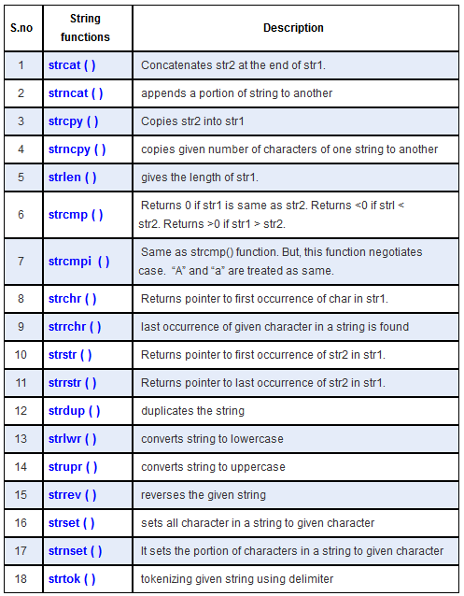
C string functions
String.h header file supports all the string functions in C language. All the string functions are given below.

