Slide 1
CARZAM
EDNA ML STRUCTURED PROJECT
CS6235- Real-time Systems
BY
Abrar Ahmed Mohammed
MS CS

Slide 2
Vehicle Classification
Identification of vehicles based on features such as model, color, type, etc
The idea is to build a model that classifies a car’s make and model given an image
With increasing monitoring systems, use cases like traffic surveillance, theft identification, smart marketing, and automated highway toll collection are interesting applications of vehicle classification
Convolutional Neural Networks aid in solving the classification problem with good accuracy

Slide 3
OVERVIEW
The problem statement is, given the labelled data, classify the datapoints based on the similarity of the features
This project does the image classification for vehicles based on features like brand, type, and colour
The vehicle image dataset is a large-scale data, it requires organizing and baselines of the dimensions of the dataset
EdnaML is a framework used for this task and it implements Residual-Net (ResNet) for the task of both single-branch and multi-branch classification

Slide 4
RESNET
CNN-based architectures suffered from vanishing gradient problem, therefore Resnet was proposed to solve the problem by introducing ‘Skip connections’ in its architecture
The skip connection connects activations of a layer to further layers by skipping some layers in between. This forms a residual block. Resnets are made by stacking these residual blocks together
The advantage of adding skip connection is that if any layer hurt the performance of architecture then it will be skipped by regularization

Slide 5
EdnaML
Machine/Deep learning workflows are difficult to manage, configure, and reproduce manually
EdnaML is a framework we use for running experiments and tracking results that gives us more control on the workflow
EdnaML defines 2 pipeline abstractions:
Experiment Execution: Here, an ML model is trained on some training data, and evaluated on some corresponding test data. We perform experiment executions with ednaml.core.EdnaML
Model Deployment: Here, a trained ML model is used for some predefined task, such as unseen data labeling, supervision, or as a hosted service. We perform deployments with ednaml.core.EdnaDeploy

Slide 6
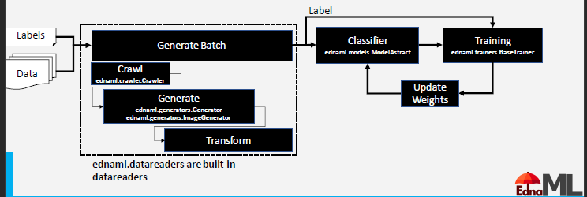
PROPOSED WORK PIPELINE
The pipeline is categorized into two parts i.e., Data and ML.
In the data section of the pipeline, we implemented a crawler that generates a list of data, a generator that generates batches of data, and a Transform to augment or transform images.
Then a classifier is implemented to obtain predictions for the individual batch.
Fig.1 CarZam Pipeline

Slide 7
Then, these predictions are compared to the ground truth and performance metrics such as accuracy and F1 score have been computed
The work has been formalized in the EDNA ML and helps us to easily track, change and reproduce the experiments. Therefore, it adds more control and structure to the Deep Learning workflow

Slide 8
Crawler
Images in each directory are labeled with their type, year, make, model, and submodel
Naming convention means make and model are combined together
Crawler is implemented which generates a list of tuples which have the structure of [(path,type,color,year,make),…….n]
Crawler has 2 components self.classes is a dictionary with information on classes and values and self.metadata which is a list of tuples data is where each entry is a data point
Then, we built reverse lookup dictionary to convert words to numbers

Slide 9
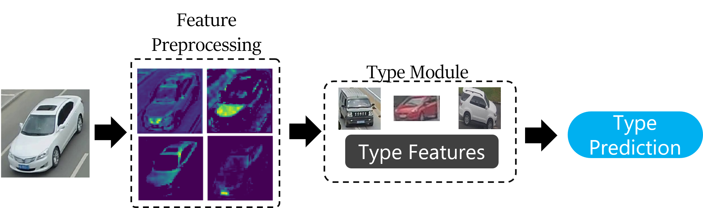
Classifier
We used Classification Generator or MultiClassificationGenerator to process the data from crawler into a format that the ML model can use to transform predictions
Single Class Classification:
The architecture looks like below for label ‘type’

Slide 10
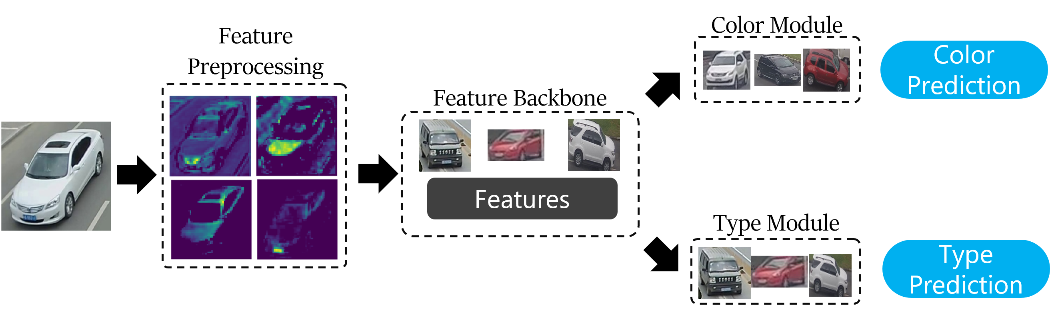
Similarly, Single class classification is applied to Vehicle color and make
Multi class Classifiers:
Multiclass classifiers try to classify multiple things at once, using the same features. Sometimes it works, if the features are co-located or have some overlap.

Slide 11
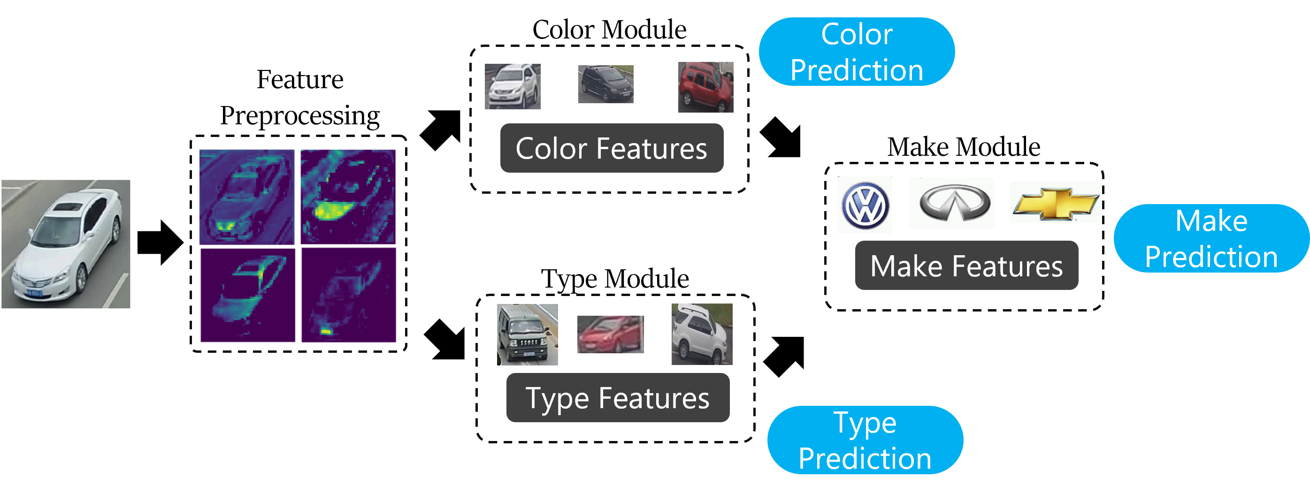
MultiBranch Classification
We tried a model that uses multiple branches, each branch for a specific label, for classification. Then we fused the branches to classify one more things. So total, three classifications from a single model.

Slide 12
Results
 | Type of Exp | Label | Accuracy | Micro F1 score | Weighted F1 score
Single class | Single vehicle type | TYPE | 41.414% | 0.414 | 0.321
 | Single vehicle color | COLOR | 76.768% | 0.768 | 0.727
 | Single vehicle make | MAKE | 53.030% | 0.530 | 0.477
Multi class | Multi-class Color-Type | Color | 74.2% | 0.742 | 0.701
 |  | Type | 31.3% | 0.313 | 0.259
 | Multiclass Color-Type-Make | Color | 72.2% | 0.722 | 0.675
 |  | Type | 36.9% | 0.369 | 0.328
 |  | Make | 21.7% | 0.317 | 0.223
Multi Branch | Color+type->Make | Color-fc | 70.7% | 0.707 | 0.650

Slide 13
 | Type of Exp | Label | Accuracy | Micro F1 score | Weighted F1 score
Multi Branch | Color+type->Make | Type-fc | 37.9% | 0.379 | 0.295
 |  | Fuse | 23.2% | 0.232 | 0.192
 |  | Color-branch | 10.6% | 0.106 | 0.065
 |  | Type-branch | 15.2% | 0.152 | 0.120

Slide 14
Thank You!

Slide 15
DELIVEREBLES
Vehicle Data loading and Pre-processing
Design & Implementation of ML Classifier using ResNet
Metric collection and reproducing the work.
Minimize error in classification when compared to ground-truth images
Presentation
Final Report

Slide 16
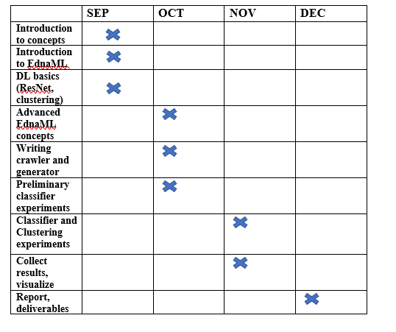
WORKPLAN

Slide 17
References
https://github.com/asuprem/GLAMOR/tree/suprem-devel-edeploy-merge

