Slide 1

About me!

Slide 2
What do I do?
Why is it important?

Slide 3

Data
Data is primary source of research
Storing and retrieving data is a painful task due to the size of it
However, when we learn about the characteristics of data file, it could be much easier to reduce the size of data

Slide 4

Data Compression
Lossy Compression: Lossy compression involves compressing data in a way that some of the information is permanently discarded. This results in a reduction in file size but also a loss of some details in the data. Examples: DCT in JPEG, MPEG
Lossless Compression: Lossless compression involves compressing data in a way that allows the original data to be perfectly reconstructed from the compressed data. Examples: Arithmetic Coding, Lempel-Ziv etc.

Slide 5

Dictionary-based Compression
Static Dictionary-
Dictionary is predefined and remains constant throughout the compression and decompression processes.
The dictionary is created based on patterns or recurring sequences found in the data.
Dynamic Dictionary-
Dictionary is built and updated dynamically as the compression progresses. It adapts to the specific patterns encountered in the data. Example: Adaptive Huffman coding

Slide 6
Limitations:
Memory Usage: Traditional dictionary-based compression algorithms may require substantial memory to store the dictionary, especially for larger datasets.
Compression Speed: Traditional dictionary-based algorithms may sacrifice compression speed for better ratios, which can be a limitation in applications where speed is crucial.
Fine-Tuning: Most of them lack fine-tuning such as support of compression levels, multi-threading

Slide 7

Z-standard (open source)
Z-standard was created to address the need for a compression algorithm that strikes a good balance between compression ratio, speed, and ease of use across various applications.
Features:
High compression ratios
Adaptive compression
Fast compression and decompression
Memory efficient
Supports Fine-tuning

Slide 8
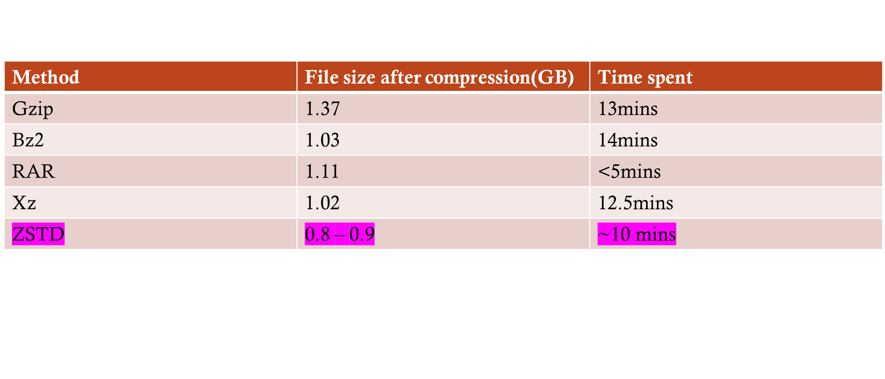
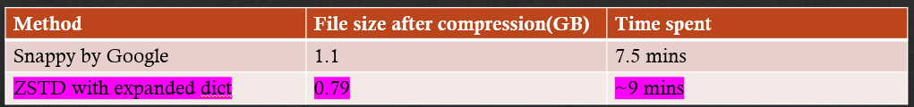
Performance of Compression Algorithms
TEST DATA SIZE – 1.49 GB

Slide 9

Future Work
Explore Machine Learning Algorithms such as PCA, Encoders for efficient compression
Use Big-data systems to bring down the compression times
Provide a seamless data retrieval platform/strategy

Slide 10

Q&A
Thank you!

