Slide 1

Project NLP | Business Case: Automated Customer Reviews
Abrar Alanazi

Slide 2
Project Overview
Goal:develop a product review system powered by NLP models that aggregate customer feedback from different sources.
Dataset:Primary Dataset: Amazon Product Reviews

Slide 3
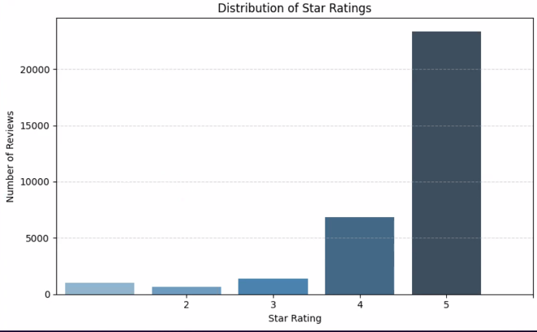
Number of reviews

Slide 4
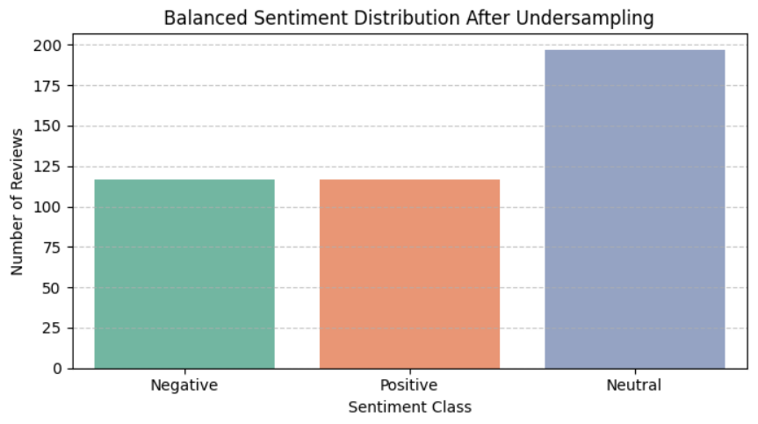
Balanced Sentiment Distribution After Undersampling

Slide 5
Task 1 – Sentiment Classification
Objective: Classify customer reviews into positive, negative, or neutral categories
Map star ratings to sentiment classes:
1–2 → Negative
3 → Neutral
4–5 → Positive

Slide 6
Model Building BERT Model
Why Chose BERT
BERT (Bidirectional Encoder Representations from Transformers) is a state-of-the-art model for understanding natural language.
It captures context in both directions (left and right), making it powerful for sentiment classification.
Pretrained on massive datasets, so it generalizes well with less training.

Slide 7
Model Performance
Accuracy: 0.9430

Slide 8
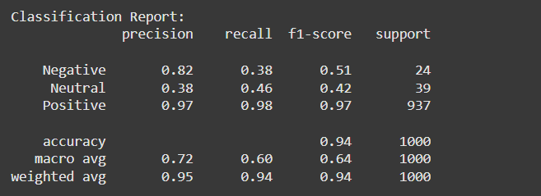
Classification Report

Slide 9
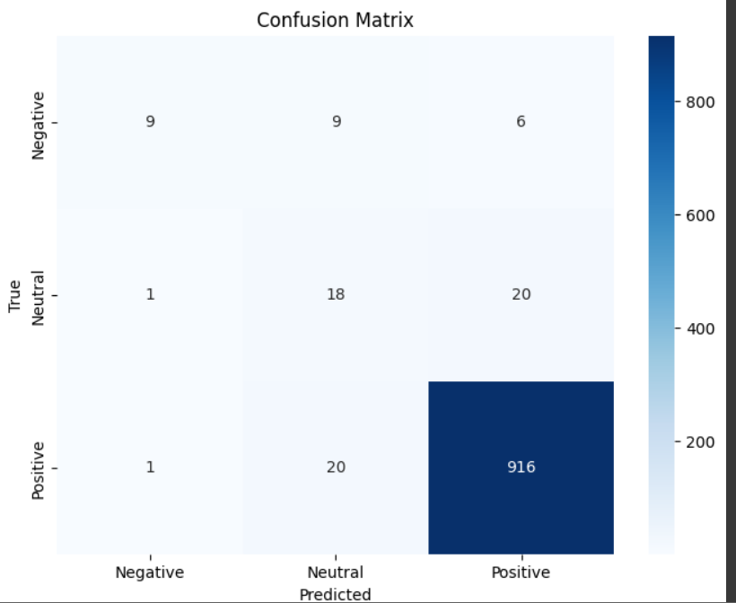
Confusion Matrix

Slide 10
Task 2 – Product Category Clustering
Group
Objective: Group products into 4–6 broader meta-categories
Extract
Extract category names from dataset
Generate
Generate embeddings using Sentence-BERT
Apply
Apply K-Means clustering (k = 4 )
Assign
Assign semantic labels to clusters:
e.g., Ebook Readers, Batteries, Accessories, etc.

Slide 11
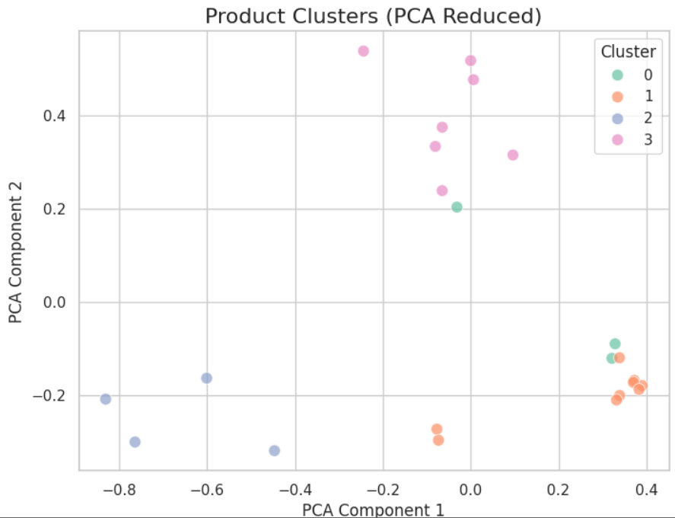
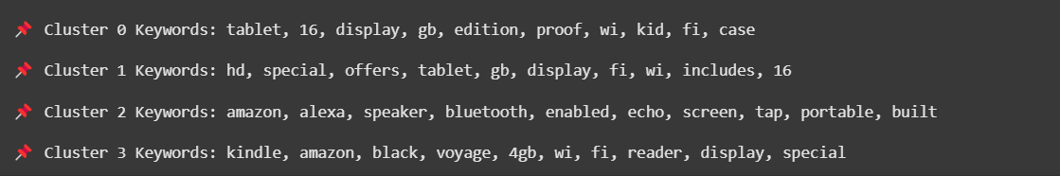
Product Category Clustering

Slide 12
Task 3 – Review Summarization
Objective: Generate short recommendation articles for each meta-category Includes:
Top 3 recommended products + key differences
Common complaints per product
Worst product and why to avoid it
Model Used: Pre-trained generative models (T5)

Slide 13
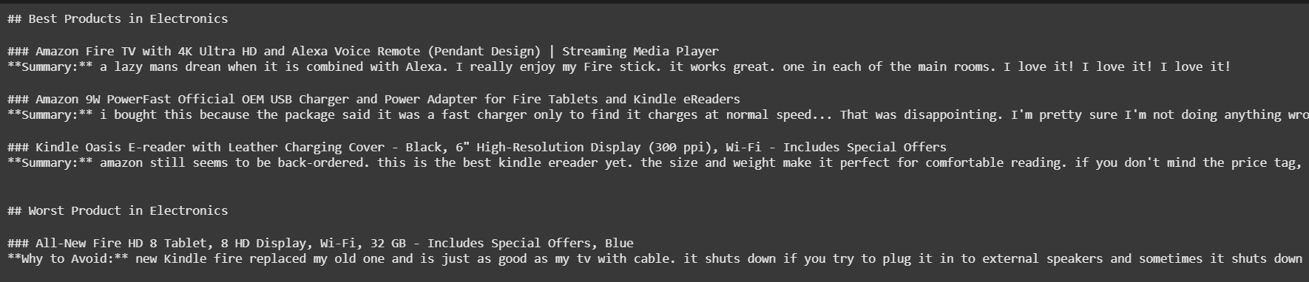
Review Summarization

Slide 14
Deployed Model:
Streamlit app for Task 1: Review Sentiment Classification using fine-tuned BERT model.

Slide 15
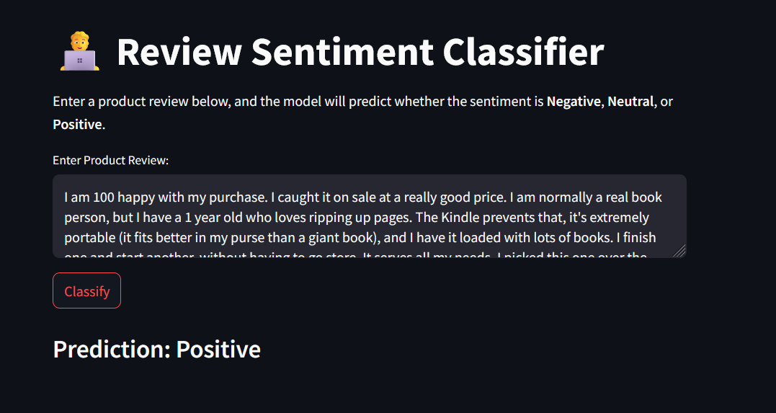
🟢 Positive

Slide 16
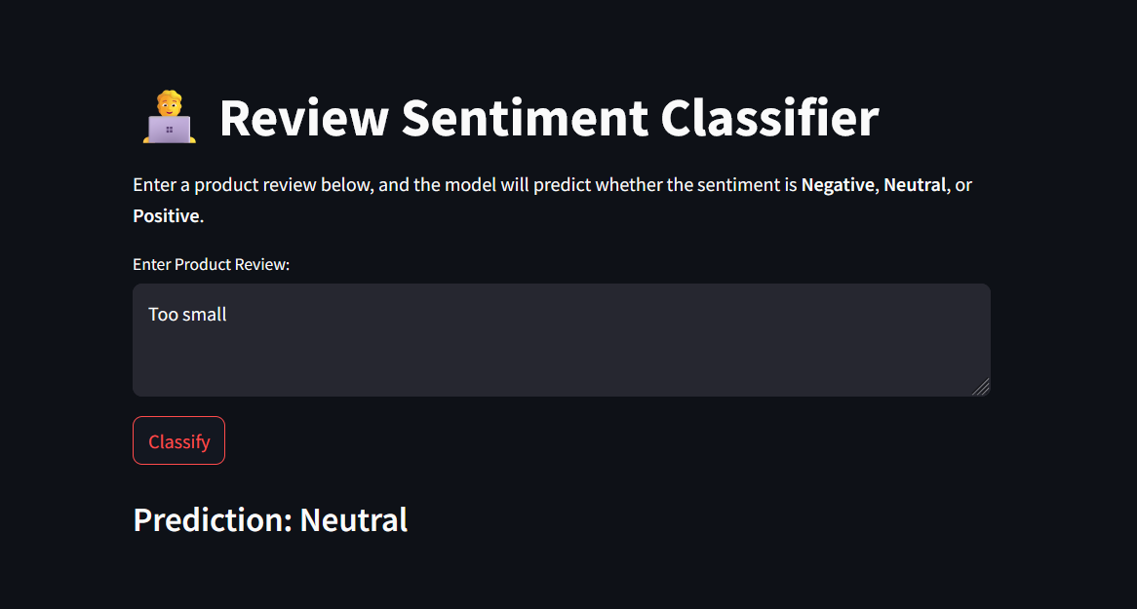
🟡 Neutral

Slide 17
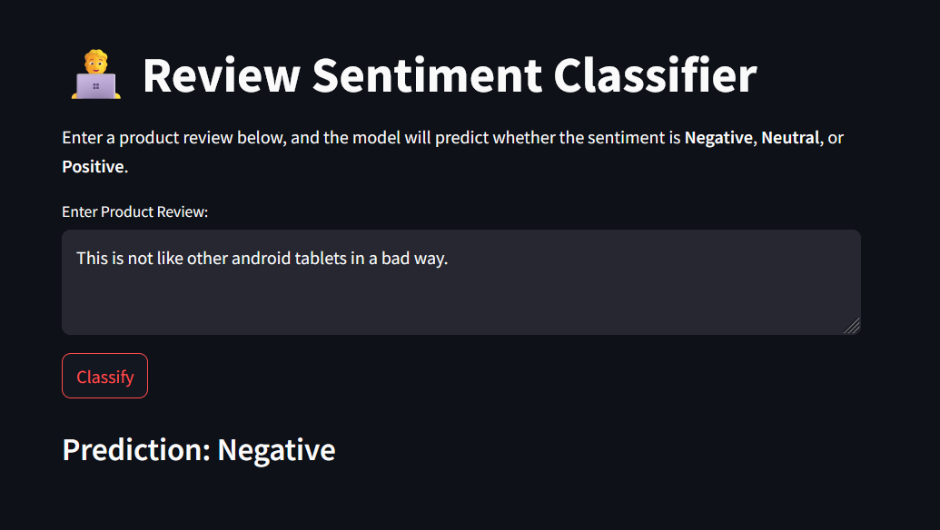
🔴Negative

Slide 18

Thank you for listening

