Slide 1
Muzapp
An NFT marketplace for musical artwork
Abrar Ul Abdin (CS191007) Poorab Gangwani (CS191092)

Slide 2
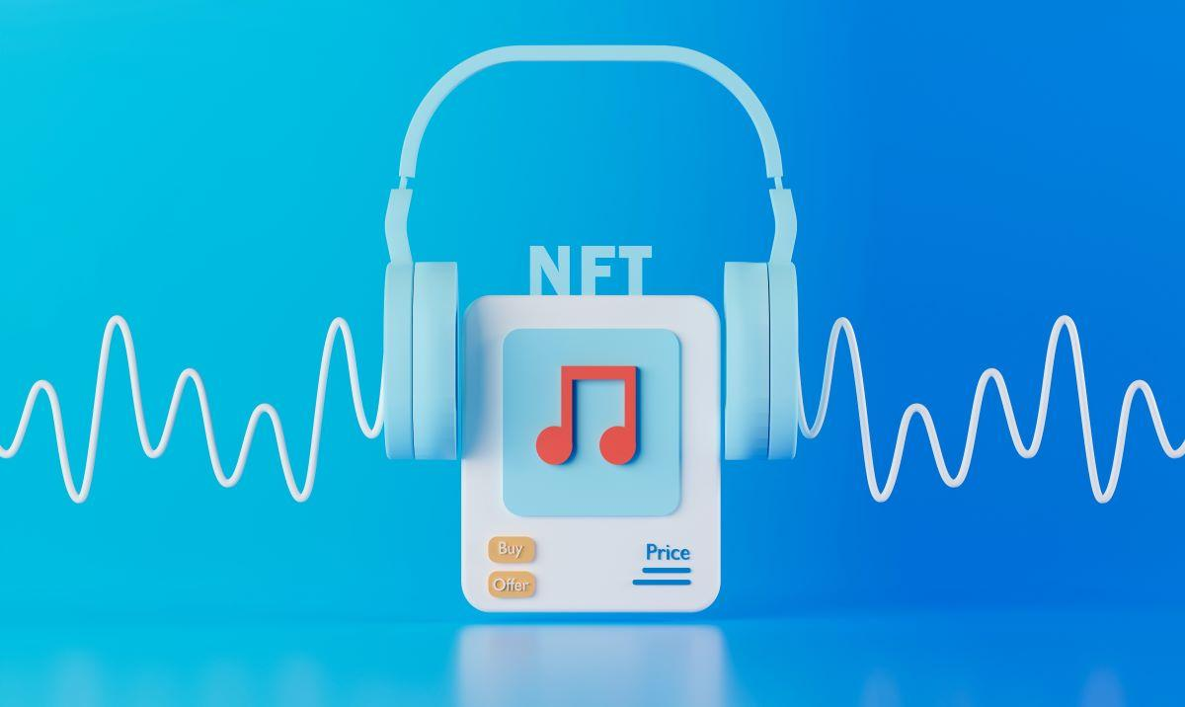
Introduction
A revolutionary NFT marketplace for musical creativity, MUZAPP is a decentralized application (DApp) which offers a platform where musicians and music collectors may display, market, and exchange their non-fungible tokens (NFTs) created from digital music. MUZAPP offers transparent ownership, copyright protection, and safe transactions throughout the music community by utilizing block chain technology.

Slide 3

Objective
To design and develop a musical NFT marketplace where musical artists can publish, promote, monetize and control their musical work independently without having to depend on 3rd party intermediaries like music companies of streaming services

Slide 4
Problem Description
Growing need for a dedicated marketplace that caters to the unique requirements of musicians, artists, and collectors
Musicians being subject to unfair deals in real life including lack of creative control and copyright over their work
Musicians being allocated a small fraction of the money generated by their music from music industries.

Slide 5
Methodology
leveraging permission less public Block Chain technology to ensure transparent ownership, secure transactions, and copyright protection for minted music NFTs
Allowing minting of music NFTs by individuals at low cost and affording full ownership and copyright
facilitating musicians with different options for strong remuneration which includes auctioning, fixed price sales, pay-per-use etc.

Slide 6
Project Scope
Wallet-based registration
Music Mint module
Profile module
Past transactions module
Rented module
Your Collection module

Slide 7
Project Scope
NFT Auction module
Fixed Price Sale form
Pay-Per-Use form
Offer Solicitation module
NFT Offers module

Slide 8
Feasibility Study
Team-based risks
Risk | Mitigation strategy
Team member falls ill or becomes indisposed, possibly resulting in unaffordable delays in their work | approach and assign (in advance) colleagues who have been kept well informed of the project and also possess necessary block chain expertise as backups to help in performance of tasks that were to be performed by the indisposed team members. Also maintain ample buffer time for tasks to make sure unexpected delays do not inflict much damage on the schedule
Misinterpretation among team members, causing abortive results in development, design or research | Daily meetings among team members and review of progress in order to speedily detect faulty execution of In-Progress tasks and remedy them. Also upload tasks on JIRA software for team members with helpful links attached to help guide in the right direction

Slide 9
Feasibility Study
Team-based risks
Risk | Mitigation Strategy
Lack of sufficient comprehension of the concepts utilized for the development and completion of the project | accommodation of relevant articles, video tutorials and consultation from supervisor at different points in the project to help in effective grasping of concepts currently utilized in present tasks.

Slide 10
Feasibility Study
Security Risks
Risk | Mitigation Strategy
Users may try to sell NFTs not owned by them and defraud unaware customers | NFT owners will be issued certificates of ownership, allowing them to validate their status as true owners to customers during transactions. Moreover, block chain explorers can be utilized to cross-check NFTs, their transactions and their ownership
Users try to mint musical NFTs which already exist | Minted NFTs are assigned unique hash codes, which will be used to prevent it’s replication or copying
Possible bugs in smart contract allowing black hat hackers to perform malicious activities like key theft | utilization of ganache platform to test and debug smart contract in different ways including penetration testing before official deployment of smart contracts

Slide 11
Feasibility Study
Performance Risks
Market Risks
Risk | Mitigation Strategy
strong latency in transactions processing and completion | Use of polygon-based chains to improve and increase speed of transactions along with better user experience
Risk | Mitigation Strategy
The success of MUZAPP depends on the acceptance and adoption of music NFTs within the target market. There is a risk that the demand for music NFTs may not be as high as anticipated. | Market research, user feedback, and continuous adaptation to market trends can help mitigate this risk.

Slide 12
Feasibility Study
Resource Requirement
Resource | Purpose
Embark IDE | Platform for Smart contract development, automatic deployment and migration
Ganache | Platform for Smart Contract Testing and Debugging
Metamask Wallet | used for creating transactions to deploy the smart contract and interact with it
EVM | used for interpreting and executing user transactions with the smart contract
Solidity compiler | Used to compile the smart contract code into bytecode for deployment
Solidity programmers | Design, develop, debug and deploy the smart contract

Slide 13
Solution Application Area
The MUZAPP, which has the music business as one of its application domains, does indeed have actual value. With the growth of internet distribution, streaming services, and digital platforms, the music business has experienced considerable changes. The demand for specialized platforms that exclusively serve the interests of musicians, artists, and collectors in terms of presenting, marketing, and exchanging their musical works still exists, though. By offering a specific NFT marketplace for musical artwork, MUZAPP aims to fills this vacuum.

Slide 14
Solution Application Area
Over the years, the music industry has undergone appreciable shifts and changes in their business models and practices which include physical CD distributions, pay-per-views, migration to digital and streaming platforms etc. but there still remains a growing desire among musical artists for the existence of a platform that can extricate them from the unfair business practices existent in the aforementioned models and provide them exclusivity over their music while also serving as a more profitable revenue stream for musicians. MUZZAP aims to satisfy this yearning by affording musicians a DeFi platform where they can, at comparatively low costs, publish their music, promote it, build their fan following and monetize it through models of choice such as pay-per-view, sale etc.
Not just musicians but music enthusiasts and collectors can benefit greatly from the MUZAPP platform as they can have rare and one-of-a-kind music NFTs at their finger tips

Slide 15




Tools/Technology
Front-end
Drizzle
React JS
MUI
Web3 JS

Slide 16
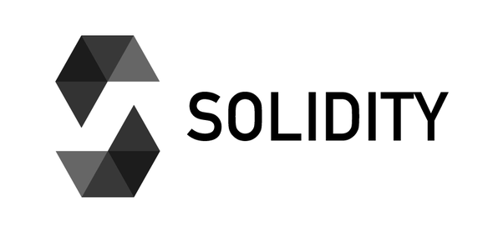



Tools/Technology
Backend
Solidity
Metamask
IDE
Embark
Visual Studio Code

Slide 17

Tools/Technology
Testing
Ganache

Slide 18
Expertise of the Team Members
The MUZAPP team has had formal schooling and theoretically intensive training in block chain and cryptocurrency concepts while also having performed independent research to further strengthen their knowledge and fructify the development process. The team will also function under the supervision of a block chain expert for better direction and performance in an attempt to materialize their vision for MUZAPP into existence

Slide 19
Milestones
Milestone 1
POC Documentation
Determine problem statement and business value
Work out features and scope
List and confirm all the hardware and software utilities
Assign roles and responsibilities
Create business model and canvas
Create work breakdown structure

Slide 20
Milestones
Milestone 2
Establish complete business logic of smart contract
Construct UML diagram
Confirm pseudo code for smart contract functions defined in UML diagram
Supervisor proof-reading and change documentation
Implement changes and improvements
Final approval

Slide 21
Milestones
Milestone 3
Complete GUI Design for Website
Design landing page including MUZAPP’s value proposition
Design Home page
Design Your Collection page displaying user’s collection of NFTs
Design Past Transactions page informing of user’s past NFT purchases and sales
Design Available NFTs page providing filtered lists of fixed price, pay-per-use, auction and open offer NFTs

Slide 22
Milestones
Milestone 3
Complete GUI Design for Website
Design Create NFT form
Design Profile Page
Design Rented NFTs Page
Design form pertaining to fixed sale NFTs for both customer and musical entity
Design form pertaining to NFT auctions for both customer and musical entity
Design form pertaining to NFT offer solicitation for both customer and musical entity
Design form pertaining to pay-per-use NFT for both customer and musical entity

Slide 23
Milestones
Milestone 4
Develop Smart Contract
Create function for minting and adding NFTs to collection
Create function for fixed price sale of an NFT
Create function for pay-per-use settings of an NFT
Create function for pay-per-use purchase of NFT
Create function for NFT auctions
Create function for NFT auction bidding
Create function for open offers sale for NFT
Deploy smart contract to ganache environment
Test and debug smart contract

Slide 24
Milestones
Milestone 5
Develop Front end
UI
Perform MUI setup
Perform web3 JS setup
Meta mask wallet integration
Develop Landing page
Develop Home page
Develop Your collection page along with all the associated forms
Develop Past Transactions page

Slide 25
Milestones
Milestone 5
Develop Front end
UI
Develop Available NFTs page
Develop Create NFT form
Develop Profile Page
Develop Rented NFTs Page

Slide 26
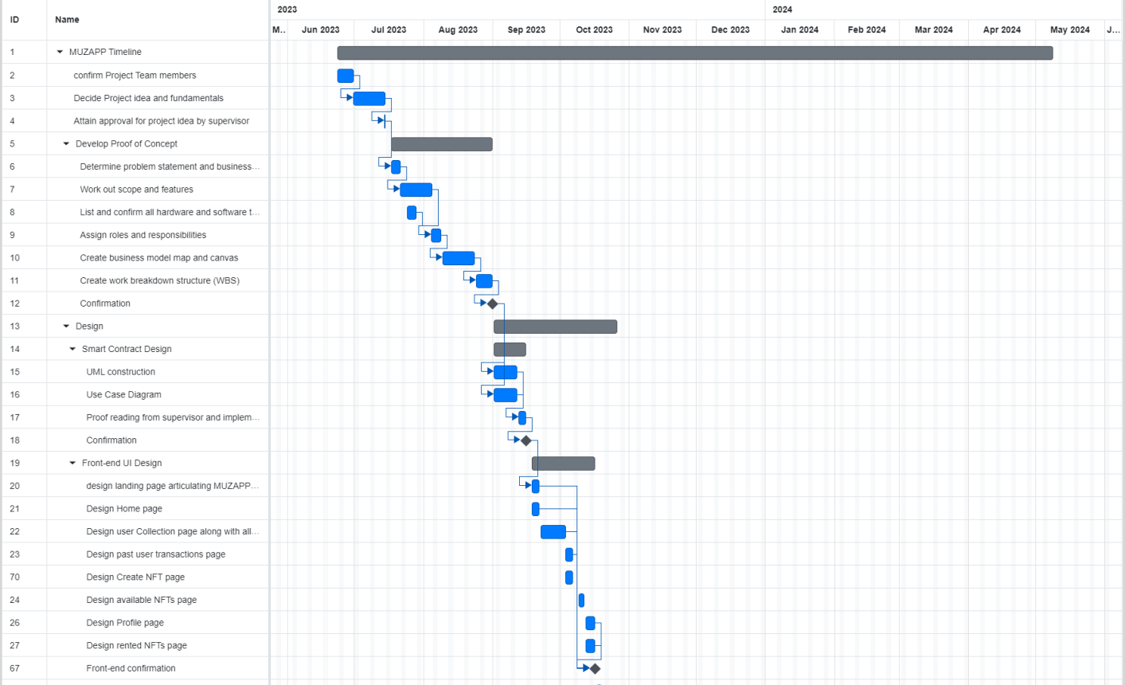
Project Schedule

Slide 27
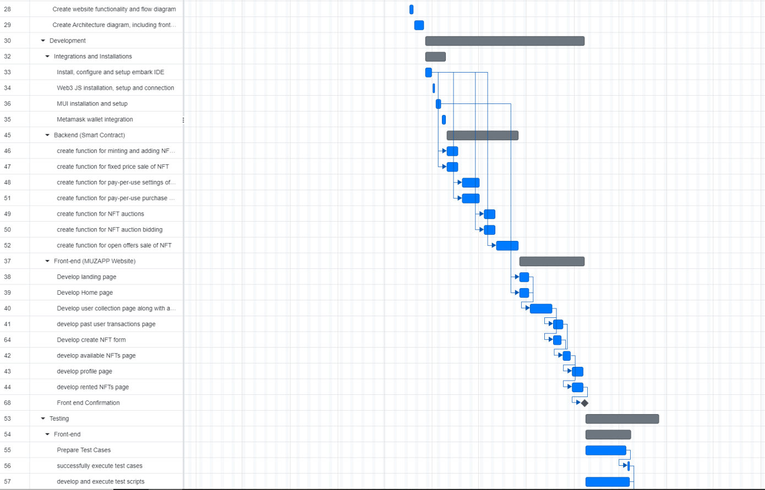
Project Schedule

Slide 28
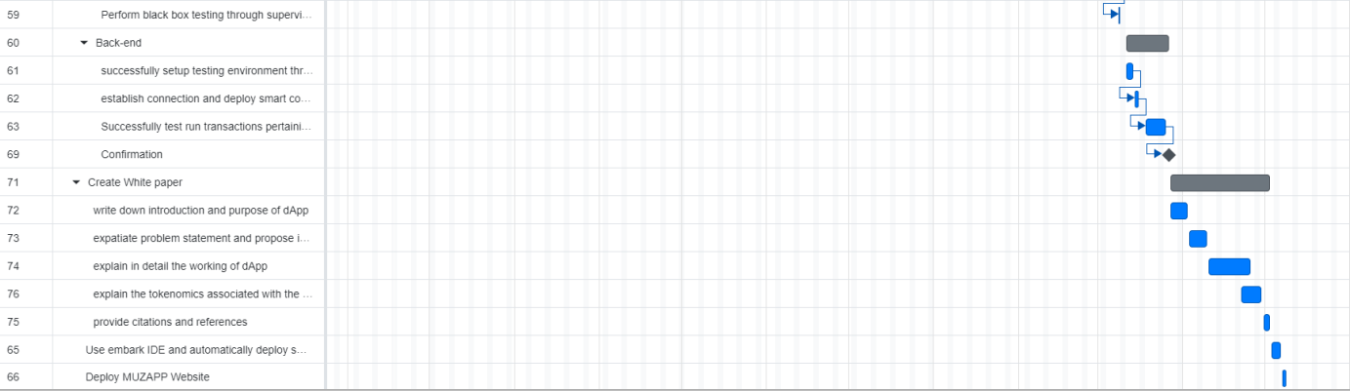
Project Schedule

Slide 29
Work Breakdown Structure
Semester I
Level | WBS | Task Description | Timeline | Notes
1 | 1 | Team and idea formation
2 | 1.1 | Confirm project team members | 23 June 2023 – 30 June 2023
2 | 1.2 | Decide project idea and fundamentals | 30 June 2023 – 14 July 2023
2 | 1.3 | Attain approval for project idea by supervisor | 14 July 2023 – 14 July 2023

Slide 30
Work Breakdown Structure
Level | WBS | Task Description | Timeline | Notes
1 | 2 | POC Development
2 | 2.1 | Determine Problem Statement and business value | 17 July 2023 – 21 July 2023
2 | 2.2 | Work out scope and features | 21 July 2023 – 4 August 2023
2 | 2.3 | confirm all hardware and software tools | 24 July 2023 – 28 July 2023
2 | 2.4 | Assign roles and responsibilities | 4 August 2023 – 8 August 2023
2 | 2.5 | Create business model map and canvas | 9 August 2023 – 23 August 2023
2 | 2.6 | Create WBS | 24 August 2023 – 31 August 2023

Slide 31
Work Breakdown Structure
Level | WBS | Task Description | Timeline | Notes
1 | 3 | Smart Contract Design
2 | 3.1 | UML Construction | 1 September 2023 – 11 September 2023
2 | 3.2 | Use Case Diagram | 1 September 2023 – 11 September 2023
2 | 3.3 | Supervisor Proof reading and Change implementation | 12 September 2023 – 15 September 2023

Slide 32
Work Breakdown Structure
Level | WBS | Task Description | Timeline | Notes
1 | 4 | GUI and Architecture
2 | 4.1 | Landing Page | 18 September 2023 – 21 September 2023
2 | 4.2 | Home page | 18 September 2023 – 21 September 2023
2 | 4.3 | User Collection page with all associated forms | 22 September 2023 – 3 October 2023
2 | 4.4 | NFT Creation page | 3 October 2023 – 6 October 2023
2 | 4.5 | Available NFTs page | 9 October 2023 – 11 October 2023
2 | 4.6 | Profile page | 12 October 2023 – 16 October 2023
2 | 4.7 | Rented NFTs page | 12 October 2023 – 16 October 2023
2 | 4.8 | Web functionality and flow diagram | 17 October 2023 – 19 October 2023
2 | 4.9 | Full System Architecture including frontend, backend and database | 20 October 2023 – 26 October 2023

Slide 33
Work Breakdown Structure
Semester II
Level | WBS | Task Description | Timeline | Notes
1 | 1 | Integrations and Installations
2 | 1.1 | Install, configure and setup embark IDE | 27 October 2023 – 31 October 2023
2 | 1.2 | Web3 JS installation, setup and connection | 1 November 2023 – 2 November 2023
2 | 1.3 | MUI installation and setup | 3 November 2023 – 6 November 2023
2 | 1.4 | Meta mask wallet integration | 7 November 2023 – 9 November 2023

Slide 34
Work Breakdown Structure
Level | WBS | Task Description | Timeline | Notes
1 | 2 | Develop Smart Contract
2 | 2.1 | Create function for Minting and adding of NFTs | 10 November 2023 – 17 November 2023
2 | 2.2 | Create function for fixed price sale of NFTs | 10 November 2023 – 17 November 2023
2 | 2.3 | Create function for pay-per-use setting of NFTs | 20 November 2023 – 1 December 2023
2 | 2.4 | Create function for pay-per-use purchase | 20 November 2023 – 1 December 2023
2 | 2.5 | Create function for NFTs Auction | 4 December 2023 – 11 December 2023
2 | 2.6 | Create function for NFT auction bidding | 4 December 2023 – 11 December 2023
2 | 2.7 | Create function for open offer sale of NFT | 12 December 2013 – 26 December 2023

Slide 35
Work Breakdown Structure
Level | WBS | Task Description | Timeline | Notes
1 | 2 | Develop Smart Contract
2 | 2.1 | Create function for Minting and adding of NFTs | 10 November 2023 – 17 November 2023
2 | 2.2 | Create function for fixed price sale of NFTs | 10 November 2023 – 17 November 2023
2 | 2.3 | Create function for pay-per-use setting of NFTs | 20 November 2023 – 1 December 2023
2 | 2.4 | Create function for pay-per-use purchase | 20 November 2023 – 1 December 2023
2 | 2.5 | Create function for NFTs Auction | 4 December 2023 – 11 December 2023
2 | 2.6 | Create function for NFT auction bidding | 4 December 2023 – 11 December 2023
2 | 2.7 | Create function for open offer sale of NFT | 12 December 2013 – 26 December 2023

Slide 36
Work Breakdown Structure
Level | WBS | Task Description | Timeline | Notes
1 | 3 | Website Creation
2 | 3.1 | Create landing page | 27 December 2023 – 2 January 2024
2 | 3.2 | Create home page | 27 December 2023 – 2 January 2024
2 | 3.3 | Create user collection page | 3 January 2024 – 17 January 2024
2 | 3.4 | Create past user transactions page | 18 January 2024 – 24 January 2024
2 | 3.5 | Create NFT creations page | 18 January 2024 – 23 January 2024
2 | 3.6 | Create available NFTs page | 24 January 2024 – 29 January 2024
2 | 3.7 | Create profile page | 30 January 2024 – 6 February 2024
2 | 3.8 | Create rented NFTs page | 30 January 2024 – 6 February 2024

Slide 37
Work Breakdown Structure
Level | WBS | Task Description | Timeline | Notes
1 | 4 | Testing
2 | 4.1 | Front-end
3 | 4.1.1 | Test case development | 8 February 2024 – 7 March 2024
3 | 4.1.2 | Test script development | 8 February 2024 – 7 March 2024
3 | 4.1.3 | Supervisor black box testing | 8 March 2024 - 8 March 2024
2 | 4.2 | Back-end
3 | 4.2.1 | Ganache setup | 11 March 2024 – 13 March 2024
3 | 4.2.2 | Smart contract deployment to ganache environment | 14 March 2024 – 15 March 2024
3 | 4.2.3 | Test run transactions pertaining to all types of NFT purchase and sale | 18 March 2024 – 25 March 2024

Slide 38
Work Breakdown Structure
Level | WBS | Task Description | Timeline | Notes
1 | 5 | White Paper Documentation
2 | 5.1 | write down introduction and purpose | 27 March 2024 – 2 April 2024
2 | 5.2 | Expatiate problem statement and proposed solution | 3 April 2024 – 9 April 2024
2 | 5.3 | Explain in detail the working of dApp | 10 April 2024 – 25 April 2024
2 | 5.4 | Describe tokenomics associated with dApp | 22 April 2024 – 29 April 2024
2 | 5.5 | Provide citations and references | 30 April 2024 – 2 May 2024

Slide 39
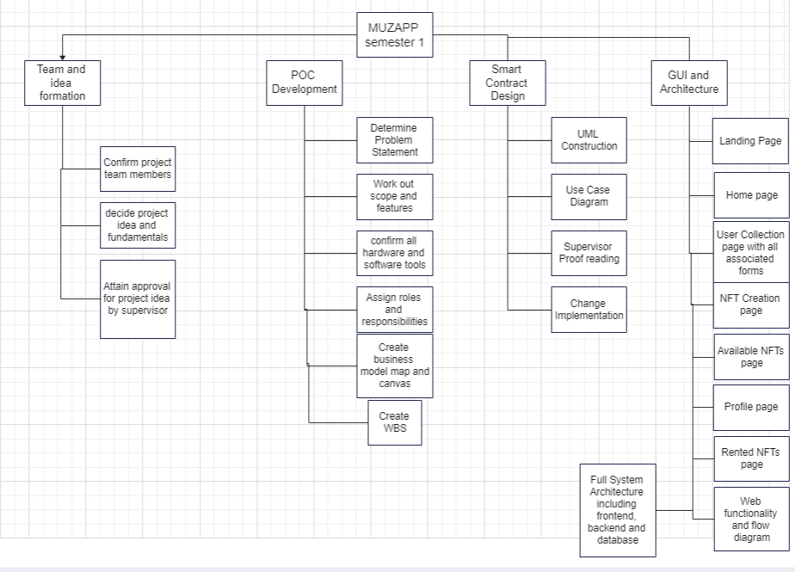
Work Breakdown Structure

Slide 40
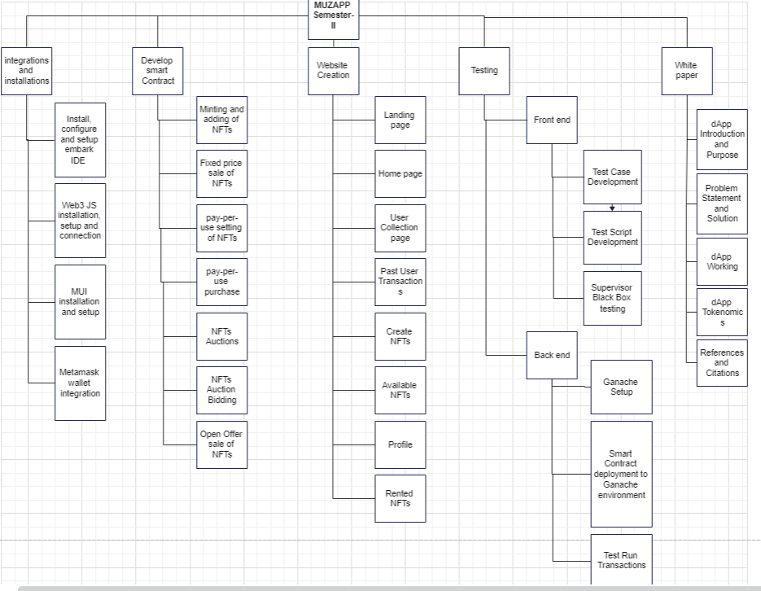
Work Breakdown Structure

Slide 41
Work Breakdown Structure

Slide 42
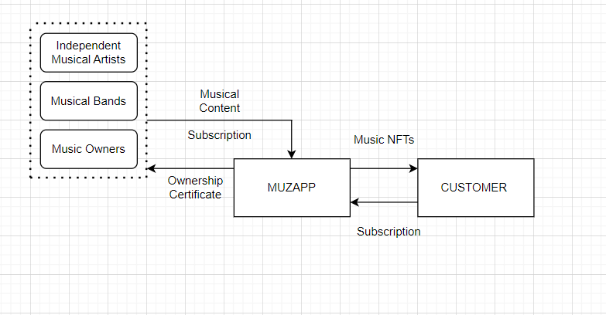
Business Model Map

Slide 43
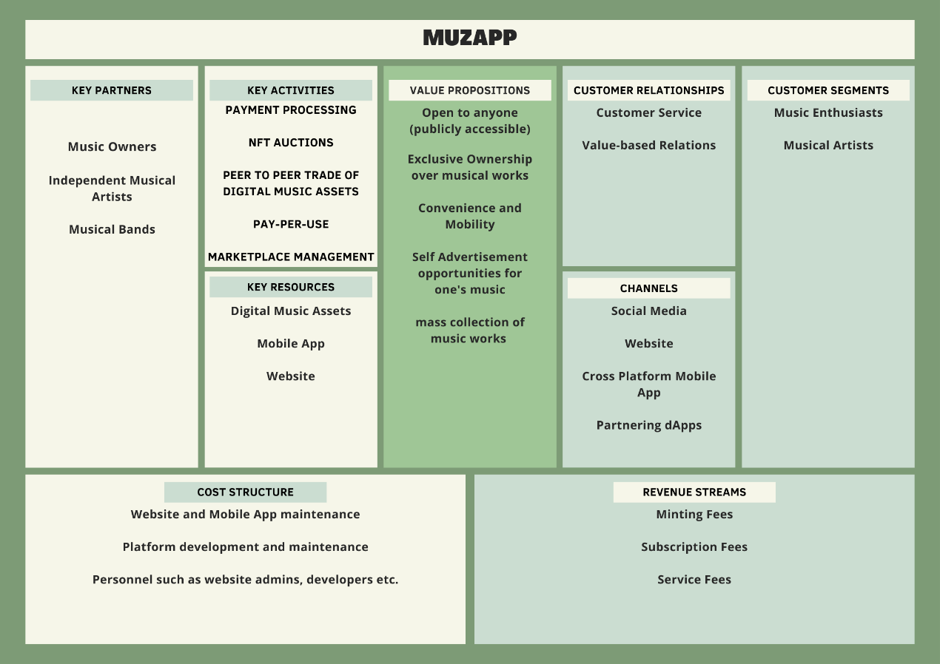
Business Model Canvas

Slide 44
References
Ani Karibian : “Challenges the Music Industry is Facing in the 21st Century”, January 17, 2022, June 24, 2023, Challenges the Music Industry is Facing in the 21st Century | Mubert Blog — Mubert Blog
Blockchain Evangelist, “choosing polygon over ethereum to build efficient dApps”, March 24, 2023, appinventiv, June 24, 2023, Choosing Polygon over Ethereum to Build Efficient dApps (appinventiv.com)
Georgia Weston, “What is Ganache Blockchain – 101 Blockchains”, 5 August 2022, June 24, 2023, What is Ganache Blockchain - 101 Blockchains

