Slide 1

PROJECT REPORT
ON
Online Car Buy/Sell
SUBMITTED TO :-
DEPARTMENT OF COMPUTER SCIENCE,
HEMCHANDRACHARYA NORTH GUJARAT UNIVERSITY,PATAN
SUBMITED BY:- PROJECT GUIDE :
NAME EXAM NO Dr Jignesh B. Patel
(1) Sunasara Abrarali Z.. 29 Mr. Amit Patel
(2) Kadiwal Shiraj A. 182
(3) Haba Faizal M. 61

Slide 2
Project Profile
Project Definition | Online Car Buy/sell System
Front End | HTML, CSS, Bootstrap,JavaScript
Back End | MYSQL , JSP, Servlet
Team Size | 3
Developed By | Sunasara Abrarali Z. Kadiwal Shiraj A. Haba Faizal M.
Submit To | Dept. of Computer Science, HNGU, Patan

Slide 3
Introduction
Online Car buy/sell means used cars including budget,model, prices, company etc.
Our project is meant to give people a better and trustworthy platform where they can sell and buy cars of their own choice and obviously on their own terms and condition.
With the help of internet and computer systems a man from remote area can buy/sell his car from anywhere the country/world.

Slide 4
Existing System
In the existing system, the registered users and unregistered users can buy/sell use cars with some searching criteria like color, company.
In this system, if the visitors can visit the website once then message will not be going in their mobile/email by the existing system.
The existing system is paid and in this system commission is taken for buying/selling used cars.

Slide 5
MODULES
User
1.1 Visitor/Guest
1.2 Registered User
1.3 Subscriber
2. Admin
2.1 Website Administrator
2.2 Content Moderator

Slide 6
1) User Module
1.1 Visitor/Guest
Can browse the website.
View listings of cars available for sale.
Read information about the website and its services.
Cannot access features related to buying or selling without subscription

Slide 7
1.2 Registered User
Can create an account on the website.
Access basic features like saving favourite listings, setting preferences, and receiving notifications.
Can access the subscription page to buy a subscription plan.
Once subscribed, can access features for buying and selling cars.

Slide 8
1.3 Subscriber
Paid user with access to premium features.
Can create listings to sell cars.
Can contact sellers and negotiate prices.
Can view detailed information about listings.
Can participate in forums or discussions related to cars.
May have access to additional perks or benefits depending on the subscription tier.

Slide 9
2) Admin Module
2.1 Website Administrator
Manages the overall functioning of the website.
Can add, edit, or remove listings.
Manages user accounts and subscriptions.
Monitors and moderates user-generated content, such as forum discussions and comments.
Handles technical issues and ensures the website's smooth operation.
Manages payment processing and subscription plans.
Responds to user inquiries and support ticketsite.

Slide 10
2.2 Content Moderator
Monitors user-generated content for compliance with community guidelines and terms of service.
Reviews and approves new listings before they are published.
Handles reported content and takes appropriate action, such as removing or editing posts that violate guidelines.
Helps enforce policies regarding prohibited items or illegal activities.
Assists users with content-related questions or concerns.

Slide 11
PROCESS
ENTITY
DATA
FLOWDIAGRAM
DATAFLOW
TABLE

Slide 12
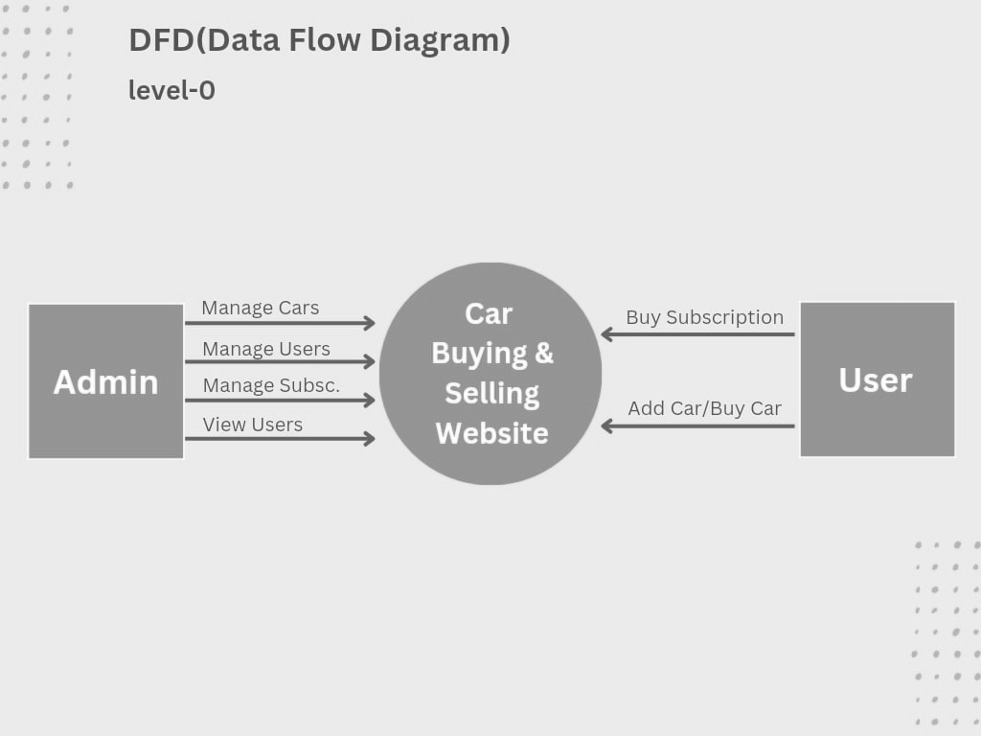
CONTEXT LEVEL

Slide 13
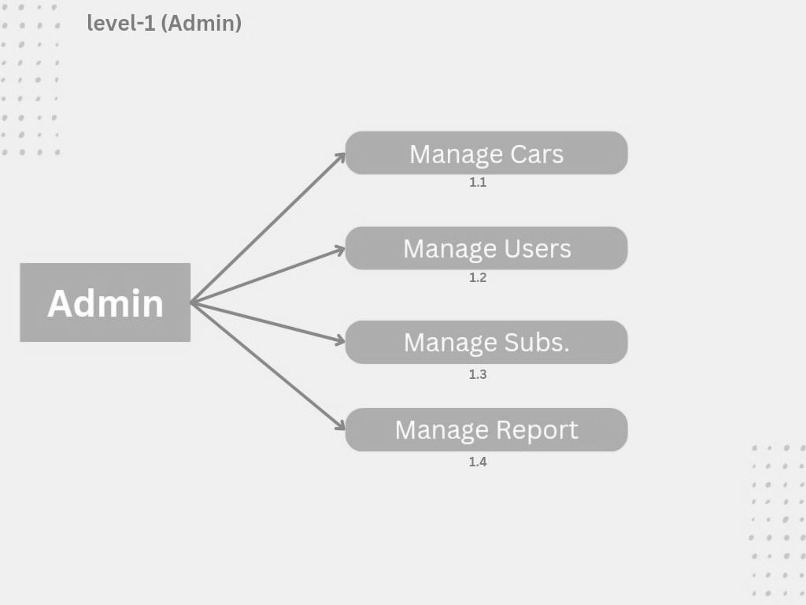
FIRST LEVEL

Slide 14
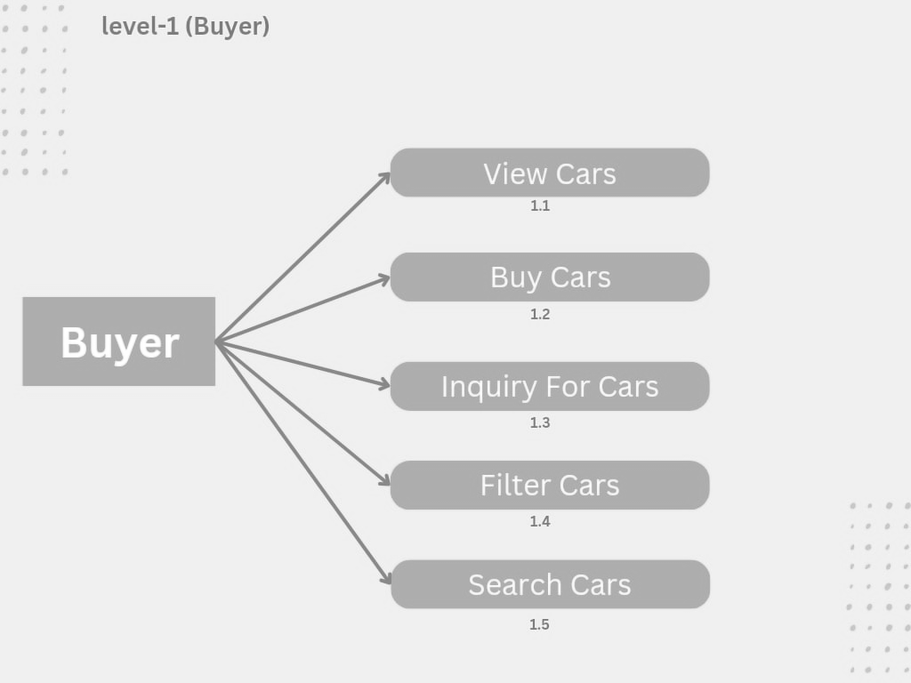

Slide 15
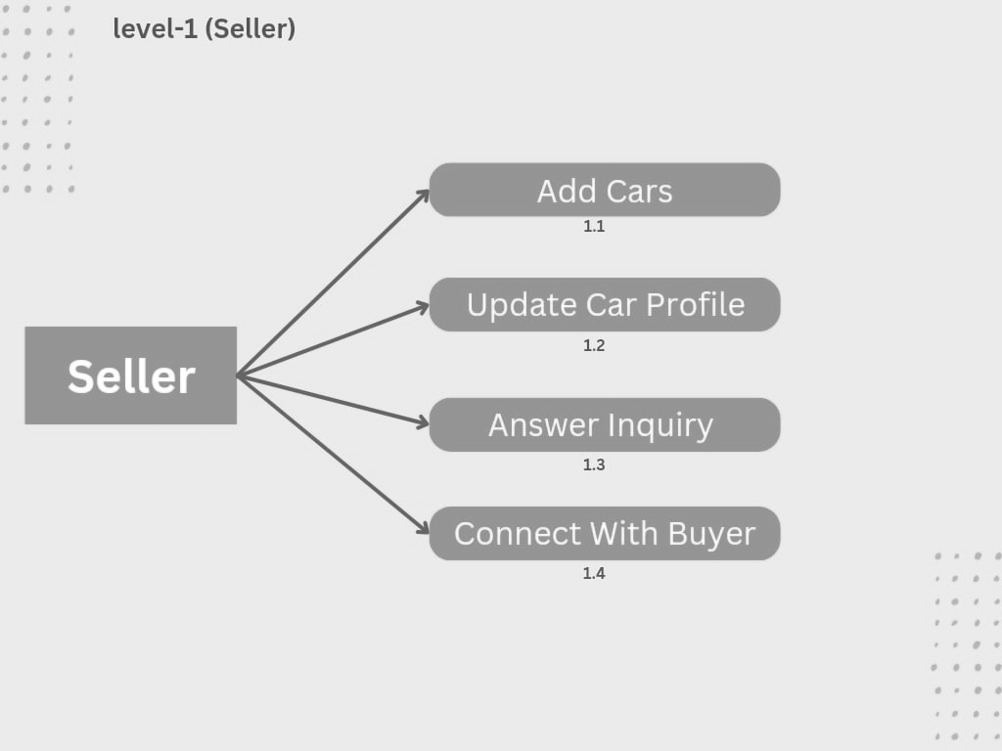

Slide 16
ER Diagram

Slide 17
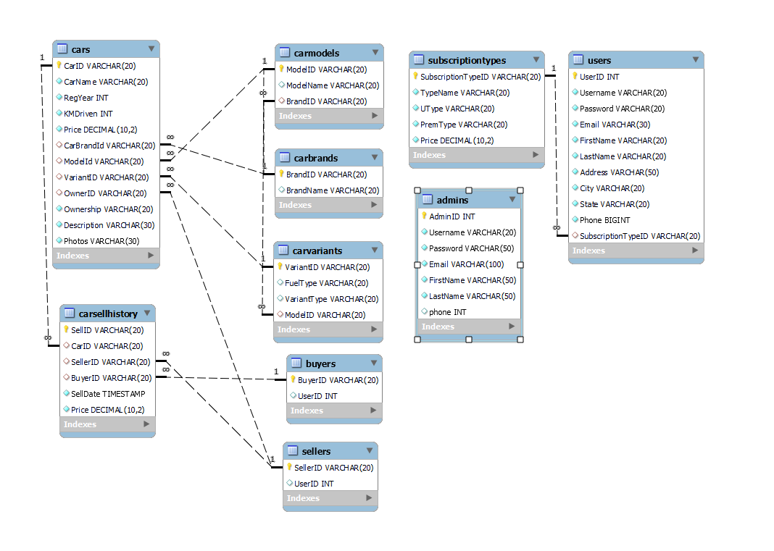

Slide 18
Data Dictionary

Slide 19
Table Name :- Users
Description :- This table is used for User registration and login .
SR.NO. | FIELD | TYPE | CONSTRAINTS | DESCRIPTION
1 | User_id | Varchar(20) | Primary Key | Unique ID
2 | U_Name | Varchar(20) | Not Null | First Name
3 | Password | Varchar(20) | Not Null | Password
4 | E_mail | Varchar(20) | Not Null | E-Mail
5 | F_Name | Varchar(20) | Not Null | First Name

Slide 20
SR.NO. | FIELD | TYPE | CONSTRAINTS | DESCRIPTION
6 | L_Name | Varchar(20) | Not Null | Last Name
7 | Address | Varchar(50) | Not Null | Address
8 | City | Varchar(20) | Not Null | City
9 | State | Varchar(20) | Not Null | State
10 | Phone | Varchar(20) | Not Null | Phone No.

Slide 21
Table Name :- Admin
Description :- This table is used for Admin login and detail.
SR.NO. | FIELD | TYPE | CONSTRAINTS | DESCRIPTION
1 | Admin_id | Varchar(20) | Primary Key | Unique ID
2 | Password | Varchar(20) | Not Null | Password
3 | F_Name | Varchar(20) | Not Null | First Name
4 | L_Name | Varchar(20) | Not Null | Last Name
5 | E_mail | Varchar(20) | Not Null | E-Mail
6 | Phone | Varchar(20) | Not Null | Phone No.

Slide 22
Table Name :- Subscription
Description :- This table used to store subscription details.
SR.NO. | FIELD | TYPE | CONSTRAINTS | DESCRIPTION
1 | Sub_id | Varchar(20) | Primary Key | Unique ID
2 | sub_Types | Varchar(20) | Not Null | Subscription Type
3 | Price | Decimal(10,2) | Not Null | Price

Slide 23
Table Name :- Sellers
Description :- This table use for seller.
SR.NO. | FIELD | TYPE | CONSTRAINTS | DESCRIPTION
1 | Seller_id | Varchar(20) | Primary-Key | Unique ID
2 | User_id | Int | Foreign Key | User Id

Slide 24
Table Name :- Buyer
Description :- This table used for buyer.
SR.NO. | FIELD | TYPE | CONSTRAINTS | DESCRIPTION
1 | Buyer_id | Varchar(20) | Primary Key | Unique ID
2 | User_id | Int | Foreign Key | User ID

Slide 25
Table Name :-Car_Info.
Description :- This table is used for add new vehicle and Car Information.
SR.NO. | FIELD | TYPE | CONSTRAINTS | DESCRIPTION
1 | Car_id | Varchar(20) | Primary Key | Unique ID
2 | Car_name | Varchar(20) | Not Null | Car Name
3 | Regis_Year | Decimal(4) | Not Null | Registration Year
4 | KM_Driven | Decimal(10) | Not Null | KM Driven
5 | Price | Decimal(10,2) | Not Null | Car Price
6 | Car_Brand_id | Int | Foreign Key | Car Brand ID
7 | Model_id | Int | Foreign Key | Model
8 | Variant_id | Int | Foreign Key | Variant

Slide 26
SR.NO. | FIELD | TYPE | CONSTRAINTS | DESCRIPTION
9 | Owner_id | Int | Foreign Key | Owner of car
10 | Ownership | Varchar(20) | Not Null | Ownership
11 | Description | Varchar(20) | Not Null | Description
12 | Photos | Varchar(50) | Not Null | Photos

Slide 27
Table Name :- Car_Brand.
Description :- This table is used to store car brand.
.
SR.NO. | FIELD | TYPE | CONSTRAINTS | DESCRIPTION
1 | Brand_id | Varchar(20) | Primary-Key | Brand ID
2 | Brand_Name | Varchar(20) | - | Brand Name

Slide 28
Table Name :- Car_Model
Description :- This table use to store car model.
SR.NO. | FIELD | TYPE | CONSTRAINTS | DESCRIPTION
1 | Model_id | Varchar(20) | Primary-Key | Unique ID
2 | Model_Name | Varchar(20) | - | Model Name
3 | Brand_id | Int | Foreign Key | Brand Name

Slide 29
Table Name :- Car_Variant
Description :- Its use to store car variants.
SR.NO. | FIELD | TYPE | CONSTRAINTS | DESCRIPTION
1 | Variant_id | Varchar(20) | Primary-Key | Unique ID
2 | Type | Varchar(20) | - | Fuel Type
3 | Variant_Type | Varchar(20) | - | Varients
4 | Model_Id | Int | Foreign Key | Model Name

Slide 30
Table Name :- CarSell_Hist
Description :- Its use to store car selling history.
SR.NO. | FIELD | TYPE | CONSTRAINTS | DESCRIPTION
1 | Sell_id | Varchar(20) | Primary-Key | Unique ID
2 | Car_id | Int | Foreign Key | Car Name
3 | Seller_id | Int | Foreign Key | Seller
4 | Buyer_id | Int | Foreign Key | Buyer
5 | Sell_Date | Timestamp () | Not Null | Date of Sell
6 | Price | Decimal(10,2) | Not Null | Price

Slide 31
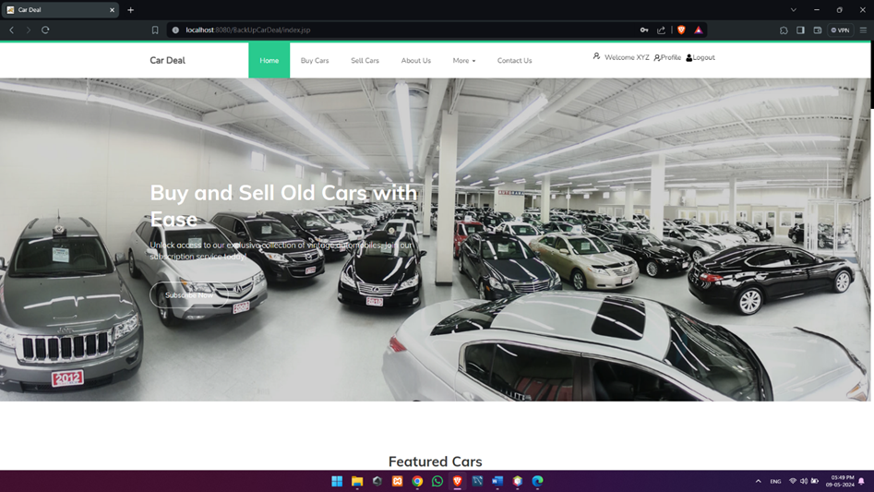
User Module :-
Home Page

Slide 32
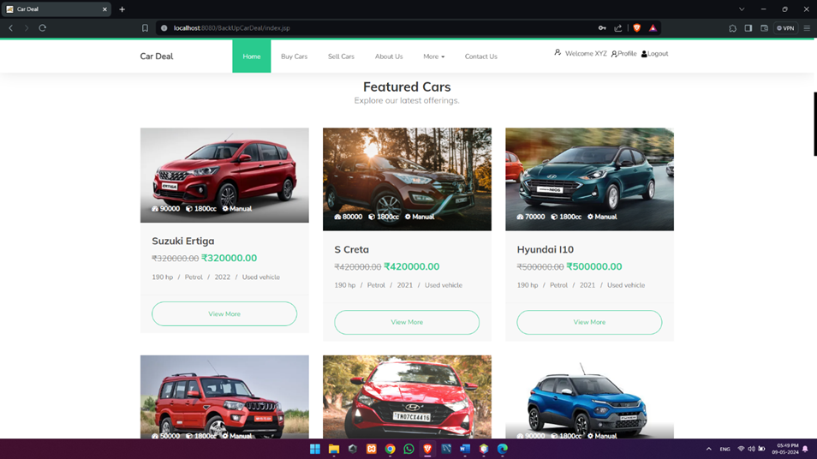

Slide 33
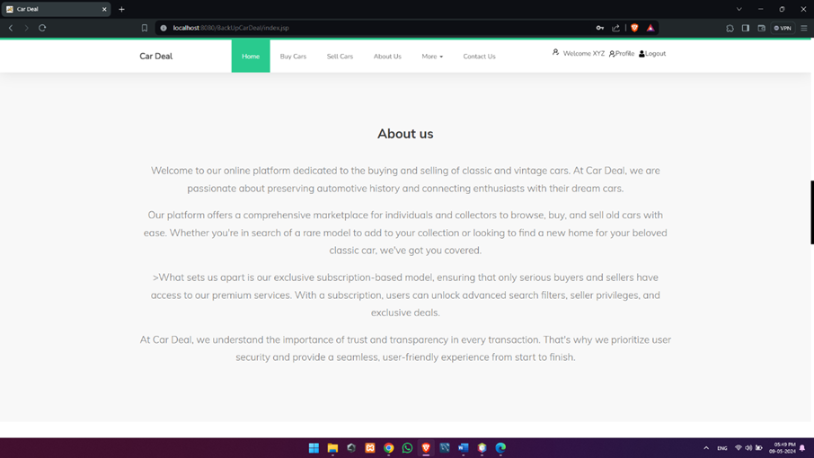

Slide 34
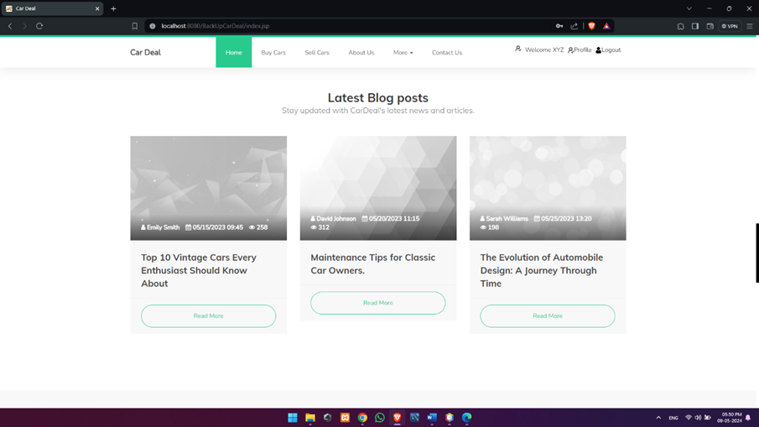

Slide 35
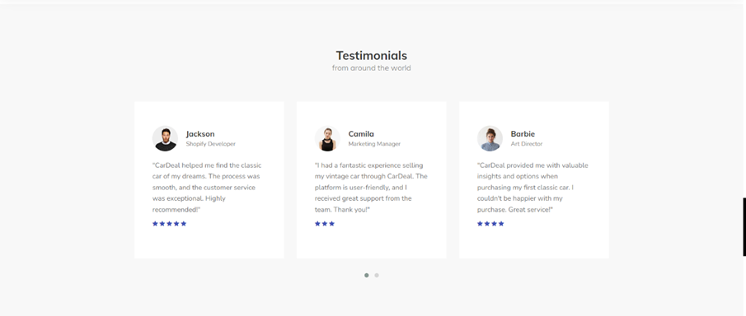

Slide 36
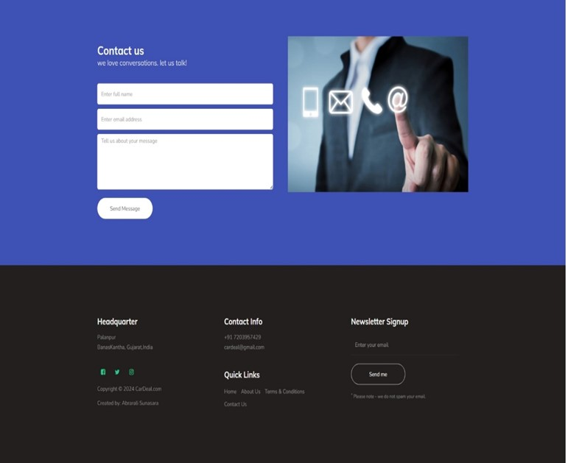

Slide 37
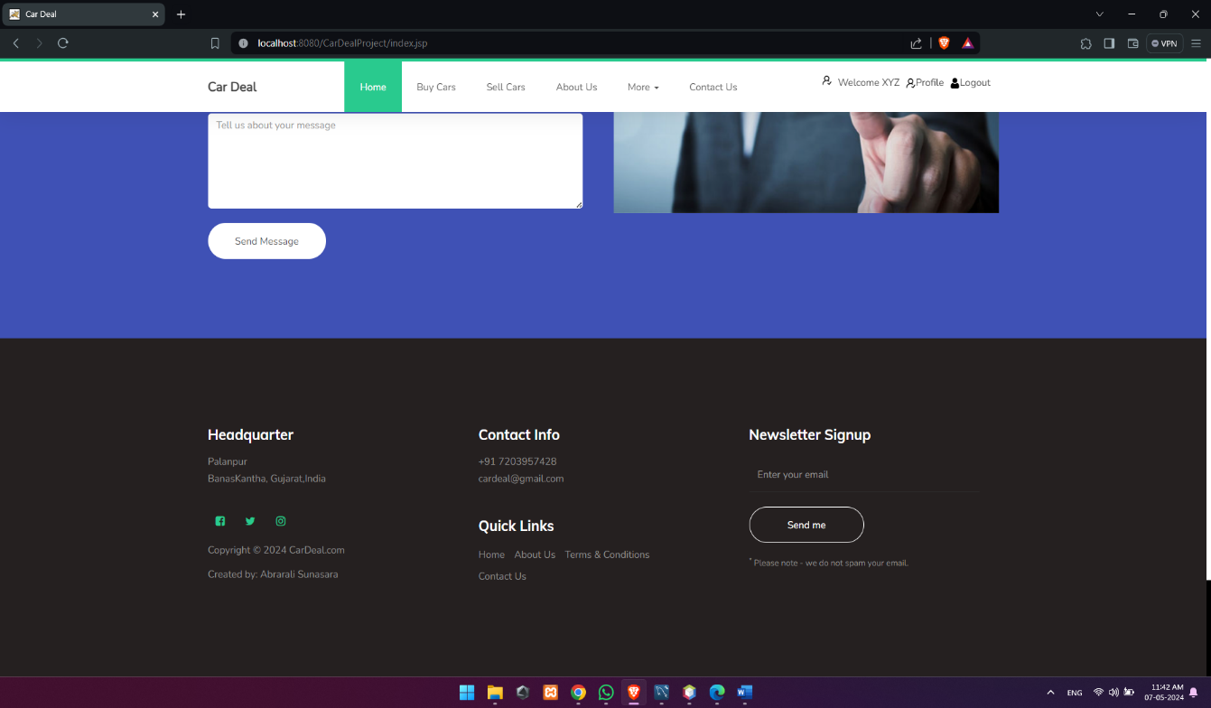

Slide 38
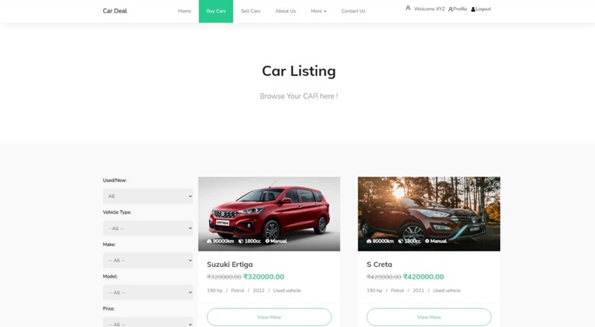
Buy Car/Listed Cars

Slide 39


Slide 40
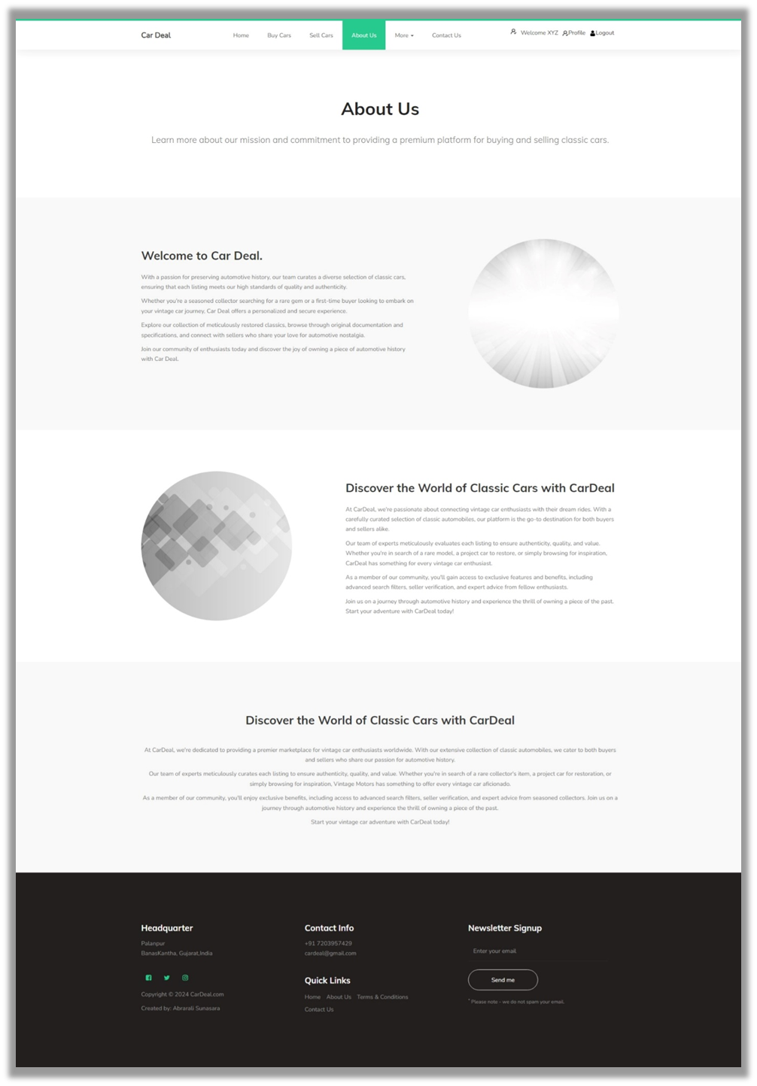
About Us

Slide 41
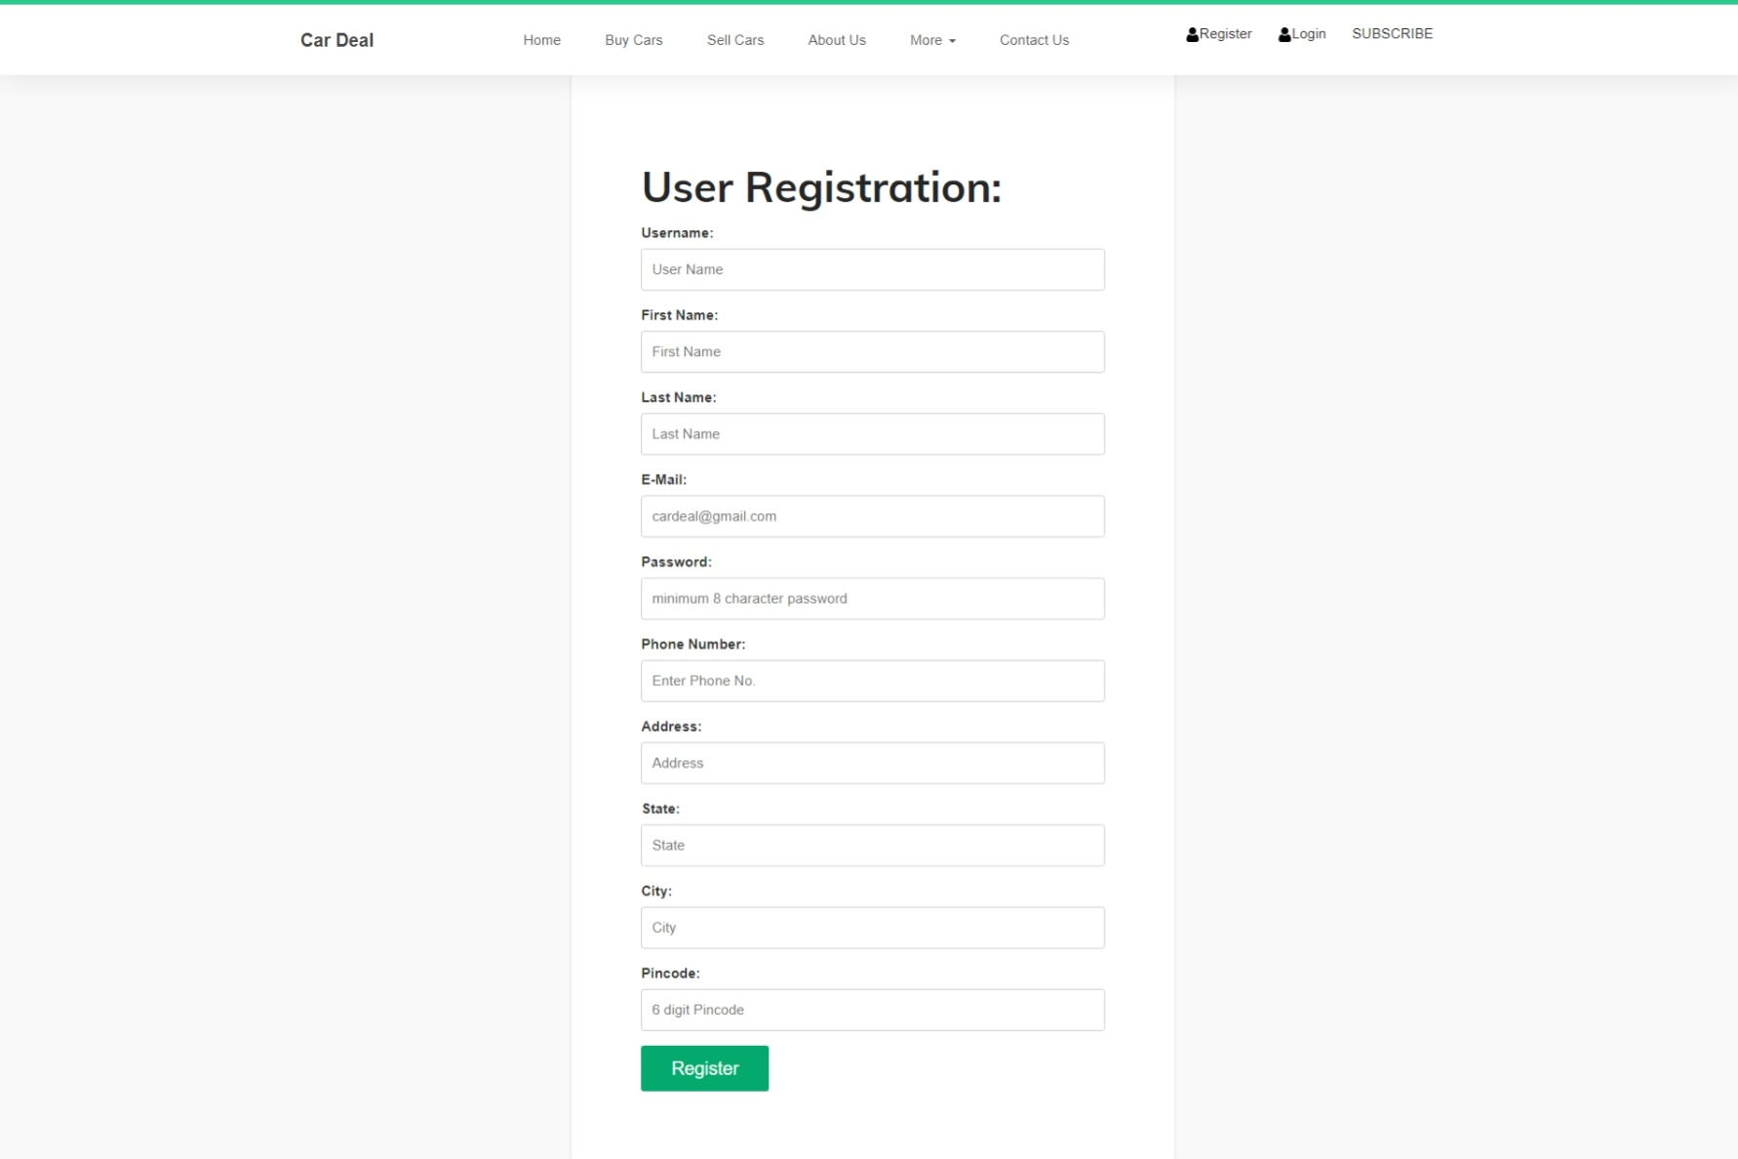
User Register

Slide 42
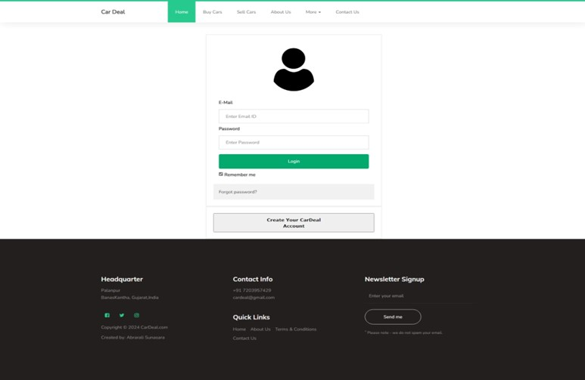
User Login

Slide 43
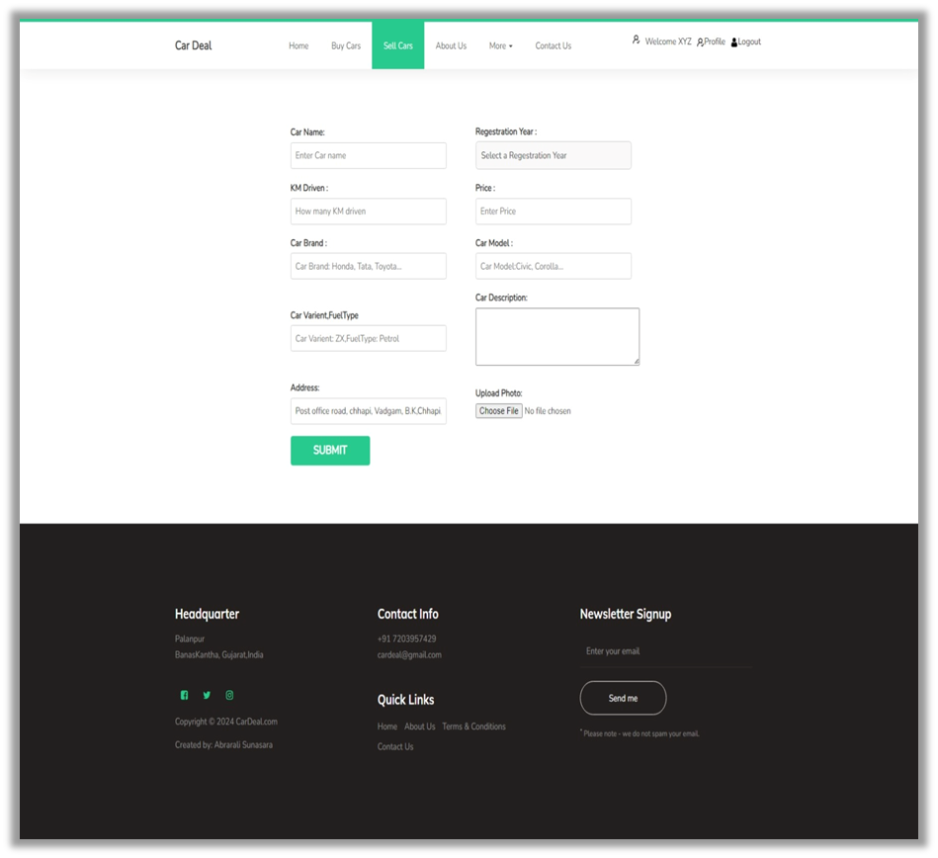
Car Listing/Sell Car

Slide 44
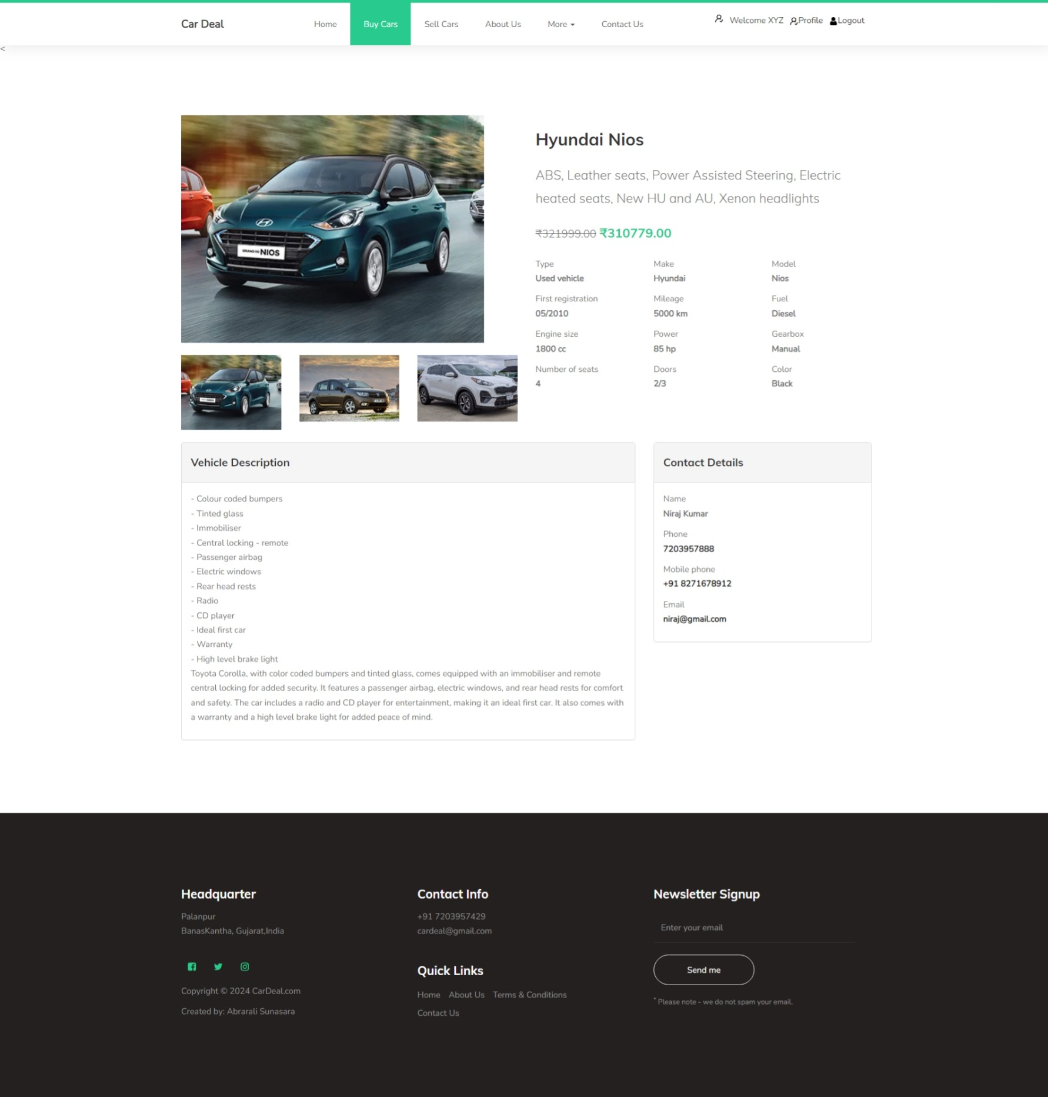
Car Details

Slide 46
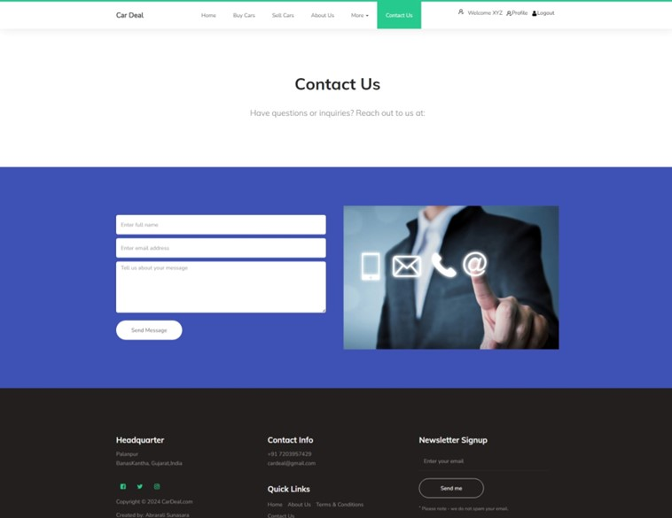
Contact Us

Slide 47
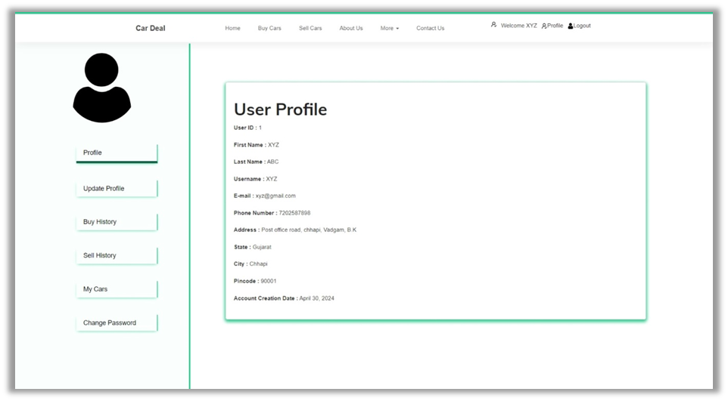
User Profile

Slide 48
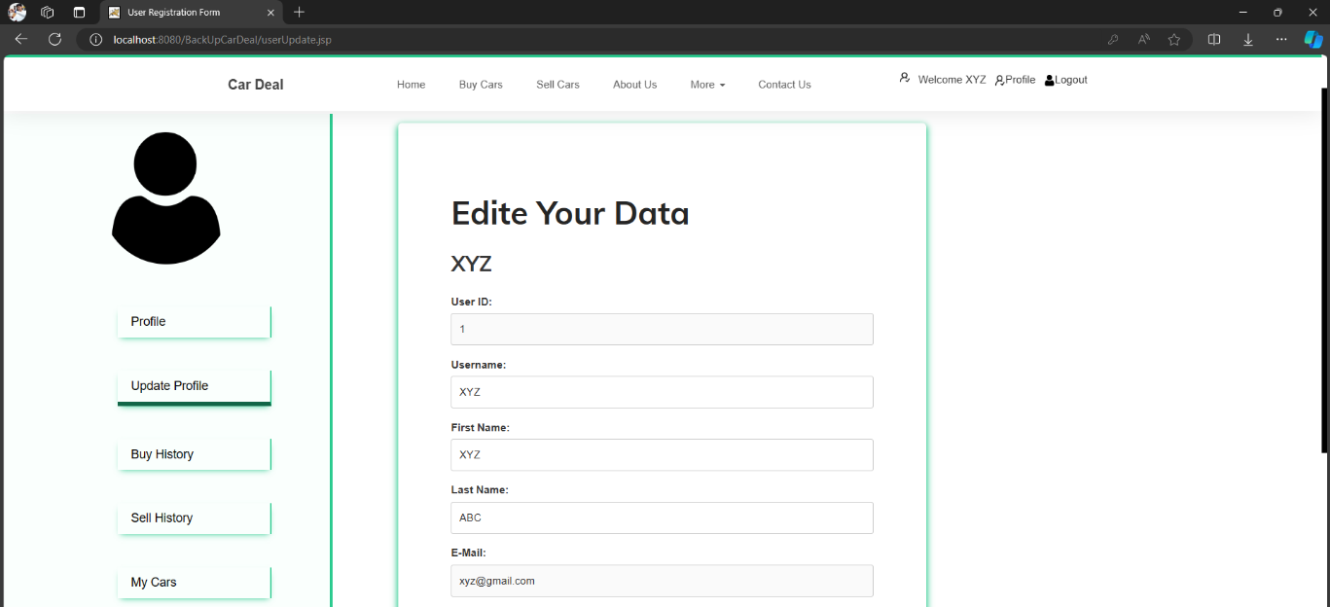
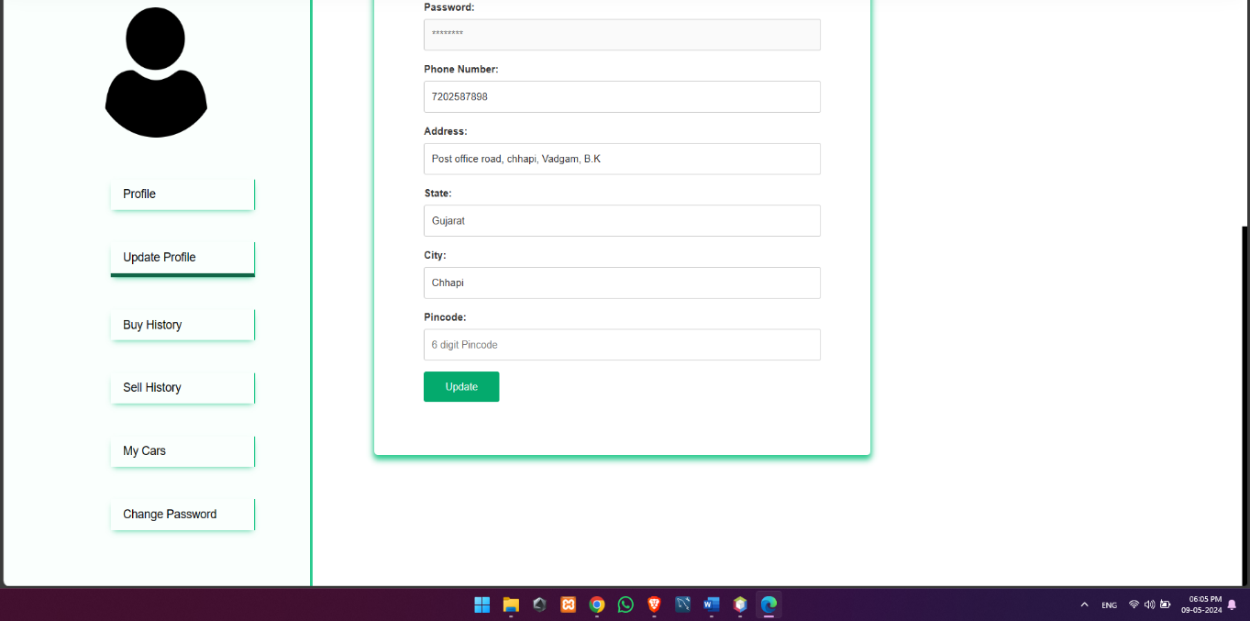
Update Profile

Slide 49
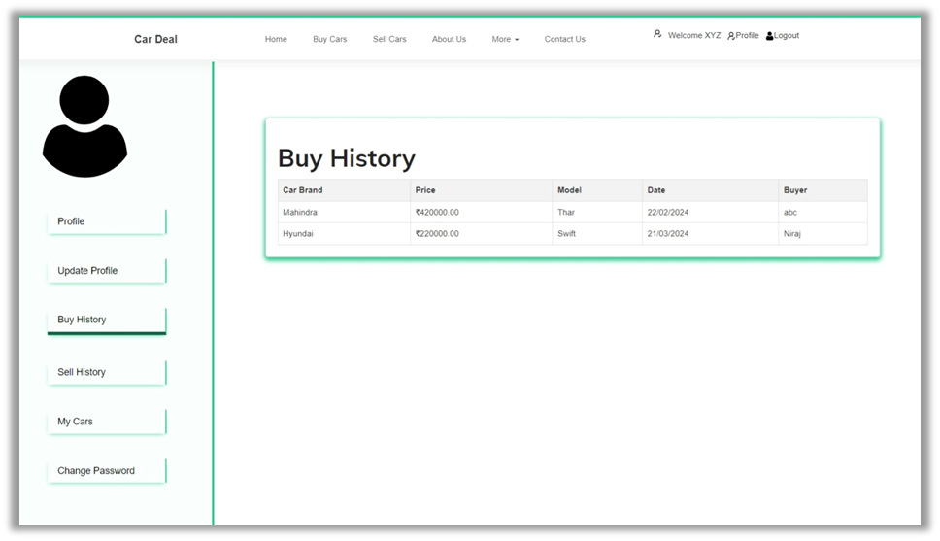
Buy History

Slide 50
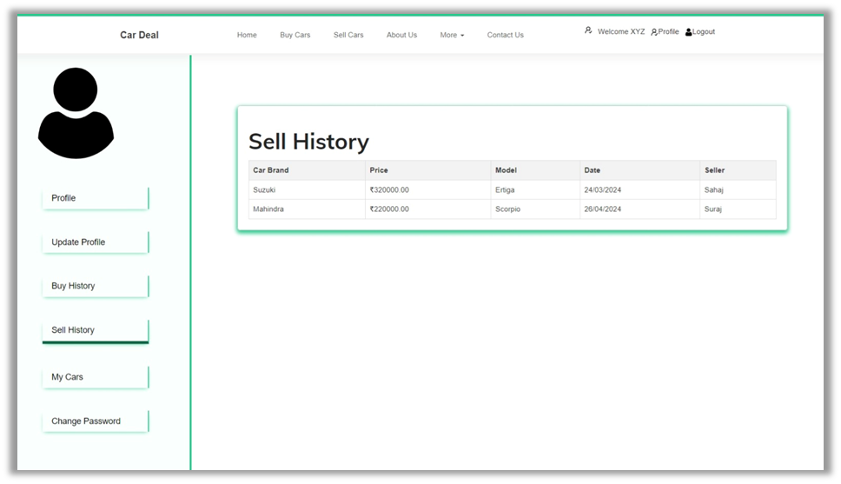
Sell History

Slide 51
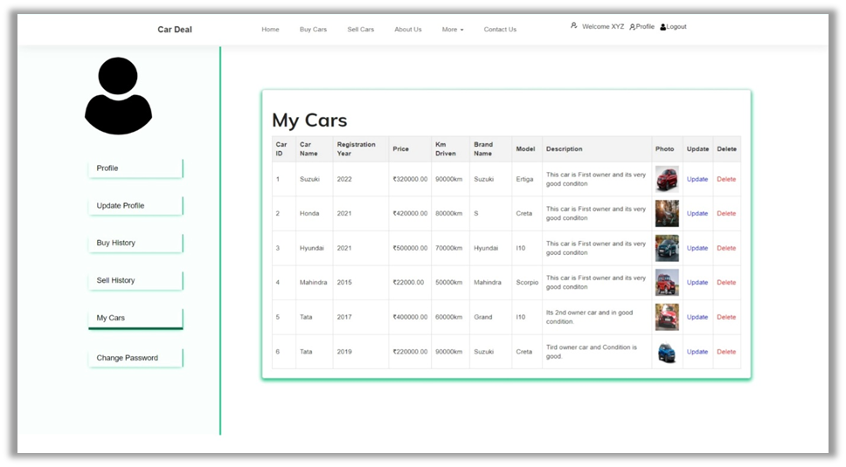
My Cars

Slide 52
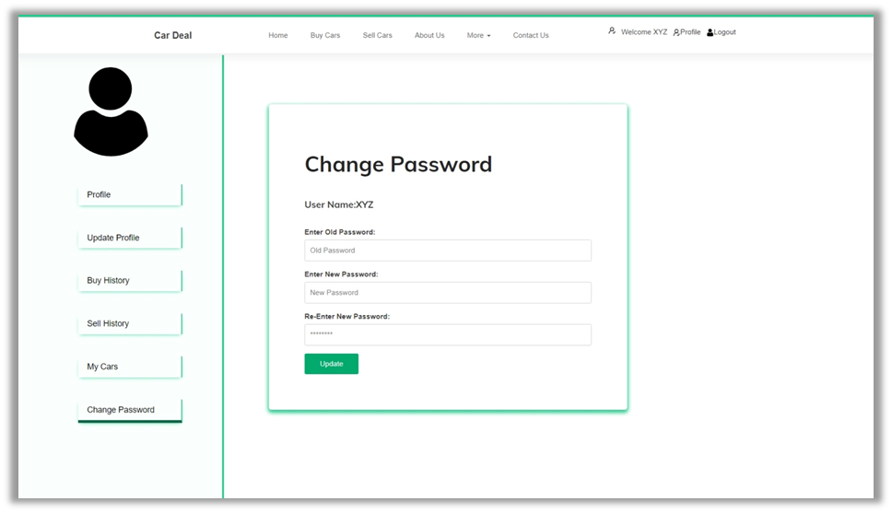
Change Password

Slide 53
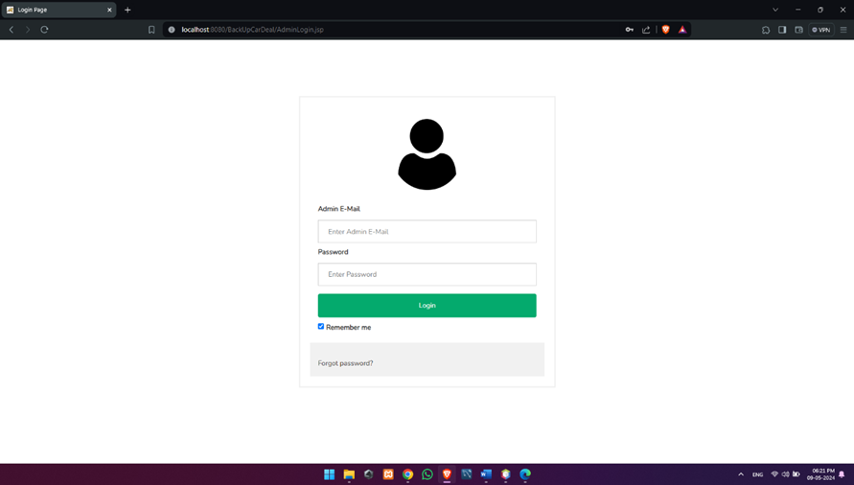
Admin Module:
Admin Login

Slide 54
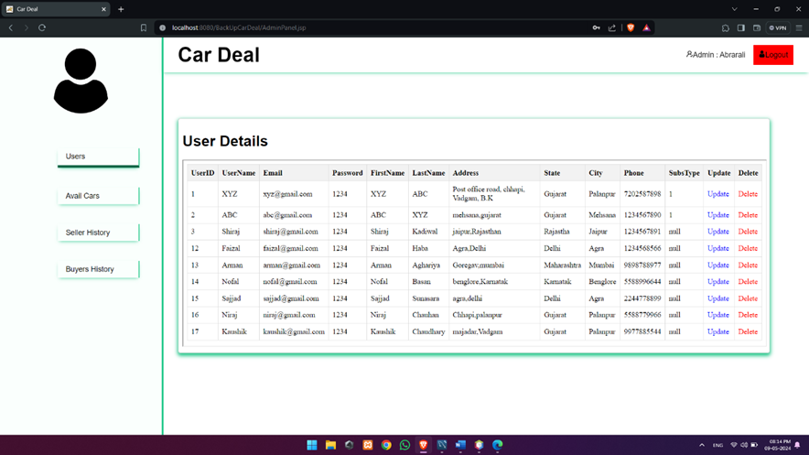
All User Details

Slide 55
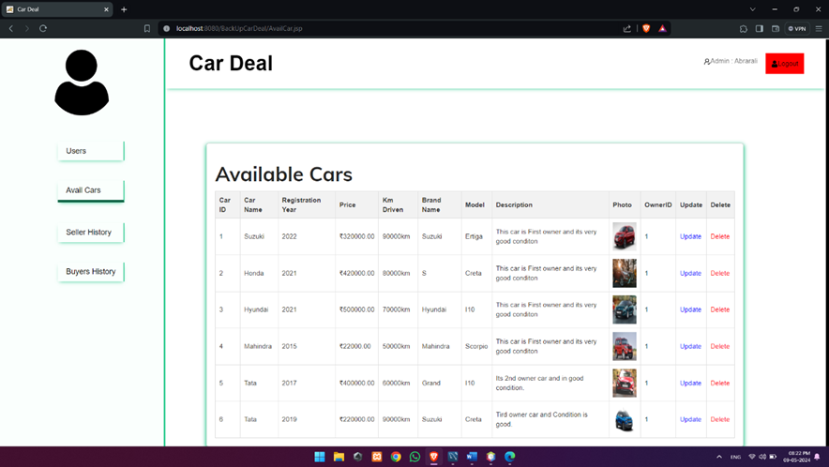
Available Cars

Slide 56
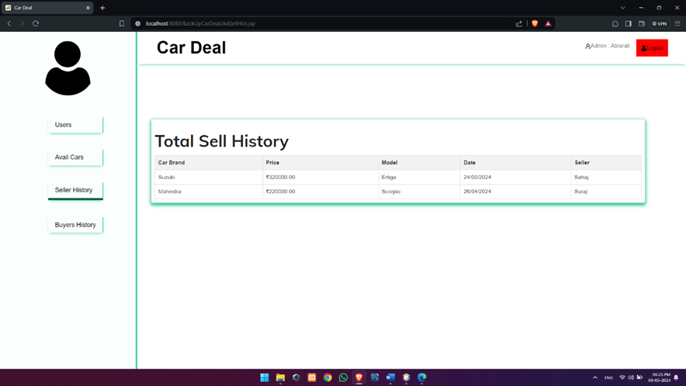
Sell History

Slide 57

Buy History

Slide 58
Conclusion
A web-based application which is used for tracking sales, services, reports, leads, accounts maintenance through online for automobile dealers. Better analysis of dealership profitability through retail sales, service and parts analysis. The features included E-mail, SMS alerts, reports, sales, purchase details, transaction, leads and vehicle, and parts ordering through E-mail. DMS solution is designed for automotive industry, and it fully supports all business processes of vehicle dealers, workshops and service companies, used card traders, vehicle importers, and spare part traders. It is completely web-based solution, so it does not require at software to be installed on different branches. The scope of the project includes that what all future enhancements can be done in this system to make it more feasible to use: Databases for different products range and storage can be provided, multilingual support can be provided so that it can be understandable by the person of any language, more graphics can be added to make it more user-friendly and understandable, manage, and backup versions of documents online.

Slide 59
Future Work
This system is developed such a way that additional enhancement can be done without much difficulty. The renovation of the project would increase the flexibility of the system. Also the features are provided in such a way that the system can also be made better and efficient functionality The programs were coded in an easier and more structured manner so that may further modifications may be incorporated easily. The processing time in this system is very lesser compared to existing system? This system has good flexibility of accommodating any more changes that might arise in the future also. In this system, data integrity is maintained and data redundancy is avoided and it increase system efficiency. The database is designed in such a way that it will be also helpful for enhancement of the system.

Slide 60
Thank You

