Slide 1
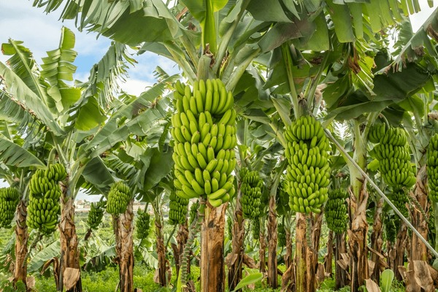
BANANA DISEASE PREDICTION MODEL
GROUP 5

Slide 2





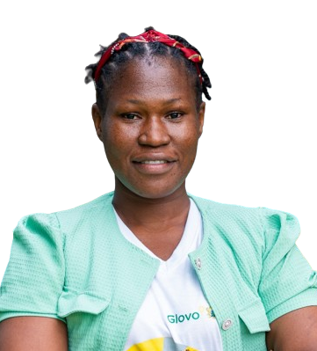

GROUP MEMBERS
Kingsley Obeng Ayisi
Emmanuel Abiodun Aderounmu
Kevin Adjei Aholou
Bodunrin O. Ahmed
Paula Jacqueline Bawuah
Priscilla Azilafu
Elikplim Gamor

Slide 3
PROBLEM STATEMENT
Banana cultivation faces significant challenges due to various leaf spot diseases that severely impact yield and quality.
The task is to develop an effective machine learning model to identify and classify these diseases from images of banana leaves, enabling timely and accurate diagnosis to reduce their impact.

Slide 4
SOLUTION STATEMENT
Our solution to the problem is to create a robust classification model for diagnosing banana leaf spot diseases using a diverse dataset of images.
The goal is to accurately classify the images into their respective disease categories, enhancing the ability to monitor and manage banana plant health and reduce the adverse effects of these diseases on banana production.

Slide 5
Classes of diseases
There are 3 classes of diseases namely;
Pestalotiopsis
Cordana
Sigatoka

Slide 6
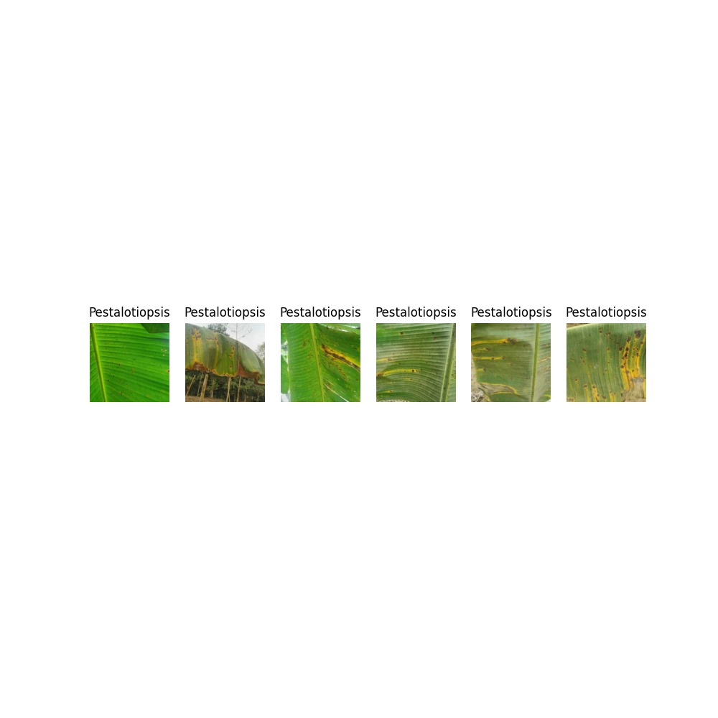
SAMPLES OF PESTALOTIOPSIS

Slide 7
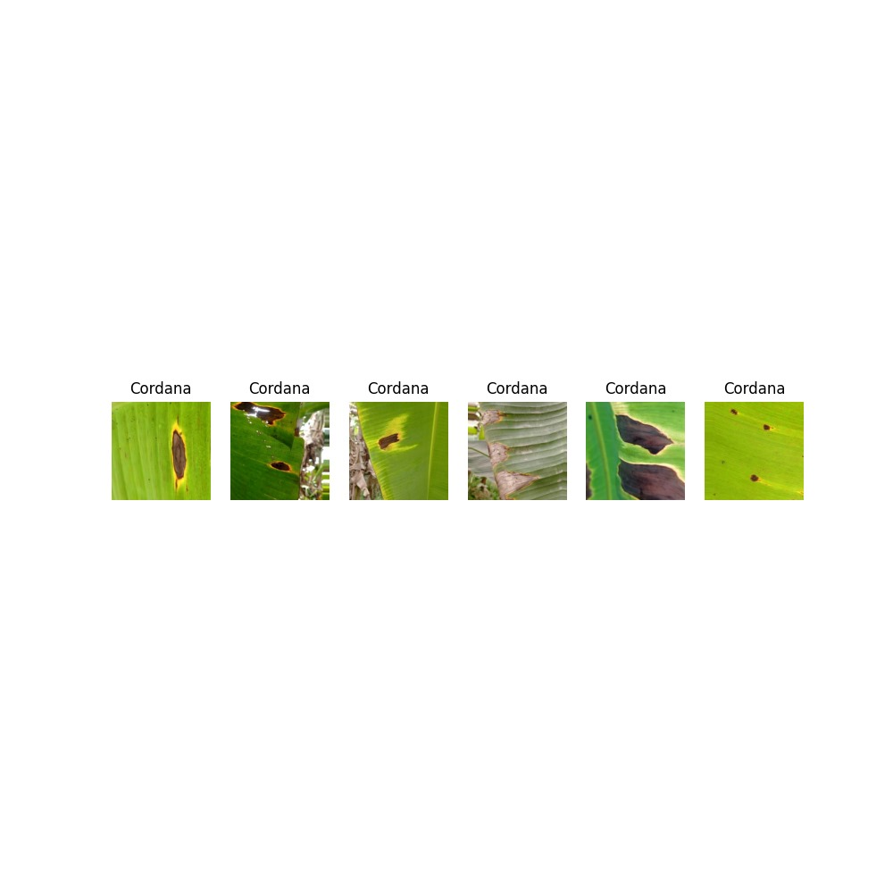
SAMPLES OF CORDANA

Slide 8
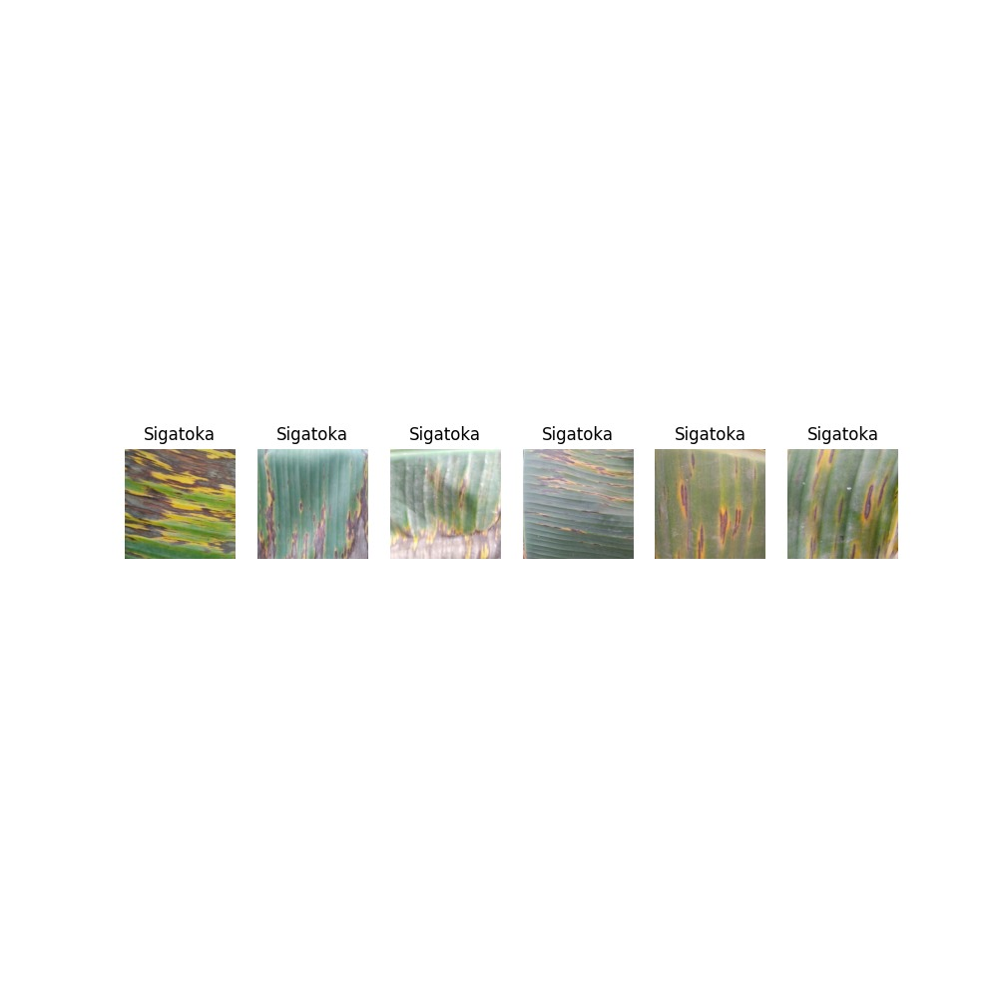
SAMPLES OF SIGATOKA

Slide 9
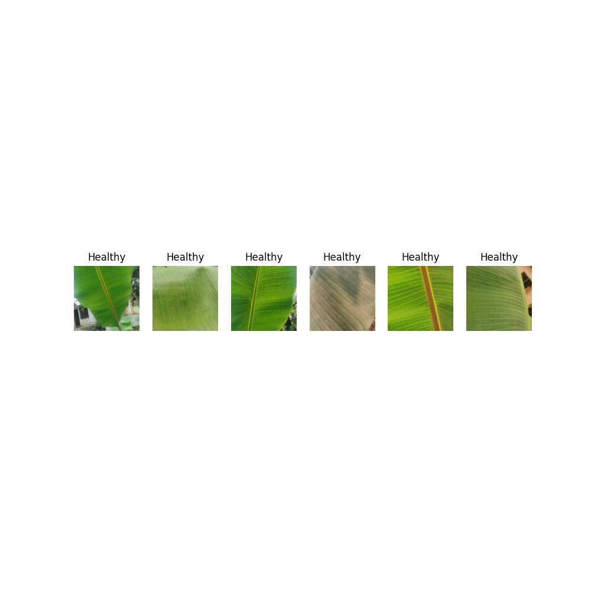
SAMPLES OF HEALTHY

Slide 10
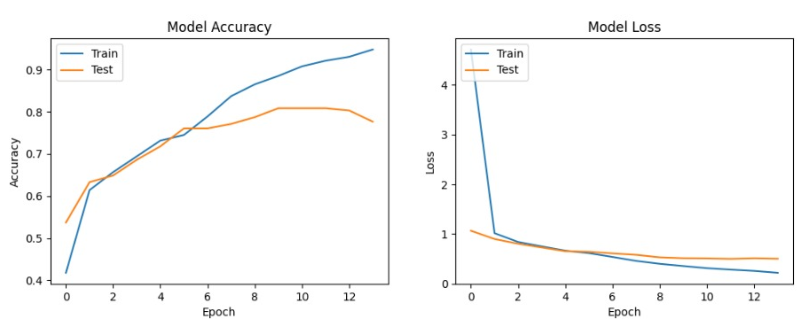
INITIAL MODEL EVALUATION

Slide 11
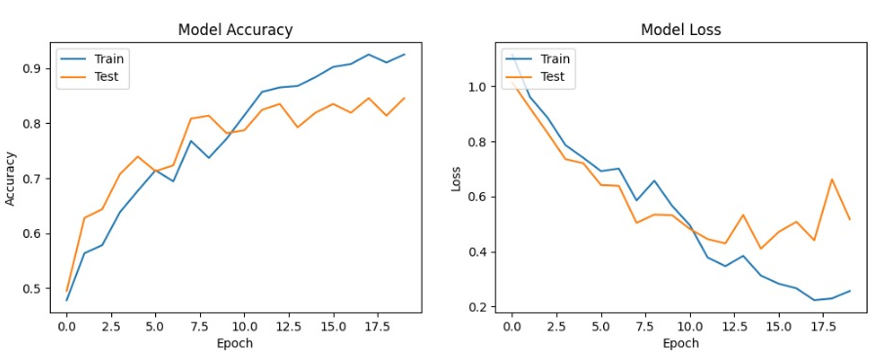
IMPROVED MODEL EVALUATION

Slide 12
REFERENCES
MODEL
DEPLOYMENT

Slide 13


Slide 14


