Slide 1
Spectrum is like…
The metaphor that doesn’t quite work but we use it anyway
Notes:
Simile vs. metaphor?
Spectrum is like… what? Get answers.
Who here has ever had to deal with code enforcement, code violations, zoning regulations, antenna regulations, or anything like that. Get answers.

Slide 2
Planned isolation
It’s been working for us for 130 years. Why stop now?
Notes:
Planned isolation in spectrum management is the equivalent of zoning regulations and code regulations in land management. Mixed use regulations are still regulations.
Spectrum is instantly re-usable. Land is not. That is the biggest, most critical failure of this spectrum-as-land metaphor that we have going on.
Planned isolation has an upper limit in dealing with population density. When cities get too crowded, planned isolation breaks down. E.g. short term rental controversies in Austin TX, rent control breakdowns in NY, the reasons that Kowloon City was finally bulldozed.
The goal of planned isolation is to reduce interference. Interference with small digital radios is a critical problem that planned isolation will no longer be able to adaquately deal with.
The massive rise of unlicensed services is something we must all deal with.

Slide 3
Spectrum *Is* like land
Like land, there’s a lot of unused acres out there.
Notes:
The average occupancy is quite reasonable. There’s no overcrowding! Divide users by Hz. Divide citizens by acre. If you fly over the US, it looks desolate. If you live in a city, it feels like you can’t get away from the people and there’s never enough parking.

Slide 4
Spectrum *Is* like land
Suitability varies enormously. It’s not one size fits all.
Notes:
Some places are way more expensive than others. Desirability is not universal. What makes North Dakota a desirable place to live compared to California? Vice versa? Who wants to live in a an active volcano? An ice sheet? Under water? On an unstable cliff? In the middle of a swamp? In the middle of the desert? Near the beach? In the foothills of a mountain range? Near a useful port? Near the freeway? Far from the freeway? We can go on and on.

Slide 5
Spectrum *Is* like land
If you want to use it, you can license it.
If you follow certain rules, you can use it without a license.
Notes:
Ask for examples of both land and spectrum, both licensed and unlicensed.

Slide 6
Spectrum *Is Not* like land
I can’t have a house one day and then water treatment plant the next day and then a restaurant the day after that on the same lot.
Notes:
Land in the US is zoned. This is often a very long and contentious process. Once zoned, in a process that may have been done decades before, land is developed. This is also long and contentious. Our local planning headache is the One Paseo development. Once developed, you are stuck with that developed land for a long time. Yes, you can tear stuff down, redevelop. But it’s very rare to rezone or redevelop in a flexible way. Spectrum is fundamentally different. Yes, big radar installations are essentially permanent on the order of decades. However, if I decommission that radar, that spectrum is immediately, instantly re-usable. With no delay, no scarring, no environmental impact, nothing. It’s as if the system never existed at all. The planned isolation metaphor fails here completely. The cost to redevelop land means that re-use is simply not designed into the system. Spectrum is completely and totally different.
Ask for examples of systems that no longer exist.

Slide 7
Spectrum *Is Not* like land
I can’t have a house one day and then water treatment plant the next day and then a restaurant the day after that on the same lot.
But I can do something like that with spectrum.
Notes:
Land in the US is zoned. This is often a very long and contentious process. Once zoned, in a process that may have been done decades before, land is developed. This is also long and contentious. Our local planning headache is the One Paseo development. Once developed, you are stuck with that developed land for a long time. Yes, you can tear stuff down, redevelop. But it’s very rare to rezone or redevelop in a flexible way. Spectrum is fundamentally different. Yes, big radar installations are essentially permanent on the order of decades. However, if I decommission that radar, that spectrum is immediately, instantly re-usable. With no delay, no scarring, no environmental impact, nothing. It’s as if the system never existed at all. The planned isolation metaphor fails here completely. The cost to redevelop land means that re-use is simply not designed into the system. Spectrum is completely and totally different.
Ask for examples of systems that no longer exist.

Slide 8
You can’t (fairly) regulate what you can’t measure!
Regulators can map and monitor a city.
How can regulators map and monitor spectrum?
Notes:
Without the parentheses, this is is not a noncontroversial statement. Can anyone think of any other examples where we have regulations for something that has no simple metrics?
Because what we learn from advances in spectrum sharing and cognitive radio may apply to those areas too.
Because whatever they do in those other areas that works then we need to start doing with spectrum.
It is very very difficult to just go out, measure the entire spectrum, and then put up a database so that everyone knows when not to tromp on someone else.

Slide 9
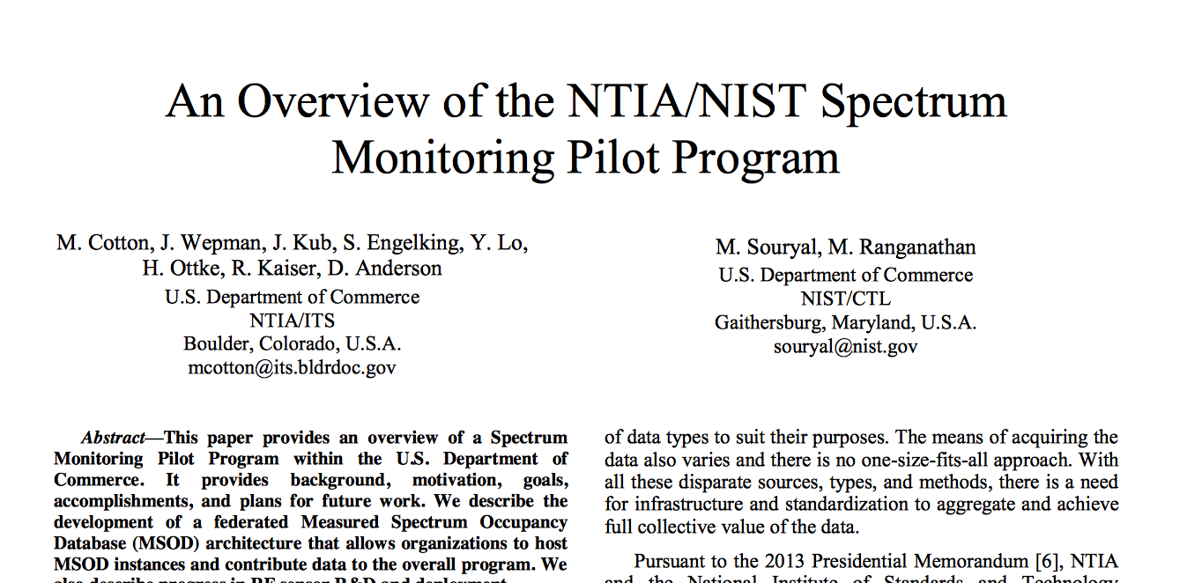
Just measure it, right?
Notes:
We’ve tried top down approaches to measuring spectrum. In 2003, the FCC tried an Interference Temperature program. It failed. Deploying sensors everywhere to measure everything is literally impossible to do for any amount of money that we want to give to regulatory agencies. This is just physics. We all make antennas, but quite often lawyers and lobbyists and our fellow citizens believe that large swaths of spectrum can be easily monitored in time and space.
Monitoring works in limited ways on limited bands in limited areas. Even with those carefully constructed monitoring programs you will miss heterogeneous signals, secondary users, directional interference, and lots of other things. You do not in any way have total situational awareness.
This program being launched now has LTE as a client. Their question is very limited.
This is the equivalent of only being able to check on green buildings for code violations but only on Thursdays, if the roof is black.
There are bands where it’s easier. I think HF would qualify here.

Slide 10
Just do some math and estimate, Right?
No.
That only works in Mathland.
No one wants to live there.

Slide 11
Just have the radio listen first!
This works, but…
Notes:
Put the smarts in the radio! What could possibly go wrong? It already has with UNII vs Radar. The Unlicensed National Information Infrastructure (U-NII)[1][2] radio band is part of the radio frequency spectrum used by IEEE-802.11a devices and by many wireless ISPs. It operates over four ranges: In 2007, the FCC began requiring that devices operating in channels 52, 56, 60 and 64 (5GHz band) must have Dynamic Frequency Selection (DFS) capabilities. This is to avoid communicating in the same frequency range as some radar. In 2014, the FCC issued new rules[9] for all devices due to interference with government weather radar systems. Fines and equipment seizure were listed as punishment for non-compliance.”
Well guess what? Devices where the sensing was disabled got out in the wild. How do you think that might have happened?

Slide 12
Just put everything in a database
Make the radio look it up before transmitting.
The radios regulate themselves.
Notes:
Put the smarts in the radio! What could possibly go wrong? It already has with TV white space re-use. Sensing before transmitting works unless you’re in a band where directional signals make you miss them. The 3.55-3.7 CBRS database is a current example. It’s not live yet, but you will have to consult this database before you can transmit.

Slide 13
What about those smarty pants 5G people?
How to tame 24-40GHz?
Global database?
No database? (individual sensing/acting agent)
Local database (mesh!)
Notes:
24-40GHz 5G management. Oh boy. Massive amounts of money have already been spent already on spectrum in these bands by companies you have never heard of and some you have. The physics of these frequencies means what?
Transmissions are short range and much more line of sight. Planned isolation means massive amounts of spectrum wholly devoted to short range directional transmissions. Base stations everywhere!

Slide 14
Case study: mesh
Interference has been the primary performance degradation in mesh networks.
Notes:
Are we (hams) interested in mesh networks?
We should be for several reasons.
If you don’t use mesh then your choices to date have been to go through a central database or be entirely independent.
When we talk about cognitive radio, or local sensing to avoid interference, and we don’t want to pre-plan who we talk to, then you unavoidably confront mesh technologies.

Slide 15
Case study: mesh
Flexibility purchased with complexity.
Maneuverability purchased with stability.
Stability bought back with more complexity.
Notes:
Anything worth doing is all about trade-offs. Mesh is a good example.
Nodes in a mesh network have two jobs. Connect with neighbors. Forward traffic out the backhaul. Nodes can come and go. There’s a variety of ways to do it, but almost all of them that we experiment with rely on WiFi and TCP/IP. Routing protocols designed for static routes are not ideal for dynamic ones. Half-duplex wifi cards mean your throughput goes down by half for each hop.
Black hole routing, jamming, and routing contention or routing flaps are major issues for mesh. One of the biggest obstacles is how random access protocols cause latency stackups in multihop networks. You can increase your throughput in some cases by tolerating latency, but when you run out of margin on the latency, things can stop working.
All of these facts mean that mesh is a very active area of research. There are so-called fourth and fifth generation products based on military mesh networks. Motorola’s products are the ones I’m most familiar with.
There are no clear winners yet in security protocols for mesh networks. Security through obscurity, whether hardware obscurity, or spectral obscurity, has been the most reliable way to exclude bad actors.
So, if you’re going to rely on mesh to create a local database that solves your interference problem in 5G, you have design challenges.

Slide 16
There has to be a better way!
There is, and DARPA wants us to figure it out.
Notes:
Put the smarts in the radio! What could possibly go wrong? It already has with TV white space re-use. Sensing before transmitting works unless you’re in a band where directional signals make you miss them. The 3.55-3.7 CBRS database is a current example. It’s not live yet, but you will have to consult this database before you can transmit.

