Slide 1
Phase 4 ground
AMSAT Symposium 2017 Update

Slide 2
Michelle w5nyv
I enjoy thinking and doing! Not necessarily in that order!
BSEE, BSCE, math minor, MSEE USC Info Theory
DEFCON, Burning Man, AMSAT, IEEE, 10-10, GNU Radio, community orchestra
https://github.com/abraxas3d
https://keybase.io/abraxas3d
https://twitter.com/abraxas3d
Just look for Abraxas3d

Slide 3
Prize time!
Stand up!

Slide 4
Stay standing if you can answer yes
Do you have a smartphone?

Slide 5
Stay standing if you can answer yes
Do you have a smartphone?
What is the transmit frequency?

Slide 6
Stay standing if you can answer yes
Do you have a smartphone?
What is the transmit frequency?
What is the receive frequency?

Slide 7
Stay standing if you can answer yes
Do you have a smartphone?
What is the transmit frequency?
What is the receive frequency?
What TIA/EIA standard does it use?

Slide 8
Stay standing if you can answer yes
Do you have a smartphone?
What is the transmit frequency?
What is the receive frequency?
What TIA/EIA standard does it use?
Would you recognize the waveform that it receives?

Slide 9
Stay standing if you can answer yes
Do you have a smartphone?
What is the transmit frequency?
What is the receive frequency?
What TIA/EIA standard does it use?
Would you recognize the waveform that it receives?
What is the dynamic range of the power output of your phone?

Slide 10
Stay standing if you can answer yes
Do you have a smartphone?
What is the transmit frequency?
What is the receive frequency?
What TIA/EIA standard does it use?
Would you recognize the waveform that it receives?
What is the dynamic range of the power output of your phone?
Without downloading an app, can you name the cell tower you’re connected to?

Slide 11
Stay standing if you can answer yes
Do you have a smartphone?
What is the transmit frequency?
What is the receive frequency?
What TIA/EIA standard does it use?
Would you recognize the waveform that it receives?
What is the dynamic range of the power output of your phone?
Without downloading an app, can you name the cell tower you’re connected to?
Can you name any field in the control frames sent to your phone?

Slide 12
Stay standing if you can answer yes
Do you have a smartphone?
What is the transmit frequency?
What is the receive frequency?
What TIA/EIA standard does it use?
Would you recognize the waveform that it receives?
What is the dynamic range of the power output of your phone?
Without downloading an app, can you name the cell tower you’re connected to?
Can you name any field in the control frames sent to your phone?
Have you ever attempted to write code for a mobile device of any type?

Slide 13
Our challenge to you
Phase 4 Ground radios have a lot of similarities to your smartphone.
Learning more about cellular and broadcast satellite protocols helps you become a much better advocate for modern amateur communications technologies.
AMSAT must implement and innovate upon modern digital standards in order to provide relevant amateur satellite service.
If you’re unfamiliar with digital multiple-access broadband microwave communications, and want to get more involved, then we are here to help.
You do not have to be an expert to participate!

Slide 14
Current Technical goals and progress
Implement DVB-S2/X for amateur satellite and terrestrial use in GNU Radio.
Provide both DIY instructions and a manufactured solution for this radio.
Design, build, and test a dual-band feed for 5 and 10 GHz applications.
Design, build, and test DVB-S2/X specific receiver blocks in GNU Radio.
Design, build, and test a GPU-based DVB-S2/X receiver.
Design, build, and test an FPGA-based DVB-S2/X receiver.
Design, build, and test an ASIC-based DVB-S2/X receiver.
Design, build, and test a polyphase filter bank mixed-input design for the Groundsat.
No crappy CODECs! All open source!

Slide 15
donations
We have solicited and received approximately $300,000 worth of donations since we restarted two years ago.
The bulk of this was an HFSS license from AnSys for Paul Wade. They liked the idea so much they gave away another one to another ham in a different technical community.
We are currently pursuing a launch donation from a non-traditional source.
Other major contributors are Ettus Research and Xilinx Incorporated. These donations were coordinated to support Zynq implementations.
Discounts for Red Pitaya, MATLAB, NVIDIA GPUs, and many other materials and software have also been successfully obtained.
The large majority of recipients of donations have contributed. A small number have not contributed back to Phase 4 Ground or responded to inquiries about their progress. At this time, this has not changed our distribution policy.
Some earmarked cash contributions to AMSAT for Phase 4 Ground have been claimed to have been made. We have not yet received a notice or summary of the availability of these funds. Should we do something differently about this?
REDACTED

Slide 16
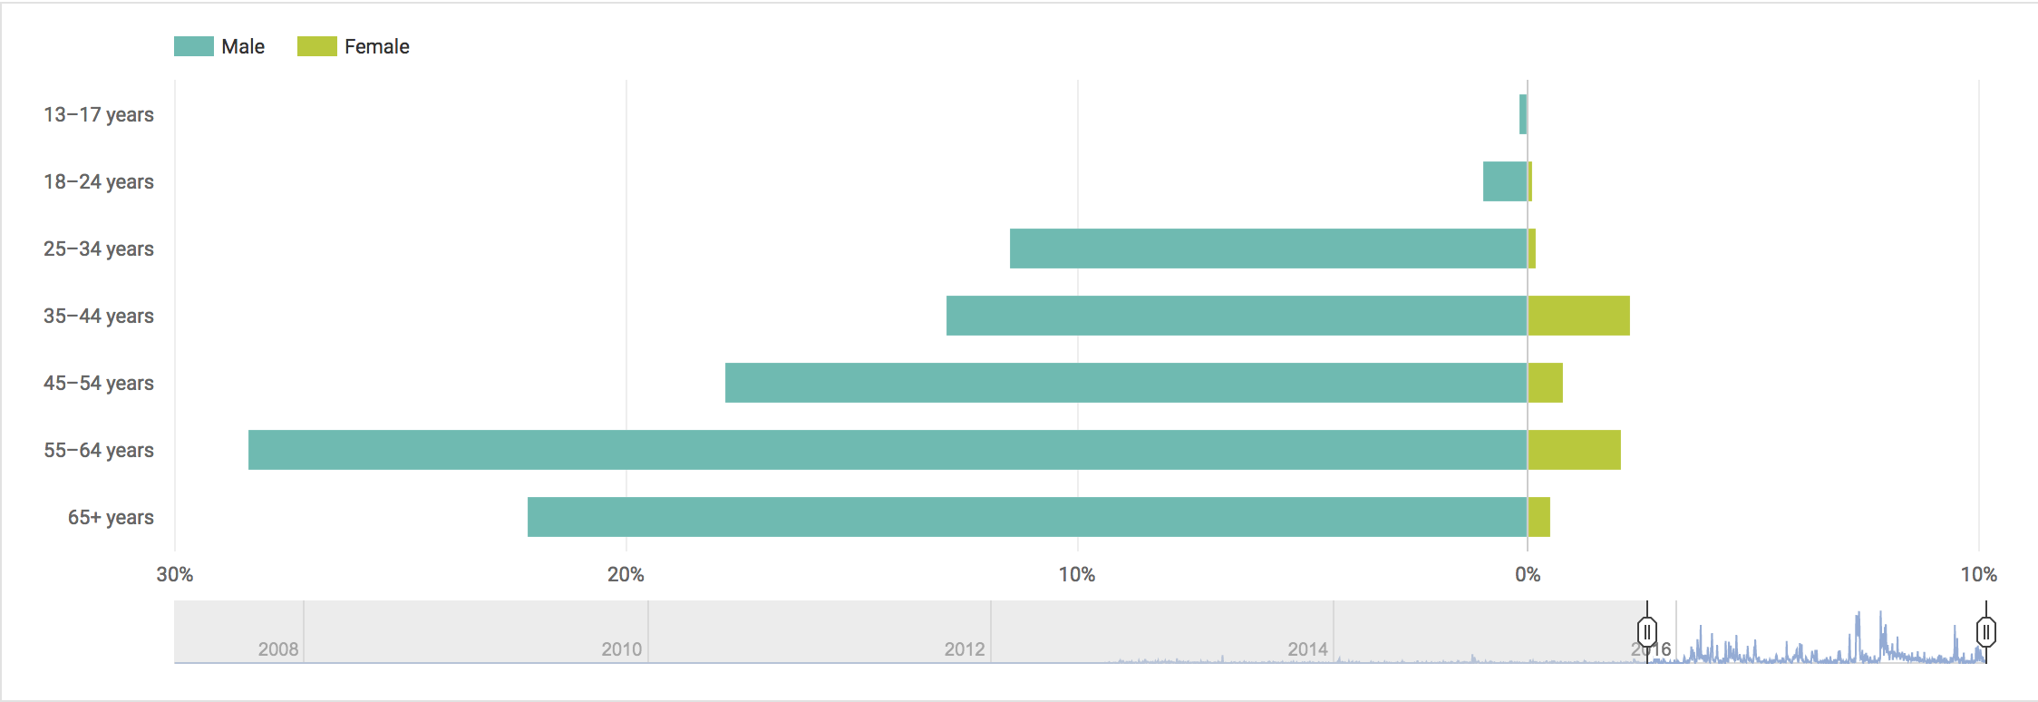
demographics
We have a poster session about this subject in the demonstration room, along with many technical summaries and a hackathon. Team is growing and diverse in at least age. Recruitment will continue indefinitely!

Slide 17
questions?

