Slide 1
Open Source Satellites
Notes:
Open Source refers to software for which the original source code is made freely available and may be redistributed and modified. There are a variety of licenses that further refine this definition. This is in contrast to proprietary software, where the original source code is not made available outside the developers or people that have NDAs or licenses to see it. The open-source movement in software and hardware has dramatically changed our engineering culture and economy for the better. Linux, Wikipedia, Apache, Project Gutenberg, Atom, GitLab, OpenSCAD, and Eclipse are only a few successful open source projects that have enabled enormous quantities of productive work and innumerable lucrative endeavors. Questions of "Why would someone sell a software product for free?" and "Why should anyone participate in a project that does not reap financial rewards?" are routinely answered by evidence of the enormous value of collaborative organizations and their work products. Most software that is written is never intended to be sold. Instead, it is intended to solve a problem for a business that does something other than sell software. For example, for academia, or to solve some individual need. So, the question "why share software instead of sell it" is the wrong question. "How can I share the cost of making this software that I never intended to sell, make it better, and get the benefit other people's work and ideas" is a better question, and the natural answer is Open Source. Open-source hardware, championed by Bruce Perens and the Maker Movement, has had a more difficult time finding solid legal ground than open-source software. Despite this, open-source hardware continues to gain influence across educational, scientific, and consumer markets. Repatriating proprietary knowledge to the commons is a mission of many hardware hackers and open-source activists. Knowledge in the commons is considered to be of great benefit. With open-source on the ascendancy, and all the obvious advantages, amateur radio seems to be the perfect place for open-source software to triumph. This is not universally true. The relatively small amateur radio market means that proprietary software can and does remain dominant in some categories. However, amateur radio experimenters have access to and an increasingly large amount of involvement within one of the most interesting and powerful open source projects in the radio world: GNU Radio. GNU Radio is a free and open source toolkit for software radio. Software defined radio is absolutely essential to all modern radio research and has already made a profound difference commercially. The trend will continue with deep learning and cognitive radio essentially re-writing the landscape of how radio is used by the public and how it is regulated by governments. In one particular area of amateur radio, the open source movement runs into a special and somewhat unique challenge. The amateur radio service includes satellites. The history of amateur satellite service in the United States dates back to 1961 when the satellite Oscar 1 hitch-hiked a ride to space along with a government spy satellite. Quietly, hams pursued a half-century long, astonishingly successful private space program that is still little-known outside of ham radio today, but has launched over 80 satellites, almost all of them as hitch-hikers along with other payloads that were the main purpose of the launch. You can find a list of what's currently in orbit and active from AMSAT.org, the website for Amateur Satellite Corporation. The challenge that we face as amateur satellite developers? Communications satellites were regulated as munitions under ITAR for many years. ITAR is the International Traffic in Arms Regulations. It is a set of United States regulations that restrict and control the export of defense and military related technologies to safeguard U.S. national security and further U.S. foreign policy objectives. The stated mission of amateur radio in the United States, which is to support advancement of the radio arts, education, emergency response, and includes language encouraging amateur radio operators to contribute to international goodwill runs into a brick regulatory wall with ITAR. Both amateur and commercial satellite development in the United States were very negatively impacted by ITAR. Open Source development, which we pursue, is all about openness and sharing. Contrast that with ITAR, which is about keeping knowledge away from countries that might use it to our peril, like North Korea. Today will talk about the impact of regulatory decisions on the collaborative history of AMSAT, the current efforts to get back on track within AMSAT, how one particular AMSAT project was restructured to avoid ITAR, and how both AMSAT-DL and AMSAT-NA are working together to implement an amateur-radio centric open source version of DVB-S2 for use in amateur satellite payloads and satellite simulators. Technical details of the DVB-S2 and S2X protocol will be discussed. This project is called Phase 4 Ground and is ongoing.

Slide 2
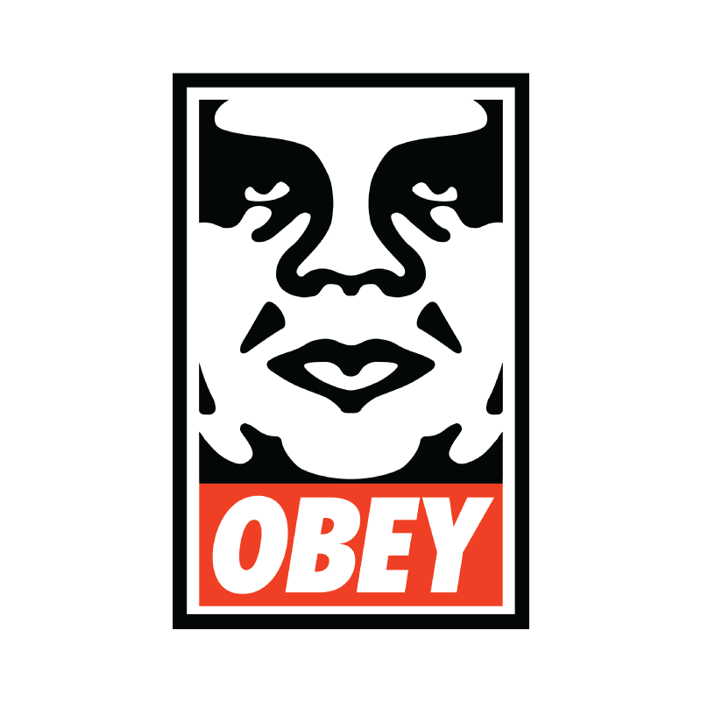
INSTRUCTIONS FOR USE
Weigh and Consider! (Harold Bloom “How to Read and Why”) Disobey!
Experiment!
Participate!
Enjoy!
More info on how to use this and many other presentation templates at www.slidescarnival.com/help-use-presentation-template Templates used are free to use under Creative Commons Attribution license. You can keep the Credits slide or mention SlidesCarnival and other resources used in a slide footer.

Slide 3
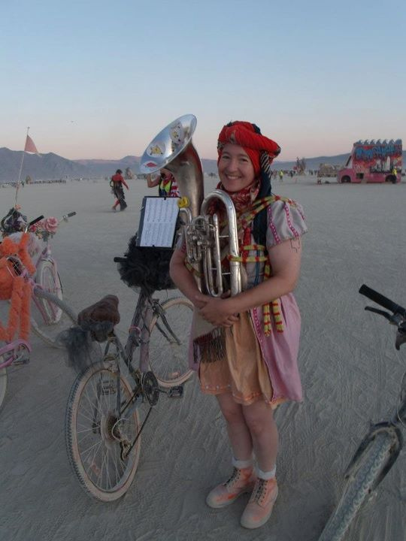
HELLO!
I am Michelle W5NYV
I enjoy thinking and doing!
Not necessarily in that order!
(MSEE Info Theory, DEFCON, Burning Man, AMSAT, IEEE, GNU Radio, Gator (punk rock), 2nd lines, street bands, community orchestras, pipe organ construction, Organ Donor lead,
Phase 4 Ground lead)
https://phase4ground.github.io/
Notes:
IEEE makes me put this in here
The also told me no swearing and not to start any bar fights. That’s a music joke. I am a practicioner.

Slide 4
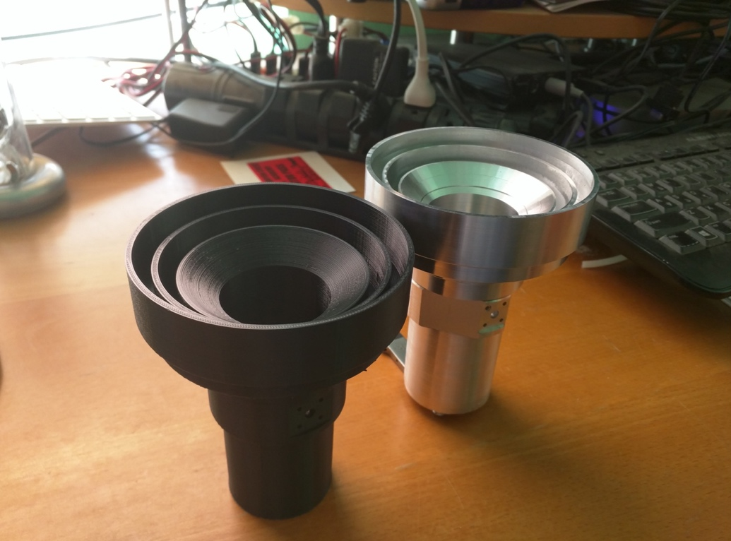
Notes:
I am not a lawyer. Do not construe anything that I say as legal advice.
I will be talking about an area of law that has serious consequences.
Some of us that work on amateur radio satellites have already suffered the threat of serious consequences. All of us have been affected by this threat.
Almost without exception, those of us that work on amateur radio satellites really hate the laws that prevent us from doing reasonable and productive good faith engineering activity. This hatred is visceral because the laws in question have had enormous unintended repercussions that administration after administration has failed to completely address. One of the biggest reasons to talk to you today is because IEEE as an organization can be a force for good in addressing this situation.

Slide 5
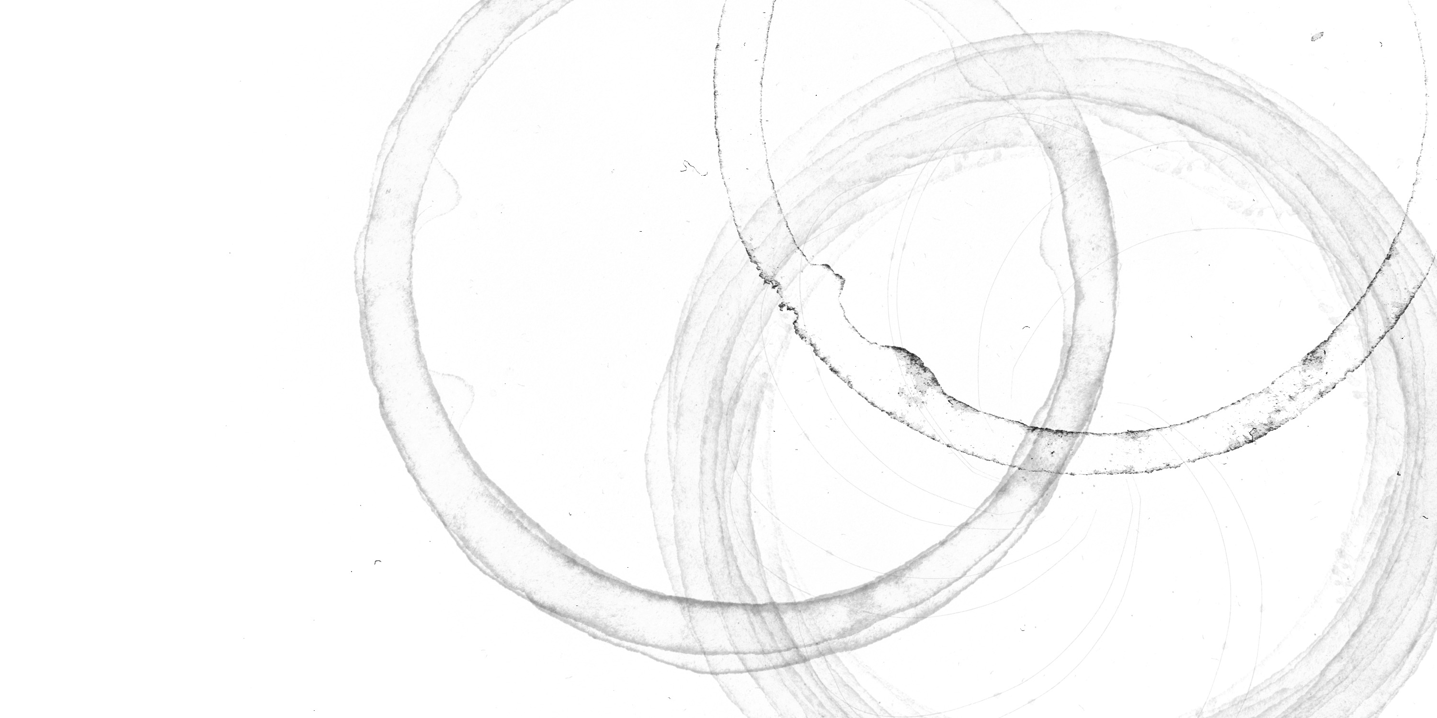
Notes:
The One True Slide.

Slide 6
AMSAT
Notes:
AMSAT amateur satellite corporation.

Slide 7
AMSAT
Open
Source

Slide 8
ITAR
AMSAT
Open
Source

Slide 9
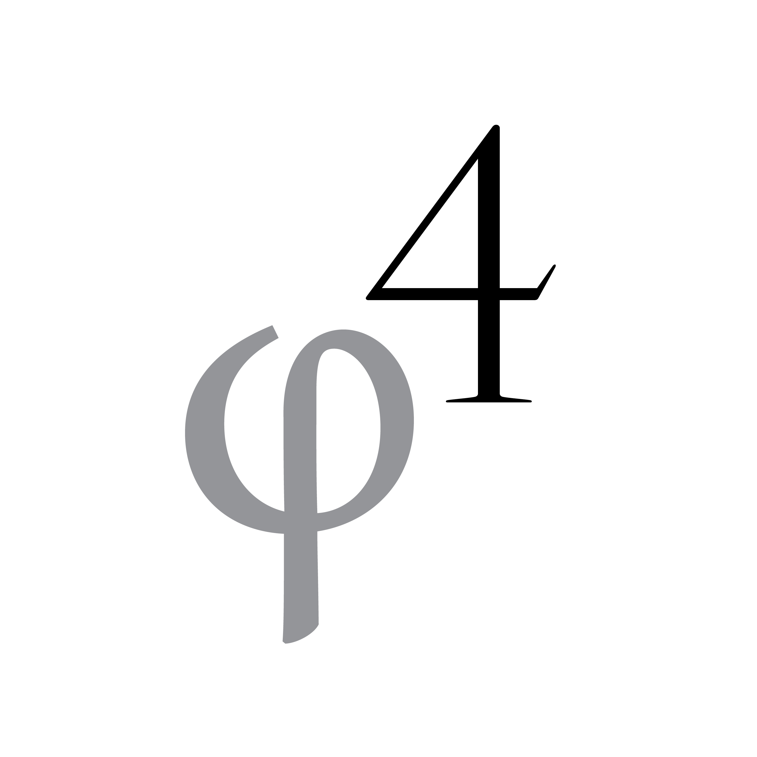
ITAR
AMSAT
Open
Source
Notes:
Three great tastes that don’t taste great together.

Slide 10
ITAR
AMSAT
Open
Source

Slide 14
Questions!

