Slide 1
GitHub Enterprise Proposal
An ITAR compliant home for payload design at AMSAT

Slide 2
The Primary Need
AMSAT’s mission is to keep amateur radio in space.
Communications Satellites are regulated under ITAR or EAR.
AMSAT does not currently have a data management system that fully complies with ITAR or EAR.
Additional regulations went into effect at the end of December 2017 https://www.law.cornell.edu/cfr/text/48/252.204-7012
Information security standards and guidelines can be found here http://nvlpubs.nist.gov/nistpubs/SpecialPublications/NIST.SP.800-171.pdf
We need to be in compliance. Minimally, with CUI.

Slide 3
The Primary Need
Payload development (that isn’t open source and public domain) needs an easy to use and easy to maintain central workspace where all US persons can work together to support AMSAT’s mission.
For open source public domain payload development, please visit AMSAT Phase 4 Space at https://phase4space.github.io/index.html

Slide 4
A Solution
There are several solutions for ITAR compliant data management and document sharing.
One compelling solution is for AMSAT to purchase GitHub Enterprise service.
This is a distributed appliance that we would run on a computer in our physical possession.
This repository service is modern, ITAR compliant, and successfully used by organizations similar to AMSAT.
They have offered a 25% discount to AMSAT because we are a 501c3.

Slide 5
Solution for 10 User Limit
In order to avoid exclusionary practices, where the 10 users are assigned and and all subsequent volunteers are turned away, the 10 user accounts could be set up as amsat1, amsat2, amsat3, amsat4, amsat5, etc.
Each user account would have a password assigned by the administrator.
Under this scheme, intermittent use for uploading and downloading documents is supported.
The administrator keeps a roster of who was assigned to each user account.

Slide 7
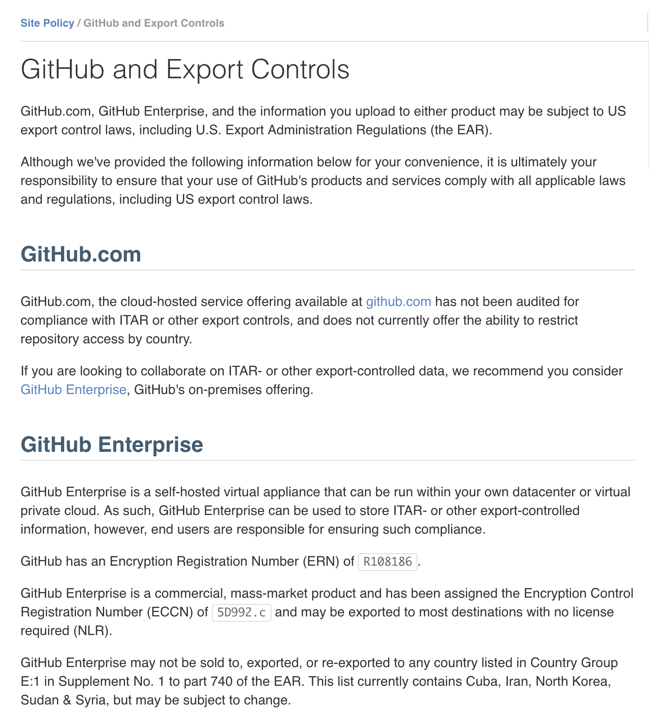

Slide 8
Pricing
GitHub Enterprise offers service in 10-user blocks.
One discounted license is $1,890, down from $2,520, paid annually. One license is 10 user account seats.
Helpful FAQ: https://enterprise.github.com/faq
A user account is considered to be dormant if it has not been active for at least a month. You may choose to suspend dormant users to free up license seats, but this should not be necessary if the user licenses are abstracted as previously discussed.
Full utilization would be $15.75 per user account per month.

Slide 9
Other 501c3 Organizations Using GitHub Enterprise
- DLR Robotic & Mechatronics Center
- Battelle Ecology - LENA Research Foundation
- Project Management Institute
- Eduserv
- IMF
- Max Planck Institue for Molecular Genetics
- Max Planck Institute for Metabolism Research
- The Linux Foundation

Slide 10
Provisioning and Installation
There are a wide variety of ways to provision and install GitHub Enterprise. Since it’s a virtual machine, we have many options.
Amazon Web Service
Azure
Google Cloud
Hyper-V
OpenStack KVM
VMWare
XenServer
https://help.github.com/enterprise/2.11/admin/guides/installation/provisioning-and-installation/

Slide 11
Administration? Training? Maintenance? Benefits?
GitHub Enterprise requires some training to use. A variety of training is provided by GitHub Enterprise. Support for GitHub Enterprise is offered at no extra cost, 24 hours a day, 5 days a week.
A volunteer would be required to administer the virtual appliance. We believe this is less work and less risk than current servers and workspaces. Volunteers have stepped forward to help assist current IT staff with administration.
The primary benefit is that ITAR compliance is positively achieved by a certified service that is a substantial improvement over the current set of SVN servers.
Payload design at AMSAT can dramatically improve, as it would have a modern, publicized, accessible, regulatory-compliant workspace. This is key to recruiting and retaining volunteer engineering talent in a competitive environment.

Slide 12
Endorsements
Howie DeFelice
Wally Ritchie
Steve Conklin
Michelle Thompson
Phil Karn
Bob McGwier

Slide 13
Motion
AMSAT shall subscribe to GitHub Enterprise in order to provide a modern consolidated document server for all ITAR-controlled payload development.
This system is open to all US persons that want to volunteer for ITAR controlled payload design for AMSAT.

