Slide 1

Phase 4 Project Update
For Escondido Amateur Radio Society
10 May 2018

Slide 2
Who are we?
What do we do?
Why should you care?
What are we doing about it?
What does the overall system look like?
What is the team doing?
What do we need?
What are the plans for a finished product?
What do these radios talk to?

Slide 3
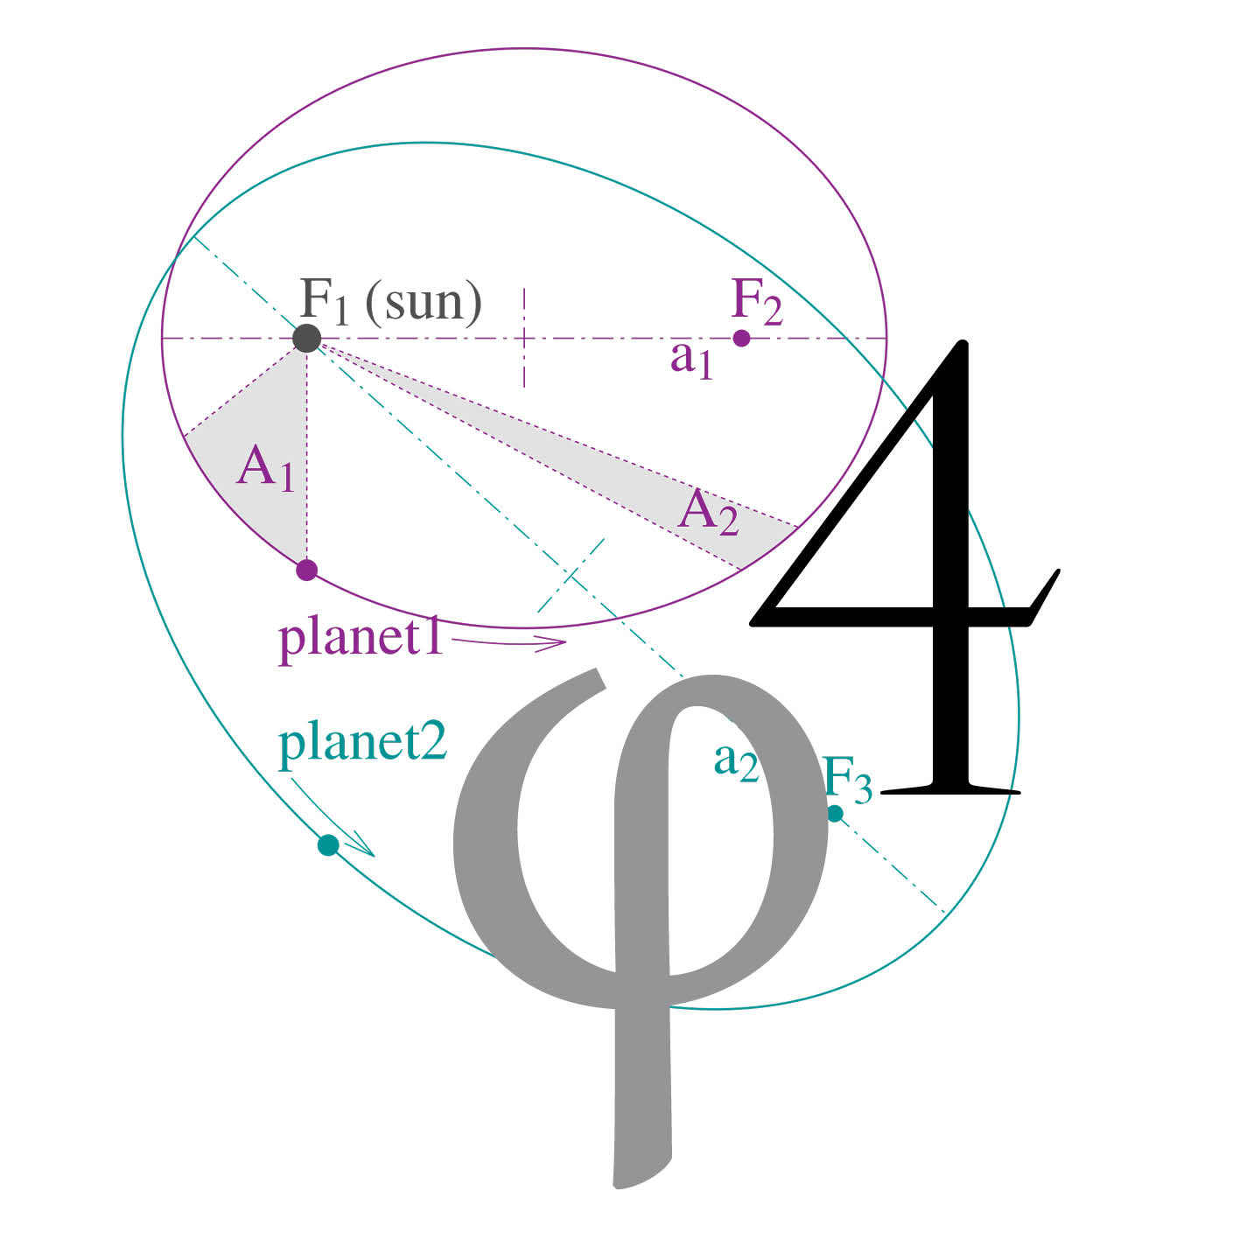
Who are we?
Open Research Institute, Inc. (ORI) is a non-profit
research and development organization
which provides all of its work to the general public
under the principles of Open Source
and Open Access to Research.

Slide 4

What do we do?

Slide 5
Why should you care?
Because a surprisingly large amount of
software and hardware in amateur radio
is closed, proprietary, or licensed in ways
that make it very difficult to
improve, learn from, or adapt.

Slide 6
What are we doing about it?
Liberating DVB-S2 and DVB-S2X
for amateur radio use!

Slide 7
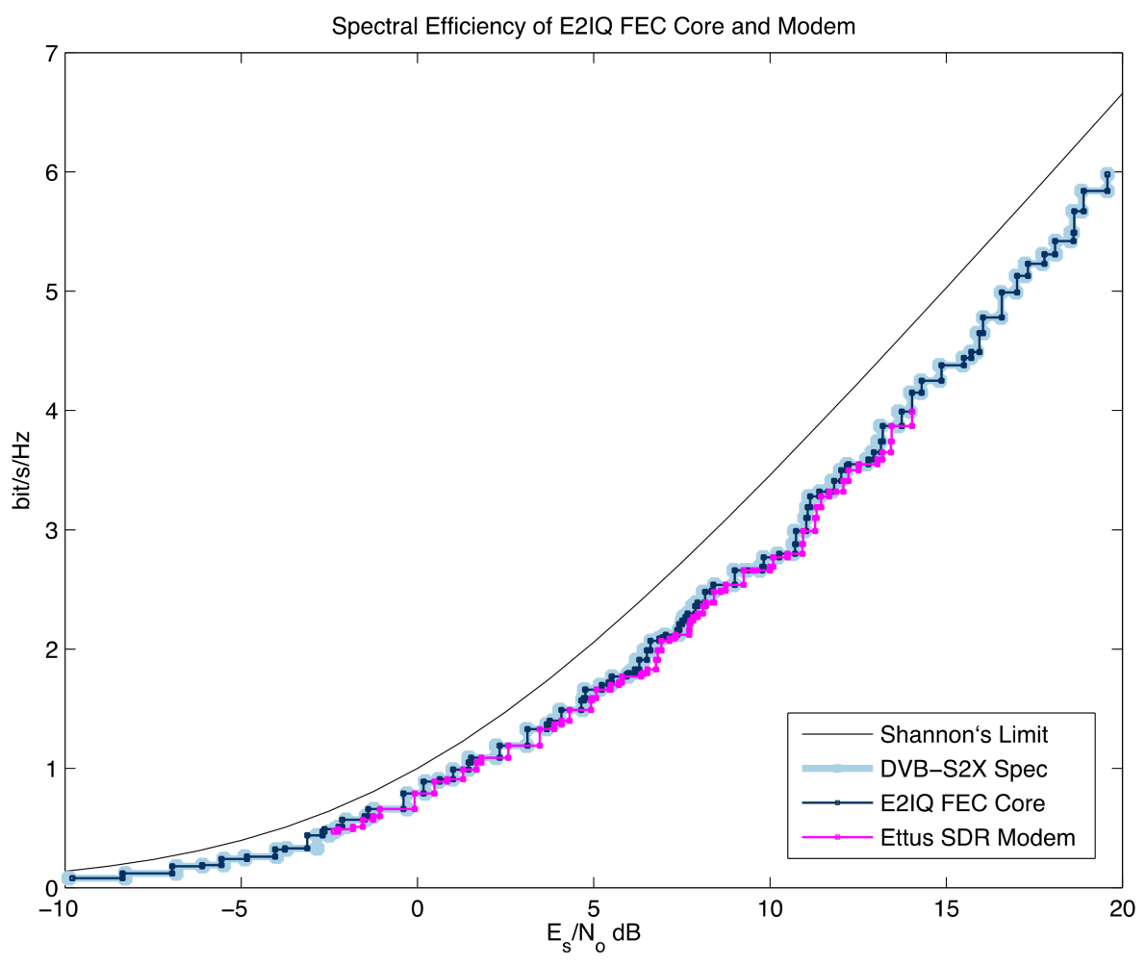

Slide 8
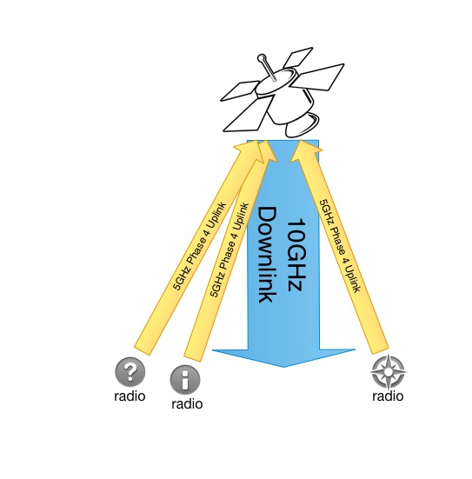
Phase 4 radios
5.645-5.655 GHz up
10.45-10.46 GHz down
What does it look like?

Slide 9
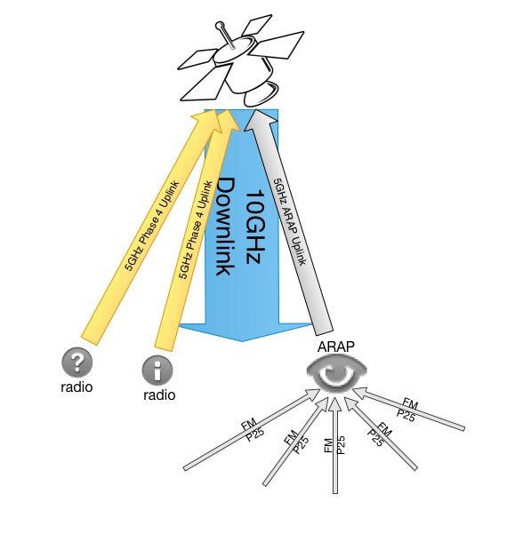
Phase 4 radios
5.645-5.655 GHz up
10.45-10.46 GHz down
What does it look like?

Slide 10
What is the team doing?
RTP multicast innovations
DVB correlators
Open Source LDPC
Dual Band Feed
Filters! 5GHz amps!
ARAP demonstrations
Having tons of fun
Buying every SDR dev board

Slide 11
What do we need?
You!
Volunteers, cheerleaders, documentarians,
artists, designers, hardware hackers,
software, hardware, firmware,
Protocol design, testing, RF design,
And on and on!
everyone is welcome

Slide 12
Plans for finished products
Reference design in GNU Radio
Trans-Ionsopheric hackable badges
Trans-Ionspheric Radios
10GHz filters
Dual Band Feeds
Lots of other possibilities!

Slide 13
What do these radios talk to?

Slide 14
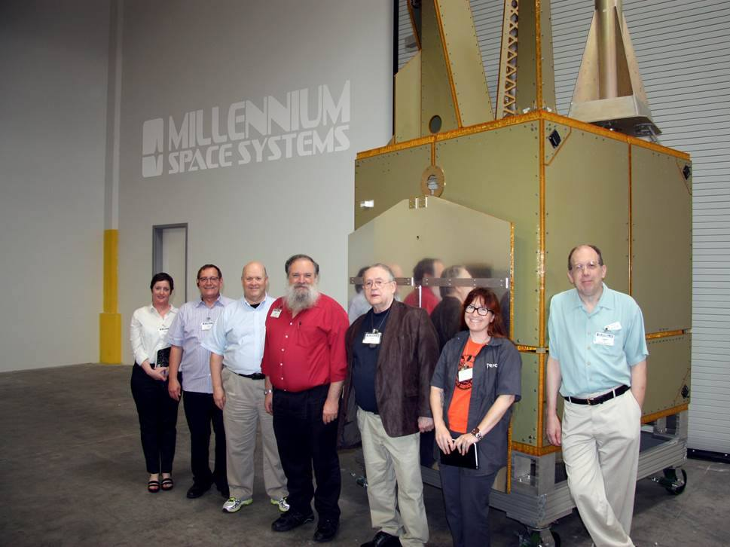

Slide 16


Slide 17
Phase 4 Ground GitHub: https://github.com/phase4ground
Phase 4 Space GitHub: https://github.com/phase4space
Mailing List: https://lists.openresearch.institute/
Open Research Institute homepage: https://openresearch.institute/
GNU Radio Homepage: https://gnuradio.org/
Libre Space UPSat: https://libre.space/projects/upsat/
Digital Video Broadcasting organization: https://www.dvb.org/

