Slide 1
Open Source Satellites
Notes:
Open Source refers to software for which the original source code is made freely available and may be redistributed and modified. There are a variety of licenses that further refine this definition. This is in contrast to proprietary software, where the original source code is not made available outside the developers or people that have NDAs or licenses to see it. The open-source movement in software and hardware has dramatically changed our engineering culture and economy for the better. Linux, Wikipedia, Apache, Project Gutenberg, Atom, GitLab, OpenSCAD, and Eclipse are only a few successful open source projects that have enabled enormous quantities of productive work and innumerable lucrative endeavors. Questions of "Why would someone sell a software product for free?" and "Why should anyone participate in a project that does not reap financial rewards?" are routinely answered by evidence of the enormous value of collaborative organizations and their work products. Most software that is written is never intended to be sold. Instead, it is intended to solve a problem for a business that does something other than sell software. For example, for academia, or to solve some individual need. So, the question "why share software instead of sell it" is the wrong question. "How can I share the cost of making this software that I never intended to sell, make it better, and get the benefit other people's work and ideas" is a better question, and the natural answer is Open Source. Open-source hardware, championed by Bruce Perens and the Maker Movement, has had a more difficult time finding solid legal ground than open-source software. Despite this, open-source hardware continues to gain influence across educational, scientific, and consumer markets. Repatriating proprietary knowledge to the commons is a mission of many hardware hackers and open-source activists. Knowledge in the commons is considered to be of great benefit. With open-source on the ascendancy, and all the obvious advantages, amateur radio seems to be the perfect place for open-source software to triumph. This is not universally true. The relatively small amateur radio market means that proprietary software can and does remain dominant in some categories. However, amateur radio experimenters have access to and an increasingly large amount of involvement within one of the most interesting and powerful open source projects in the radio world: GNU Radio. GNU Radio is a free and open source toolkit for software radio. Software defined radio is absolutely essential to all modern radio research and has already made a profound difference commercially. The trend will continue with deep learning and cognitive radio essentially re-writing the landscape of how radio is used by the public and how it is regulated by governments. In one particular area of amateur radio, the open source movement runs into a special and somewhat unique challenge. The amateur radio service includes satellites. The history of amateur satellite service in the United States dates back to 1961 when the satellite Oscar 1 hitch-hiked a ride to space along with a government spy satellite. Quietly, hams pursued a half-century long, astonishingly successful private space program that is still little-known outside of ham radio today, but has launched over 80 satellites, almost all of them as hitch-hikers along with other payloads that were the main purpose of the launch. You can find a list of what's currently in orbit and active from AMSAT.org, the website for Amateur Satellite Corporation. The challenge that we face as amateur satellite developers? Communications satellites were regulated as munitions under ITAR for many years. ITAR is the International Traffic in Arms Regulations. It is a set of United States regulations that restrict and control the export of defense and military related technologies to safeguard U.S. national security and further U.S. foreign policy objectives. The stated mission of amateur radio in the United States, which is to support advancement of the radio arts, education, emergency response, and includes language encouraging amateur radio operators to contribute to international goodwill runs into a brick regulatory wall with ITAR. Both amateur and commercial satellite development in the United States were very negatively impacted by ITAR. Open Source development, which we pursue, is all about openness and sharing. Contrast that with ITAR, which is about keeping knowledge away from countries that might use it to our peril, like North Korea. Today will talk about the impact of regulatory decisions on the collaborative history of AMSAT, the current efforts to get back on track within AMSAT, how one particular AMSAT project was restructured to avoid ITAR, and how both AMSAT-DL and AMSAT-NA are working together to implement an amateur-radio centric open source version of DVB-S2 for use in amateur satellite payloads and satellite simulators. Technical details of the DVB-S2 and S2X protocol will be discussed. This project is called Phase 4 Ground and is ongoing.

Slide 2

INSTRUCTIONS FOR USE
Weigh and Consider! (Harold Bloom “How to Read and Why”) Disobey!
Experiment!
Participate!
Enjoy!
More info on how to use this and many other presentation templates at www.slidescarnival.com/help-use-presentation-template Templates used are free to use under Creative Commons Attribution license. You can keep the Credits slide or mention SlidesCarnival and other resources used in a slide footer.
Notes:
Award the sweater! Best holiday decoration! Or Stand up! Stay standing if: Do you have a smartphone?
What is the transmit frequency?
What is the receive frequency?
What TIA/EIA standard does it use?
Would you recognize the waveform that it receives?
What is the dynamic range of the power output of your phone?
Without downloading an app, can you name the cell tower you’re connected to?
Can you name any field in the control frames sent to your phone?
Have you ever attempted to write code for a mobile device of any type?

Slide 3
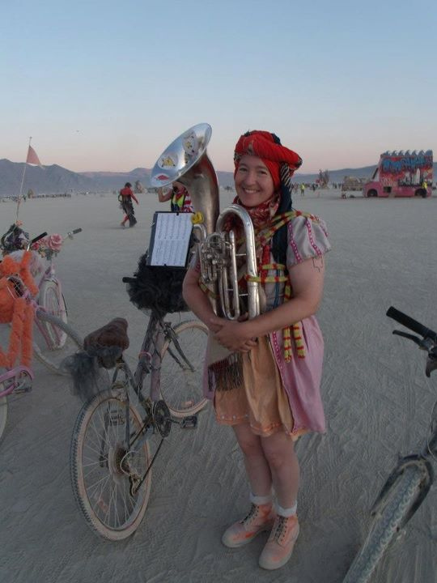
HELLO!
I am Michelle W5NYV
I enjoy thinking and doing!
Not necessarily in that order!
(MSEE Info Theory, DEFCON, Burning Man, AMSAT, IEEE, GNU Radio, Gator (punk rock), 2nd lines, street bands, community orchestras, pipe organ construction, Organ Donor lead,
Phase 4 Ground lead)
https://phase4ground.github.io/
Notes:
IEEE makes me put this in here
The also told me no swearing and not to start any bar fights. That’s a music joke. I am a practicioner.

Slide 4
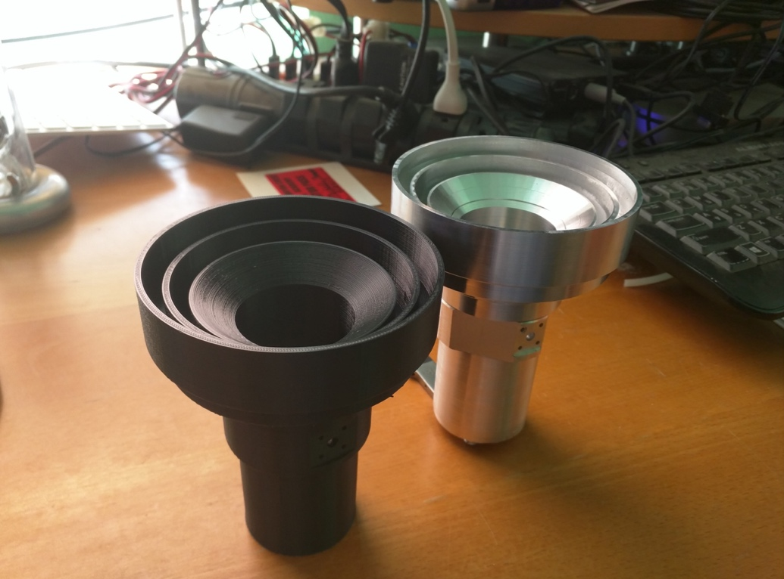
Notes:
I am not a lawyer. Do not construe anything that I say as legal advice.
I will be talking about an area of law that has serious consequences.
Some of us that work on amateur radio satellites have suffered legal consequences. All of us have been affected by the constant threat of legal consequences.
Almost without exception, those of us that work on amateur radio satellites really hate the laws that prevent us from doing reasonable and productive good faith engineering activity. This hatred is visceral because the laws in question have had enormous unintended repercussions that administration after administration has failed to completely address. One of the biggest reasons to talk to you today is because IEEE as an organization can be a force for good in addressing this situation. Engineering needs representation and advocacy. IEEE has four paid lobbyists that work to advance engineering in the US. Part of your dues get us a toehold in the government. Help them. Consider running for office. Contact staffers about issues you know about and offer your expertise. Get active.

Slide 5
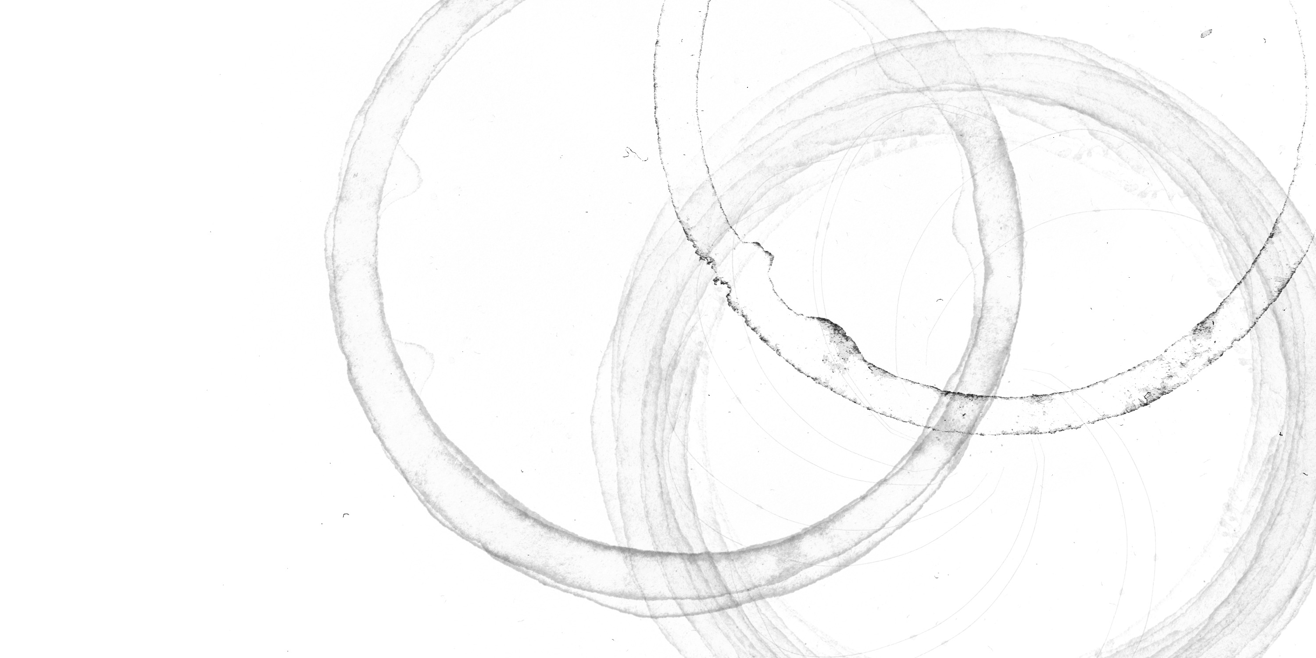
Notes:
The One True Slide.

Slide 6
AMSAT
Notes:
How many of you are amateur radio operators? Amateur radio is a government licensed service that allows use of radio frequency spectrum for purposes of
non-commercial exchange of messages
wireless experimentation
self-training
Recreation
Radiosport
Contesting
emergency communication. This is in contrast to commercial broadcasting, public safety (such as police and fire), or professional two-way radioservices (such as maritime, aviation, taxis, etc.). Each country administers its own licensing scheme and these government bodies coordinate with each other through the International Amateur Radio Union (IARU). The amateur radio service includes satellites. The history of amateur satellite service in the United States dates back to 1961 when the satellite Oscar 1 hitch-hiked a ride to space along with a government spy satellite. Quietly, hams pursued a half-century long, astonishingly successful private space program that is still little-known outside of ham radio today, but has launched over 80 satellites, almost all of them as hitch-hikers along with other payloads that were the main purpose of the launch. Secondary or hosted payloads are very common.

Slide 7
AMSAT.org
Notes:
You can find a list of what's currently in orbit and active from AMSAT.org, the website for Amateur Satellite Corporation.

Slide 8
AMSAT
Open
Source
Notes:
Open Source
How many of you use open source every day?
Google, amazon!
Open Source refers to software for which the original source code is made freely available and may be redistributed and modified. There are a variety of licenses that further refine this definition. This is in contrast to proprietary software, where the original source code is not made available outside the developers or people that have NDAs or licenses to see it. The open-source movement in software and hardware has dramatically changed our engineering culture and economy for the better. Linux, Wikipedia, Apache, Project Gutenberg, Atom, GitLab, OpenSCAD, and Eclipse are only a few successful open source projects that have enabled enormous quantities of productive work and innumerable lucrative endeavors. Like Google. And Amazon. Open source moves the value conditions further out to the edges, so that we can conquer entirely new areas, have new products, new capabilities, and advance computer science. Questions of "Why would someone sell a software product for free?" and "Why should anyone participate in a project that does not reap financial rewards?" are routinely answered by evidence of the enormous value of collaborative organizations and their work products. Most software that is written is never intended to be sold. Instead, it is intended to solve a problem for a business that does something other than sell software. For example, for academia, or to solve some individual need. So, the question "why share software instead of sell it" is the wrong question. "How can I share the cost of making this software that I never intended to sell, make it better, and get the benefit other people's work and ideas" is a better question, and the natural answer is Open Source. Open-source hardware, championed by Bruce Perens and the Maker Movement, has had a more difficult time finding solid legal ground than open-source software. Despite this, open-source hardware continues to gain influence across educational, scientific, and consumer markets. Repatriating proprietary knowledge to the commons is a mission of many hardware hackers and open-source activists. Knowledge in the commons is considered to be of great benefit.

Slide 9
ITAR
AMSAT
Open
Source
Notes:
The challenge that we face as amateur satellite developers?
Communications satellites were regulated as munitions under ITAR for many years.
ITAR is the International Traffic in Arms Regulations.
It is a set of United States regulations that restrict and control the export of defense and military related technologies to safeguard U.S. national security and further U.S. foreign policy objectives.
The stated mission of amateur radio in the United States, which is to support advancement of the radio arts, education, emergency response, and includes language encouraging amateur radio operators to contribute to international goodwill runs into a brick regulatory wall with ITAR.
Both amateur and commercial satellite development in the United States were very negatively impacted by ITAR. Open Source development, which we pursue, is all about openness and sharing. Contrast that with ITAR, which is about keeping knowledge away from countries that might use it to our peril, like North Korea.

Slide 10

ITAR
AMSAT
Open
Source
Notes:
Three great tastes that don’t taste great together.
And that is where we found ourselves in 2008 when we first attempted to make a broadband digital payload for AMSAT.
Traditional VHF satellites are FM repeaters. Commercial off the shelf equipment can be used to operate them. It’s narrowband analog. Those bands are crowded and bandwidth of your individual signal is very limited.
Moving to microwave digital broadband amateur satellites is necessary. Smaller antennas, enormous bandwidths, amazing digital magic, learning modern tools and techniques, and advancing the radio art.
Hamvention 2008 taken aback.
Having to repeatedly defend digital broadband microwave over and over to the amateur radio community, especially the satellite community, was one of the biggest consumers of my time as a project lead. So I stopped doing it.

Slide 11
ITAR
AMSAT
Open
Source
Notes:
Our innovation as an organization. GTFO. Traditionally ground station was commercial gear you went and bought, but how many HROs have a 5GHz up and 10GHz digital radio waiting for you to use with AMSAT’s future payloads?
We had to make ordinary transceivers. Nothing we were going to do had anything to do with ITAR. Why stay combined with the payload project?
Split off! Go open source!
We still need our central node, since we’re essentially a star network with the central node in the sky. We need the communications package. We need a satellite simulator.
We call it a Groundsat.
It has no ITAR content in it. It’s just the communications part. A big honking FPGA, a host processor, all run by lots of software. Our primary prototyping tool, and the framework that is used for our reference design, is GNU Radio.

Slide 12
ITAR
AMSAT
GNU
Radio
Open
Source
Notes:
The One True Slide.
Bathed in a sea of GNU Radio! GNU Radio is an open source digital signal processing framework for software defined radio. GNU Radio allows computer science to take its rightful place. Defining hardware. Controlling hardware. Defining waveforms. Deriving meaningful data out of signals that sound like noise. It is a golden era for software defined radio and GNU Radio is absolutely central.

Slide 13
ITAR
AMSAT
GNU
Radio.org
Open
Source
Notes:
Find out about GNU Radio at GNU Radio.org

Slide 14
Notes:
The Backup Plan Burden That incident at Hamvention 2008? The hostility to digital communications in amateur radio? It’s still going on. “Believe it or not, the "but we need a backup" argument almost eliminated any digital at all from the Phase 4B payload in early 2017. Digital was allocated 10% of the bandwidth at best, but only after the payload would be all analog for the first year. It took repeated, lengthy, uncomfortable conference calls in order to get the "backup" transponder modes moved to the bootloader, where they actually could be of some service as a backup, instead of nuking the entire bandwidth in a quasi-permanent state. It didn't matter that the link couldn't even be reliably closed with an analog transponder. It didn't matter that a big honking FPGA would be wasted in space by doing this. It didn't matter that the negative performance effects from having a transponder in the same band as the tiny rump of digital were a big problem. This did change, but it was hard contentious work. The most effective aspect was that the people actually doing the work weren't interested in being ordered to implement nothing more than a backup plan. That's why was have the term “Backup Plan Burden”. Backup Plan in this context is a loaded term. It's what was used to justify limiting digital modes on the AMSAT Fox program to a "telemetry under voice" approach, it was used to neuter SDX before that, and has already come up with the next generation AMSAT cubesat GOLF discussions. The problem? It's as if a failure of a digital mode is somehow worse than a failure of an analog mode. If analog sats are allowed to fail, and they definitely are allowed to fail, then perhaps digital satellites should be allowed to fail with at the same rates.” When we try to fight back we are told to shut up, or that there has to be a balance.

Slide 17
Questions!

