Slide 1


Slide 2
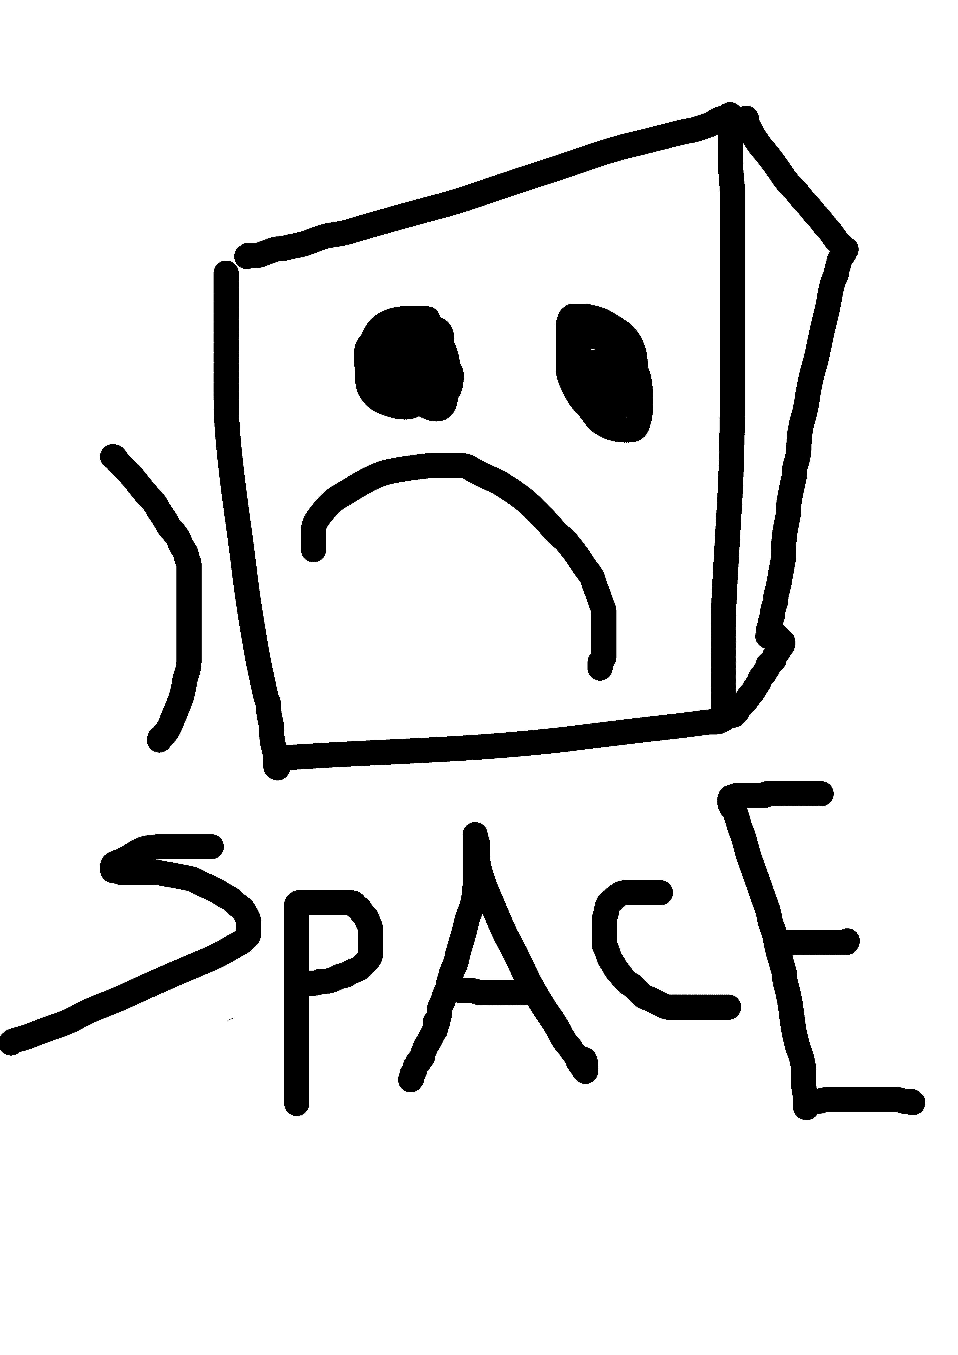


Slide 3
Common Air Interface Document

Slide 4
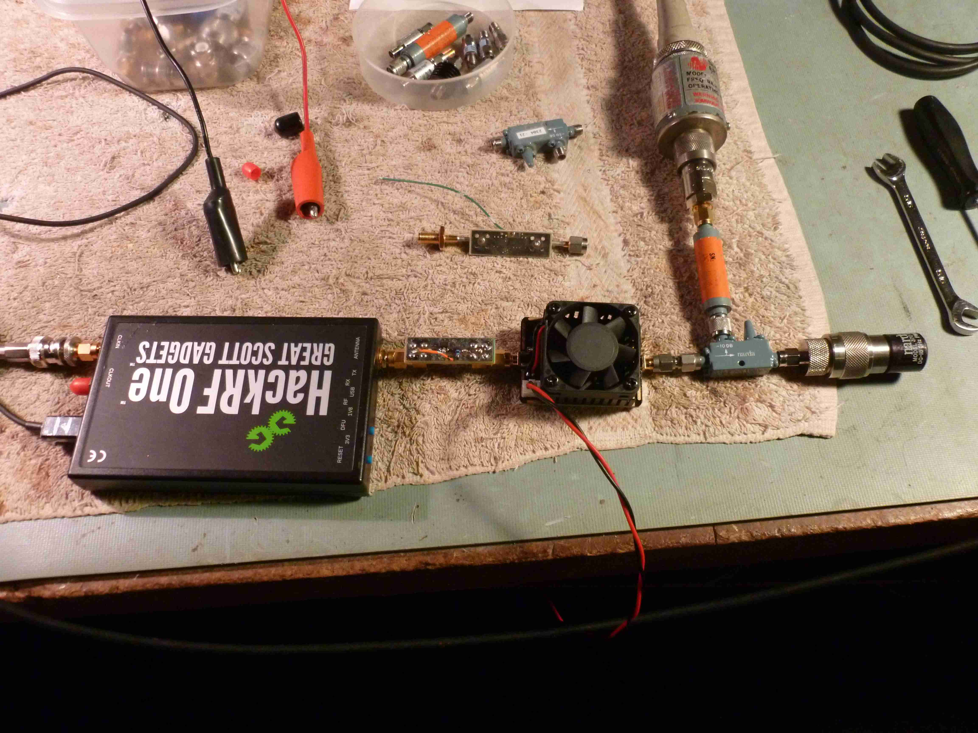
Design, Build, Test, Publish, Review, Repeat
Open Source
Open Process
Volunteers
Students and
Faculty (VT)
Corporations

Slide 5
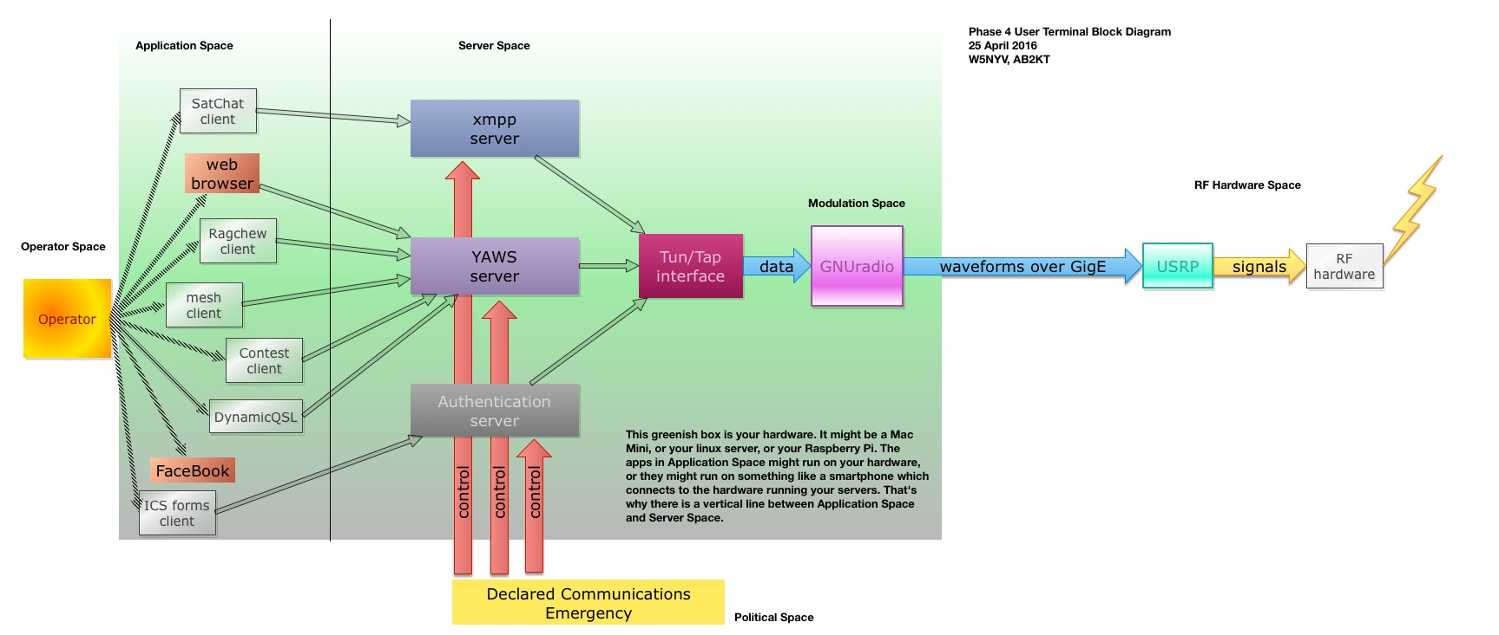

Slide 7
Questions!

