Slide 1
Open Source Satellites
Notes:
This is the lesson I keep learning in the field of algorithmic musical composition. Usually the hard way. What does “representation” mean.
What does “matters” mean.
Representation is the core of model thinking. We are in the business of modeling reality.
Everything is a filter. Everything. Models rely entirely on representations. And so do algorithms.

Slide 2

INSTRUCTIONS FOR USE
Weigh and Consider! (Harold Bloom “How to Read and Why”) Disobey!
Experiment!
Participate!
Enjoy!
More info on how to use this and many other presentation templates at www.slidescarnival.com/help-use-presentation-template Templates used are free to use under Creative Commons Attribution license. You can keep the Credits slide or mention SlidesCarnival and other resources used in a slide footer.

Slide 3
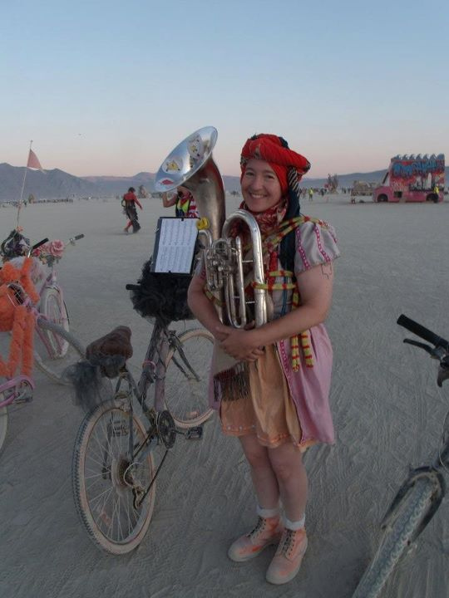
HELLO!
I am Michelle W5NYV
I enjoy thinking and doing!
Not necessarily in that order!
(MSEE Info Theory, DEFCON, Burning Man, AMSAT, IEEE, GNU Radio, Gator (punk rock), 2nd lines, street bands, community orchestras, pipe organ construction, Phase 4 Ground)
https://phase4ground.github.io/
Notes:
IEEE makes me put this in here
The also told me no swearing and not to start any bar fights. That’s a music joke.

Slide 4
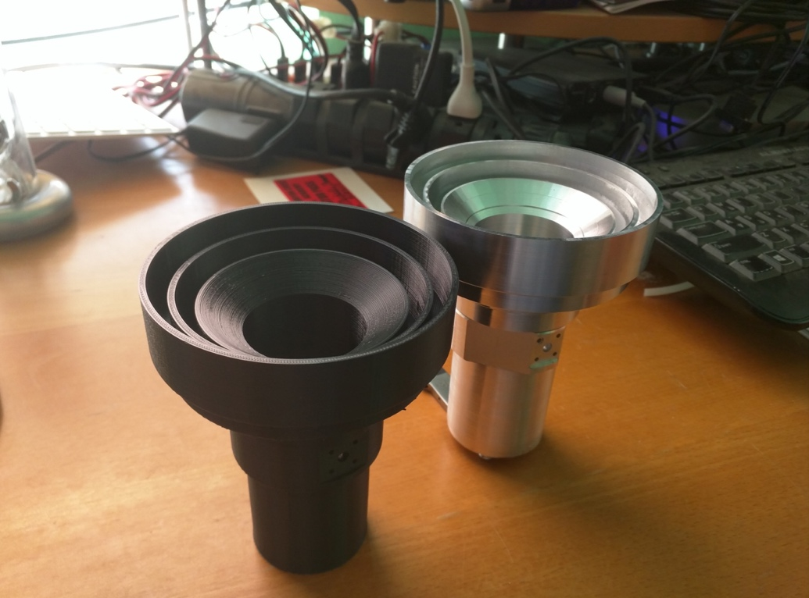
Notes:
In some cases, the way you represent something has very little effect on the manifestation. Music is a very difficult case. The representation actually matters a lot.

Slide 9
Questions!

