Slide 1
Open Source DVB-S2/X GNU Radio
2018 Open Source
CubeSat Workshop

Slide 2
Who are you?
W5NYV
MSEE Information Theory from USC
Active in IEEE Information Theory Society
Co-founder of Open Research Institute
Lead of Phase 4 Ground
DVB-S2 and DVB-S2X are central technologies
The receivers will be in GNU Radio!
The hardest part is considered to be LDPC decode

Slide 3

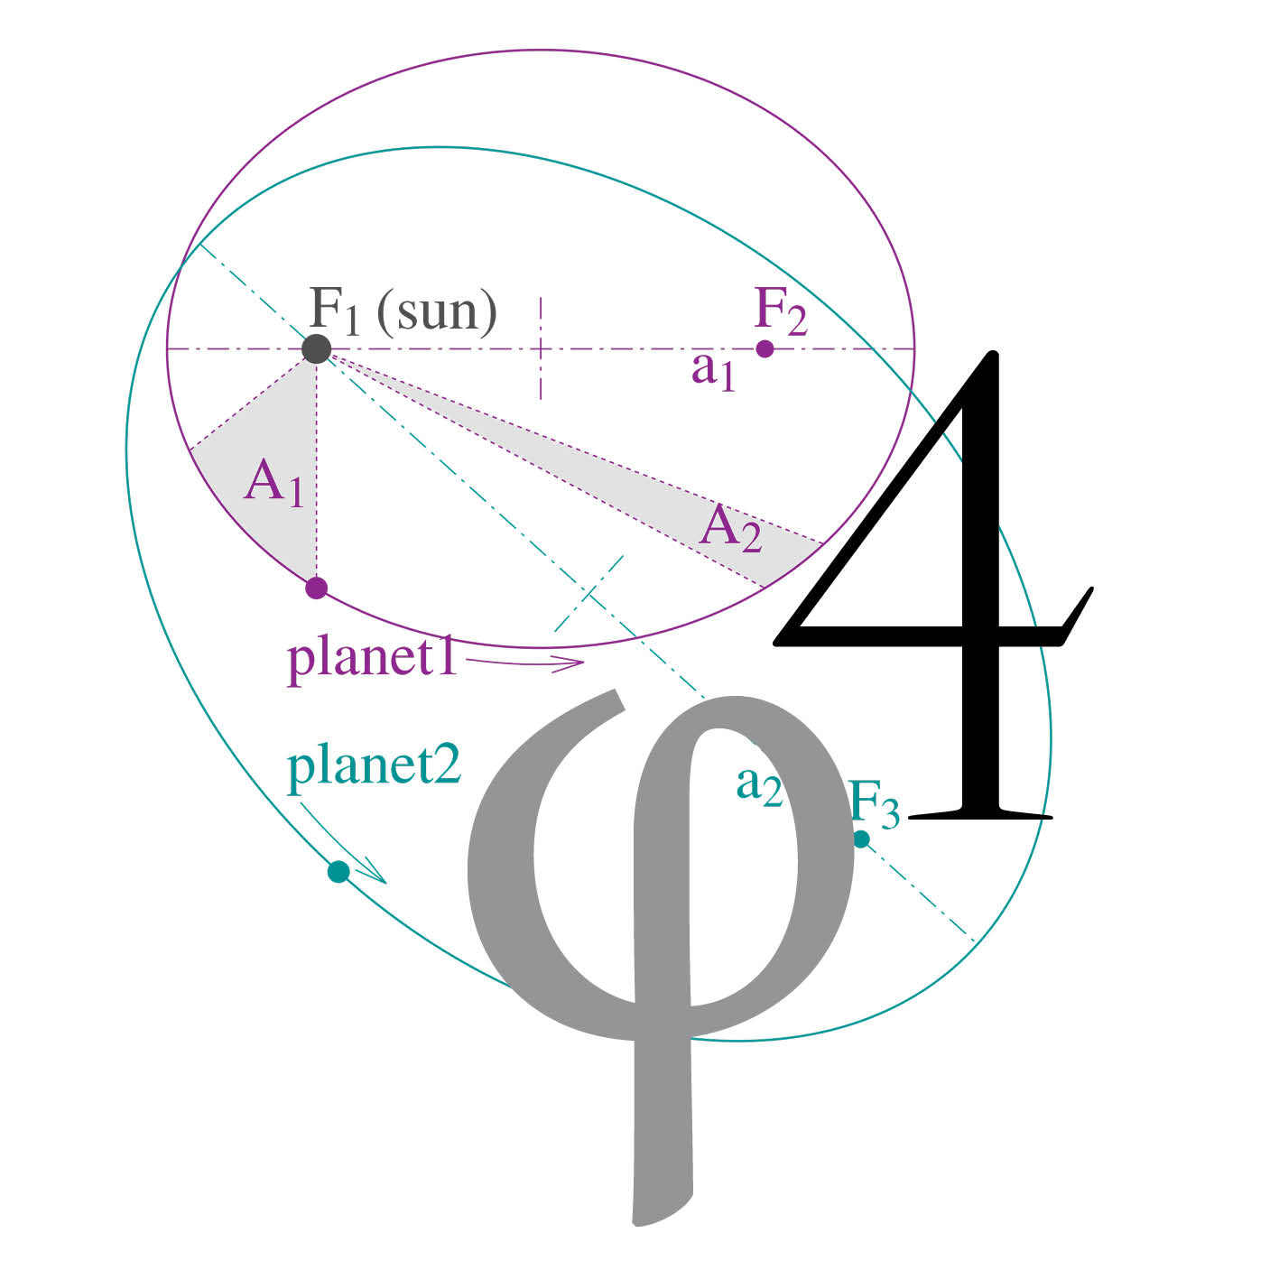
Who are we?
Open Research Institute, Inc. (ORI) is a non-profit research and development organization which provides all of its work to the general public under the principals of Open Source and Open Access to Research.
Phase 4 Ground
Phase 4 Space
Open Cars
Open Codecs

Slide 4
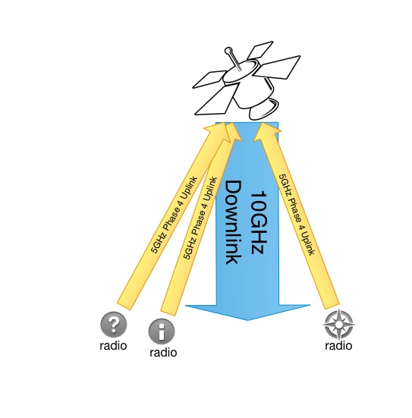
5.645-5.655 GHz up
10.45-10.46 GHz down
MSK channelized uplink
DVB-S2/X downlink
Amateur space and
terrestrial sub-bands
are right next to each other.
Phase 4 Ground radios
Notes:
DVB-S and DVB-S2 is the most widely used communications standard for the downlink for broadcast satellite television. The transport layer, or the part of the protocol that is delivering broadcast content, is usually MPEG video. We don’t want to be limited to MPEG video for an amateur radio system. MPEG is great for video. There’s a way to carry general data within the MPEG stream, but it’s not very efficient or elegant. Fortunately, this is a solved problem. There’s a protocol from DVB written and ready to go called generic stream encapsulation, or GSE. GSE replaces MPEG. Using GSE as the transport stream protocol in DVB-S2 turns it into a very useful digital pipe, capable of supporting lots of simultaneous users transmitting and receiving all types of data, from live voice, to voice memos, to images, to video, to files, to whatever your station supports. That’s what our downlink looks like.
The uplink is a channelized part of the spectrum, in our case 5GHz. The frequency division multiple access uplink is received by a polyphase filter bank, the streams are received and processed, the ones that will be retransmitted are combined and multiplexed into a time division packetized format, and that entire signal is transmitted as one “pipe” using DVB-S2/X on the downlink. Managing this multiplexing is a big job and requires careful protocol design.
Uplink channelization can be changed on the fly with advanced polyphase filter banks, but our current system design is to provide approximately 100kHz wide 4-ary minimum shift keying (4-ary MSK) channels. Your digital signal is assigned some number of channels. Your signal includes information about your radio and your identity. There is an acquisition protocol so that random kerchunking won’t do anything other than raise the noise floor. If you are not heard in the downlink channel assignment, then your radio won’t transmit. Being constant amplitude, this type of modulation relaxes some of the amplifier requirements at 5GHz. Work on the 5GHz transmitter side is going well and one of several proposed prototype board layout is under review right now.

Slide 5
What is the team doing?
RTP IP Multicast SDR innovations (Phil Karn)
DVB correlator (fixing gr-corr_est, new work by Manolis)
Open Source LDPC decode, GPU to FPGA (and MATLAB)
Dual Band Feed, 5GHz and 10GHz
GSE published work (wireshark dissector, gr-dvbgse)
Filters! 5GHz amps!
ARAP demonstrations*
Having tons of fun – everyone welcome!
Buying every SDR dev board we can find (we can help test them!)

Slide 6
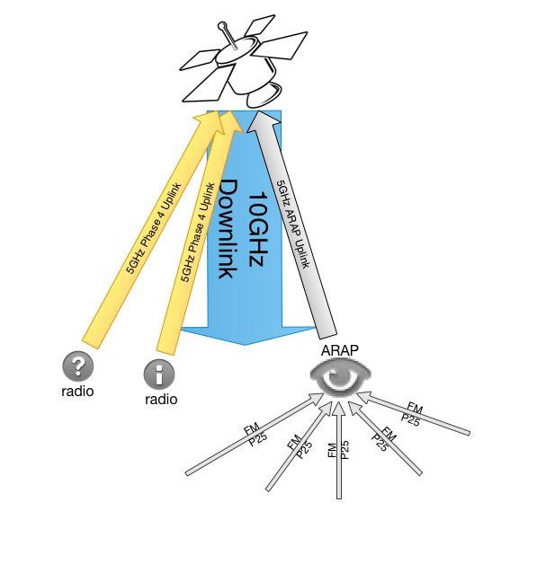
5.645-5.655 GHz up
10.45-10.46 GHz down
ARAP Demo
Notes:
What about legacy signals?

Slide 7
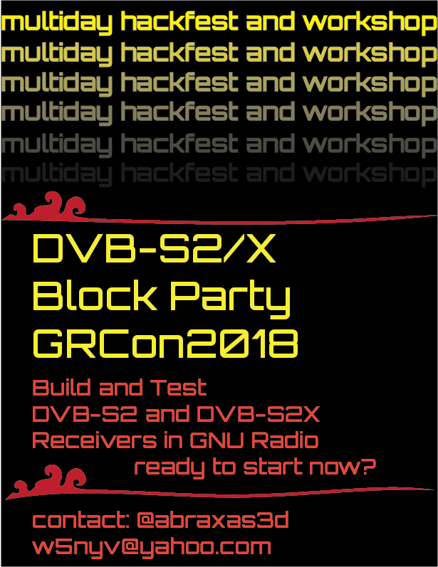



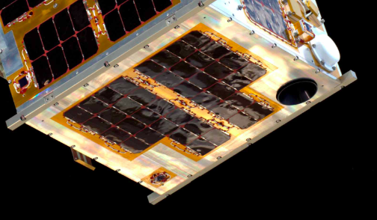

Slide 8
How to find us?
https://github.com/phase4ground
https://openresearch.institute
Slack
Mailing list (at openresearch.institute)
@abraxas3d

Slide 9
Notes:
Thank you for coming to my TED talk

