Slide 1

4 on 4
Phase 4 Update for Palomar Amateur Radio Club
November 4, 2015
Notes:
This template can be used as a starter file to give updates for project milestones.
Sections
Sections can help to organize your slides or facilitate collaboration between multiple authors. On the Home tab, under Slides, click Section, and then click Add Section.
Notes
Use the Notes pane for delivery notes or to provide additional details for the audience. You can see these notes in Presenter View during your presentation.
Keep in mind the font size (important for accessibility, visibility, videotaping, and online production)
Coordinated colors
Pay particular attention to the graphs, charts, and text boxes.
Consider that attendees will print in black and white or grayscale. Run a test print to make sure your colors work when printed in pure black and white and grayscale.
Graphics, tables, and graphs
Keep it simple: If possible, use consistent, non-distracting styles and colors.
Label all graphs and tables.

Slide 2



Phase 4
A digital microwave geosynchronous amateur radio satellite service system made possible by a partnership between Virginia Tech, AMSAT, and Millennium Space Systems.
Notes:
What is the project about?
Define the goal of this project
Is it similar to projects in the past or is it a new effort?
Define the scope of this project
Is it an independent project or is it related to other projects?
* Note that this slide is not necessary for weekly status meetings

Slide 3
The AMSAT Phase System Explained
Phase 1
Phase 2
Phase 3
Phase 4
Phase 5
battery-powered only, short-lived, technology test-bed
LEO with comms and solar panels
Elliptical orbit, with telemetry and control
GEO!
Lunar or planetary
Ascent Project
Phase 4 Project

Slide 4
Phase 4 – Not Just a Satellite Project
Satellite Service
Terrestrial Service
This mission (Phase 4b) is expected to last at least a year, but possibly four, before the satellite is placed in a parking orbit. This means that satellite service will be for a limited time on this mission. We are hoping to leverage this successful mission into having our own geosynchronous satellite (or satellites) with a longer life. Phase 4a is a AMSAT-DN project.
Using the launch as a motivator, we will create ground stations and equipment that will live on past the satellite mission. Terrestrial service is built-in from the beginning. The system will be fun, useful, reconfigurable, powerful, and will make getting on the microwave bands much easier and much more accessible than they have been in the recent past. Use them or lose them!

Slide 5
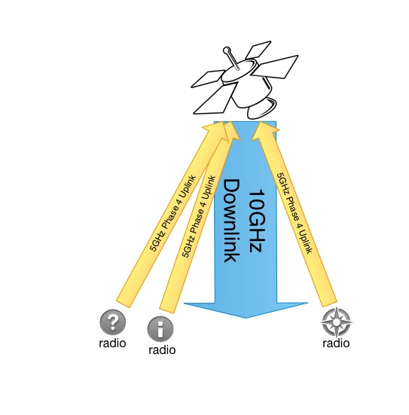
Use Cases

Slide 6
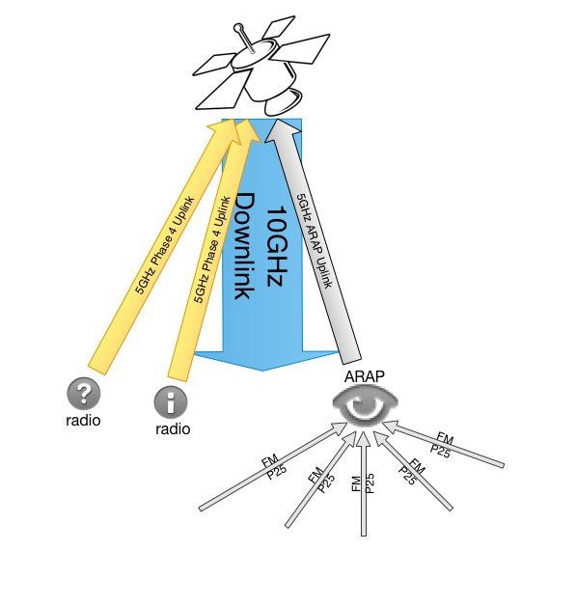

Slide 7
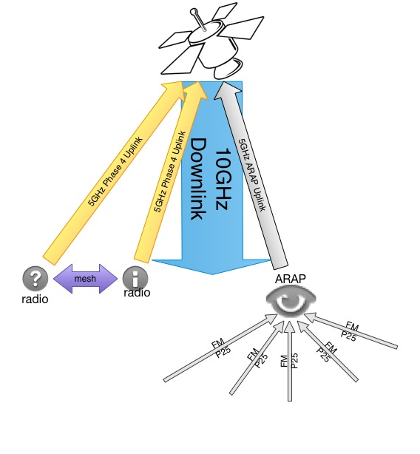

Slide 8



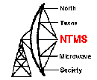
Who else is directly supporting this project?
Palomar Amateur Radio Club, Escondido Amateur Radio Society, Dixon Lake Recreation Area, North Texas Microwave Society, Federal Emergency Management Agency, Amateur Radio Relay League…
Notes:
There’s a lot of support

Slide 9
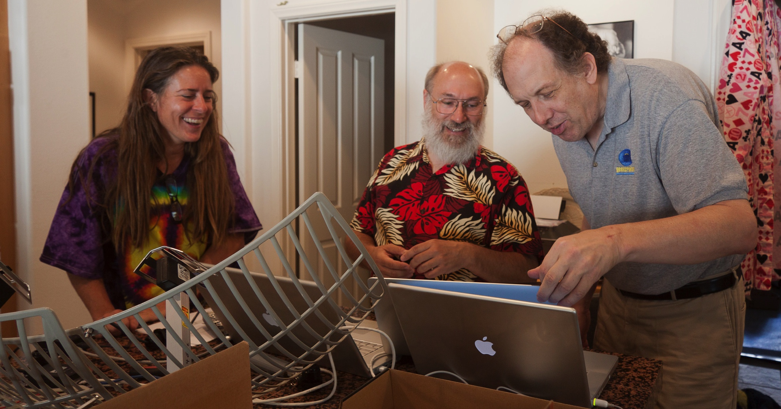
And lots of volunteers!

Slide 10
Current Status
We have a growing team of 40 volunteers/employees
A $100,000+ rideshare payload study at MSS is underway
We are expecting a late 2016 or early 2017 launch
We will have 100 watts of power from the spacecraft
We will enjoy access to the coldplate
We can use several external areas on the spacecraft for antennas
We do not have to control the spacecraft
Ground station development is completely open source
Space segment development is ITAR controlled
Notes:
35 volunteers from across the US and Canada
The study at Millennium Space Systems is to make sure that the amateur radio payload will not interfere in any way with the primary mission, and to confirm what spacecraft resources we will have access to.

Slide 11
Issues and Resolutions
International Traffic in Arms Regulations directly affects this project
What and how did it impact the project?
Time wasted, stress increased, harsh and unnecessary limits on human resources
Splitting up the project into Ground and Space allowed for open source development of the ground station while enabling the space segment development to continue to comply with ITAR.
Teams are now separate and communicate through the Air Interface Document, which defines the radio link between satellite and stations on the ground.
Notes:
ITAR (International Traffic in Arms Regulations) and the EAR (Export Administration Regulations) are export control regulations run by different departments of the US Government. Both of them are designed to help ensure that defense related technology does not get into the wrong hands. Satellites are a controlled technology.

Slide 12

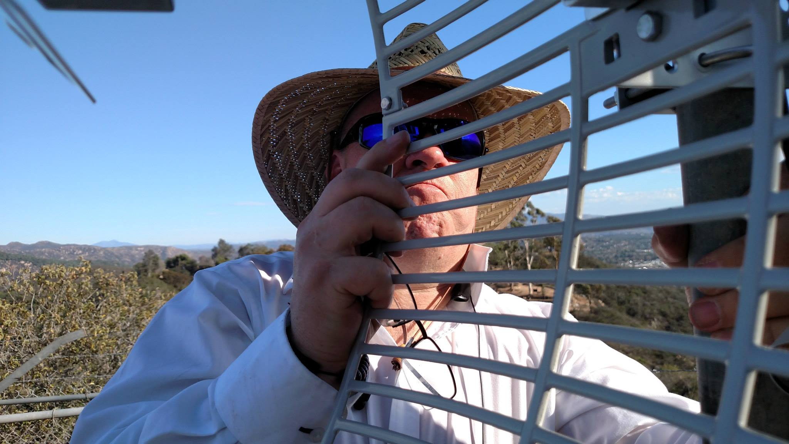
Phase 4 Top-level Team Structure
Common Air Interface
Phase 4 Ground Team
Phase 4 Space Team
https://github.com/phase4ground
Notes:
United through github!

Slide 13

Phase 4 Ground Team Structure

Slide 14
It’s All About The Team
RF Hardware
5GHz link
Applications
QSO party
Digital Hardware
USRP prototyping
10GHz link
Antennas
SatChat 1k
Servers
Xmpp
YAWS
Authentication
Antenna Prototyping
EmComm
Stereo Field
FractalQSL
Mesh radio interface

Slide 15
Phase 4 Ground Leadership Supports the Team
helps
Michelle W5NYV
Ground Team Lead
helps
Bill Reed
Project Manager
helps
Jerry
AMSAT VPE
helps…
Bob N4HY
Director Hume Center VT

Slide 16
Development System
Groundsat is a satellite simulator
ARAP is an amateur radio access point
User Terminals are individual Phase 4 radios

Slide 18
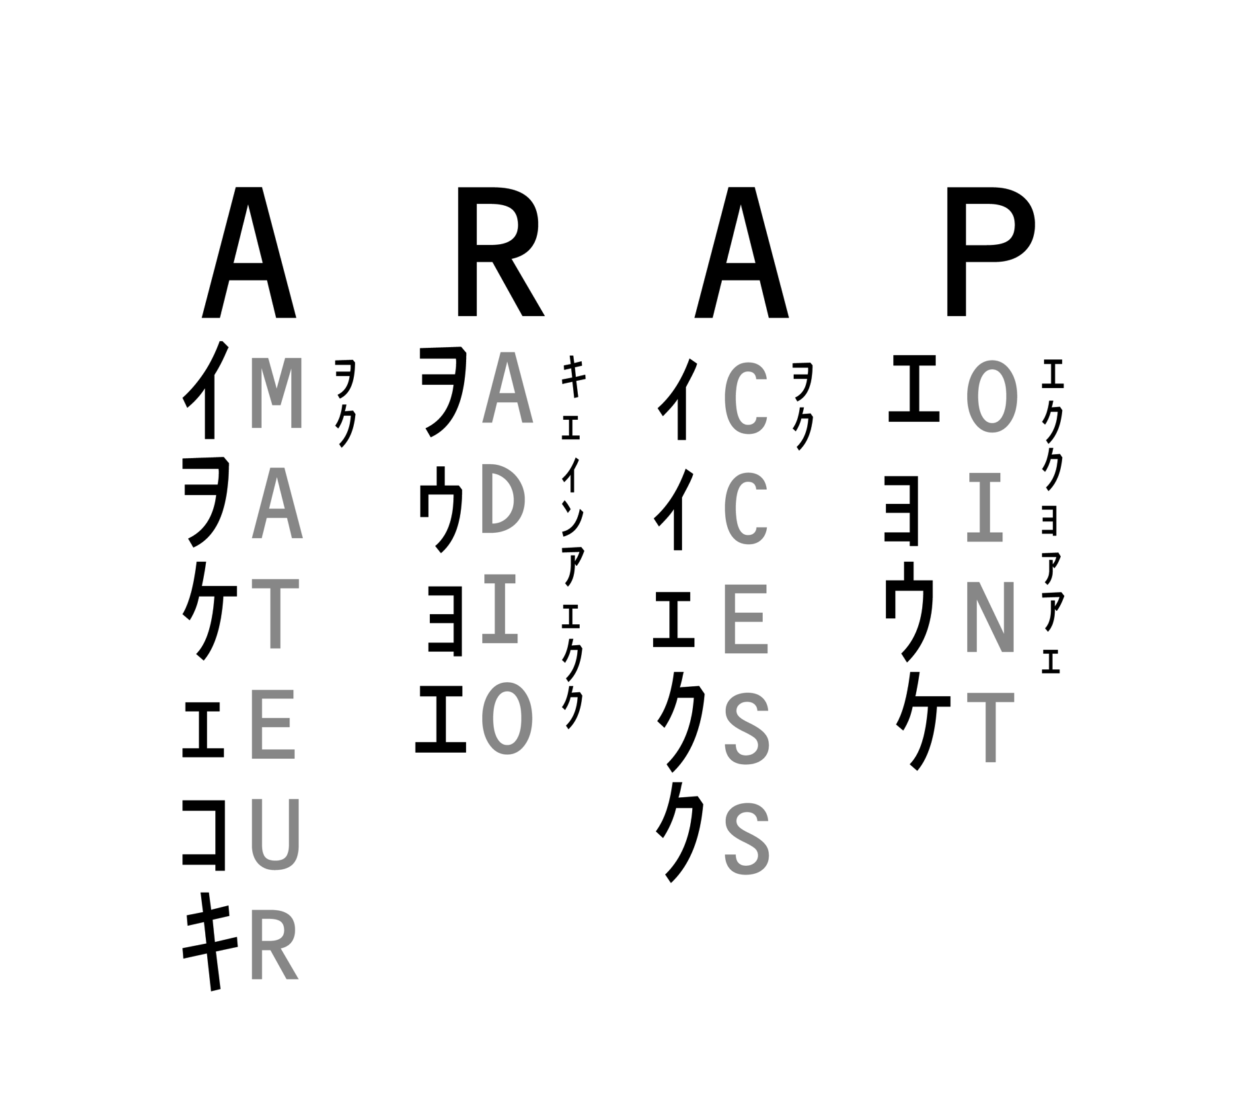

Slide 19
Timeline
Milestone 1
Milestone 2
Milestone 3
Date 1
Date 2
Milestone 4
Date 4
Date 3
Notes:
The following slides show several examples of timelines using SmartArt graphics.
Include a timeline for the project, clearly marking milestones, important dates, and highlight where the project is now.

Slide 20
Timeline
Date 1
Date 2
Date 3
Date 4

Slide 21

Looking Ahead
When is the next milestone?
What are the expected deliverables?
Known risks and issues
What is the investigation timeline for these issues?
What are the immediate next steps?

Slide 22
Dependencies and Resources
Project
Vendors
Manufacturing
Sales
Engineering
Remote Teams
Notes:
What are the dependencies that affect the timeline, cost, and output of this project?

Slide 23
Appendix
Notes:
Prepare slides for the appendix in the event that more details or supplemental slides are needed. The appendix is also useful if the presentation is distributed later.

Slide 24
Appendix
Budget
Design documents
Marketing plan
Supplemental documents
Contact information

